Slide 1
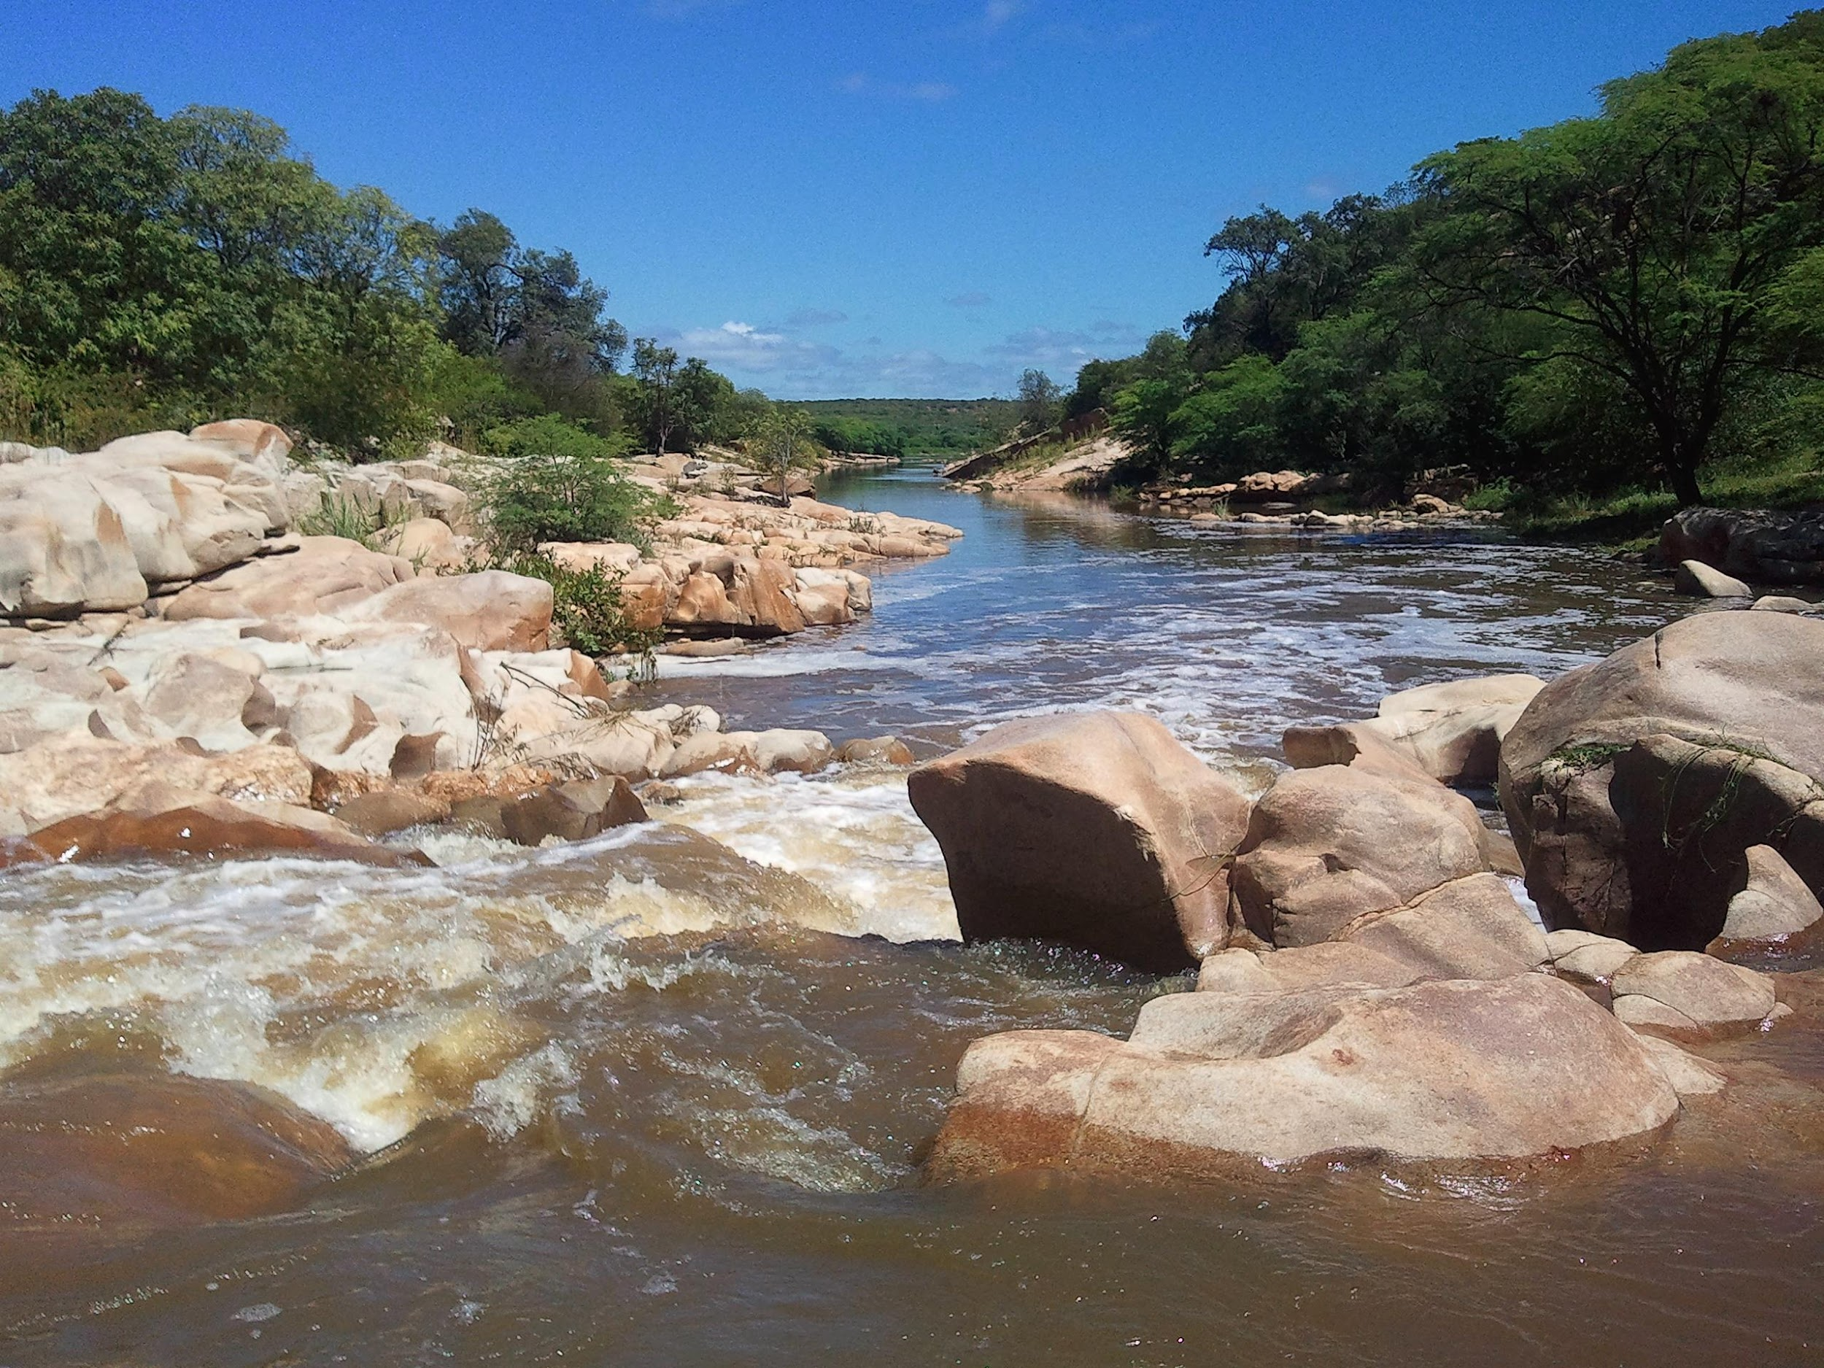

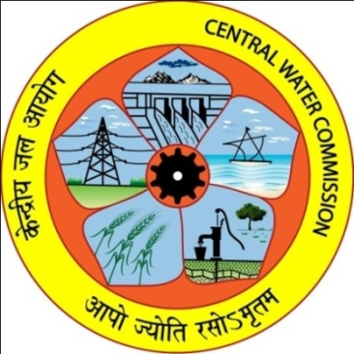

Beneficial Collaboration for Distance Learning Training in Hydrological Sciences
Mr. Matthew Kelsch, UCAR The COMET® Program
Mr. Claudio Caponi, World Meteorological Organization
Mr. S N Pande, National Water Academy
Responding to Challenges Beyond the New Normal:
A WMO Global Campus Collaborative Webinar Event
20-22 January 2021
Notes:
Welcome to the webinar and thank you for attending. My name is Matt Kelsch with UCAR’s COMET Program in the U.S. state of Colorado. I will present a 12-year experience with multi-agency, global collaboration that made online courses in hydrological sciences possible and effective. Our success would not have been possible without the dedicated expertise of our collaborators in the World Meteorological Agency and partnering agencies, including Regional Training Centers (RTCs), most notably the National Water Academy in Pune, India, the Kenya Meteorological Agency, and the National institute for Water and Atmospheric Sciences in New Zealand. Our team effort began well before the COVID-19 pandemic, but the new challenges positioned us well to expand and improve upon the distance learning experience.

Slide 2

Benefits of Collaboration
Optimal combination of global expertise and local knowledge
  Topic area experts and guidance from international organizations
  Local expertise and interactions to make the training relevant
Establish meaningful partnerships
  Subsequent efforts and projects benefit from
  establishment of friendly and trusted relationships
Build diverse global knowledge in topic areas
  Student participants and instructors learn from each other, broadening and diversifying their knowledge
Beneficial Collaboration for
Distanced-Learning Training in Hydrological Sciences
20-22 January 2021
Notes:
There are many benefits from multi-agency, global collaborations, including these key ones. Collaboration allows us to attain an optimal combination of global expertise and local knowledge. The training courses to date have experts from international organizations. It is also important to use local and regional experts who can assist with integrating relevant local issues and experience into the lessons and assignments. Multi-agency collaborations lead to the establishment of meaningful and productive partnerships, and those partnerships are especially important during the period of COVID restriction. Course instructors and student participants can build a more thorough and diverse knowledge base within the hydrological sciences.

Slide 3



Distance Learning Experience
Cost effective
  Reaches a broad and diverse audience without the cost of travel
Accessible and flexible
  Scheduling flexibility with self-paced lessons
  Live sessions can supplement self-paced lessons
Interaction and local relevance
  Questions, chats and forums encourage discussion
  Assignments require student input on local issues
Beneficial Collaboration for
Distanced-Learning Training in Hydrological Sciences
20-22 January 2021
Notes:
Global collaborations are the means to organize and develop useful content for hydrological training. Distance learning is the tool to deliver that training to a broad and diverse set of global learners. Some key benefits of distance learning when compared to the in-person live classroom instruction are as follows. It is cost effective a since there are no travel expenses. And during COVID, travel has been further restricted, thus increasing the importance of distance learning. It is accessible and flexible because the training is done on a computer. The hydrological training is mainly self-paced so that students can schedule their course time when it is most convenient for them. Course completion is still done within a time window, but students have some flexibility within that window. A couple short live sessions are used to supplement the self-paced lessons. For some, limited access to computers and wifi connections is problematic. This limitation is accommodated by providing course lessons via a thumb drive so that the students can use their limited wifi time for quiz completion. Interactions are encouraged, and in some cases required, through questions, chats, and course forums. Assignments, in particular, focus on local issues and require student input in the form of short written reports, field observations, and online exercises.

Slide 4
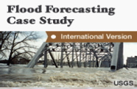
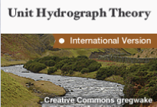
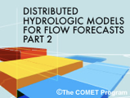
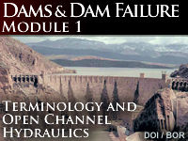
Effective Training Through
Collaboration and Distance Learning
Basic Hydrological Sciences Course, 2009-2020
  Fourteen 7-week courses, 79 countries, 585 completions
Advanced Topics in Hydrologic Sciences,
Hydraulics, and Hydrometeorology
  Four 7-week courses, 34 countries, ~200 completions
  For each course:
  8-11 lessons, some tailoring to region
  Written assignment focused on local concerns
  Instructor interactions through course website
Beneficial Collaboration for
Distanced-Learning Training in Hydrological Sciences
20-22 January 2021
Notes:
Through global collaborations and distance learning tools, effective self-paced distance learning courses include three that have been successfully delivered multiple times and one that will debut in 2021.
There have been fourteen 7-week courses on Basic Hydrological Sciences between 2009 and 2020 with hundreds or participants from 79 countries. Of those, 585 participants (about 80%) successfully completed all course requirements and received a certificate of completion. WMO Region II has delivered the most courses thanks to the tireless efforts of experts at the National water Academy in Pune, India. The course offered in 2020 showed increased number of participants during COVID.
A somewhat more advanced collection of lessons called Topics in Hydrological Sciences, Hydraulics, and Hydrometeorology, is a 6-week course that has been delivered four times to hundreds of participants in 34 countries, with ~200 successful completions.
Both of these courses consisted of between 8 and 11 lessons that can be tailored somewhat based on the local needs and expertise. A key element of these courses is the mandatory short written assignment that allows the student to describe a local event, phenomena, or agency while addressing course topics. Through these short reports students can apply course objectives to relevant local issues, and the instructors can expand their knowledge of hydrological agencies and phenomena. Throughout the course the instructors are available for online discussions and questions through the course forum.

Slide 5
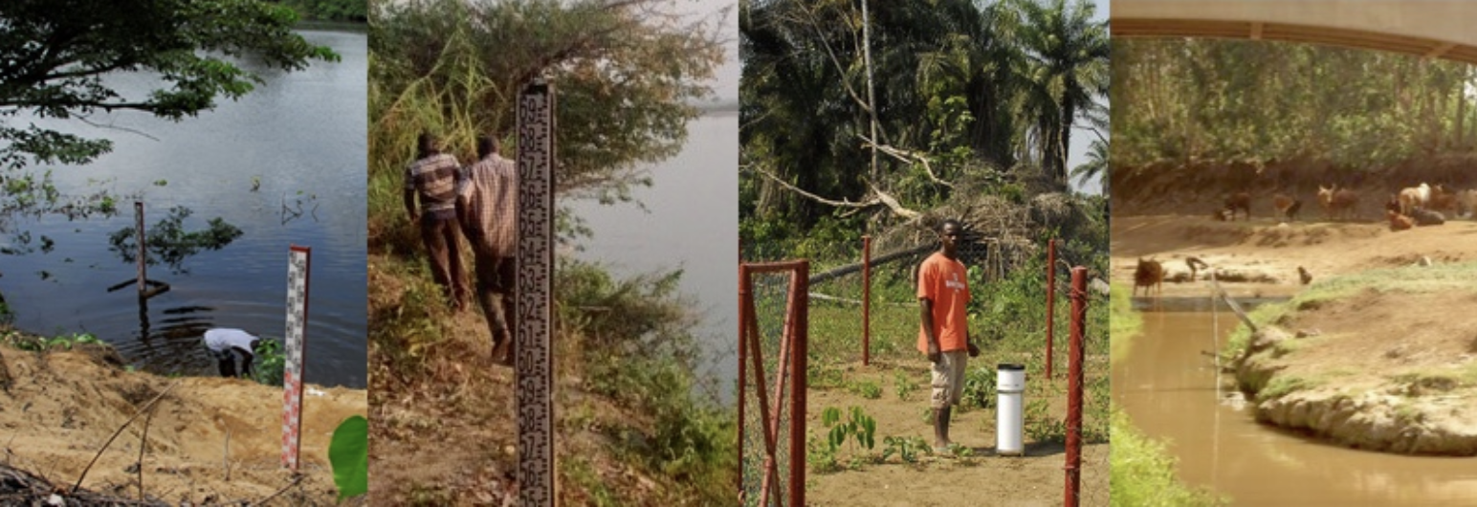

Effective Training Through
Collaboration and Distance Learning
3. Hydrological Technicians Course 2017-2018
  2 eight-week courses, 13 countries, 27 completions
  Collaborated with National Institute of Water and Atmospheric Research (New Zealand)
  Local expertise from collaboration with Kenya Meteorological Department
  Very “hands on” with field assignments (photos and measurements)
Beneficial Collaboration for
Distanced-Learning Training in Hydrological Sciences
20-22 January 2021
Notes:
The third of the distanced learning course in hydrological sciences had a different approach for requiring local participation. This course, Hydrology Technicians, is an 8-week course first offered to Region V in I 2017, and then to Region I in 2018. There have been 27 successful completions in 13 countries. Collaboration with the National Institute for Water and Atmospheric Sciences, NIWA, in New Zealand was crucial for providing material and an instructor. The Kenya Meteorological Department provided useful input for the revision of some aspects of the course before delivering it to Region I.
This course required more hands-on assignments, including visiting field locations to make measurements and observations. These assignments proved to be too difficult for some participants which accounts for the lower completion rates when compared to the other courses; only 25% of those enrolled completed the Region V delivery. Therefore, adjustments were made for the Region I course that allowed some sharing of photos and videos between participants. The completion rate for the Region I course improved to more than 50% with the revisions that were implementation as a result of collaboration and local input. These hands-on activities can take the place of in-person learning during COVID.

Slide 6

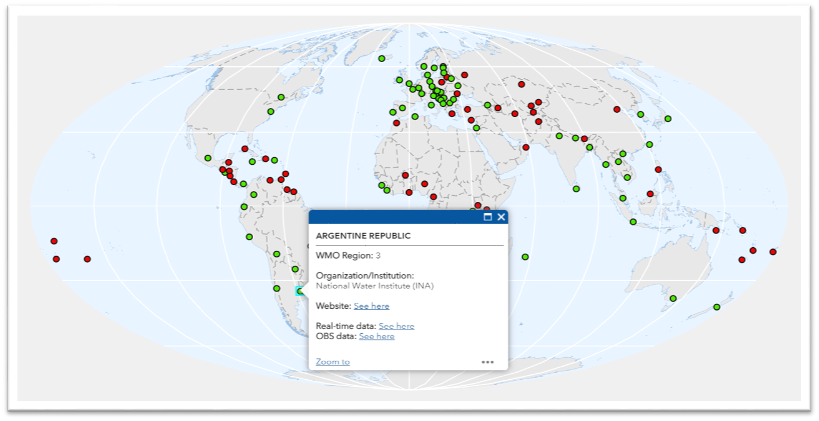


Effective Training Through
Collaboration and Distance Learning
4. WMO Hydrological Observing Systems (WHOS) Course
  Initial six-week course to be delivered in 2021
  Global collaboration and interoperability of hydrological data and metadata
  Transboundary data exchange to benefit National Hydrological Services (NHSs)
Data Providers
Data Users
Beneficial Collaboration for
Distanced-Learning Training in Hydrological Sciences
20-22 January 2021
Notes:
A multi-week distance learning course to be delivered for the first time in 2021 is the WMO Hydrological Observing Systems (WHOS) course. A key learning objective is to demonstrate how National Hydrological Services (NHSs) can benefit from improved publication, use, and interoperability of hydrological data. This is an important goal, especially for transboundary river basins (basins that are shared by more than one country) within the global hydrological community.

Slide 7
Beneficial Collaboration for Distance Learning Training in Hydrological Sciences
QUESTIONS?
Mr. Matthew Kelsch, UCAR The COMET® Program
kelsch@ucar.edu
Mr. Claudio Caponi, World Meteorological Organization
ccaponi@wmo.int
Mr. S N Pande, National Water Academy
shailendrapandenwa@gmail.com
Responding to Challenges Beyond the New Normal:
A WMO Global Campus Collaborative Webinar Event
20-22 January 2021
Notes:
I hope you were able to see how the use of multi-agency, global collaboration and distance learning tools can result in effective hydrological training that benefits a large and diverse set of hydrological entities and students across the world.

