Slide 1
Introduction to the WDQMS web tool (ECMWF) and potential differences in results of WIGOS monitoring centers
Cristina Prates
cristina.prates@ecmwf.int
With thanks to :
Tanja Kleinert
Online Workshop for Regional WIGOS Centres in RA I (SADC)
19-21 October 2020

Slide 2

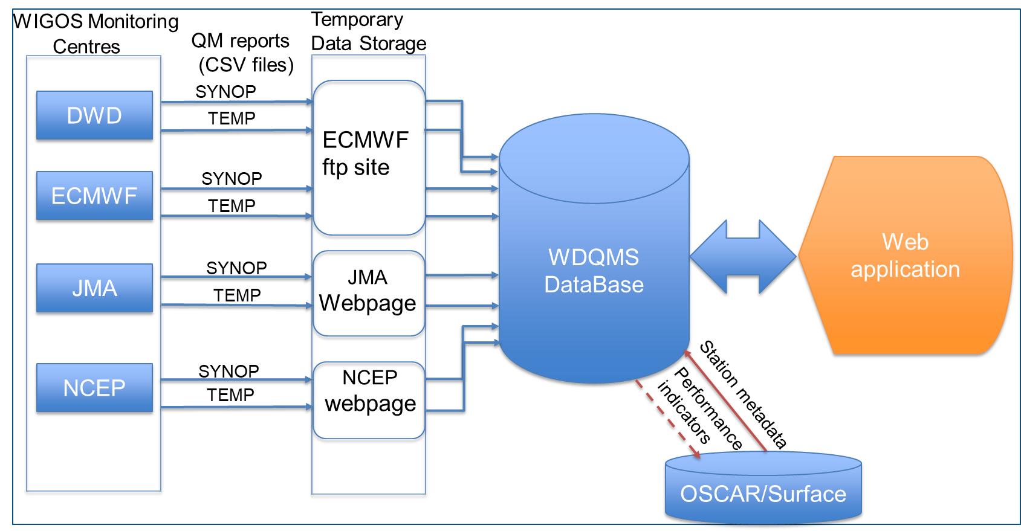



WDQMS web tool: NWP-based quality monitoring system
6-hourly reports: 00, 06, 12 and 18UTC
Statistics computed daily: changes in OSCAR/Surface are reflected only next day.

Slide 3
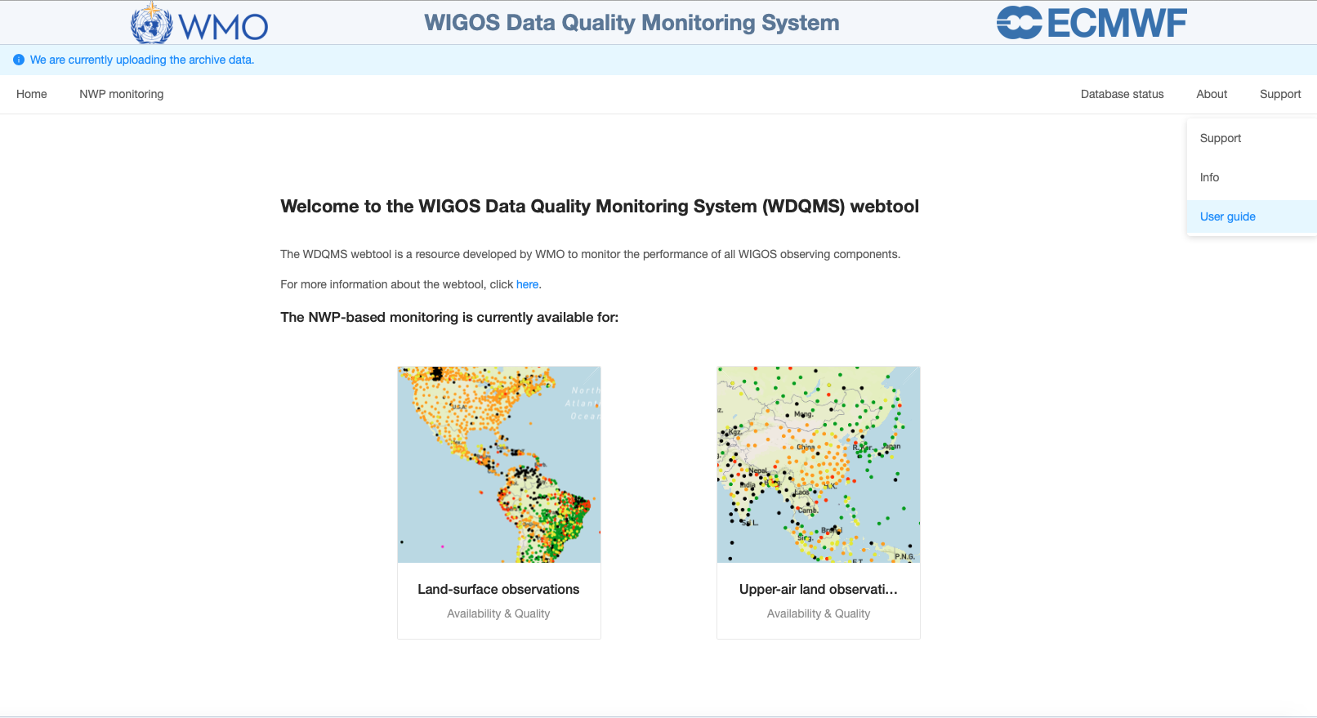
WDQMS web tool: Landing Page
https://wdqms.wmo.int/

Slide 4
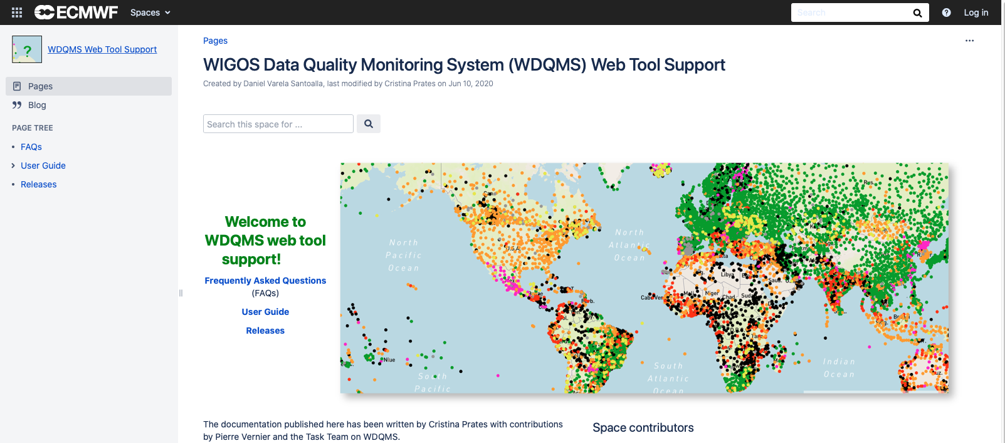
WDQMS web tool Support: FAQs and User Guide

Slide 5
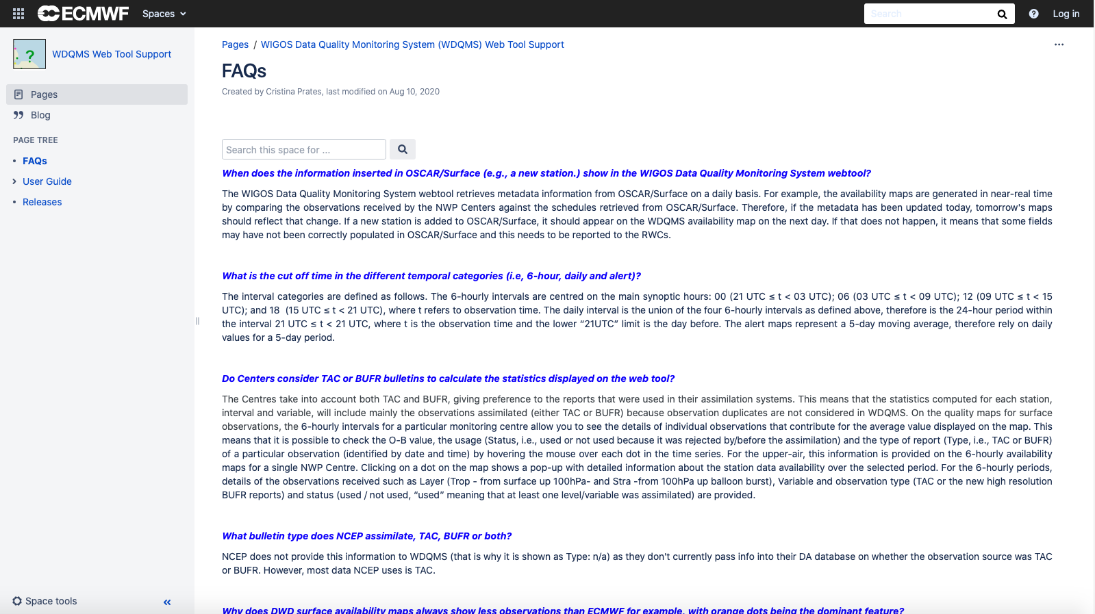
WDQMS web tool Support: FAQs and User Guide

Slide 6
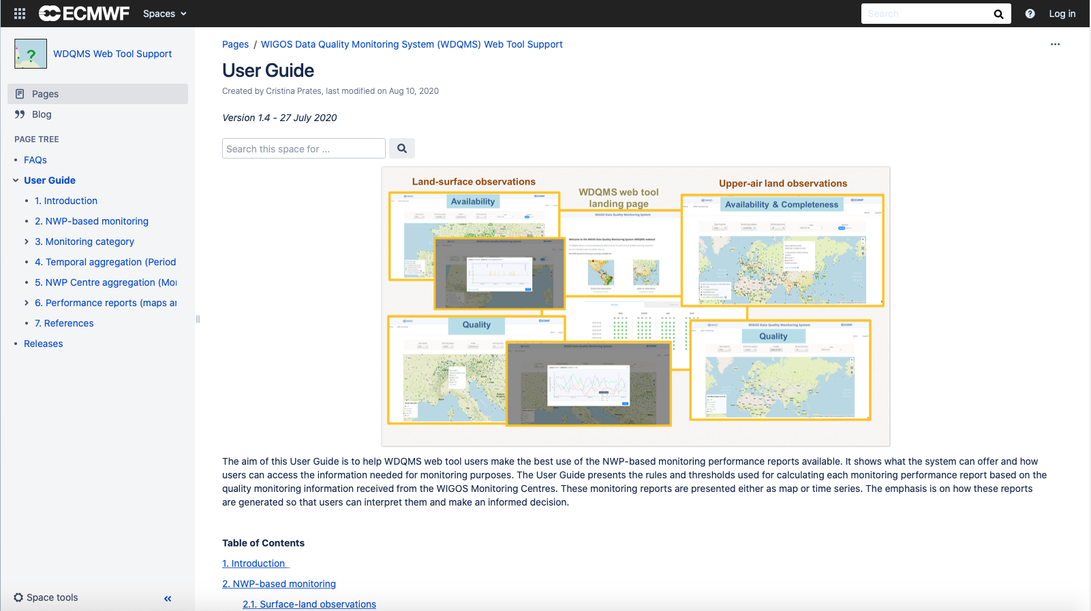
WDQMS web tool Support: FAQs and User Guide

Slide 7
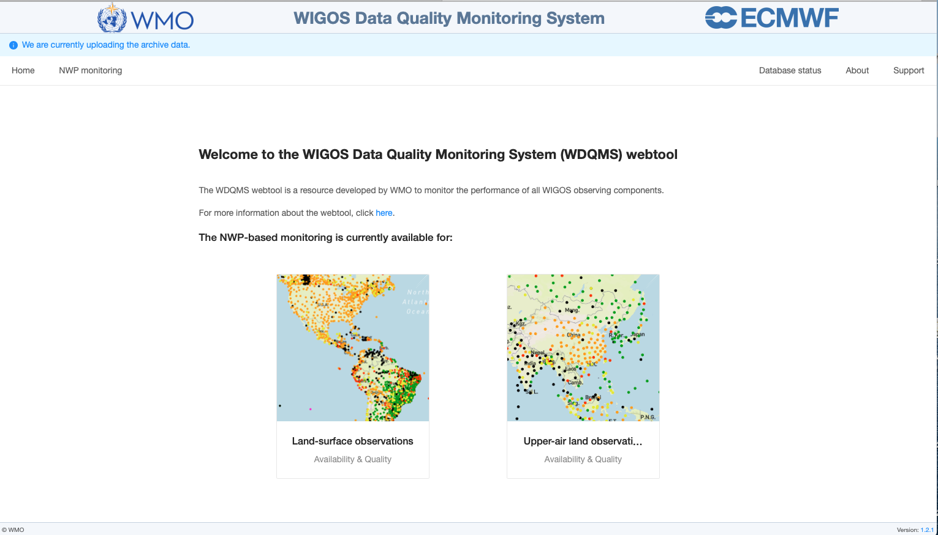
WDQMS web tool: Landing Page
This presentation will be about the monitoring of land-surface observations !
https://wdqms.wmo.int/

Slide 8
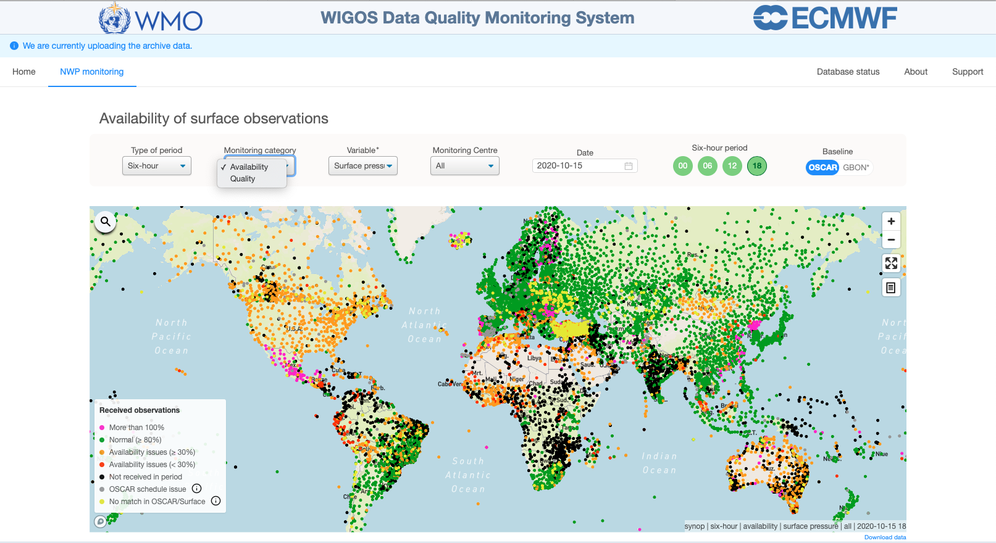
WDQMS web tool: Monitoring category
    The WDQMS web tool offers two different selections of quality monitoring categories under ‘Performance’
    ‘Availability’ - comparing the observations received via the WIS to those expected according to the schedule of international exchange declared in OSCAR/Surface (or GBON) requirements.
    ‘Accuracy’ - Average of Observation minus Background (O-B) values over the selected period (e.g. 6-hourly or daily)
    → station
    display only
    if O-B values
    available
    (no display
    of “no data”
    – no black dots)
‘Timeliness’-
Currently not available!
To be noted: in the WDQMS context “observations received” means the observations that were made available to the assimilation system of each NWP centre and are considered as a good proxy for the observations disseminated on the GTS.

Slide 9
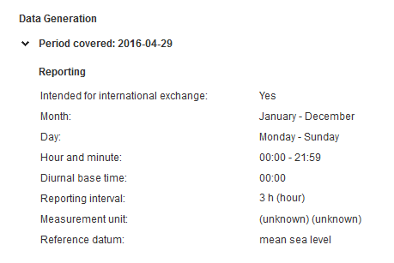
WDQMS web tool monitoring category: availability
    The WDQMS web tool offers the selection of two different baselines: ‘OSCAR’ and ‘GBON’
    ‘OSCAR’ baseline refers to the data availability performance obtained by:
    comparing the observations received via the WIS to those expected according to the schedule of international exchange declared in OSCAR/Surface metadata
Example of an OSCAR/Surface
pressure reporting interval

Slide 10
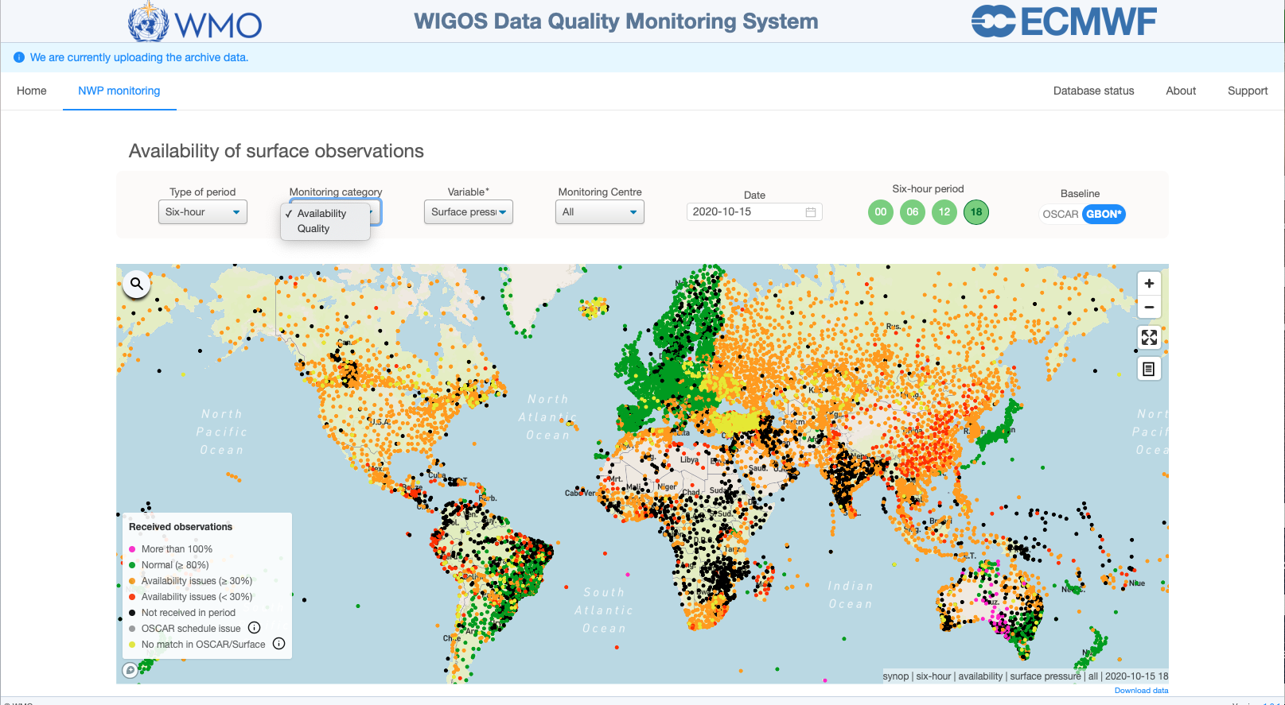
WDQMS web tool monitoring category: availability
    The WDQMS web tool offers the selection of two different baselines: ‘OSCAR’ and ‘GBON’
    ‘GBON’ baseline refers to the data availability performance obtained by:
    comparing the observations received via the WIS to those expected according to GBON schedule. Currently based on the provisional GBON requirements, i.e., hourly observations for surface.
    In some regions the stations perform worse compared to the
    display considering
    ‘OSCAR’ as baseline

Slide 11
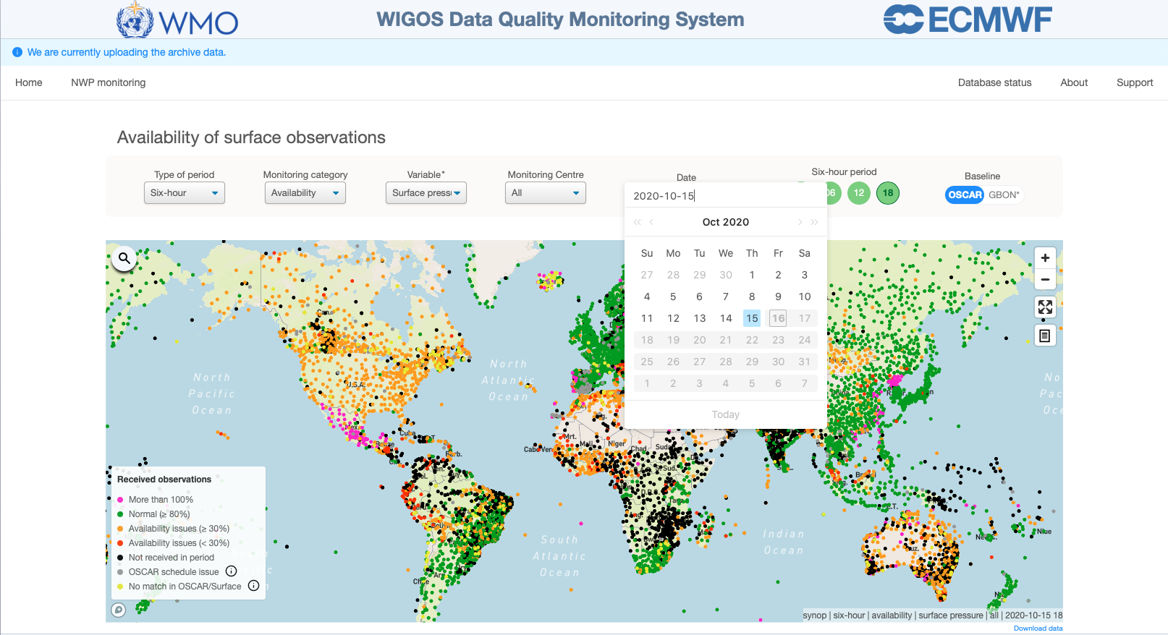
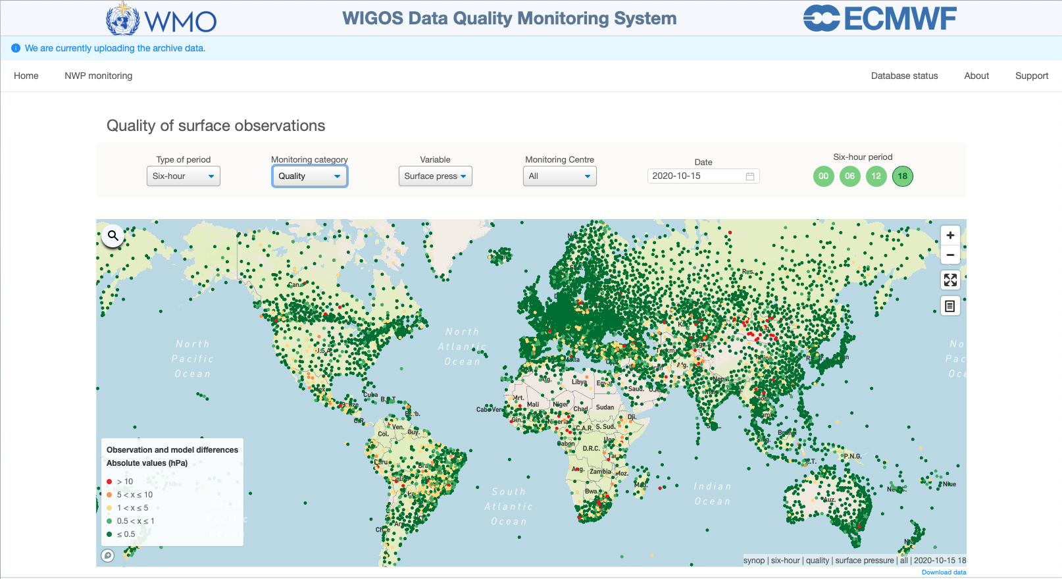
Date and Temporal aggregation (Period)
    The WDQMS web tool offers the selection of a particular date and three different types of periods
    6-hour period (the monitoring information is aggregated in four 6-hourly periods: 00, 06, 12 and 18UTC)
    → available for ‘Availability’ and ‘Accuracy’
The map displays the availability performance for each station highlighting differences in reporting performances as well as issues related to the station metadata recorded in OSCAR/Surface.
The map shows how the observing network complies with the NWP requirements set for the selected variable.

Slide 12
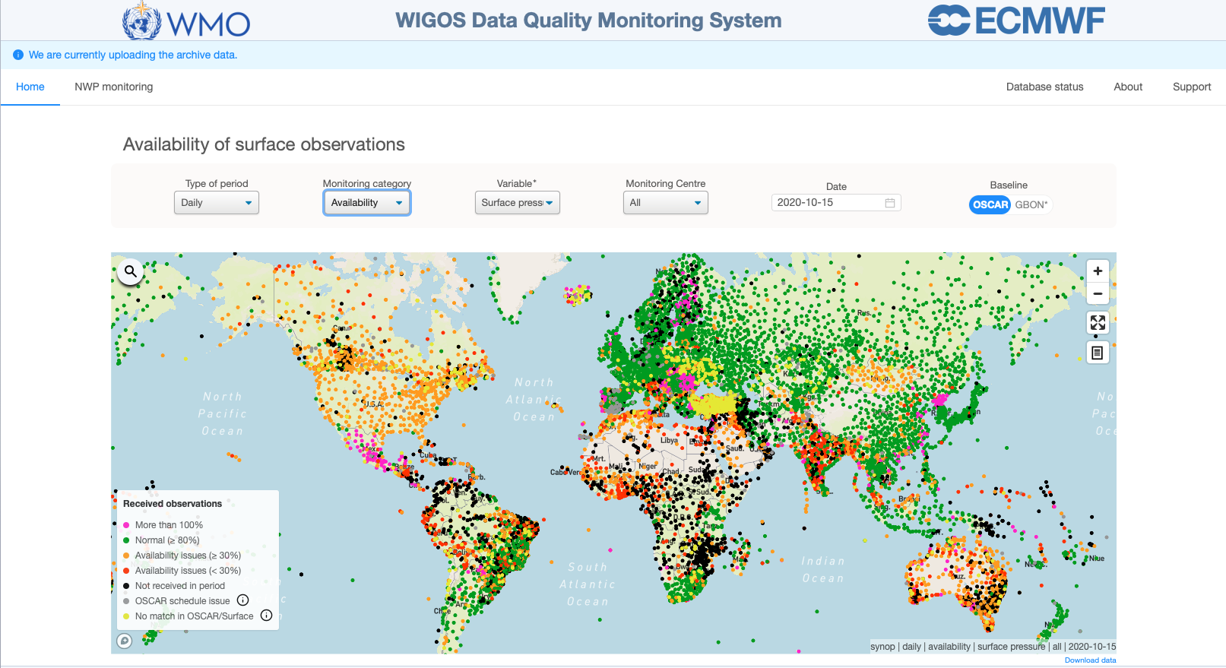
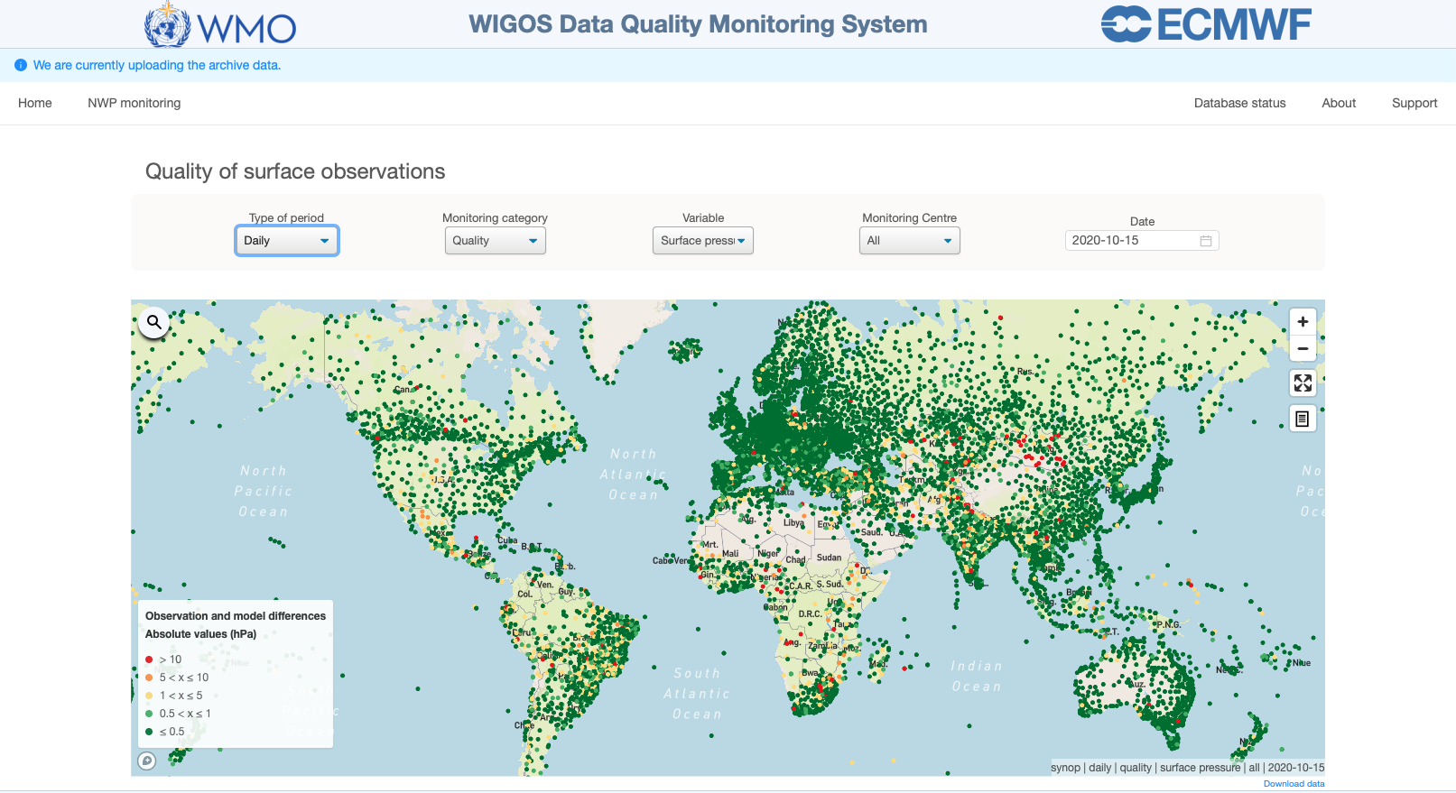
Date and Temporal aggregation (Period)
    The WDQMS web tool offers the selection of a particular date and three different types of periods
    Daily (the monitoring information is aggregated over a 24-h period)
    → available for ‘Availability’ and ‘Accuracy’

Slide 13
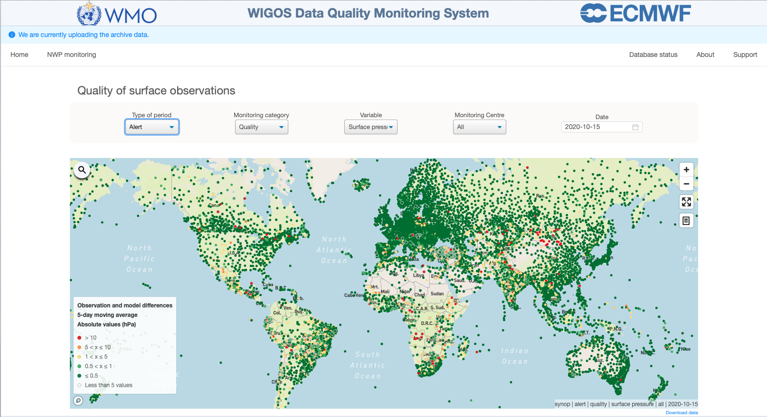
Date and Temporal aggregation (Period)
    The WDQMS web tool offers the selection of a particular date and three different types of periods
    Alert (an aggregation based on a 5-day moving average which relies on daily values for a 5-day period)
    → available for ‘Accuracy’ only at the moment

Slide 14
Type of Period: Daily versus Alert
    The alert map is based on the 5-day average (which is based on the latest 5 daily mean values when available).
    This measure is mainly used to take into account the persistence of an existing daily issue.
    Cases in which an issue deteriorates may be reflected in the daily map quicker than in the alert map.
    However, model performance under certain conditions might be the reason for sudden outliers that wouldn´t last more than a couple of days (such as in the case of a bad short-range forecast)
    Hence, it is better to have the alert with 5-day average because the influence of different model performance will probably not be seen in the 5-day average and will not trigger a false issues.

Slide 15
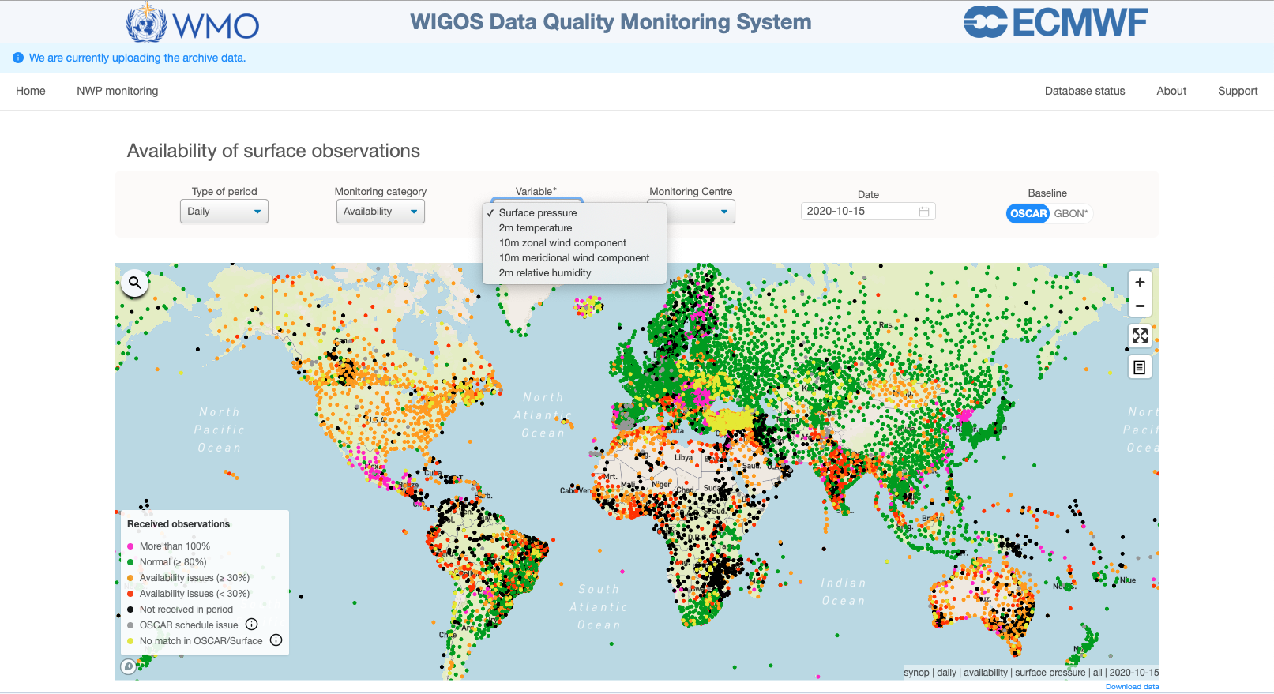
Variables monitored in the WDQMS web tool
    The WDQMS web tool allows the selection of a particular variable for evaluation: surface pressure, 2m temperature, 10m zonal wind component, 10m meridional wind component, 2m relative humidity)
    To be noted: most of the land surface messages received from GOS stations contain several variables ➔ in most cases if one variable is missing all other variables will be missing too, for a particular station. However it’s worth checking because in some cases surface pressure can be missing whereas the others may not.
Availability

Slide 16
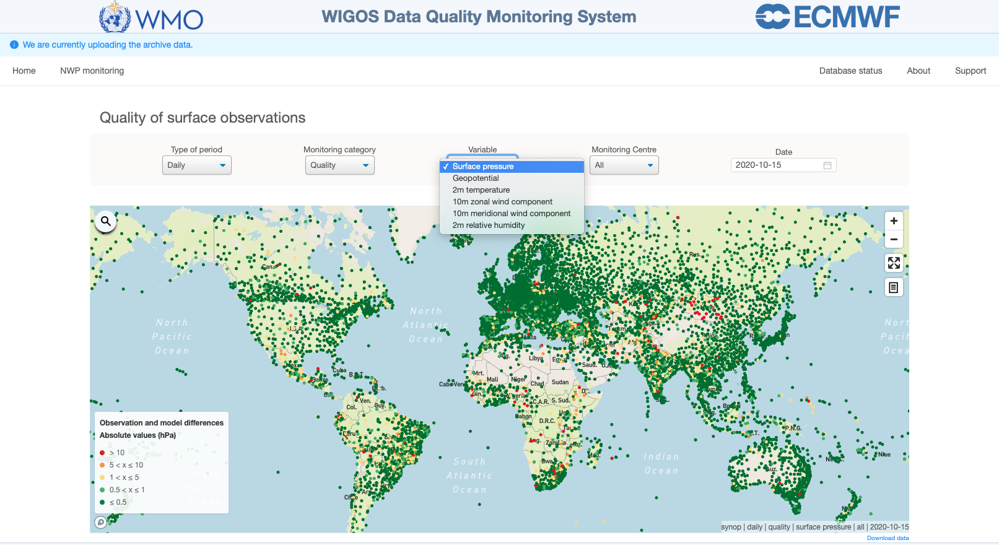
Variables monitored in the WDQMS web tool
    The WDQMS web tool allows the selection of the variable ‘Surface pressure’ and ‘Geopotential’ for accuracy
    To distinguish between land stations in mountainous areas (high elevation stations which report geopotential instead of mean sea level pressure) and the rest of the land surface stations
    WIGOS MCs assess surface pressure, while in the case of stations
    in mountainous areas they assess geopotential height (ECMWF and JMA only).
Quality/Accuracy

Slide 17
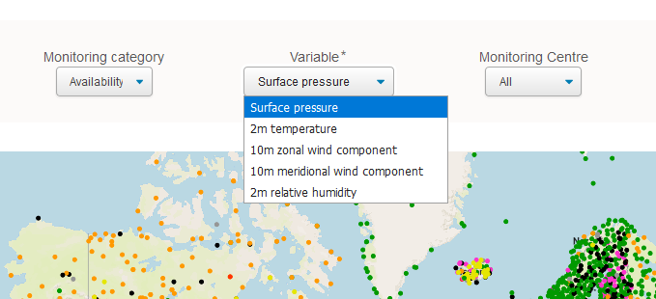
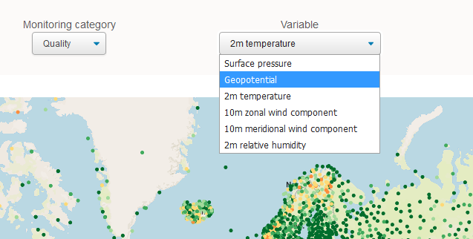
Variable ‘Surface pressure’ and ‘Geopotential’
    In the ‘Availability’ map these two variables are combined to ‘Surface pressure’
    In the ‘Accuracy’ map these two variables are displayed to be able to evaluate the results for surface pressure and geopotential height separately.

Slide 18
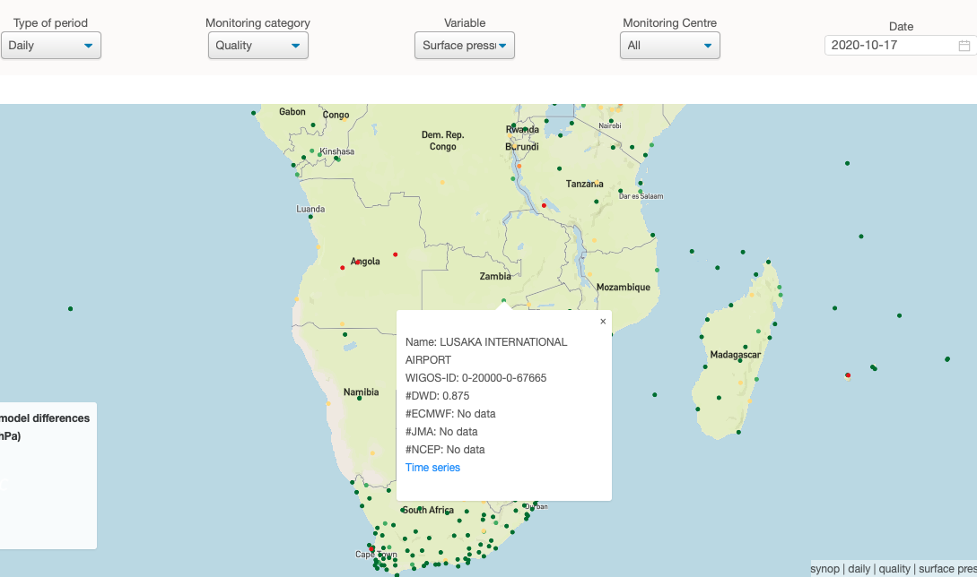
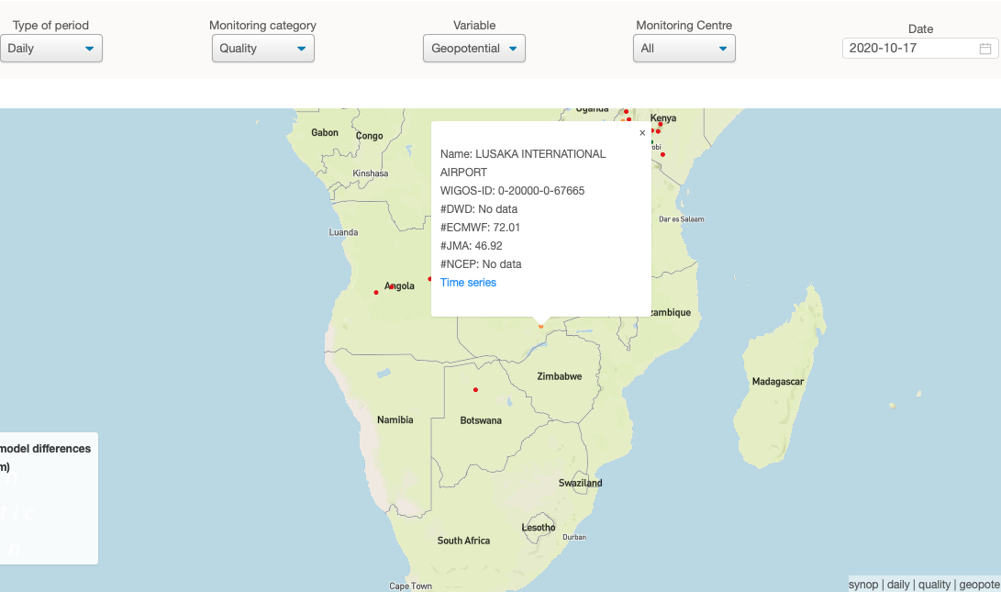
Variable ‘Surface pressure’ and ‘Geopotential’
    Same station can appear in both (Surface pressure and Geopotential) view maps (option “All” selected) due to differences in the monitoring results provided by the different WIGOS MCs.
    Lusaka International Airport (1152 m): results for surface pressure (DWD) and geopotential (ECMWF and JMA).

Slide 19
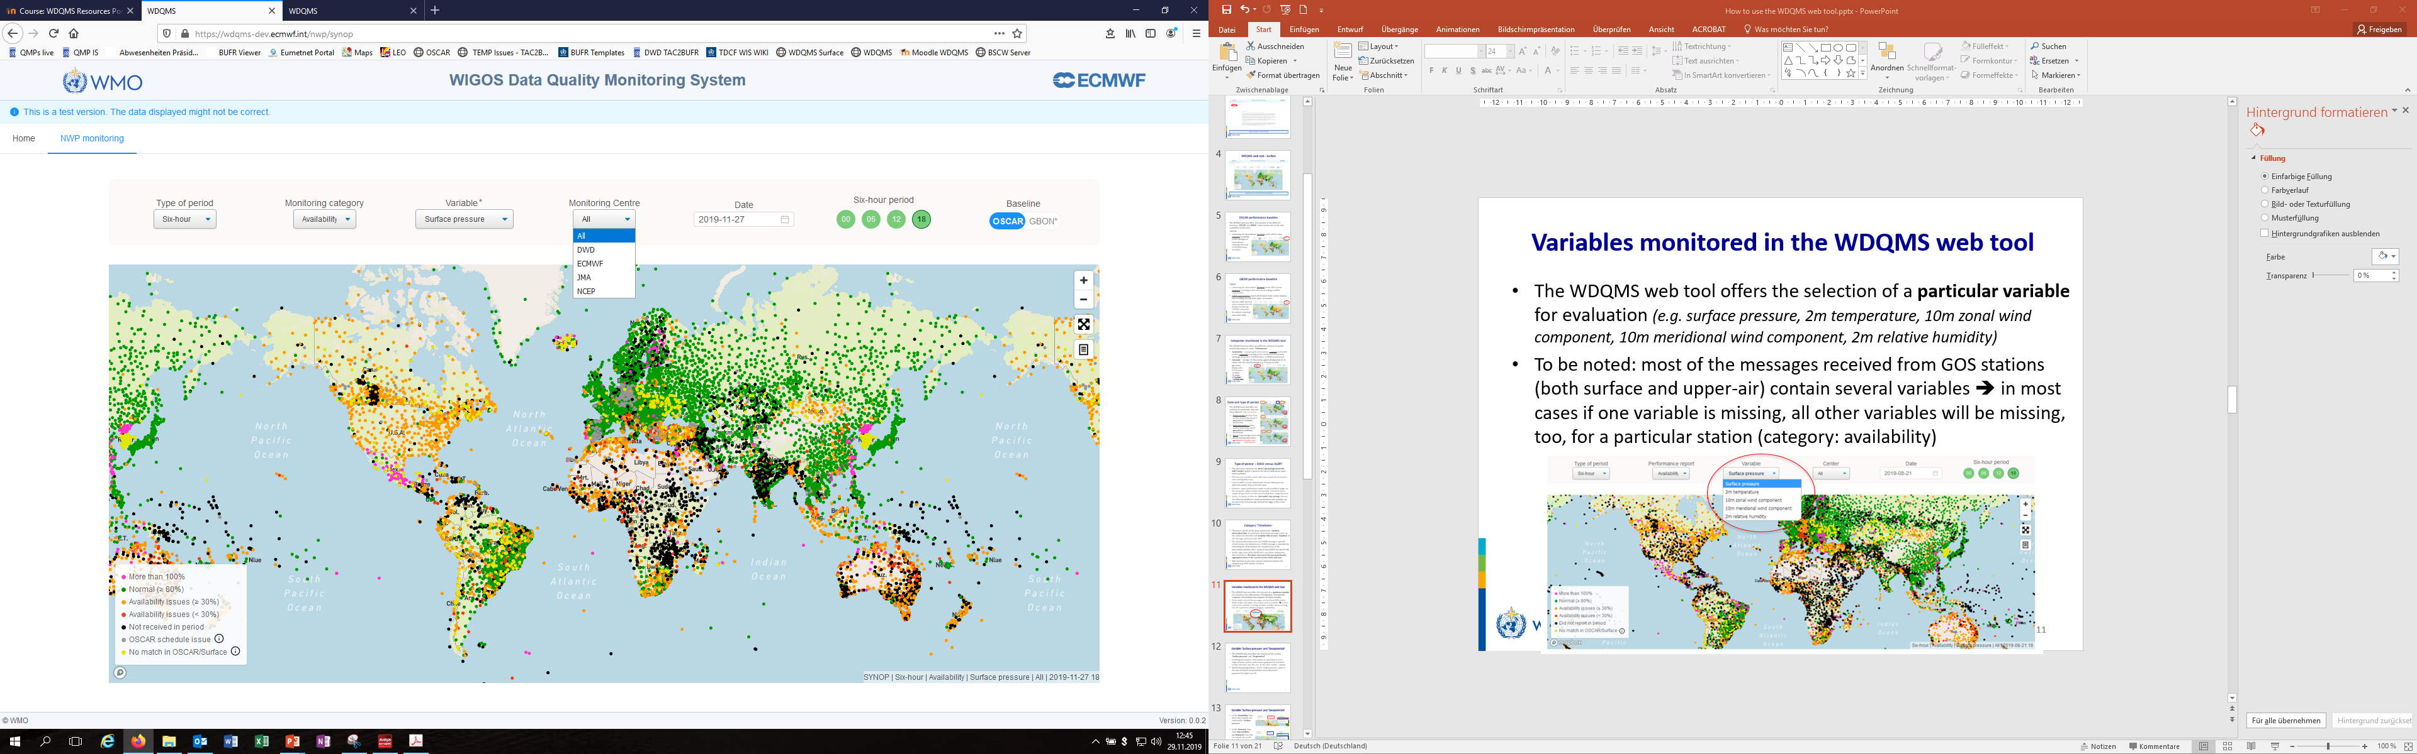
NWP Centre aggregation – Monitoring Centre
    The WDQMS web tool allows selecting results of a particular WIGOS Monitoring Centre or the aggregation of all centres.
    If ‘All’ is selected the results of all WIGOS MCs are combined into one figure concerning ‘Availability’ and one figure for ‘Accuracy’.
    The WIGOS MC results might differ due to various reasons (e.g. higher number of received observations in availability due to longer DA cut-off times)
    Hence, the combined selection of daily performance of the quality monitoring category availability will show the best of all Centres, respectively the maximum availability result.
    For accuracy the NWP model whose background field is closest to the observed value (i.e. smaller O-B values) will be selected as it exhibits the best performance result.

Slide 20
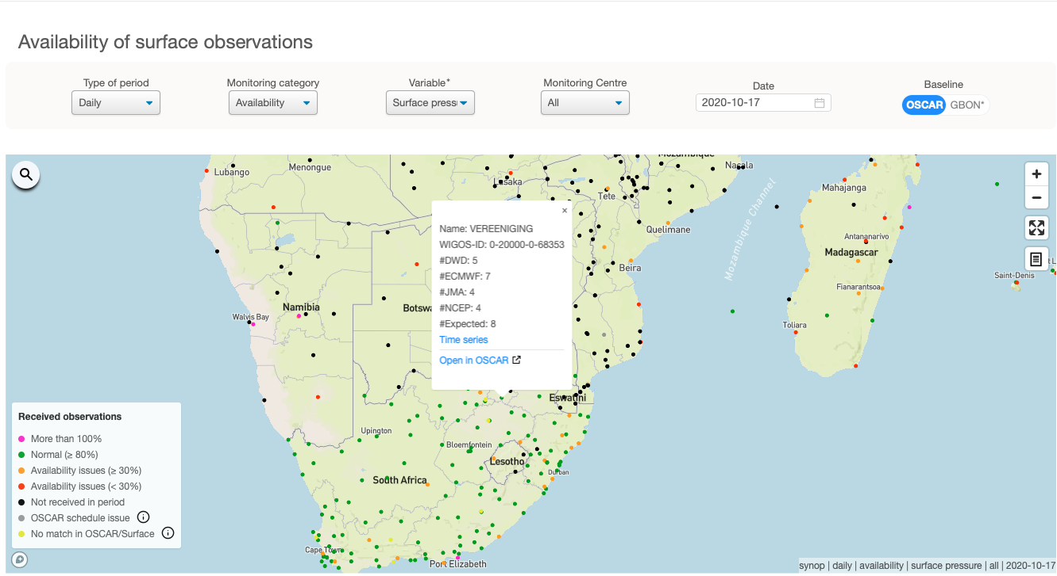
Detailed performance of a particular station for ‘Availability’
    Clicking on a dot on the map opens up a screen with detailed information about the station data availability.
    The popup window displays:
      the station name and WIGOS Station Identifier (WSI)
      the number of received messages of a selected WIGOS MC or each WIGOS MCs (if ‘All’ selected under ‘Monitor Center’) as well as the number of expected messages according to the schedule declared in OSCAR/Surface metadata for the selected type of period (6-hourly, daily)

Slide 21
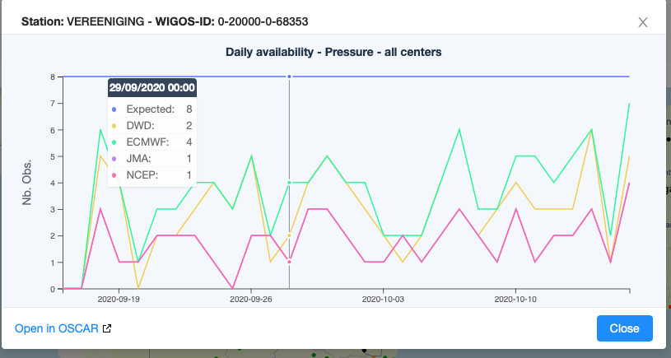
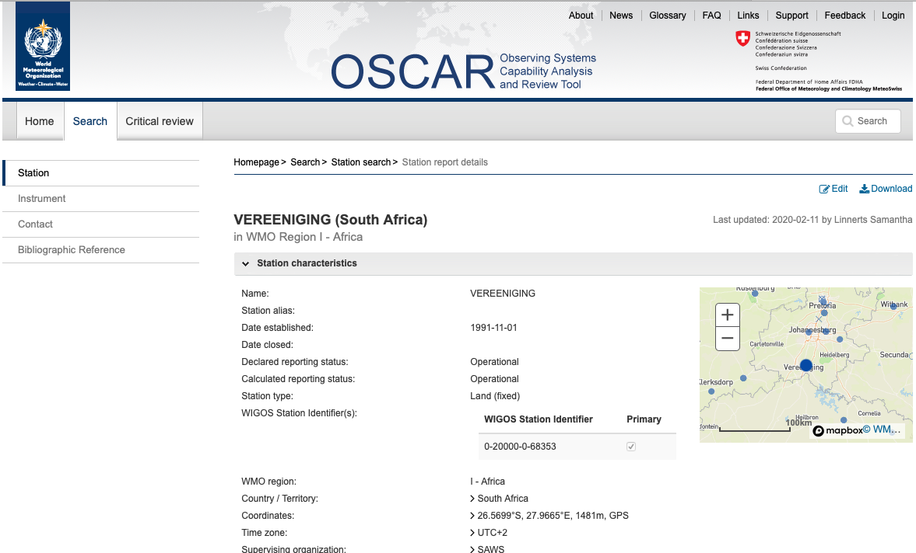
Detailed performance of a particular station for ‘Availability’
The popup window contains:
a link to the station´s availability time series (30 days) displaying the number of messages of a selected WIGOS MC or each WIGOS MCs (if ‘All’ selected under ‘Monitoring Center’) as well as the number of expected messages according to the schedule declared in OSCAR/Surface metadata for the selected period (6-hourly, daily)
a link to the corresponding metadata page of the station in OSCAR/Surface

Slide 22
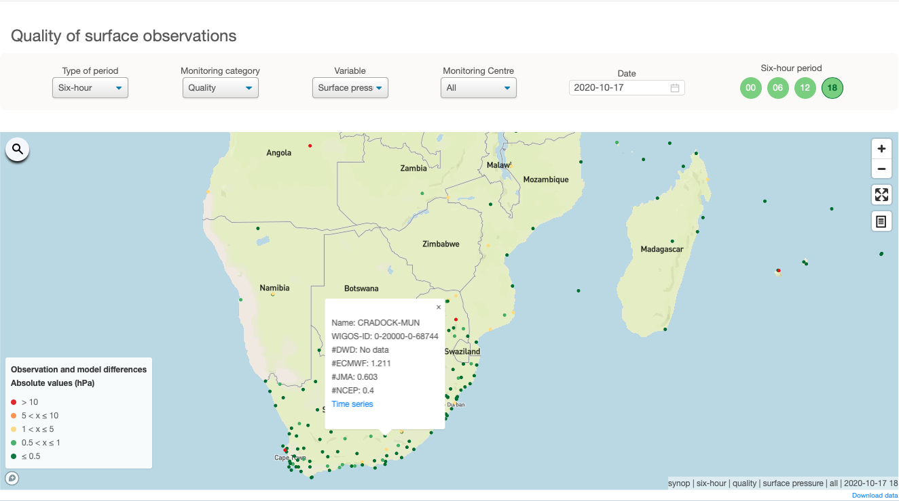
Detailed performance of a particular station for ‘Accuracy’
    By clicking on a particular station the WDQMS web tool displays more details about the accuracy performance of the station
    A popup window displays:
      the station name and WIGOS Station Identifier (WSI)
      the O-B values of a selected WIGOS MC or each WIGOS MCs (if ‘All’ selected under ‘Center’) of the selected variable (e.g. surface pressure)

Slide 23
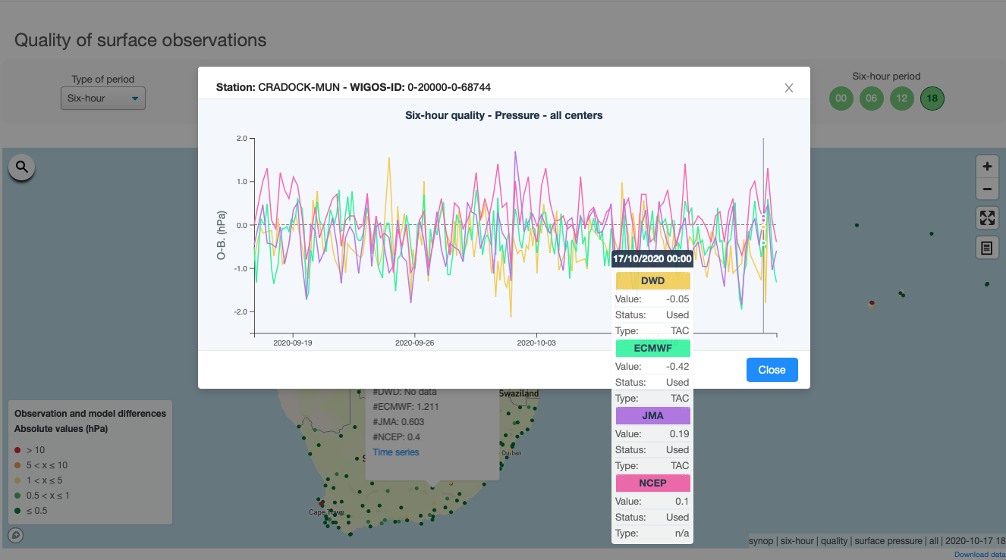
Detailed performance of a particular station for ‘Accuracy’
    The popup window contains a link to the station’s time series displaying the O-B results of the previous periods (6h/daily steps) for each WIGOS MC (WIGOS MCs with the same results will overlap, the cursor popup information will show all results of each WIGOS MC)

Slide 24
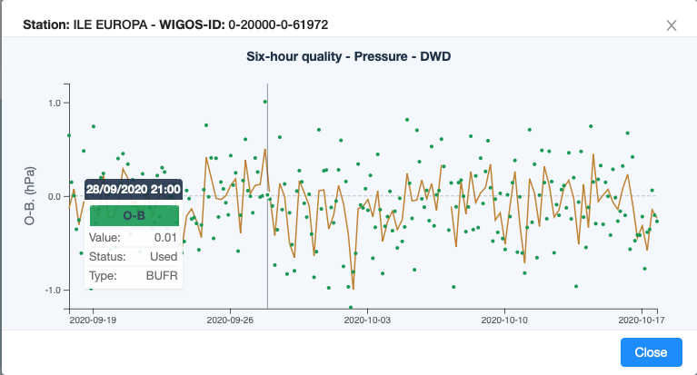
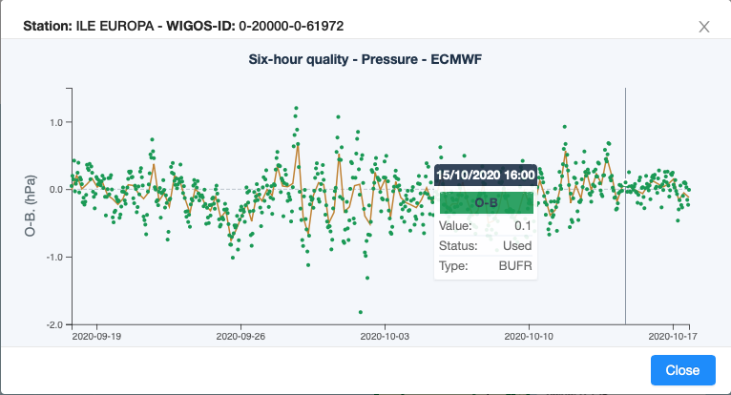
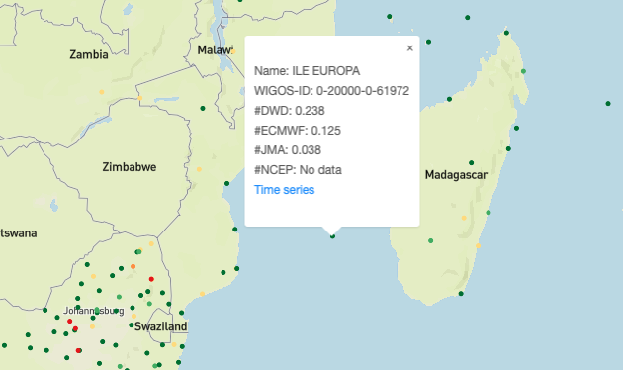
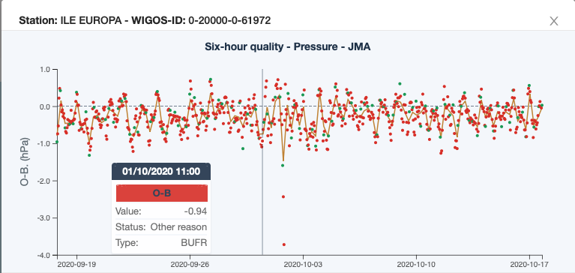
Detailed performance of a particular station for ‘Accuracy’
Used
Not Used
It is worth noting that the 6-hourly intervals for a particular monitoring centre will allow to see the details of individual observations that contribute to the average value displayed on the map. This means that it is possible to check the O-B value, the usage (Status, i.e., used or not used because it was rejected by/before the assimilation) and the type of report (Type, i.e., TAC or BUFR) of a particular observation (identified by date and time) by hovering the mouse over each dot in the time series.
DWD
ECMWF
ILE EUROPA (France) in WMO Region I - Africa
JMA

Slide 25
Thank You for listening!
Questions?

Slide 26
WDQMS: Differences in NWP monitoring reports
But we need to bear in mind the way the four different NWP DA systems deal with observations:
NCEP, provides information only on the data that pass a quality control step prior to DA, therefore part of the data available that is deemed to be of poor quality or duplicate is filtered out and not available to the DA.
ECMWF, provides monitoring information of all observations available to the DA, even data deemed to be of poor quality (rejected and/or blacklisted by the system). Observations may not be available when a serious coding issue prevents the acquisition system to extract any meaningful value. Assimilates surface pressure observations hourly and geopotential height for some high-altitude stations.
DWD doesn’t provide O-B values if the observation is not considered in the assimilation. And they tend to assimilate surface pressure observations every 3h rather than hourly.
JMA provides O-B values even if the observation is not used in the assimilation although they tend to assimilate surface pressure observations every 3h rather than hourly. Also assimilate geopotential height in some high-altitude stations.

