Slide 1

Workshop for Regional WIGOS Centres
in RA I (SADC)
Introduction to the
Regional WIGOS Centre and its daily tasks

Slide 2
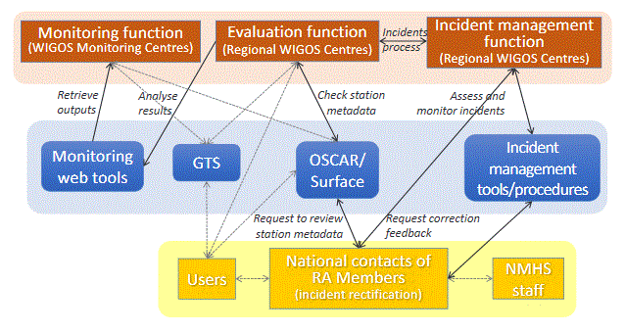
The WDQMS process
RWC
    RWC evaluate the performances and initiate the incident management system in case of non-compliance
Notes:
WIGOS monitoring function: WIGOS monitoring centres provide quality monitoring information on a 6-hourly basis
Quality monitoring reports as basis of the WIGOS monitoring function
Categories data availability, timeliness and data quality
Provide input to the WIGOS evaluation function.
WIGOS evaluation function: generates routine performance reports measured against reference sources
From the quality monitoring reports
From metadata about the observing stations, from the Observing Systems Capability Analysis and Review (OSCAR)/Surface tool,
From the WMO Information System (WIS).
WIGOS incident management function: takes up the issues that the evaluation function raised as incidents, and follows up actions with the data supplier to resolve the incident.

Slide 3
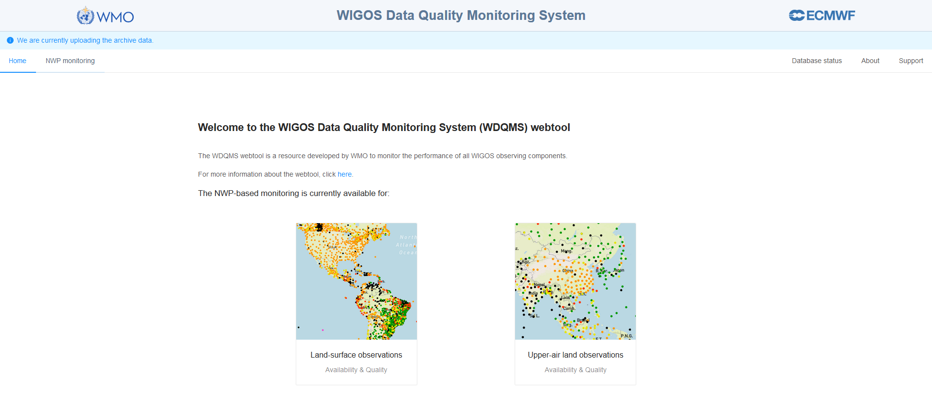




Regional WIGOS Centres daily tasks
    Regional WIGOS Centres (RWC) should evaluate the performance of stations of countries under their responsibility.
    This should be done on a daily basis by reviewing the automated quality monitoring reports received from the WIGOS Monitoring Centres (global NWP centres) which are displayed in the the WDQMS web tool (https://wdqms.wmo.int/ ).
https://wdqms.wmo.int/

Slide 4
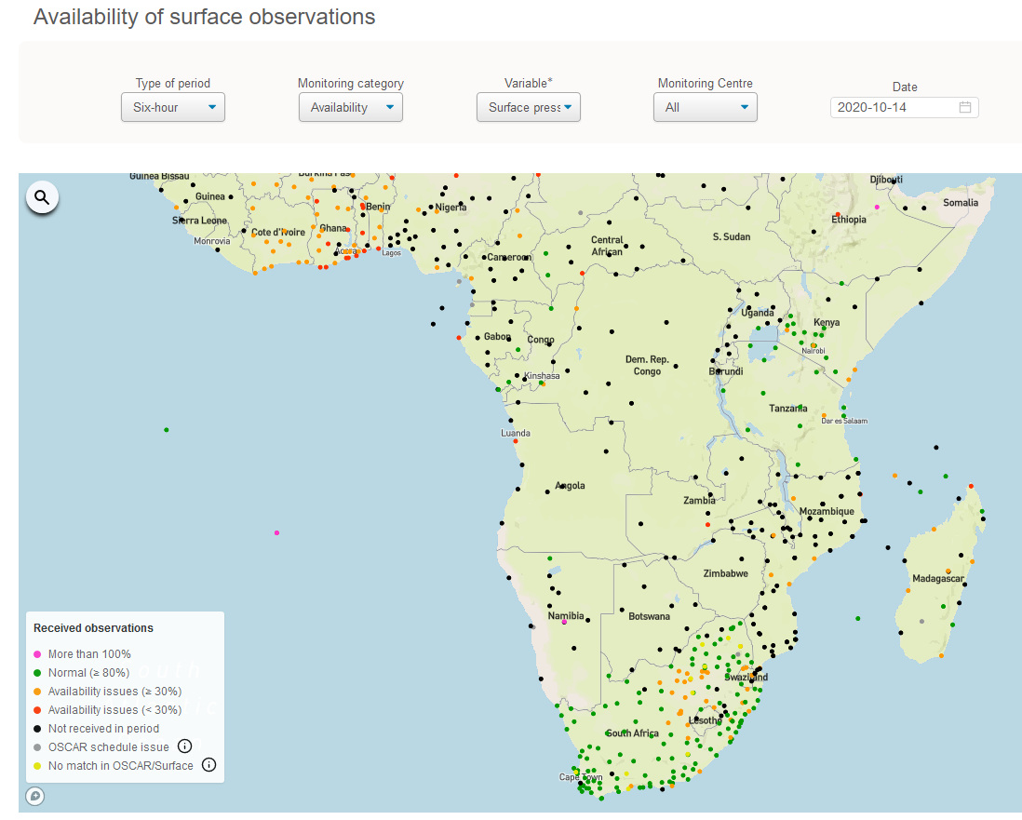
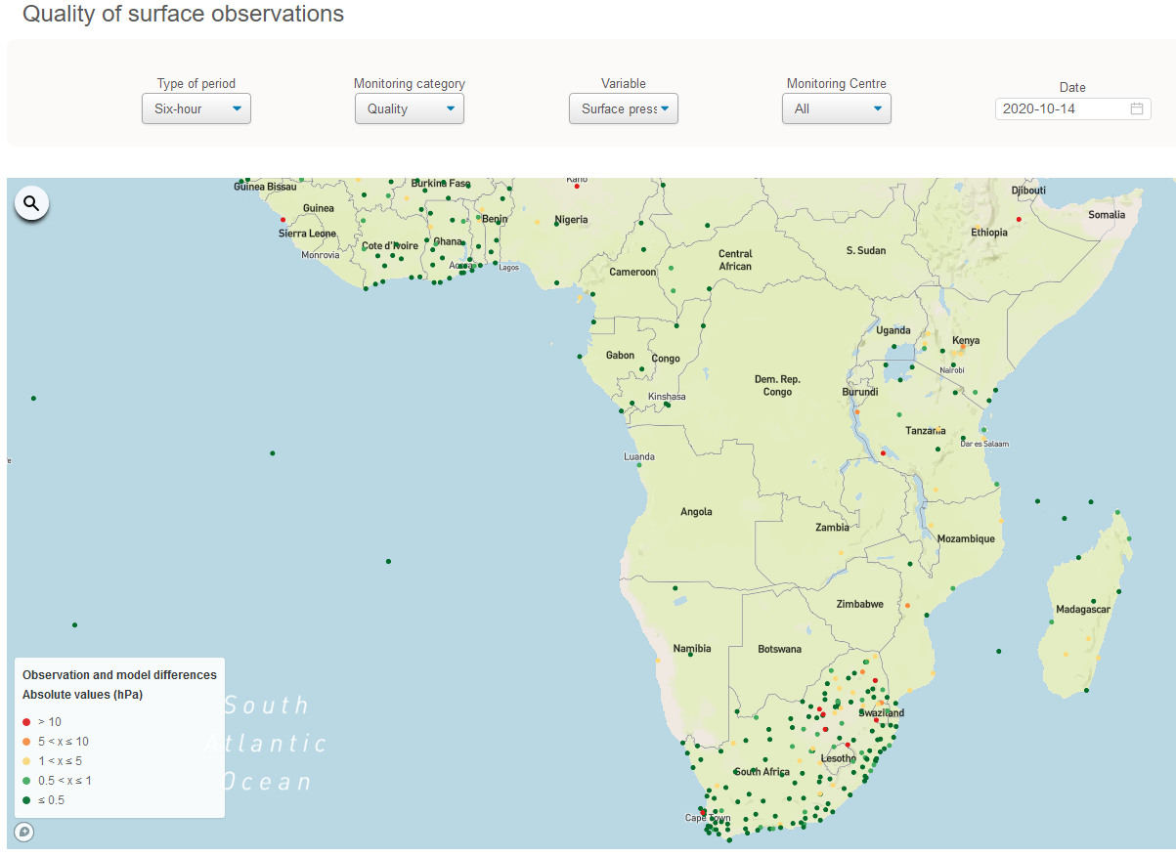
RWC evaluating the performances
    Check the performance concerning the three main categories data availability, (timeliness) and accuracy (bias as the measure of trueness, standard deviation as the quantitative measure of precision) regarding the WDQMS performance targets.
    Follow the same quality evaluation processes if an issue has been reported to the RWC by a user (e.g. by a Global NWP Centre or a Member of a Regional Association).
Data availability
Accuracy

Slide 5
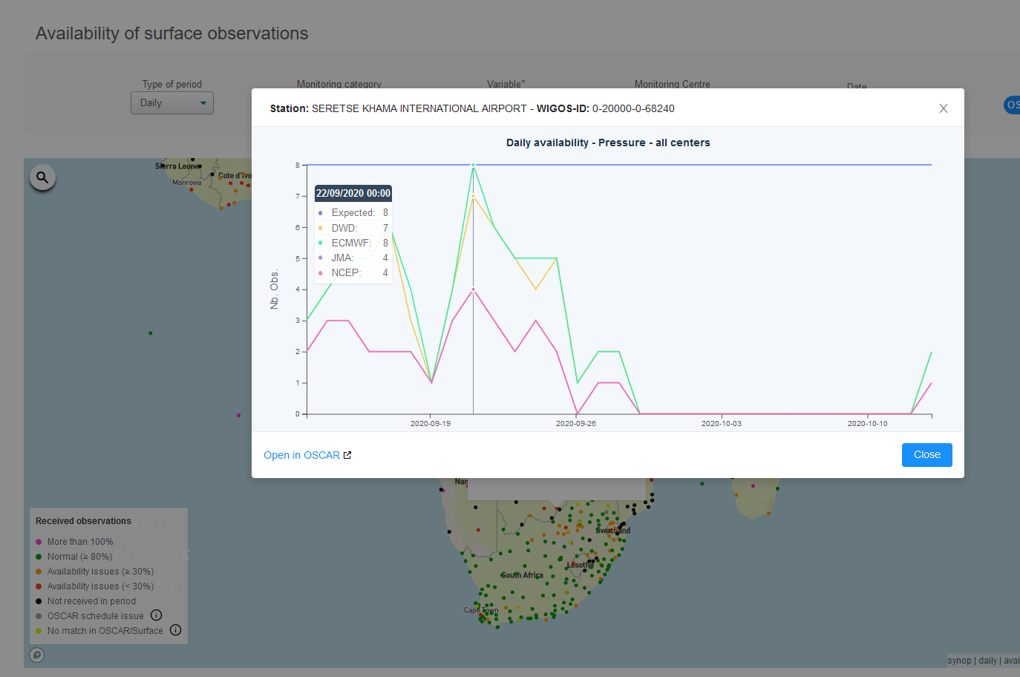
Identify stations showing non-compliance
    Reasons for non-compliance related to data availability might be
    The station did not report
    any data in the last days
    The total number of reports
    is significantly lower than
    the expected number of
    observations as defined in
    the observing schedule in
    WIS and OSCAR/Surface
    The data arrived with a significant delay, which may lead to a situation where data could not be used in near-real-time applications, e.g. for nowcasting purposes (category: timeliness);

Slide 6
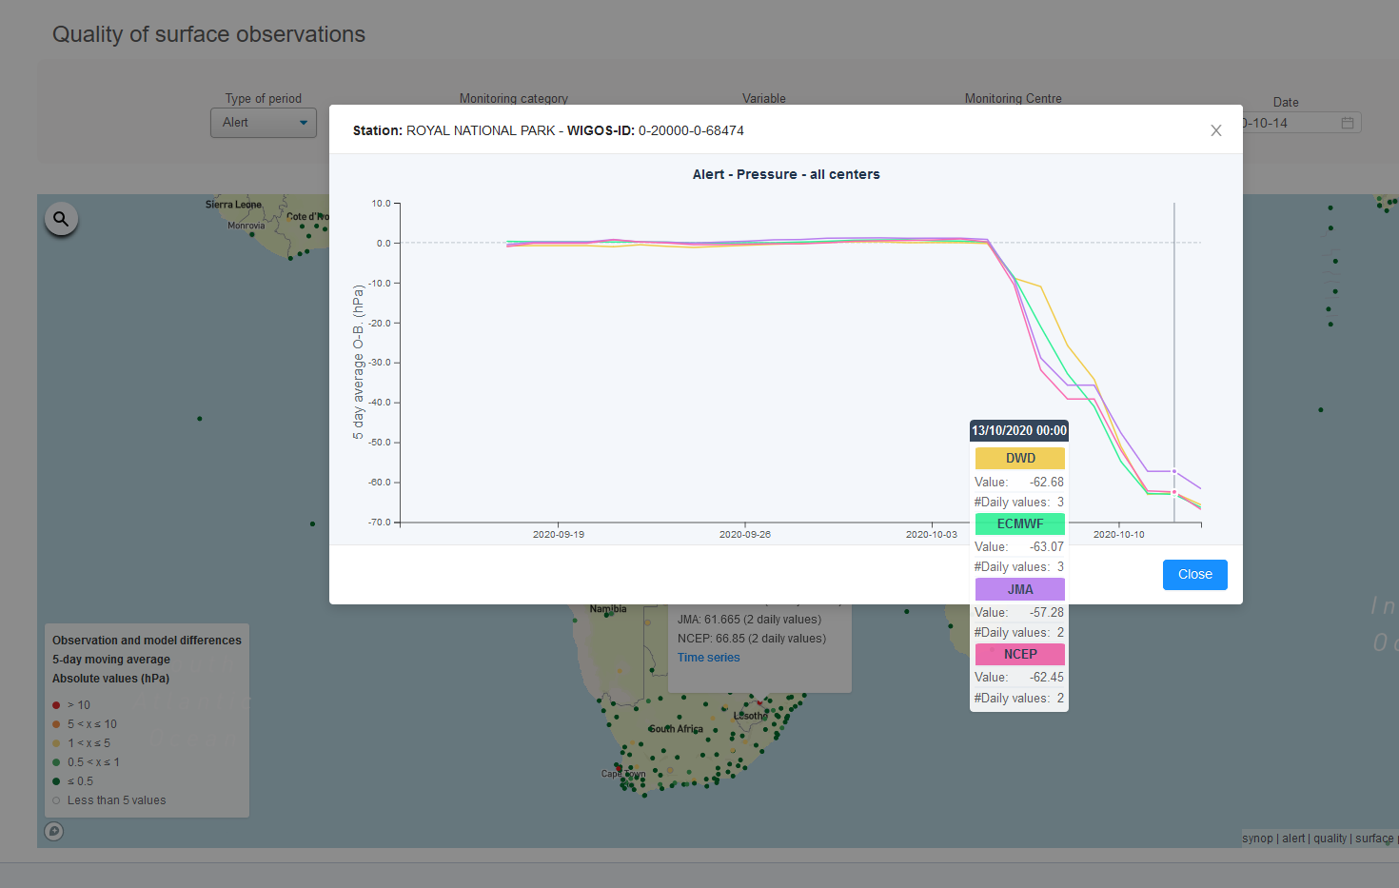
Identify stations showing non-compliance
    Reasons for non-compliance related to accuracy might be
    The daily averaged accuracy statistics exceed the WMO threshold requirements concerning a particular variable / several variables, e.g. for GBON stations or according to OSCAR/Requirement

Slide 7
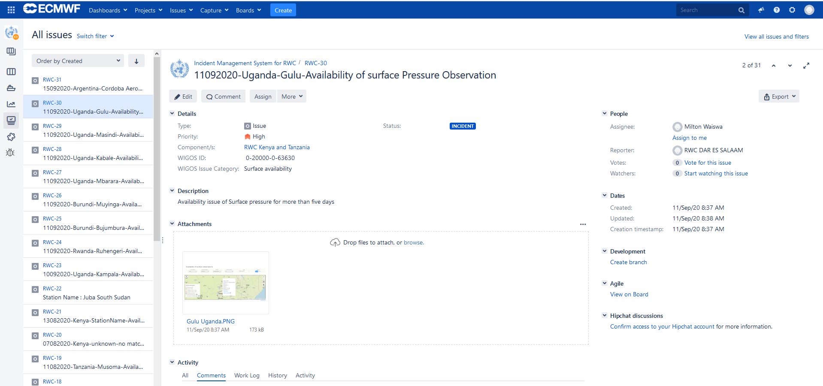
Issues identified
    If an issue has been identified this should be recorded in the Incident Management System as part of the incident management process (issue identification - part A)
(https://jira.ecmwf.int/projects/RWC)

Slide 8
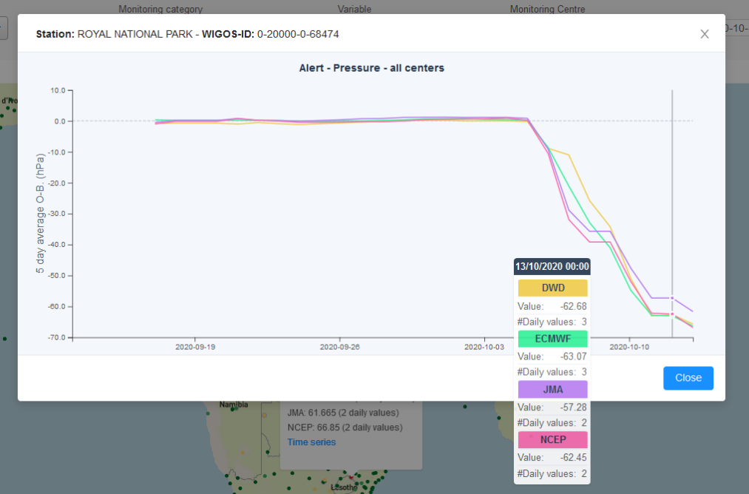
Issues identified in previous days
    Check the status of issues identified (e.g. if the station did not report any or suspicious data) in the following days.
    Stations with identified issues should be checked again as to whether the performance improved, e.g.
      did the station start reporting again,
      did the station report as many reports as expected again,
      did the data start arriving without delays again or
      did the measurement uncertainty of observations improved again and therefore remained within the agreed targets on a daily average
?

Slide 9
Incident tickets in case of non-compliances
    In the case of an ongoing non-compliance of a particular station raise an incident ticket by describing the incident, according to the incident management procedure.
    The results from various WIGOS Monitoring Centres might differ. Hence, initiate an incident management procedure only if most WIGOS Monitoring Centres show similar results (e.g. data are missing in most Global NWP Centres).
    When several stations of a country show the same non-compliance, one incident ticket might be raised for all the stations
    If an issue continued for 5 (or more) days an Incident management process (IMP) should be initiated by giving the incident ticket an incident ticket number and to contact the
    data provider asking for incident rectification.

Slide 10
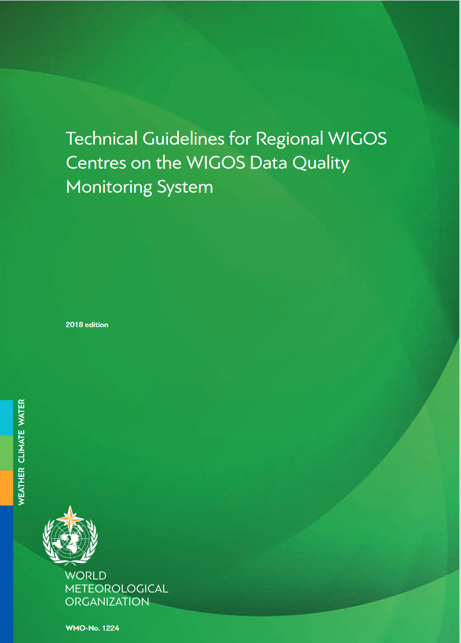
RWC evaluation background and priorities
    ‘Technical Guidelines for Regional WIGOS Centres
    on the WIGOS Data Quality Monitoring System’
    WMO-No. 1224
    The RWC should base their evaluation of the
    data availability and accuracy performances on
    the performance targets outlined in WMO-
    No. 1224 or on particular performance targets,
    e.g. GBON requirements or other network or
    regional requirements.
    Frequent issues are described in WMO-No. 1224
    The incident management process shall be prioritized according to the priority levels for surface land stations and radiosonde stations described in WMO-No. 1224, e.g. giving very high priority if several or all stations of a country are affected.

Slide 11
Issues which “disappeared”
    If an issue “disappeared” within the 5 days of monitoring because the performance of the station improved again, no formal incident management process has to be initiated (no incident ticket number has to be defined) and the issue will be closed.
    In this case, the issue reporter should be informed about the improved performance and the closure of the issue.

Slide 12
Monitoring of raised incident tickets
    RWC should monitor the status of raised incident tickets on a daily basis, and ensure that the country to which an incident has been reported:
      Confirmed the reception of a new incident ticket;
      Provided an appropriate action proposal containing details of the cause of the incident, proposed actions and a timeline to resolve the incident;
      Provided weekly updates and even “no change” reports;
      Reported on incident rectification.
    Close an incident ticket after the national contact of the country has reported incident rectification, check the improvement in performance of the station in question, confirm successful rectification of the incident, and inform issue reporters about successful incident rectification and closure of the report.

Slide 13
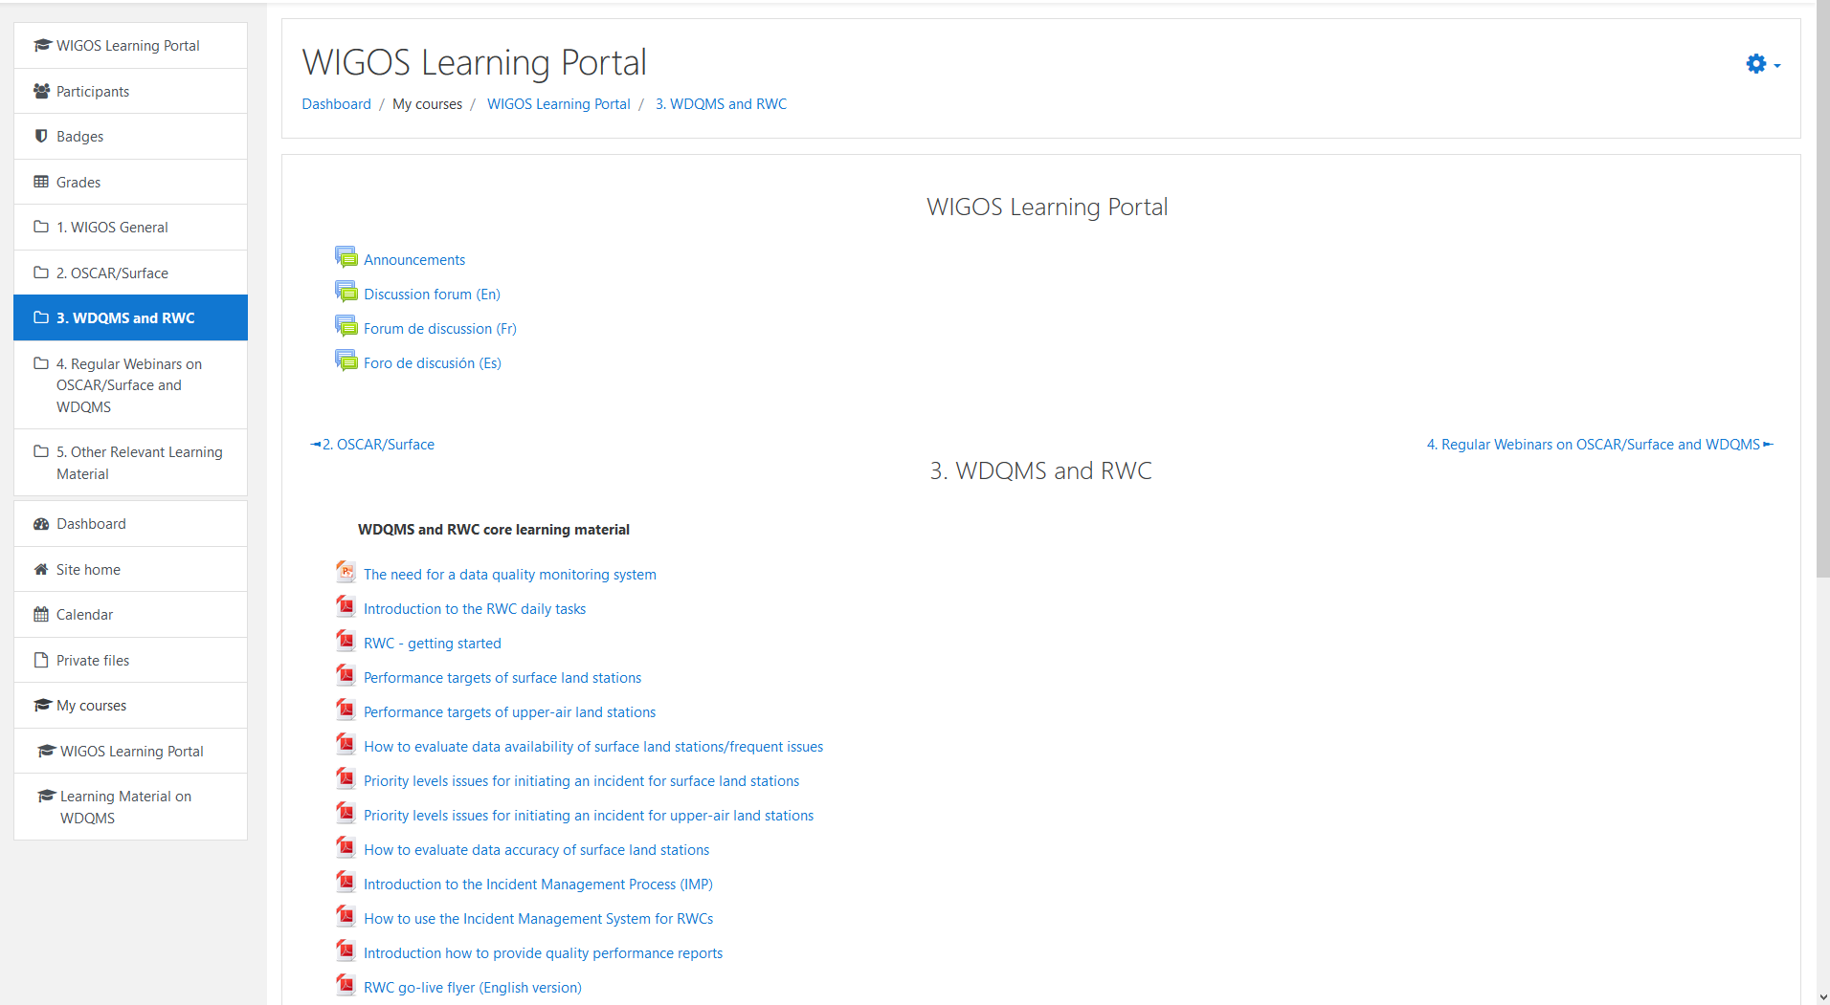
How to do the work in practice…
    How to fulfil the RWC tasks and which background information is required can be found on the WIGOS Learning Portal
    https://etrp.wmo.int/course/view.php?id=146

Slide 14

Thank you
Tanja.Kleinert@dwd.de
www.wmo.int/wigos

