Slide 1

Workshop for Regional WIGOS Centres
in RA I (SADC)
How to evaluate
data availability and data accuracy
FOCUS ON LAND-SURFACE STATIONS

Slide 2
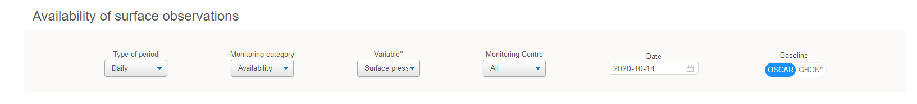
Category ‘Availability’
    RWC may select the Monitoring category ‘Availability’ in the web tool to evaluate the performance related to data availability
    The monitoring of data availability is based on performance figures of WIGOS Monitoring Centres (MC) obtained from comparing the observations received to those expected to be ingested to the WMO Information System (WIS) according to the schedule of international exchange determined from OSCAR/Surface metadata.
    If at least one WIGOS Monitoring Centre shows ‘Normal’ (green) and others show different results, e.g. ‘Availability issues’ (orange or red) no action is required by the RWC.

Slide 3
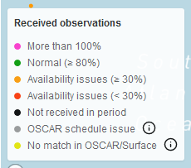
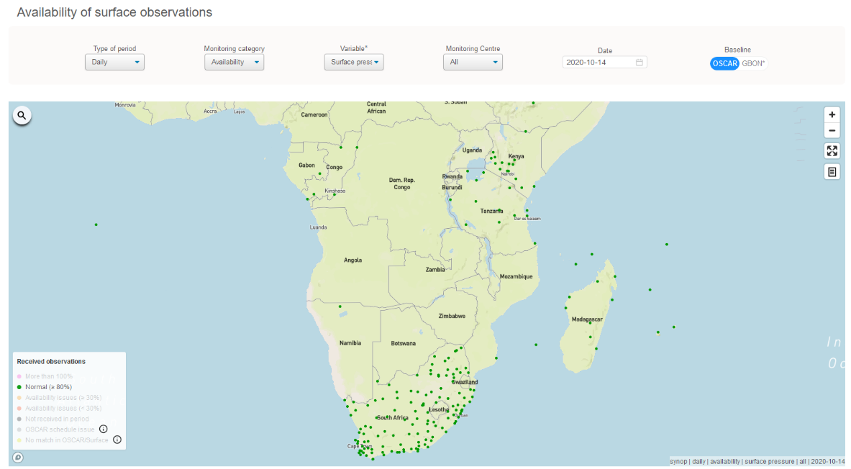
Normal (≥ 80%)
    Stations shown as green dots
    Normal (≥ 80%) – station is performing well
    ➔ no action required ☺

Slide 4
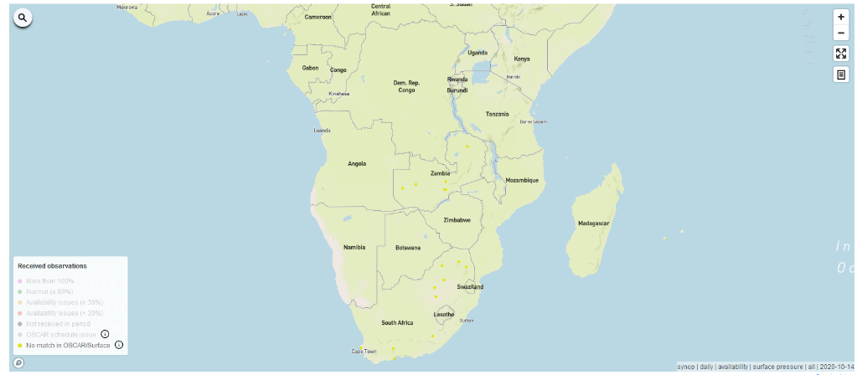
No match in OSCAR/Surface
    No match in OSCAR/Surface – although data available on WIS!
    Stations shown as yellow dots, are reporting but has not been registered in OSCAR/Surface so far, or at least there is no match of the station ID (potential reason: NMHS might not have sufficient number of WMO IDs but did not migrate to WSI yet).
    RWC to initiate an incident management process asking WDQMS NFP to contact OSCAR/Surface NFP

Slide 5
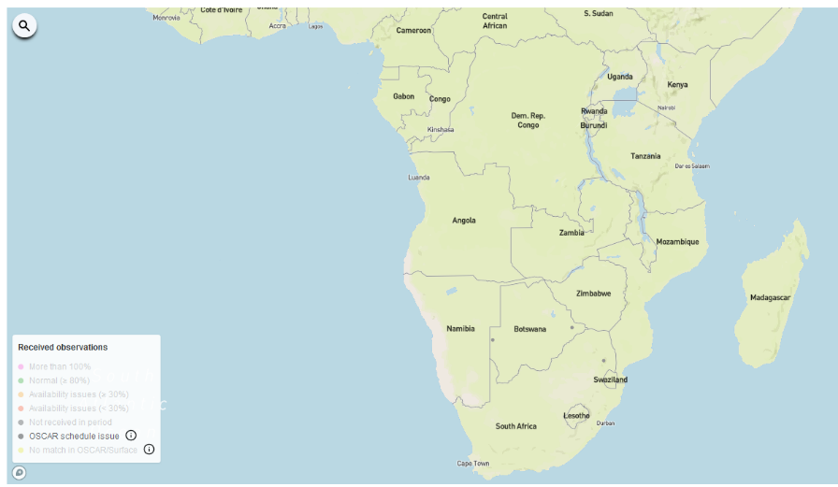
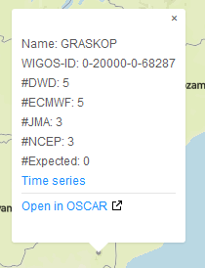
OSCAR schedule issue
    Stations shown as grey dots are reporting but there seem to be issues in the OSCAR schedule (potential reason: NMHS might report higher temporal resolution but didn´t set the field ‘international exchange’ correctly → ‘#Expected’ = 0).
    RWC to initiate an incident management process asking WDQMS NFP to contact OSCAR/Surface NFP
Stations:
68070
68140
68287

Slide 6
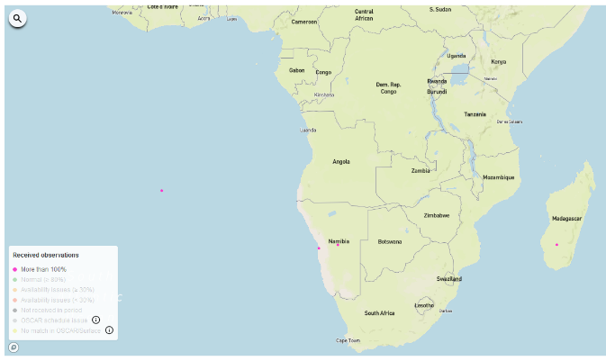
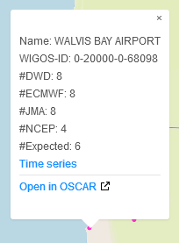
More than 100%
    Stations shown as pink dots
    More than 100% - actually a ‘happy problem’ because more data are shared internationally than indicated in OSCAR/Surface
    Most likely there is an issue with the expected number of measurements in the metadata field ‘Reporting interval’ in OSCAR/Surface for this particular variable (→ see ‘#Expected’)
    RWC to initiate an incident management process asking WDQMS NFP to contact OSCAR/Surface NFP to make corresponding changes in
    OSCAR/
    Surface
    metadata
Stations:
68098
68110
67152

Slide 7
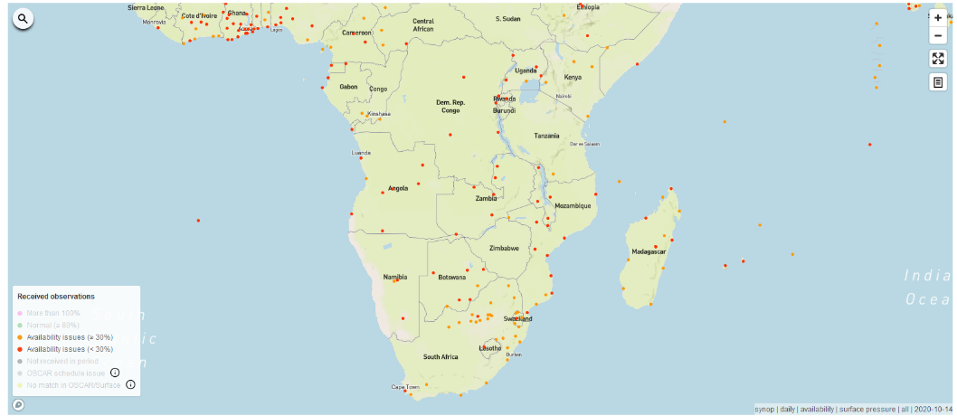
Availability issues (≥30%) and (<30%)
    Stations showing orange or red dots have availability issues
    If they continue to appear having ‘Availability issues‘ especially when selecting ‘All’ Centers and the ‘Daily’ display
    RWC to initiate an incident management process asking WDQMS NFP to take actions to investigate the cause of the incident and to find a solution (issues often related to incorrect entries in OSCAR/Surface on reporting interval)

Slide 8
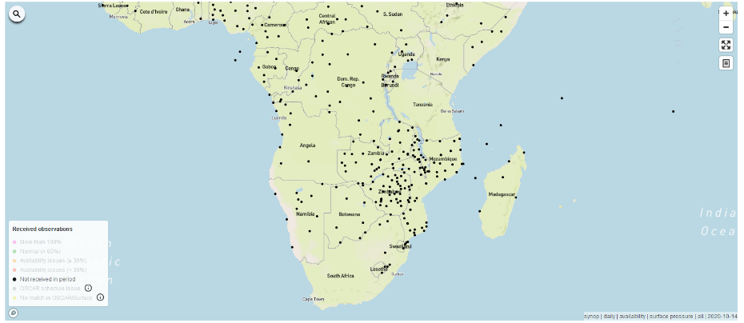
Not received in period
    Data from stations shown as black dots were ‘Not received in
    period ‘ – this is shown especially when selecting ‘All’ Centers and the ‘Daily’ display
    If data of this station were not received since a longer period of time (more than 5 days) it is a ‘silent station’
    RWC to initiate an incident management process asking WDQMS NFP to take actions to investigate the cause of the incident and to find a solution

Slide 9
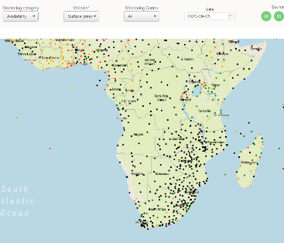
Reasons for ‘no data received’
    There are several reasons for no data being received by the WIGOS Monitoring Centres. The causes for these issues have to be clarified by the country concerned; these could be for example:
    Station is not intended to report to WIS (only national use of the data intended) ➔ WDQMS NFP together with OSCAR/Surface NFP to check GOS affiliation in OSCAR/Surface
    No data received due to technical issue at site (issues related to data transmission or sensor malfunctioning) ➔ WDQMS NFP to work with WIS NFP and/or maintenance technician to check data transfer from site or sensors at site
    Station data is expected in the WIS but no
    data available ➔ WDQMS NFP to work with
    WIS NFP to check WIS dissemination
    (e.g. outage 8th/9th Sept 2020)

Slide 10
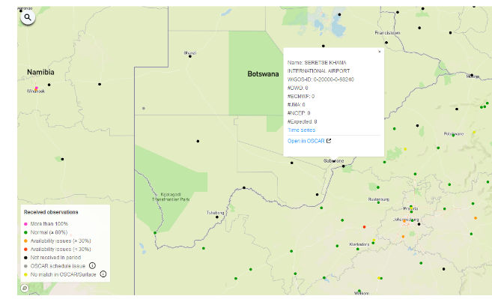
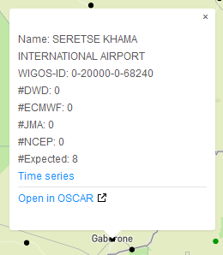
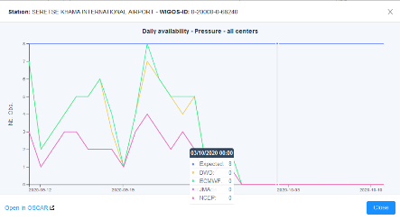

Example - data outage of a particular station
    Station 68240 SERETSE KHAMA INTERNATIONAL AIRPORT
    usually reports to WIS
    However, since 30th September 2020 no data were available on WIS (No. of obs. received by each of the WIGOS MC = 0), shown as dot in availability map
    The data outage continued until 13th October 2020 (13 days)
    RWC would have to raise an incident ticket concerning this data outage after 5 days the latest, i.e. on 04th October 2020

Slide 11
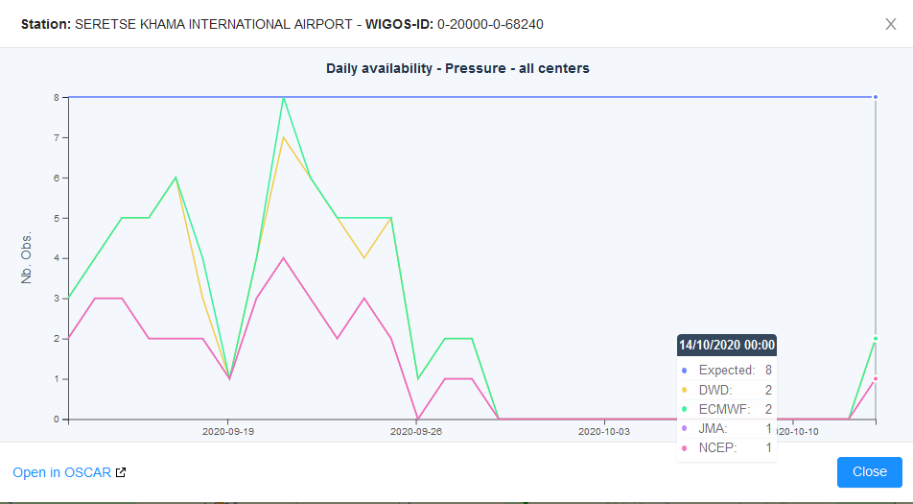
Example - data outage of a particular station (cont.)
Station started reporting to GTS again on
14th October 2020
Data outage

Slide 12
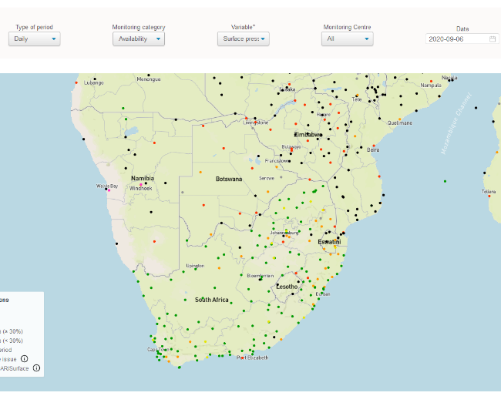
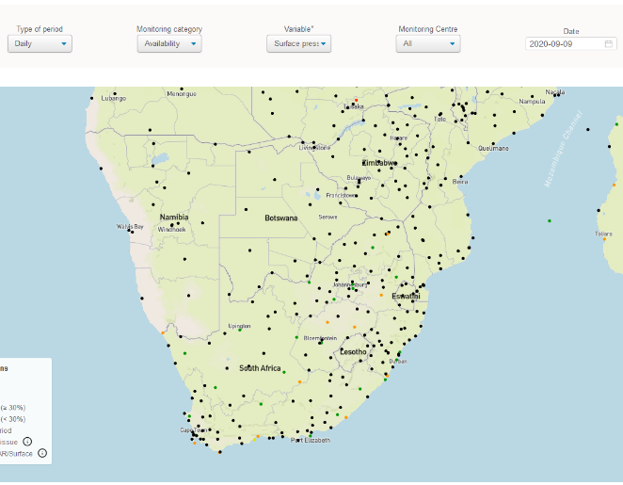
Example - data outage of entire country/ies
    Most of the observations for SADC countries were not received during the period 8 to 10 September 2020.
    This might have happened due to technical challenges at the
    RTH because the stations in South Africa were operational.
    RWC shall raise an incident ticket as soon as possible after recognizing this incident to rectify this incident ASAP!

Slide 13
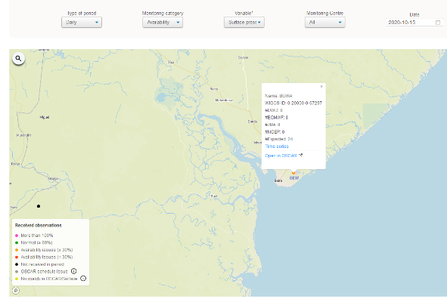
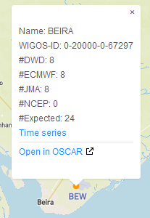
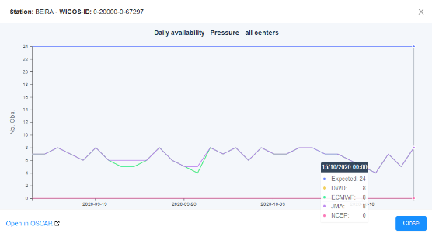

Example – incorrect OSCAR/Surface metadata
    Station 67297 BEIRA reports 6 to 8 messages per day to WIS
    However, the expected number of observations according to OSCAR/Surface are 24 per day, dot in availability map
    According to OSCAR/Surface the station reports pressure on an hourly basis (Reporting interval: 1 h (hour))
    RWC should raise an incident ticket asking WDQMS NFP together with OSCAR/Surface NFP to check the metadata

Slide 14
Category ‘Quality’
    RWC may select the Monitoring category ‘Quality’ in the web tool to evaluate the performance related to accuracy
    The WDQMS web tool provides ‘Quality’ performances as Observation against Background (O-B) values averaged over a selected period (6-hourly or daily) of a particular variable
    (e.g. surface pressure/geopotential height, 2m temperature, 10m zonal wind component, 10m meridional wind component, 2m relative humidity).
    If at least one WIGOS Monitoring Centre (MC) shows low (good) O-B results (green dots) most likely the issue is related to the corresponding WIGOS MC which shows larger O-B results → no action required by RWC

Slide 15

Constraints of O-B results
    NWP models base on observations from the respective regions and the observations are interpolated to the model layers
    O-B results of pressure observations are quite reliable because the pressure can be interpolated to the relevant levels quite well
    However, large O-B results of temperature and relative humidity are often caused by model biases. Especially in winter times and in areas with steep orography models cannot always resolve strong temperature inversions and thereby might lead to wrong 2m temperature or 2m relative humidity forecasts.
    Therefore O-B results of the variables 2m temperature and
    2m relative humidity have to be considered with care.
    Hence, incident tickets should only be raised in case
    of ongoing large errors in O-B results with an increasing
    trend → stations showing or dots

Slide 16
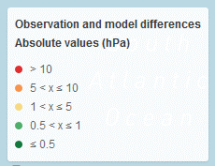
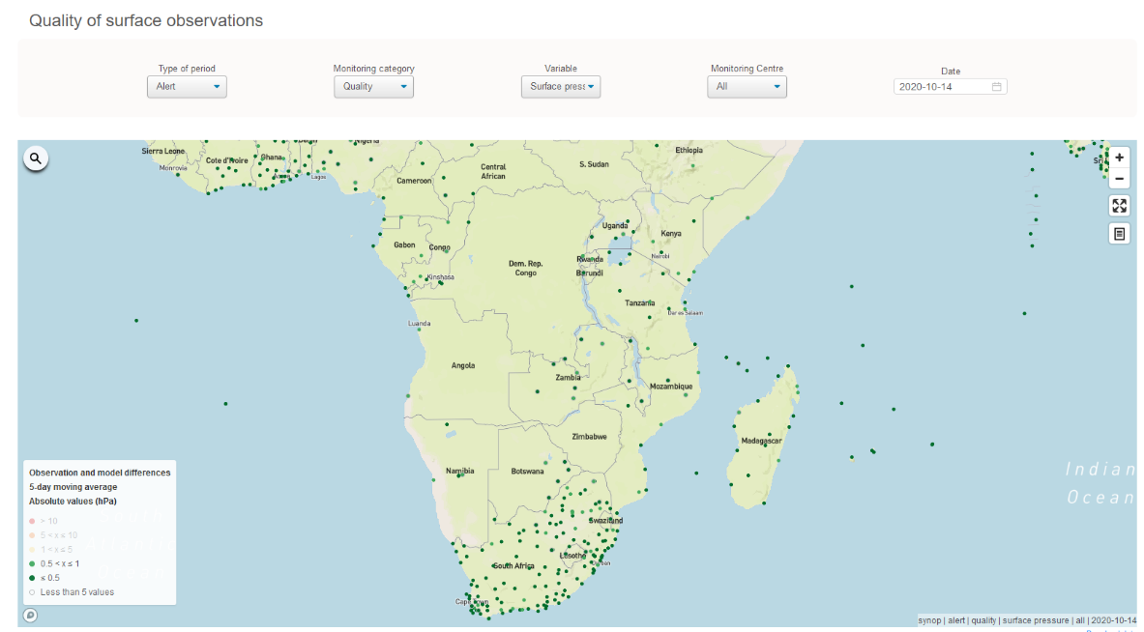
Absolute pressure obs values ≤ 1 hPa
    Stations shown as green dots
    The quality of pressure observations is good,
    the station is performing well
    ➔ no action required ☺

Slide 17
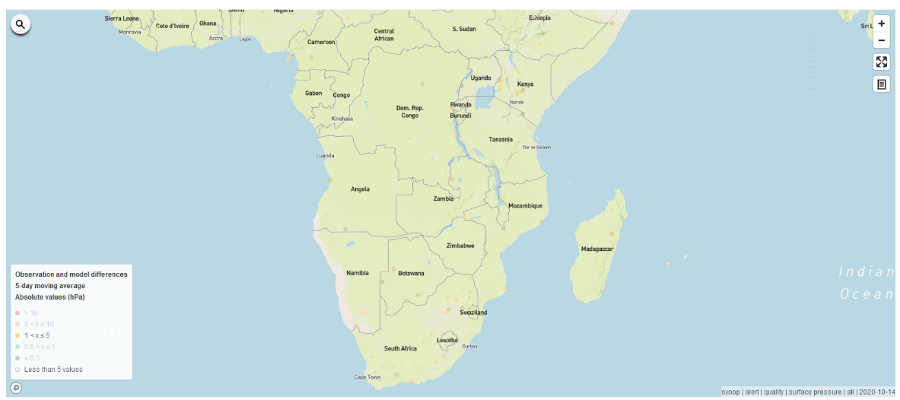
Absolute pressure obs values 1 - 5 hPa
    Stations showing yellow dots have quality issues
    If they continue to appear having quality issues especially when selecting ‘All’ Centers and the ‘Daily’ or ‘Alert’ display
    RWC to initiate an incident management process with medium priority ( ) asking WDQMS NFP to take actions to investigate the cause of the incident and to find a solution

Slide 18
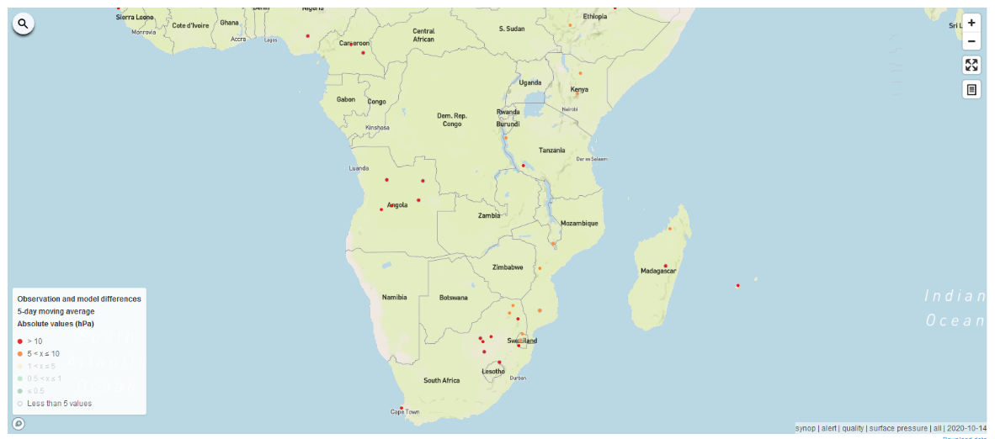
Absolute pressure obs values > 5 hPa
    Stations showing orange or red dots have large quality issues
    If they continue to appear having quality issues especially when selecting ‘All’ Centers and the ‘Daily’ or ‘Alert’ display
    RWC to initiate an incident management process with high ( ) or very high priority ( ) asking WDQMS NFP to take actions to investigate the cause of the incident and to find a solution

Slide 19
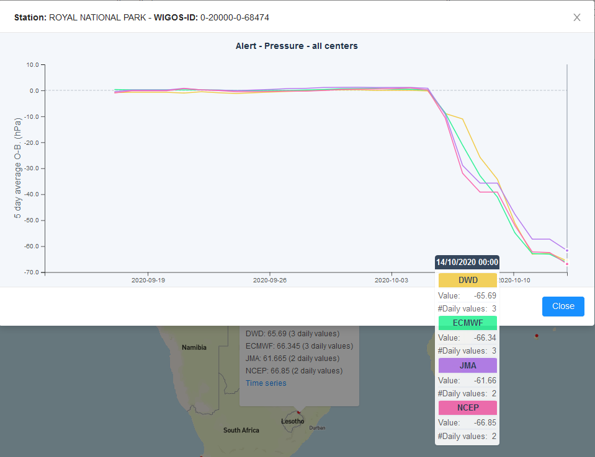
Example No. 1 – worsening pressure O-B results
    Station 68474 ROYAL NATIONAL PARK showed low pressure O-B results (≤ 1 hPa) but since 06th October 2020 the O-B results dropped significantly (≥ - 60 hPa) for all monitoring centres
    Potentially sensor drift leading to increasing wrong measurements at site
    RWC would have to
    raise a ticket related to
    this incident after 5 days
    the latest, i.e. on
    11th October 2020

Slide 20
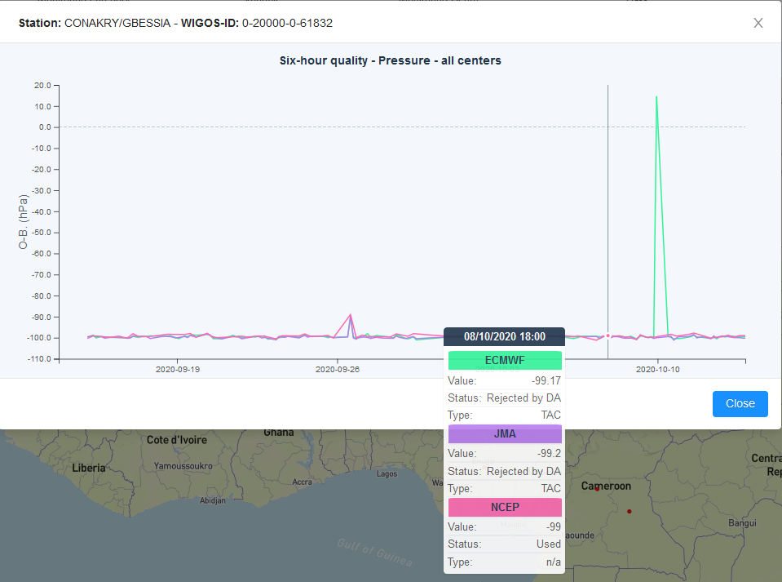
Example No. 2 – continuous large pressure
O-B results
    Station 61832 CONAKRY/GBESSIA shows constant large pressure
    O-B results
    Most likely related to incorrect metadata being used as background for data assimilation by WIGOS MCs (either from OSCAR/Surface or BUFR messages)
    RWC to raise a ticket
    related to this incident
    to check with NFP the
    barometer height and
    station height in OSCAR/
    Surface and/or BUFR
    metadata as well as
    with MC FP

Slide 21
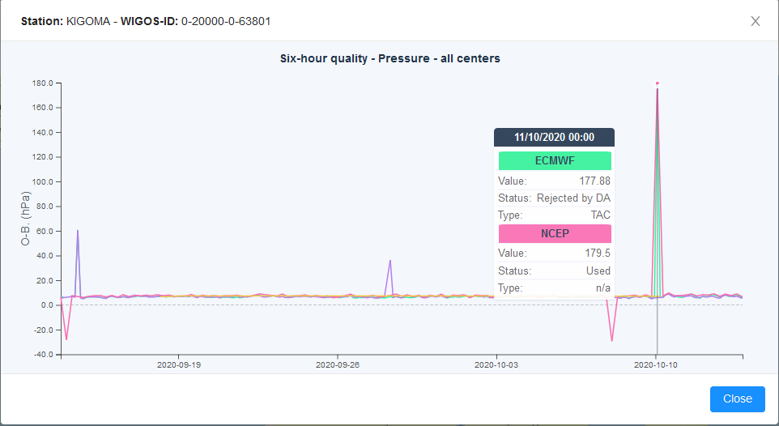
Example No. 3 – sporadic dips in pressure O-B results
    Station 63801 KIGOMA shows sporadic dips in pressure O-B results
    Most likely related to sporadic incorrect measurements or readings at site
    RWC would have to raise a ticket related to this incident if the issue is frequently reoccurring

Slide 22
RWC starting to operationalize…
    When starting its WDQMS operations RWC should initiate incident management processes for long-term ongoing issues of the following types of issues before getting into detail with special incidents of particular stations:
    Monitoring category ‘Data availability’
      No match in OSCAR/Surface
      Stations which didn´t report for a longer period of time
      (i.e. so-called ‘silent stations’)
      Stations reporting more than 100%
    Monitoring category ‘Quality’
      Ongoing, constant large surface pressure O-B results
      (most likely related to incorrect OSCAR/Surface metadata)

Slide 23

Thank you
Tanja.Kleinert@dwd.de
www.wmo.int/wigos

