Slide 1

Incident Management System
for RWCs using JIRA ECMF
Zulkarnain
zulkarnain@wmo.int
credit to Daniel Varela Santoalla, ECMWF
Workshop for RWC in RA I (SADC)
19-21 October 2020

Slide 2
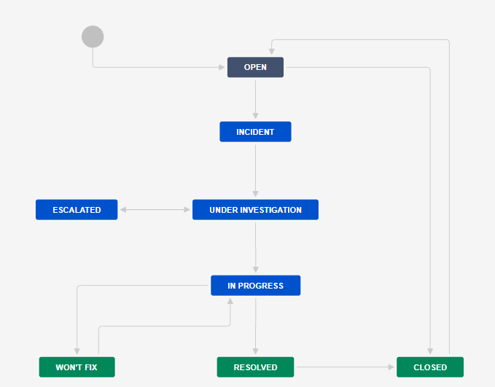
Workflow of the System
All users can raise new issue/ticket
RWC will raise a ticket issue and evaluate the issue
RWC close the ticket if the issue disappeared
RWC decide to raise an incident
RWC change status and wait for proposed solution
NFP receive the ticket and acknowledge that
In some cases, RWC can escalate an incident, e.g. no response from NFP
NFP proposes the solution
NFP provides regular updates
RWC validates the NFP proposal and updates the status
NFP informs RWC about the incident rectification
RWC put a ticket to won’t fix if any incident seems can not be resolved
RWC can reopen a closed ticket
RWC put back a ticket from wo’t fix to in progress if a resolve action identified
RWC to confirm that incident has been resolved
RWC close the ticket if incident has been resolved

Slide 3
Users role
RWCs
Issue new ticket
Reopen a closed ticket
Update the ticket status into incident, under investigation, in progress, resolved, won’t fix, or escalated
WDQMS NFPs (Members)
Monitoring Centres
Issue new ticket
Issue new ticket
Propose resolve actions through comments
Add comments to the ticket, as necessary
Add comments to the ticket, as necessary
Close ticket

Slide 4
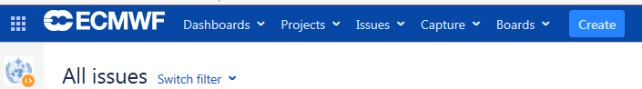
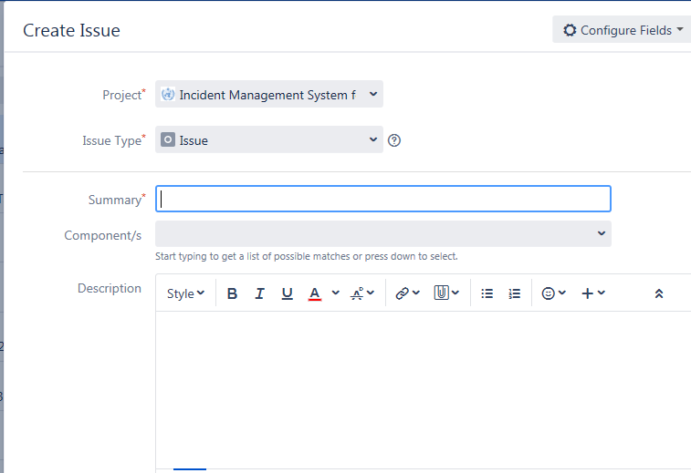
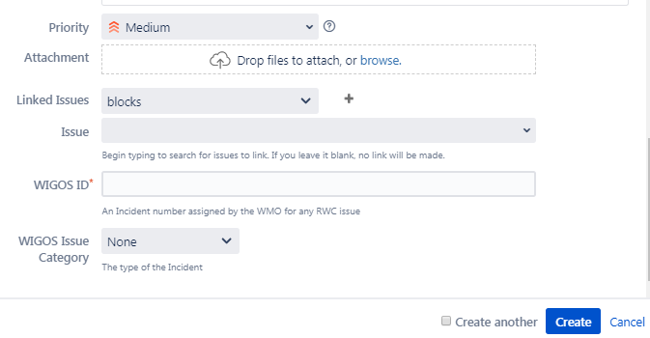
Issue Identification

Slide 5
Fields for new issue
OPEN
Several information must be filled in to create a new issue including:
Project*: ‘Incident Management System for RWC’
Issue type*: ‘issue’ (by default)
Summary*: a brief explanation of issues raised using this format:
ddmmyyyy-country-station/location-issue
example: 21102020-Botswana-Ghanzi-no data received
If more than one station of a country show the same non-compliance, station/location could be typed e.g. three stations or stations
*mandatory fields

Slide 6
Fields for new issue – cont.
OPEN
Reporter: by default according to the account logged in (can be any user)
Assignee (only appear in RWCs’ account): at the beginning, it will automatically be assigned to RWC, RWC should assign this ticket to Member (NFP) if RWC has decided to raise the ticket as incident
Component: RWC being responsible for this station
Description: Details concerning the issue
Priority: priority level according to the Technical Guidelines for RWC on the WDQMS (Annex 2)

Slide 7
Fields for new issue (cont)
OPEN
Linked issues: if the issue is related with any previous issues
WIGOS ID*: WIGOS Station Identifier (WSI) registered in OSCAR/surface. If more than one station is reported in this ticket, use one of their WSI (details about the other WSIs will go into the Description field)
WIGOS issue category:
  Type of observation: surface or upper air,
  Category performance: availability, quality or timeliness
Notes:
A screen-shot with these fields should be added, similar to slide 3

Slide 8
Incident Process Initiation
One of the two options must be performed by RWCs when receiving new ticket according to their evaluation:
Convert the ticket into ‘incident’. If it is decided to raise an issue into an incident, RWC must assign this incident to specific Member (NFP) →
Decide ‘no incident’ for the ticket, the issue has been resolved or has disappeared without further action taken by the RWC → ‘CLOSED’
INCIDENT
CLOSED

Slide 9
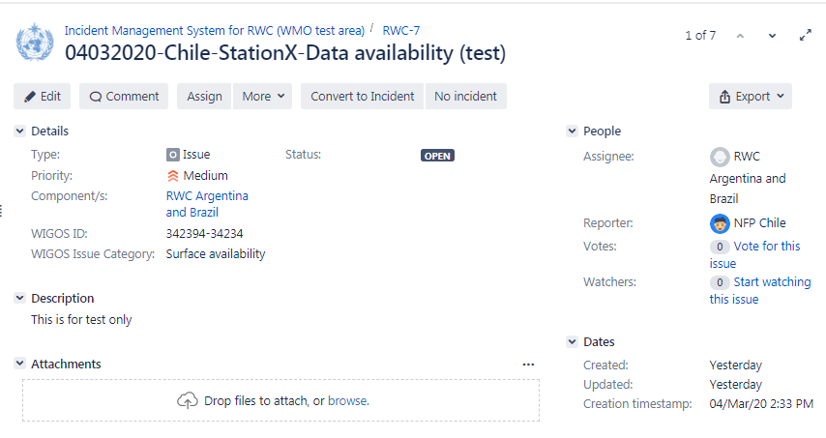
RWC's response to the new ticket
If decided to be raised as incident
RWC can correct/ edit critical details of the ticket if needed, and add more detailed description
Requesting additional information from reporter as needed
If decided to raise an incident, ticket must be assigned to relevant NFP/ Member
If decided as no incident because issue disappeared

Slide 10
Receipt confirmation and action proposal from Members
To make the RWC aware that the country has taken over the task of following up the incident, NFP/ Member must acknowledge the incident. RWC will confirm the ticket when receive acknowledgement from NFP →
Potential comments should be added to the ticket
NFP should continuously update the ticket status. On the other hand, RWC regulary request update to NFP
→
If there is no confirmation from NFP, RWC should contact NFP using other media (e.g. email).
RWC escalate the incident to a WMO Secretariat, that will bring it a higher level (e.g. PR) if necessary →
UNDER INVESTIGATION
IN PROGRESS
ESCALATED

Slide 11
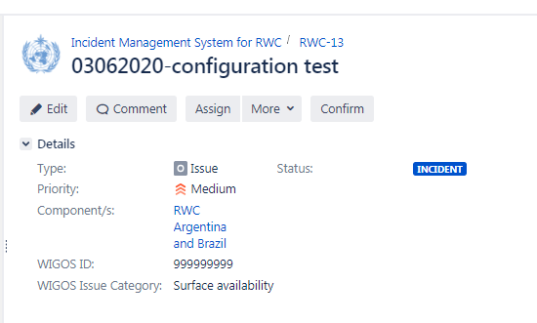
Confirm the ticket when receive acknowledgement from NFP
RWCs confirms the ticket into under investigation

Slide 12
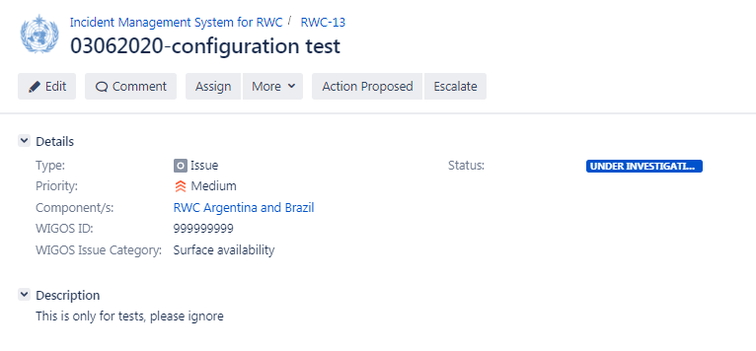
Review and validate action proposal added by Members
RWC receives action proposal added by Member

Slide 13
Incident Rectification
If the incident has been rectified by the country , NFP to inform RWC
The RWC will check whether the incident ticket can be closed or has to be kept open due to ongoing non-compliance and underperformance compared to the WDQMS performance targets →
In the case of ongoing non-compliance, the RWC will ask the NFP to take further actions
RESOLVED

Slide 14
Won’t fix incident
WON´T FIX
it might be found that an incident cannot be rectified because no (immediate) action can be taken
In this case, the RWC should put the incident into the log of “Won’t fix”
RWC and/or NFP regularly monitor the incident put in “Won’t fix” and whenever it is found that an action can be taken to rectify the incident, RWC bring the ticket back to “in progress”.

Slide 15
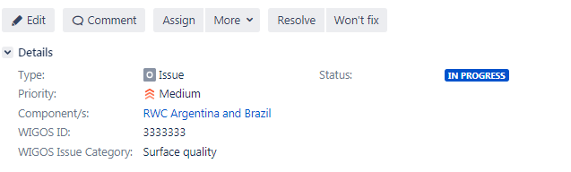
Incident rectification or won’t fix incident
If the incident has been rectified
If an incident cannot be rectified because no (immediate) action can be taken

Slide 16
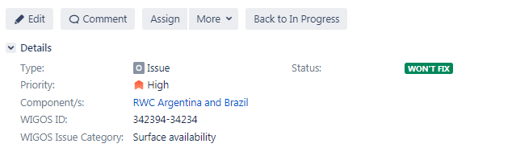
Won’t fix incident
If it is found that an action can be taken to rectify a “won’t fix” incident

Slide 17
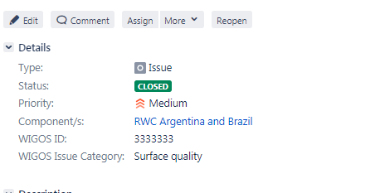
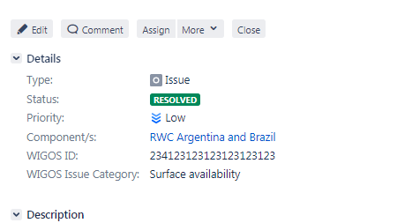
Closure of incident ticket
CLOSED
If the incident has been successfully rectified the incident ticket will be closed

Slide 18

Thank you
zulkarnain@wmo.int
https://community.wmo.int/activity-areas/wigos

