Slide 1
OSCAR/Surface webinar
Release 1.5.4
21 September 2020

Slide 2
Topics
Timeline release 1.5.4
Implemented changes and examples
  WMDR XML upload
    Submission of multiple WIGOS IDs
    Checks on WIGOS IDs
    Strategies for matching of XML entities into the database
Bug fixing

Slide 3
Timeline Release 1.5.4
1

Slide 4


Timeline Release 1.5.4
Available from:
21.09.2020 on the test environment → https://oscardepl.wmo.int/surface
29.09.2020 on the productive environment → https://oscar.wmo.int/surface
Test
Release 1.5.3
Release 1.5.4
Release 1.6.0
07
08
09
10
11
12
01
21.09.2020
Prod
Release 1.5.3
Release 1.5.4
Release 1.6.0
07
08
09
10
11
12
01
29.09.2020

Slide 5
Implemented changes and examples:
WMDR XML upload
2

Slide 6


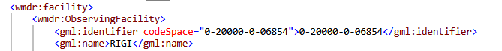

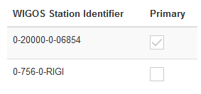
Submission of multiple WIGOS IDs
Submission of multiple WIGOS Ids possible via:
  GUI
  WMDR XML
How?
  Comma separated list of WIGOS IDs under wmdr:facility/wmdr:ObservingFacility/gml:identifier
  First WIGOS ID in the list is always the «primary» one
New!

Slide 7
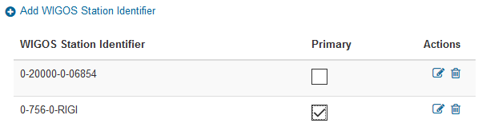
Submission of multiple WIGOS IDs
Update of attribute «primary»:
  GUI
  WMDR XML
How?
  Edit the station and check the «primary» box
  Place «primary» ID as first in the list under wmdr:facility/wmdr:ObservingFacility/gml:identifier
New!
or

Slide 8
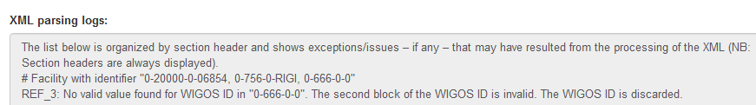
Checks on WIGOS ID
Rules applies for generation of new WIGOS Ids. Checks are in place on:
  GUI
  WMDR XML
Format
Value of issuer of identifier (second block)
  NFP/ME/NMHS: ISO country number based on country of station
  PFP/Data Center: Issuer of identifier of program(s) of responsibility
New!

Slide 9

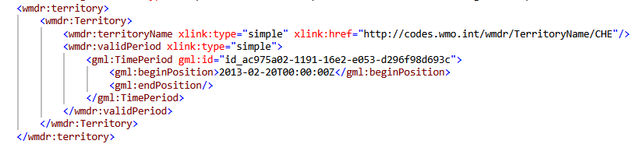
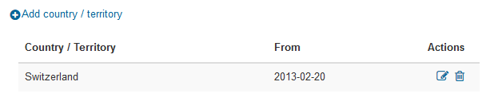
Strategies for matching of XML entities
  GUI vs WMDR XML
 | GUI (human readable) | WMDR XML (machine and human readable)
hierarchy | Fields grouped in forms | Elements contain other elements (entities)
Identification of information | User can visually locate field of interest | Based on name and position (hierarchy) of XML elements
Action (insert/ correct/ update) | Icons to support user | Pre-defined rules applied by the XML parser at XML submission

Slide 10
Strategies for matching of XML entities
  GUI vs WMDR XML
 | GUI (human readable) | WMDR XML (machine and human readable)
hierarchy | Fields grouped in forms | Elements contain other elements (entities)
Identification of information | User can visually locate field of interest | Based on name and position (hierarchy) of XML elements
Action (insert/ correct/ update) | Icons to support user | Pre-defined rules applied by the XML parser at XML submission
New!

Slide 11
Strategies for matching of XML entities
How to insert / update / correct information using WMDR XML submission:
    Gml:id
    Key made of content
Gml:id:
    ID associated with the entity (group of elements) that uniquely identifies it at the station
    When submitting new elements via XML users can assign gml:ids, otherwise the system assigns a random value automatically → every entity supporting a gml:id has a gml:id value assigned.
    Assigned gml:ids can be viewed/extracted by exporting the WMDR XML of a station
    By providing the value of the gml:id any element of the entity identified by it can be updated

Slide 12
Strategies for matching of XML entities
Gml:id: insert vs update/correct
    System read value of gml:id
    System check if an entity with the same gml:id exists for that station
      If yes, it updates/correct its content
      If no, it inserts a new entity
    → By providing the value of the gml:id any element of the identified entity can be updated

Slide 13
Strategies for matching of XML entities
  How to insert / update / correct information using WMDR XML submission:
    Gml:id
    Key made of content
  Key made of content:
    Specific element(s) are likely to uniquelly identify an entity at the station (key)
    The system extracts the values of the key and try to match it with existing content in OSCAR/Surface
    The value(s) of the key cannot be changed using the WMDR XML upload

Slide 14
Strategies for matching of XML entities
  Key made of content: insert vs updates
    Specific element(s) are likely to uniquelly identify an entity at the station
    The system extract the values of the key and try to match it with existing content in OSCAR/Surface
      If a match is found the rest of the content is corrected/updated
      If no match is found a new entity is inserted
    → The value(s) of the key cannot be changed using the WMDR XML upload

Slide 15
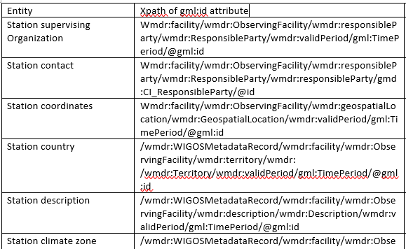
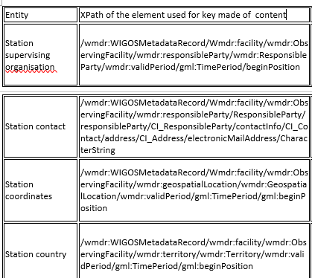
Strategies for matching of XML entities
  How do I know which elements support a gml:id and which elements within an entity are used as key?
    User manual

Slide 16
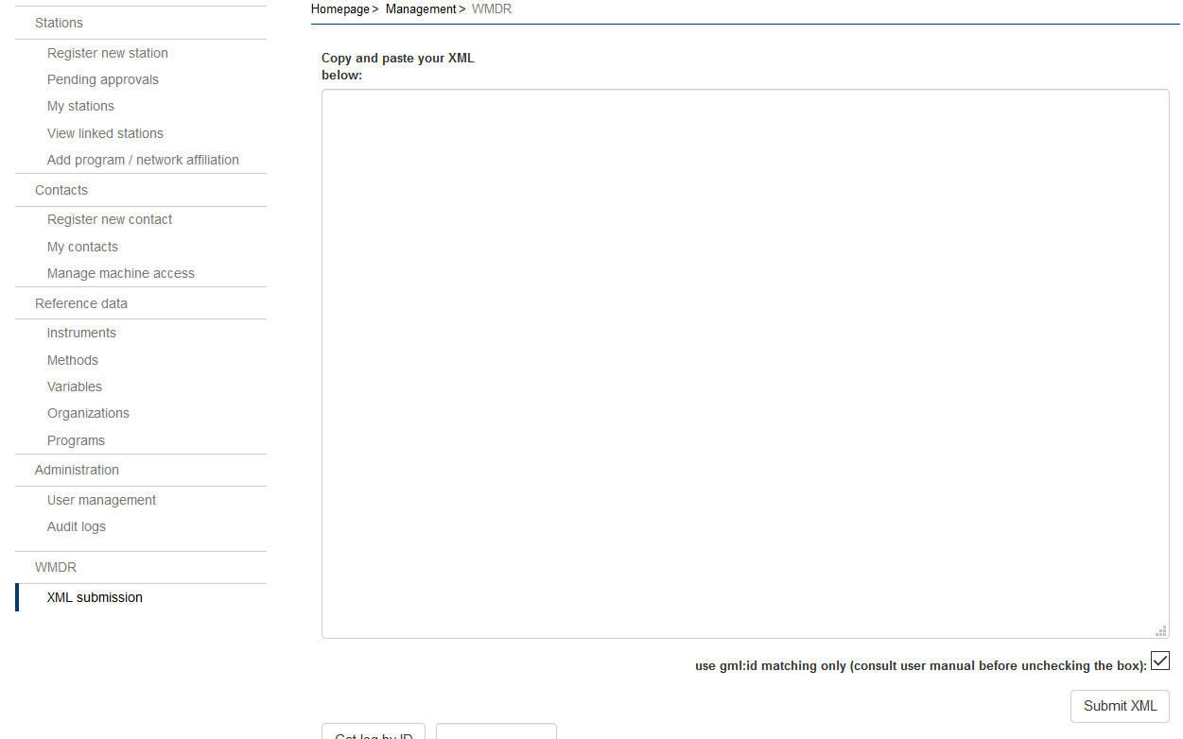
Strategies for matching of XML entities: modes
How does the application know if a gml:id or a key made of content should be used to match entities?
two «modes» available:
  Match by gml:id only (default)
    Every entity supporting a gml:id must contain a gml:id value
  Match by gml:id, only when it is provided, otherwise match by key made of content.
    Every entity supporting a gml:id will be matched by gml:id if it is provided. If omitted, the key made of content will be used
Oscardepl.wmo.int/surface/rest/api/upload/useOnlyGmlIds={TRUE/FALSE}

Slide 17
Strategies for matching of XML entities: examples
Examples:
  Match by gml:id only (default)
      Use case 1a: insert new observation
      Use case 1b: update existing observation
        Every entity supporting a gml:id must have a gml:id value
  Match by gml:id, only when it is provided, otherwise match by key made of content
      Use case 2a: insert new observation
      Use case 2b: update existing observation
        All elements that constitute the key must be provided

Slide 18
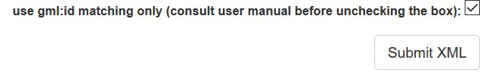
Example: use only gml:id
Use case 1a: insert new observation
Test data:
  Station RIGI
  New observation (+deployment+data generation)
    Affiliation: GOS
    Variable: Atmospheric pressure
    Geometry: point
    Measurements started: today
    Observing method: Barometer, mercury column
    Height of instrument above reference surface: 2m
    Reporting: from today, 24/7, every 10 min, national data exchange
Procedure:
  Check which entities support gml:ids
    Observation (→no gml:id support, key = variable+geometry)
    Deployment (→ wmdr:Deployment)
    Data Generation (→ wmdr:DataGeneration)
  Download WMDR of existing station
  Copy/paste existing observation to have a basis to work on
  Adjust metadata, assign new value for gml:id
  Submit XML with checkbox checked

Slide 19
Example: use only gml:id
Use case 1b: update existing observation
Test data:
  Station RIGI
  Existing observation
    Affiliation: GOS
    Variable: Atmospheric pressure
    Geometry: point
    Measurements started: today→yesterday
    Observing method: Barometer, mercury column
    Source of observation: automatic
    Height of instrument above reference surface: 2m
    Reporting: from today→yesterday, 24/7, every 10 min, national→international data exchange
Procedure:
  Check which entities support gml:ids
    Observation (→no gml:id support, key = variable+geometry)
    Deployment (→ wmdr:Deployment)
    Data Generation (→ wmdr:DataGeneration)
  Download WMDR of existing station
  Adjust metadata, assign new values for gml:id
  Submit XML with checkbox checked

Slide 20
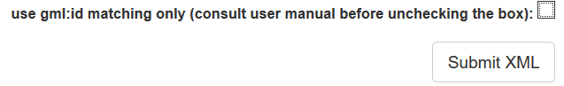
Example: use key made of content
Use case 2a: insert new observation
Test data:
  Station RIGI
  New observation (+deployment+data generation)
    Affiliation: GOS
    Variable: Atmospheric pressure
    Geometry: point
    Measurements started (depl. from): today
    Observing method: Barometer, mercury column
    Height of instrument above reference surface: 2m
    Reporting: from today, 24/7, every 10 min, national data exchange
Procedure:
  Check how the key is made of for:
    Observation (key= variable+geometry)
    Deployment (key= depl. from+observ.method+height above ref. surface)
    Data Generation (key= from date, temp. Rep. Interval, reporting schedule)
  Download WMDR of existing station
  Copy/paste existing observation to have a basis to work on
  Adjust metadata, remove values for gml:ids
  Submit XML with checkbox unchecked

Slide 21
Example: use key made of content
Use case 2b: update existing observation
Test data:
  Station RIGI
  Existing observation
    Affiliation: GOS
    Variable: Atmospheric pressure
    Geometry: point
    Measurements started: today→yesterday
    Observing method: Barometer, mercury column
    Source of observation: automatic
    Height of instrument above reference surface: 2m
    Reporting: from today→yesterday, 24/7, every 10 min, national→international data exchange
Procedure:
  Check how the key is made of for:
    Observation (key= variable+geometry)
    Deployment (key= depl. from+observ.method+height above ref. surface)
    Data Generation (key= from date, temporal reporting interval, reporting schedule)
  Download WMDR of existing station
  Adjust metadata, remove values for gml:id
  Submit XML with checkbox checked

Slide 22
Strategies for matching of XML entities: conclusions
Which «mode» should I use and why?
  Match by gml:id only (default):
    Pro: safest mode, no risk of mismatch
    Contra: need to first export WMDR XML to know gml:ids or store all them locally
    → Best for workflow: download – update – resubmit WMDR XML on GUI
  Match by gml:id, only when it is provided, otherwise match by key made of content.
    Pro: user decides for each entity individually the best matching strategy
    Pro: only used gml:ids can be stored locally
    Contra: in case of matching by key made of content not all elements can be corrected/updated
    → Best for automatic (programmatic) generation and submission of WMDR XMLs

Slide 23
Bug fixing
3

Slide 24
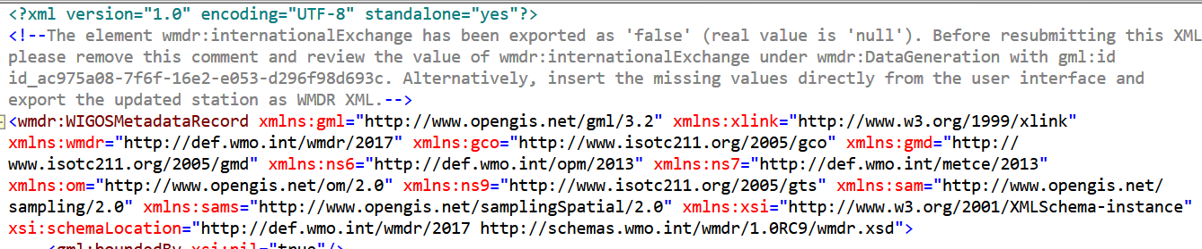
Bug fixing
Export of WMDR XMLs with incorrect value of «international exchange flag»
  Missing value of «international exchange flag» for a number of stations
  WMDR XML export requires either a TRUE or FALSE value for «international exchange flag», empty element cannot be exported
  Export as FALSE by default, whenever missing
  Export comment at the top of the XML informing user of default export, asking to review values and remove comment before resubmitting (comment makes XML invalid)
    Example: station 0-20000-0-71451

Slide 25
Bug fixing
WMDR XML: Submission of instruments into the instrument catalogue only possible for one measured variable.
GUI: Station report map: neighbouring stations disappear when zooming in
GUI: «edit profile» functionality not working

Slide 26
Questions?

