Slide 1

OSCAR/Surface webinar #15
The relationship between OSCAR/Surface and the WIGOS Data Quality Monitoring System

Slide 2
WIGOS Data Quality Monitoring System (WDQMS)
Operational since March 2020
One of the pillars of WIGOS
Monitor availablity, quality and timliness of WIGOS component observing systems
First phase: surface and upper-air stations
Monitoring reflects observations as seen by WIGOS monitoring centers. Currently: DWD, ECWMF, NCEP and JMA (other centers are welcome to join)
Next phases: add additional WIGOS component observing systems & WIS GTS monitoring

Slide 3
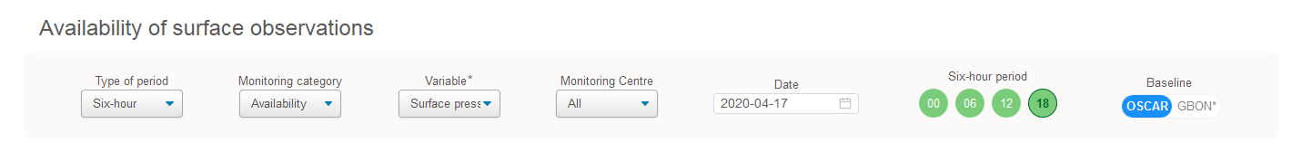
WDQMS (cont.)
Monitoring by variable (temperature, pressure, wind, precipiation)
Monitoring by 6h and daily intervals (monthly to be implemented)
User can choose which monitoring center to use, or select «best of all»
Also: quality

Slide 4
Live system
https://wdqms.wmo.int

Slide 5
Which stations are monitored?
WDQMS obtains station information from OSCAR/Surface
  Surface stations
    facilityType: seaFixed, lakeRiverFixed, lakeRiverMobile, landFixed, landMobile, landOnIce and airFixed
    International Exchange == True
    Observes one of the variables monitored (pressure, temperature, precipitation, wind)
  Upper Air stations
    StationClass: upperAirRadiosonde, upperAirPilot
  Only currently «operational» or «partlyOperational» stations are considered.
  The operating status of the network/program affiliated with the variable is used

Slide 6
What determines the status/color of a station?
The number of observations received at monitoring centers is compared either, to
  OSCAR/Surface schedule metadata
  A provisional GBON baseline (1h surface and 2-daily upper-air observations)
OSCAR/Surface schedules
  Combine all schedules for the variable and compute number expected for given 6-h period
  Default schedule applied if none in OSCAR/Surface (3h for surface and 12h for upper air)
  Online tools allows to find out number of expected

Slide 7
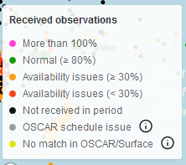
Status/color (cont.)
Number received is compared with number expected (green, orange, red, black, pink)
Yellow: data received by monitoring center but no entry in OSCAR/Surface
Grey: data received by monitoring center & OSCAR/Surface entry, but schedule indicated no report
Examples:
  number expected 6, number received 3 => orange (50%)
  Number expected 6, number received 7 => pink (>100%)

Slide 8
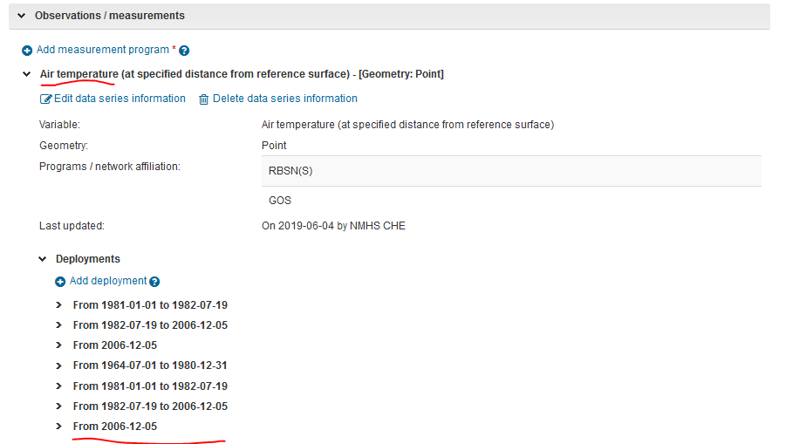
Most cirtical elements in OSCAR/Surface

Slide 9
FAQ
Why is my station being monitored in WDQMS?
  Check international exchange flag
  You are observing a variable tracked by WDQMS (pressure, temperature, wind, humidity)
  Deployment not closed?
  Operating status of affiliated network?
  Reporting interval in data generation
Why is my station _not_ being monitored in WDQMS?
  See above
Why is my station red/orange but I am making all the observations
  Observations get lost in transit
  Schedule information in OSCAR/Surface not correct

Slide 10

Thank you
Questions?

