Slide 1

Webinar #13 – Practical API examples
continued
9 December 2020 – webinar #12
WIGOS project office

Slide 2
Agenda
Introduction
API overview
API examples
  Updating station schedules with custom logic
Feedback and discussion

Slide 3
The OSCAR/Surface webinar
Monthly webinar with varying topic
Audience are OSCAR/Surface Focal Points and Users
Normally every first Monday of the month 11h UTC
Hosted in the WMO BlueJeans
Please suggest topics

Slide 4
Spread the word!
Register (self-enroll) to the OSCAR/Surface Resources course in moodle
Browsing is public
Register to receive emails and post to the forum

Slide 5
Today’s speakers
Timo Pröscholdt (WIGOS Project Office)

Slide 6
The OSCAR/Surface API
Recap

Slide 7
API OSCAR/Surface
API = application programming interface
Access information in machine readable format
Submit information with a computer programme

Slide 8
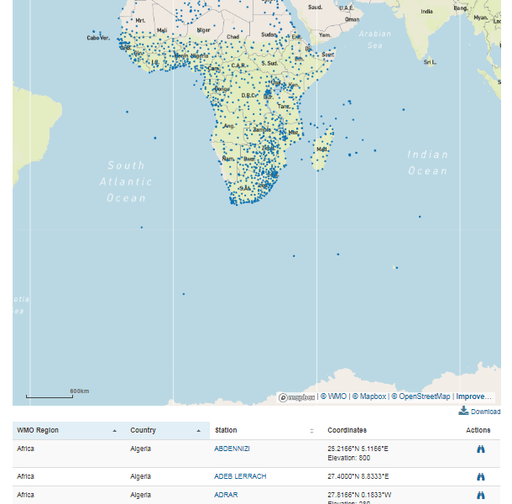
OSCAR/Surface API
Get a machine readable list
Accesible via URL:
Parametres similat to the UI
https://oscar.wmo.int/surface/rest/api/search/station?
programAffiliation=GOS&territoryName=SEN

Slide 9
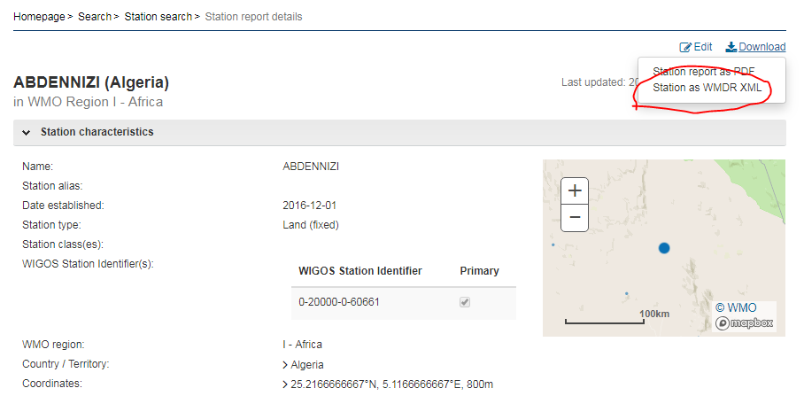
Different example
Download a statin in XML format (machine readable)
XML allows to integrate the information into an IT process

Slide 10
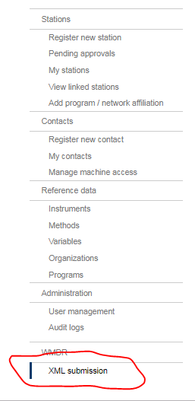
Upload a station to OSCAR/Surface
Upload a station in XML format to
OSCAR/Surface
Upload several stations at the same time quickly
Link to existing databases
des bases de doneés existantes
More details on XML in next presentation

Slide 11
Access rights
OSCAR/Surface National Focal Point
The Focal Point can genrate a «token» to use the API in a programme
Example token: «7d0efe16-6473-4754-ad3c-e01f0434a81e»

Slide 12
«testbed»
To the the XML interface without risking to intefer with the operational system
URL: https://oscardepl.wmo.int/surface
The testbed is reset every Monday

Slide 13
THE third practical example
Updating stations in Germany

Slide 14
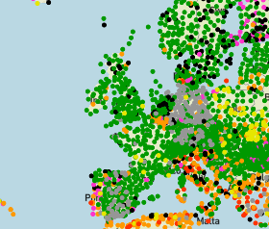
Example #3: OSCAR update for WDQMS
German stations displayed grey
in WDQMS
Incorrect schedule information
in OSCAR/Surface
Update stations using batch job
Set 1h international 7/24 schedules instead of 30min national one

Slide 15
Detailed plan
Obtain list of German stations
Identify stations with 30min schedule
Update schedule to 1h and set international exchange flag
Use python program
Caveats
  Invalid XML files
  Complex XML standard

Slide 16
Python & Jupyter Notebooks
Python code
Oscar client library (oscar_lib)
Jupyter notebooks
Library & notebook available on github

Slide 17
How to run the code?
Get a python distribution: anaconda
Install required packages with package manager «pip»
Clone webinar repository with notebooks
requirements.txt lists required packages (pip install –r requirements.txt)

Slide 18
More information
In the OSCAR/Surface manual
In the moodle OSCAR/Surface
https://etrp.wmo.int/course/view.php?id=146
Blog
Webinar
Presentations

Slide 19
Where to go from here?
Continue to develop the oscar_lib
OpenSource
Do you have staff resources that could be (virtually?) seconded to work on the library?
Ultimately: build a web-client for batch operations

Slide 20

Thank you
www.wmo.int/wigos

