Slide 1

Webinar #12 – Practical API examples
9 December 2020 – webinar #12
WIGOS project office

Slide 2
Agenda
Introduction
API overview
API examples
  Finding stations changed since
  How to reproduce Volume A
  Updating station schedules with custom logic
Feedback and discussion

Slide 3
The OSCAR/Surface webinar
Monthly webinar with varying topic
Audience are OSCAR/Surface Focal Points and Users
Normally every first Monday of the month 11h UTC
Hosted in the WMO BlueJeans
Please suggest topics

Slide 4
Today’s speakers
Luisa Ickes (WIGOS Project Office)
Timo Pröscholdt (WIGOS Project Office)

Slide 5
The OSCAR/Surface API

Slide 6
API OSCAR/Surface
API = application programming interface
Access information in machine readable format
Submit information with a computer programme

Slide 7
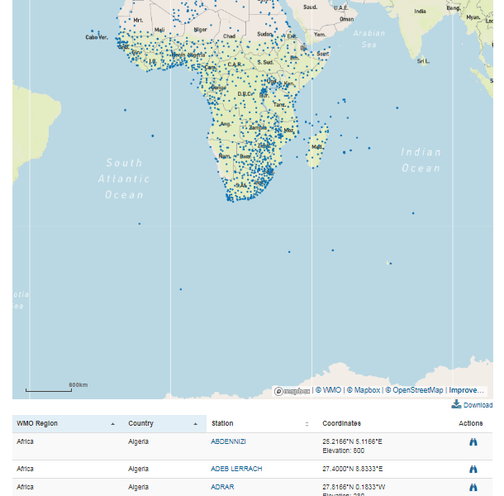
OSCAR/Surface API
Get a machine readable list
Accesible via URL:
Parametres similat to the UI
https://oscar.wmo.int/surface/rest/api/search/station?
programAffiliation=GOS&territoryName=SEN

Slide 8
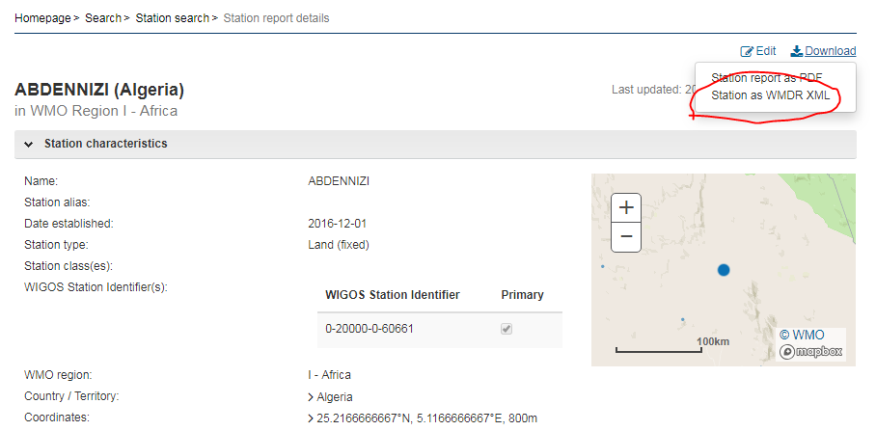
Different example
Download a statin in XML format (machine readable)
XML allows to integrate the information into an IT process

Slide 9
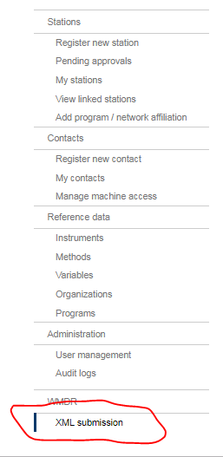
Upload a station to OSCAR/Surface
Upload a station in XML format to
OSCAR/Surface
Upload several stations at the same time quickly
Link to existing databases
des bases de doneés existantes
More details on XML in next presentation

Slide 10
Access rights
OSCAR/Surface National Focal Point
The Focal Point can genrate a «token» to use the API in a programme
Example token: «7d0efe16-6473-4754-ad3c-e01f0434a81e»

Slide 11
«testbed»
To the the XML interface without risking to intefer with the operational system
URL: https://oscardepl.wmo.int/surface
The testbed is reset every Monday

Slide 12
Three practical examples

Slide 13
Python & Jupyter Notebooks
Python and Jupyter notebooks
git
..

Slide 14
Example #1: changed stations
We would like to identify stations that changed since a given date
List of stations can be obtained through API
But result does not contain the last changed date
Solution: download individual stations, extract lastmodification date and compare

Slide 15
Example #2:

Slide 16
Example #3:

Slide 17
More information
In the OSCAR/Surface manual
In the moodle OSCAR/Surface
https://etrp.wmo.int/course/view.php?id=146
Blog
Webinar
Presentations

Slide 18

Thank you
www.wmo.int/wigos

