Slide 1



Review of University Collaboration and SYMET 13 Implementation in RA I
Cairo, Egypt
28 October – 01 November 2019
RTC –ESPA Madagascar
Dr RAMANAKOTO Toky Nandrasana
Notes:
I’m the new head of Department of MTO. from June, that I took the post of head of Department.
I'm happy to be here today and introduce our RTC
Madagascar is a French-speaking country
Our RTC is a francophone center
I will do my best for this presentation in English

Slide 2
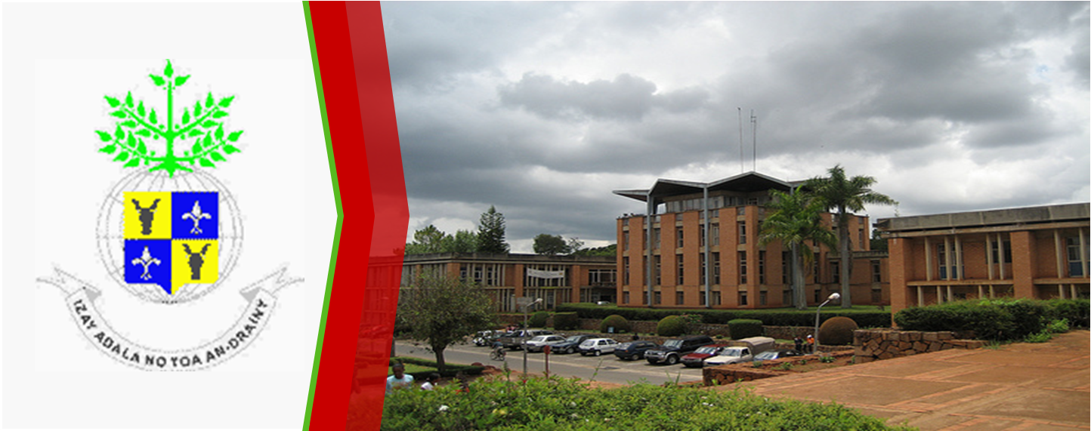
University of Anatananarivo
President of the University
Ecole Supérieure Polytechnique d’Antananarivo
(ESPA)
Director
Meteorology Department
Head of Departement
Notes:
Firstly, let me talk about the administrative structure of the RTC.
There is the university of Antananarivo.
ESPA is one of the instituts owned by the university. And the Meteorological department is in the ESPA.
ESPA contains 13 Departments.
And they are on supervising of Ministry of Higher Education and Scientific Research.

Slide 3

RTC –ESPA Madagascar
Two (02) types of Diplomas: Bachelor’s Degree and Master
Bachelor’s Degree: 02 diploma options (academic training)
Sciences et Techniques d’Observations, de Traitements et d’Informations Météorologiques et Hydrologiques
Sciences et Techniques de Prévisions Météorologiques et Hydrologiques
Master : 03 diploma options
Systèmes d’Observations, de Traitements, et d’Informations Météorologiques et Hydrologiques
Systèmes de Prévisions Météorologiques et Hydrologiques
Engineering de Développement Durable et du Changement Climatique
Notes:
On this foffowing slide, i’m going to develop about diploma
We issue two types of diplomas.
The License has 02 options and
Master (engineer) has 03 Options.

Slide 4
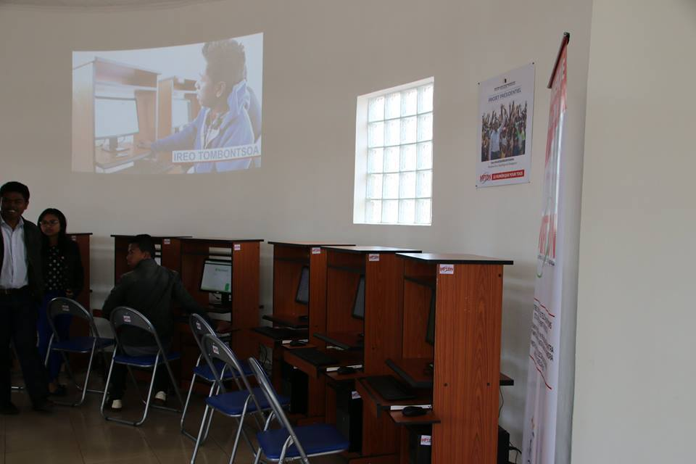
Overview of RTC ESPA Madagascar
Multidisciplinary teaching team ( 20% permanent teacher et 80% external professor)
  permanent teacher : 50% mathematicians
  Non-permanent teacher : 70% Meteorology experts from NHMS (DGM Madagascar)
Applied research : Tool creation – need partner institutions
Some local and internal partners / collaborators
Notes:
we have multidisciplinary teaching teams whose 20 percent a permanent teacher and 80% external professor.
50% of permanent teachers are mathematicians. we have a strong scientific base, especially mathematics, computer science.
And 70% of non-permanent teachers are meteorological experts from the DGM
Recently, we have focused more on applied research and the application and contribution of meteorology in other fields.
The thesis were based instead on the creation of work tools and the need partner institutions.
So we have some local partners

Slide 5
Collaboration
Internal collaboration within the University,
Between department of ESPA
  Creating of automatic mini weather station (Meteorology -Telecom - Electronic),
  Doctoral training , (Meteorology - Cognitive sciences), limited student number
Between Institutions
  bio-climatology (Meteorology Dpt – Animal Biology Dpt)
  Doctoral training , (Meteorology Dpt – Laboratoire Dynamique de l’Atmosphère et du Climat et des Océans LDyACO), limited student number
Notes:
On this slide I will talk about existing collaborations
internal collaborations of the university
Between department of ESPA,
for Example (Meteorology-Telecom-Electronic), for Creating of automatic mini weather station (a work in progress)
collaboration with other institutions of the university
bio-climatology (Meteorology Dpt – Animal Biology Dpt),
For example: displacement of primates in relation to climate change

Slide 6
Partner Institution for training courses
Aviation Civil de Madagascar ACM,
Agence pour la Sécurité de la Navigation Aérienne ASECNA Madagascar,
Bureau National de Gestion des Risques et des Catastrophes BNGRC
Notes:
Here are the main partners for training courses
Civil aviation of Madagascar,
Agency for the Safety of Air Navigation ASECNA Madagascar
BNGRC National Risk and Disaster Management Office

Slide 7


Educational partnership with the NHMS (DGM),
DGM experts teach at ESPA
Practical work done at the DGM
Close cooperation with GIZ Madagascar
Capacity Building on CC Integration Policy, MAHTP, MSP
Notes:
Another partners
Pedagogical Collaboration with the NMHS (DGM),
DGM experts teach at ESPA,
Most of our practical work is done at DGM
Recently, GIZ turned to us and DGM and other establishment to form a team for a capacity building project.
GIZ is funded by the German government and the European Union
Trainer Collaboration with GIZ: Capacity Building on CC Integration Policy

Slide 8

Needs in cooperation
Creation of a platform for discussion and direct communication between the RTCs, ........
Exchange of skills, mobility of trainers, commercialization of university research
Training of future Professor (Successor, Several teachers and experts soon retired),
Cooperation for host institutions for PhD students,
Need funding for research work for a PHD.
Need for funding and scientific cooperation for the creation of a laboratory for measuring the atmosphere (no atmospheric laboratory yet)
Search for international partner or collaborator
Notes:
To end my presentation, i’m going to talk about future cooperation.
Until now, we do not really find the means to capitalize our research or product.
After a few years, several teachers will be retired,.
We need cooperation for host institutions for PhD students and also need funding for research work for a PhD.
I would like to point out that only Doctor or PhD student could be recruited at the university
And the last point, Need for funding and scientific cooperation for the creation of a laboratory for measuring the atmosphere

Slide 9
THANK YOU
RTC –ESPA Madagascar
Dr RAMANAKOTO Toky Nandrasana

