Slide 1


NUIST/RTC NJ and Contributions to Africa
Professor MA Tinghuai
Exec. Deputy Director WMO RTC Nanjing (NUIST)
Dean, College of Intentional Students, NUIST
October 29, 2019

Slide 2

Contents
1
NUIST Strength
What are your key strengths as an institution?
2
Win-win Cooperation
What can you offer (other) RTCs in RA-I?
How could you benefit from working with the (other) RTCs in RA-I?
Notes:
双赢合作

Slide 3
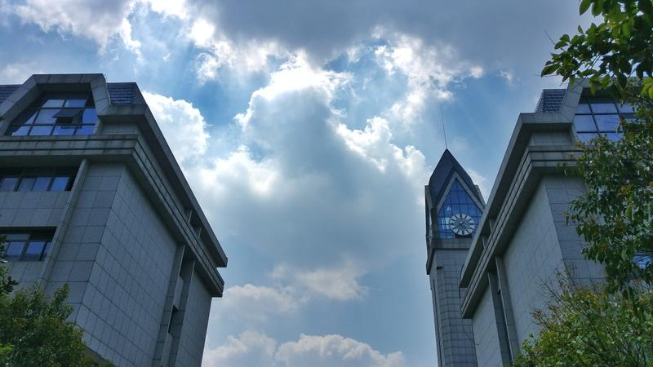
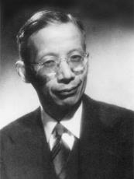

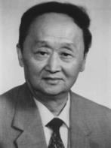

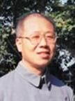


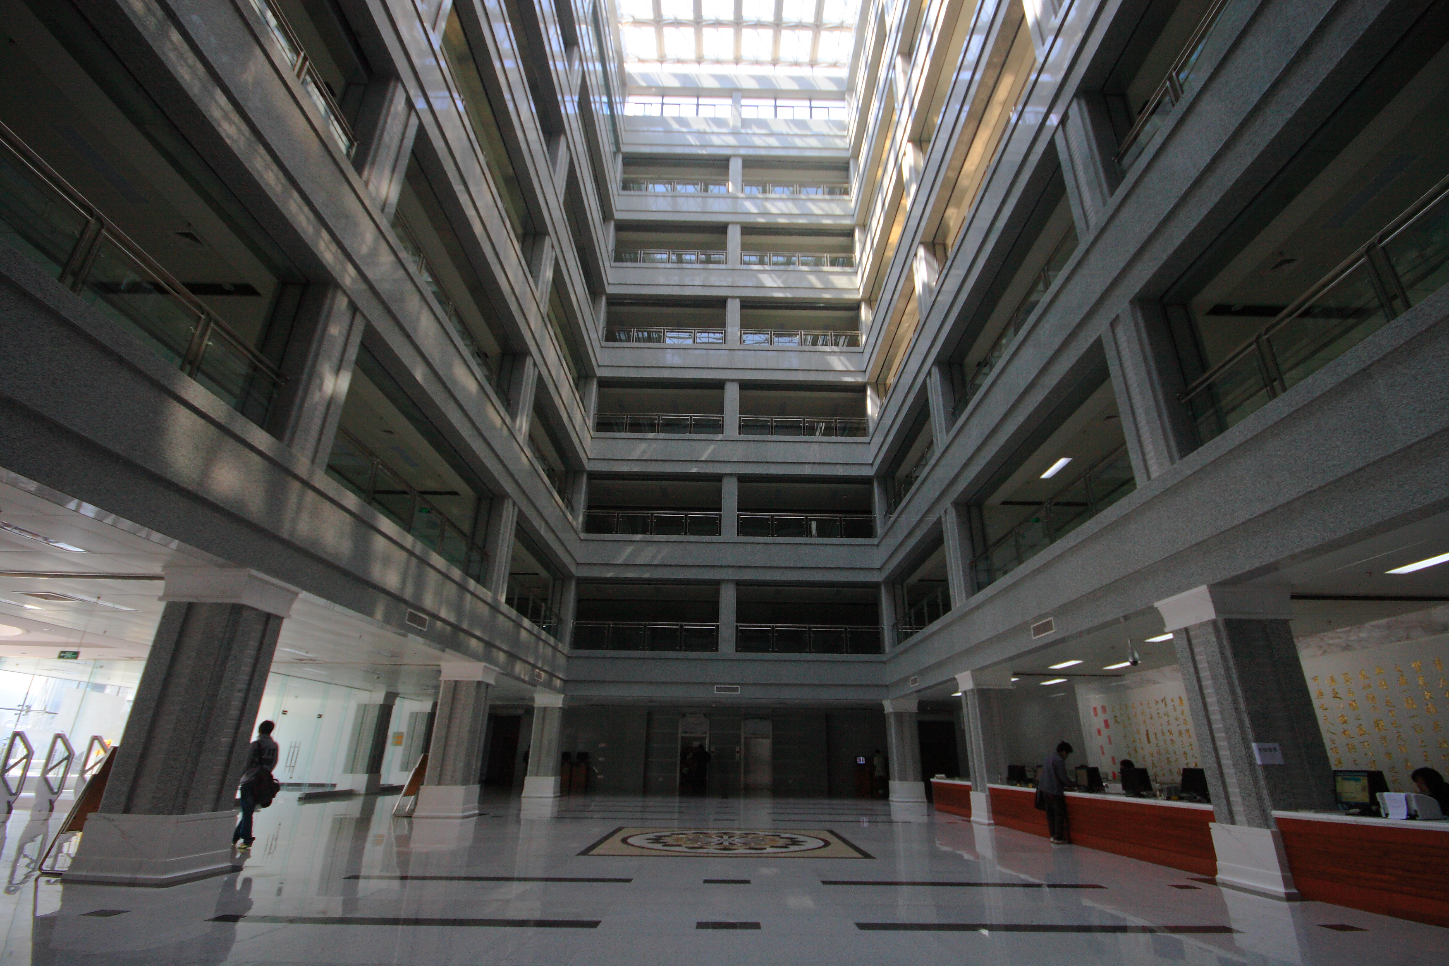
1
NUIST Strength——History and Development
1902 | 1921 | 1960 | 1978 | 2004 | 2005 | 2017
Sanjiang Normal School | ZHU Kezhen, National Southeast University | Nanjing Institute of Meteorology | National Key University | Nanjing University of Information Science and Technology | Excellence in MOE Evaluation | Double First-Class; High-level University
Initiators
Founders
International Model
ZHU Kezhen
TU Changwang
ZHU Hezhou
ZHANG Jijia
FENG Xiuzao
TAN Ding
TIAN Mingyuan
WENG Duming
Russian State Hydro-meteorological University
Prominent Chinese Meteorologist, Geologist and Educator
Founder of China’s modern geology and meteorology
Meteorologist, Founder of China’s Contemporary Meteorology
1st Dean of NUIST Met. Department, then Deputy Director of National Institute of Met. Science
1st Professor Team Leader, Member, Chinese Academy of Engineering
1st Deputy Director of Agro-met Institute
1st Director of The University Observatory
1st Dean of Atmos. Observation
Founder of Climatology
Originated from Dept. of Physics, University of Moscow
1930 Moscow Hydro-Met Institute
1945 Leningrad Hydro-met Institute
1998 RSHU
PhD, Moscow University, 1960
School of US Met. Officials, 1947
Education Experience in the USA,1967
Education Experience in the USA,1947
Imperial College London 1930
University of Liverpool 1932
Supervisor: Carl-Gustaf Rossby
National Southwest Associated University, 1940
UC Berkeley, 1948
Leningrad Hydro-met Institute,1958
University of Illinois 1910
University of Harvard 1913
Specialized programs
Application-oriented curriculum
Solid foundation of knowledge
Deep insights of study areas
Inherent Global Perspective
Notes:
1902文脉，1921学缘，1960办学，1978重点，2004更名，2005评估，2017双一流及高水平大学

Slide 4

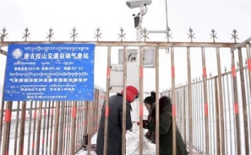
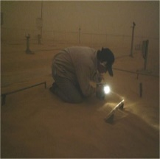
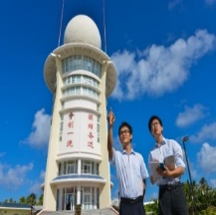
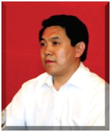
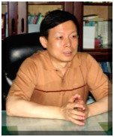
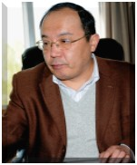
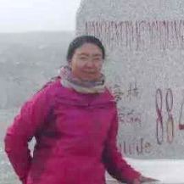
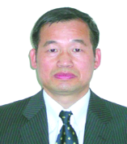
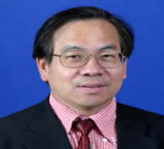
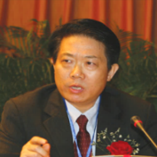
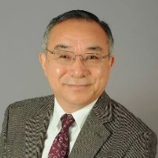
1
NUIST Strength——Serve meteorological cause
Focus on Meteorology
Contribute the global
International talent cultivation
NUIST alumni are found with
72% of total number of Chinese professors in meteorology in the world.
RSC, AGU and AMS (20+)
NOAA (87) and NASA (23)
WMO Deputy SG (1) and directors (4)
Waliguan Weather Station---- the highest worldwide
Weather Station in the desert
Weather Station on Sansha Island
About 160,000 graduates，scatter over mountains, islands, deserts and polar regions. 60% Chief Forecasters, 50% researchers and heads of provincial meteorological bureaus
Meteorological Leaders
Professional Backbone
ZHENG Guoguang
MInistry of Emergency Management
CMA
XU Xiaofeng
CMA
Jiala
Director, Tibetan Obervatory
Zhuoma
Chief Forecaster, Tibetan Public Service Centre
CHEN Jingming
RSC, Canada
YAN Hong
Deputy SG WMO
WANG Xueliang
NOAA NCEP
JIN Feifei
AMS Fellow,
Tenured Professor, University of Hawaii
Notes:
Serve meteorological cause
服务行业

Slide 5

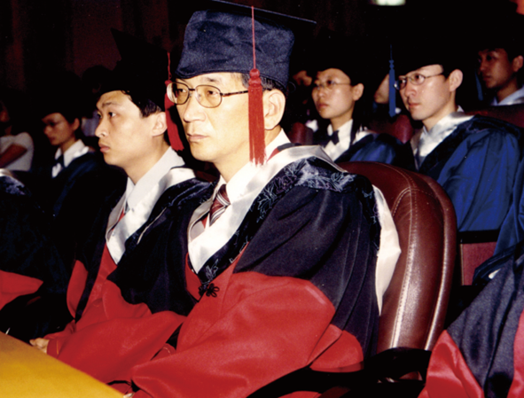
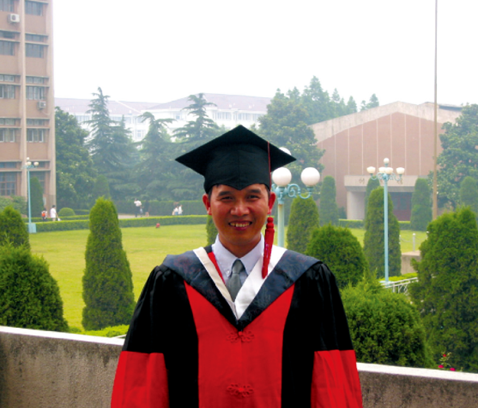

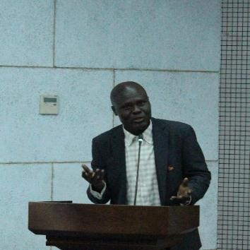
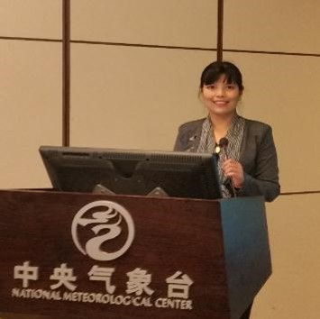

1
NUIST Strength——International Talent Cultivation
Son Tae Song
Yang Wenkan
1st International PhD with NUIST，June 2002
First Master in June 2004
Vietnam
OGWANG BOB ALEX
ZIN MIE MIE SEIN
PHD, Uganda
PHD, Burma
Work in Food and agriculture organization of the united nations
Degree
Non degree
Total
70 Countries
361 Masters （152 in Meteorology）
58 Doctors（41 in Meteorology）
Structure Improving
Notes:
International Education

Slide 6

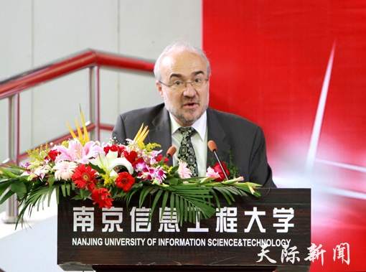
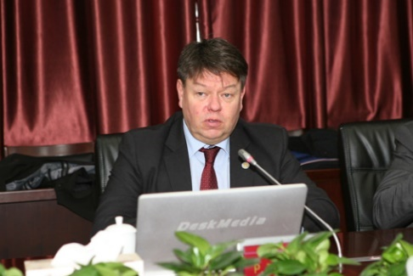
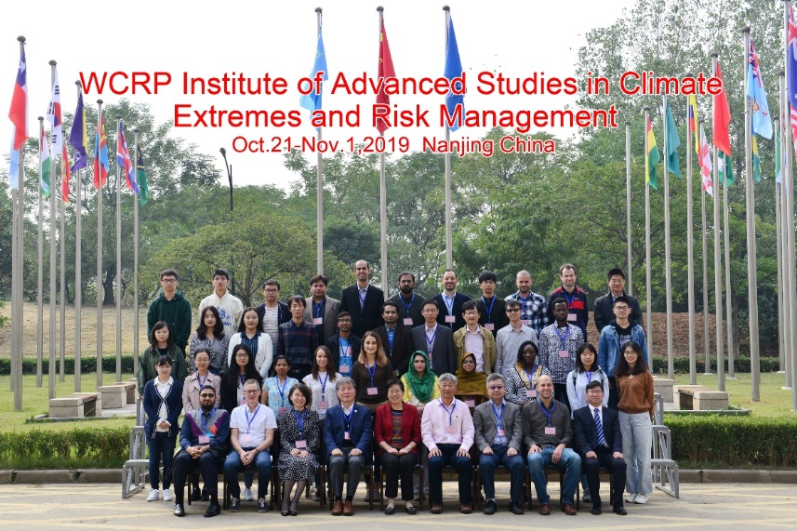
1
NUIST Strength——WMO Regional Training Centre Nanjing
Unveiling of the WMO RTC in 1994.
3626 trainees from 157 countries and regions （Dec. 2018）
11 national meteorological administrators or PR with WMO
Recognition from WMO Presidents and SGs
One of 28 regional centers of WMO and one of the most active member in the community.
Europe
Oceania
Africa
Asia
America
Asia
Africa
America
Europe
Oceania
1991
1210
213
116
96
Notes:
SG： Secretary General
Since its foundation, WMO RTC NJ has won high reputation for its high quality of training. When Dr. Petteri Taalas, WMO SG visited NUIST in Dec. 2015, his remarks greatly encouraged NUISTers.

Slide 7
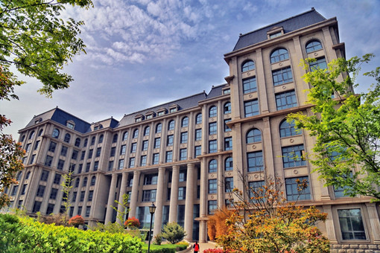
1
NUIST Strength——The scale of cultivation
About 1000 per year, 48% of China total number
100 doctors per year, 24% of China total;
350 masters per year, 43%of China total

Slide 8

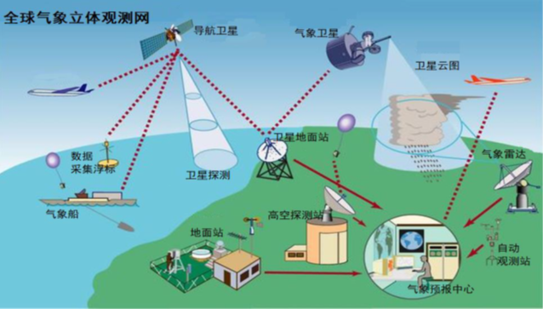


1
NUIST Strength——Development relying on characteristic
Discipline layout: One Core, Two Wings, Three Dimensions
Interdisciplinary Special Zone
Electronics, Information, Telecommunications……
interdiscipline
Environment, Ecology, Hydrology
Core:
Atmospheric Science
Geography, Oceanography, Remote Sensing
Supporting Discipline Groups
interdiscipline
Automation
Microelectronics
New Materials
……
AI
Robot
Big Data
……
Basic Discipline Groups
Biggest Meteorological University
Notes:
Development relying on characteristic 特色发展

Slide 9







1
NUIST Strength——Comprehensive strength
International Rankings
Top ESI 1%
Discipline | Time | Present Ranking
Geophysics | 2015.7 | 5‰
Engineering | 2016.9 | 6‰
Computer Science | 2017.5 | 3‰
Environment and Ecology | 2018.9 | 1%
27
45
39
74
2018-2019 International University Rankings (Mainland, China)
R&D Total Funds
350 Million RMB in account
R&D 660 Million RMB
Per capita
380,000 per capita
Platform
International Joint Lab
2011 Coordination Innovation Centre
Provincial-Ministerial Joint Lab
No. 40 in China
First Prize in National Teaching Achievement Award
Double First-Class Initiative
NO. 1 in MOE Evaluation in 2012,2017
Key Edu. Strategy of Chinese Gov’t in 2017.
Atmos. Sci.
Notes:
Comprehensive strength ： 综合实力
R&D Total Funds ： reaserch and development 科研经费
Per capita： 人均

Slide 10
Contents
1
NUIST Strength
What are your key strengths as an institution?
2
Win-win Cooperation
What can you offer (other) RTCs in RA-I?
How could you benefit from working with the (other) RTCs in RA-I?

Slide 11
2
Win-win Cooperation
From January 1st 2018, Africa
Notes:
First of all, NUIST and RTC-NJ have made significant contributions to meteorological education and training in Africa.
Since January 1, 2008, we have trained 922 long-term students and 333 short-term students for Africa. For academic students, there were 400 undergraduates, 340 postgraduates, 51 doctoral postgraduates.
(Majors coverage by at least: 258 students in science, 267 in engineering, 167 in economics, 94 in management, 2 in agriculture, 1 in law, 1 in art, 1 in literature)

Slide 12
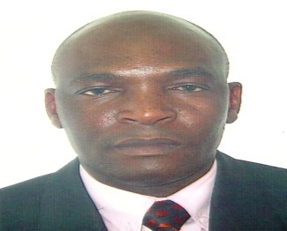
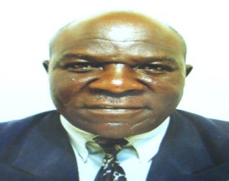
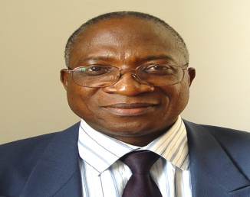

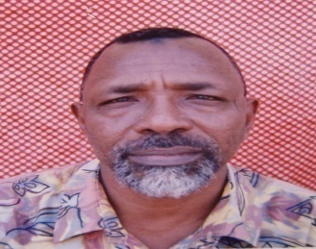
2
Win-win Cooperation
Outstanding Alumni
Amos MAKARAU
（Zimbabwe）
Jacob NKOMOKI
（Zambia）
Guehi Goroza
（Ivorian）
Franz Uirab
（Namibian）
Muzamil Abdelrahman Abdel Gadir
（Sudan）
Passport name | Gender | Nationality | Alumni Category | Duration of study | Majors studied/Training courses | Work unit | Duties
OGWANG BOB ALEX | M | Uganda | master PHD | 2009.10-2011.07 2011.04-2015.07 | Meteorology Climate System and Global Change | Uganda National Meteorological Authority | Principle Meteorologist
OWITI ZABLONE OKOLLAH | M | Kenya | PHD | 2009.09-2012.06 | Atmospheric Science | Kabianga University | Head of the Department of Environmental Research and Natural Resource management
LETUMA MOSUOE ERIC | M | Lesotho | master | 2010.09-2012.06 | Meteorology | Lesotho Meteorological Service | Senior Meteorologist
OYEDE MODOUKPE INES | F | Benin | master | 2011.09-2013.06 | Meteorology | National Meteorological Service of Benin | Meteorologist
ABULANGI RAMADAN KAMIL | M | South Sudan | master | 2016.09-2018. 07 | Meteorology | Ministry of Information, Communications and Posts | Secretary
Notes:
（5人照片，参加过短期培训，从左到右分别是
Director of Zimbabwe meteorological department 津巴布韦气象局局长 （2016年8月访问过中国气象局, 由气象局网页上获知）
Director at Zambia Meteorological Department 赞比亚气象局长 （Linked in 上获得，无更新时间等详细信息）
Former Director of the Ivorian Meteorological Agency 科特迪瓦气象局原局长（黄老师确认）
Director of the Namibian Meteorological Service 纳米比亚气象局局长 （黄老师确认）
Former Director of the Sudan Ese Meteorological Agency 苏丹气象局原局长（黄老师确认）
(下表是学历生中的代表，不是照片中5人)

Slide 13


2
Win-win Cooperation
Nuist
Africa
Study/exchange opportunities in China
Scholarships/Funds
online lectures
fundings for more training events
Experts, scholars, funds
Students
Scholars
RTCs
NUIST Branch
Meteorological Education Institutions
Establishment of the China-Africa Meteorological Education Forum
Notes:
Offer African students and scholars more study opportunities, more scholarships
Open our web-based course resources to training centres in Africa, even opening branches in Africa.
We can provide more training opportunities at the African Training Centre, at a cost we consider.
We can provide human support to Africa and send experts and scholars to help Africa.
In response to the initiative of the Forum on China-Africa Cooperation, we can establish a China-Africa Meteorological Education Cooperation Organization to promote meteorological education on both sides.

Slide 14

Invitation
10 May 2020,
60th anniversary of NUIST,
30th anniversary since WMO RTC Nanjing located in NUIST
“One belt and one road Meteorological education forum”
Thanks for your attention!

Slide 15
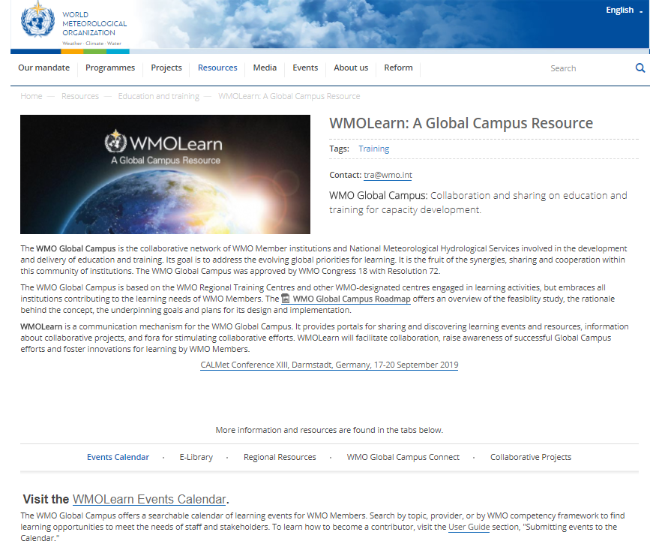
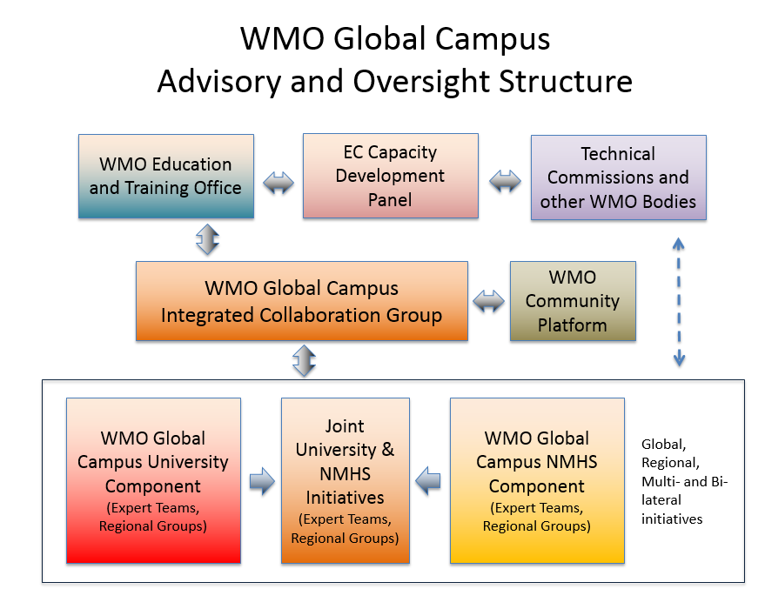
WMO Global Campus Review

Slide 16
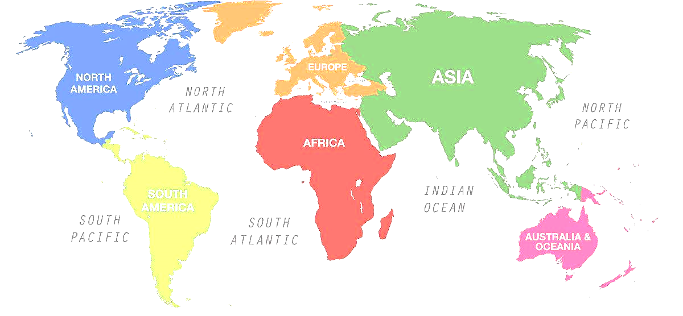
3
NUIST Propositions——Whole Idea
Global Campus
Chairman (Director of WMO Training Division) Or Chairman-in-Office
Community
Regional division（Core Node）
(eg. NUIST -> Asia and Africa)
Hardware / software construction
Maintenance
Coordination
Notes:
我们提议组建一个共同体，推动全球校园建设。可以设置 主席轮值概念或者WMO培训司司长任主席（总协调者），各区域分工建设，比如雷丁筹建欧洲，我们筹建亚非。
We propose to form a community to promote the construction of global campuses. The Chairman's Rotating Concept or the WMO Training Division Director can be set up as The Chairman (General Coordinator), and regional labour division can be set up, such as Reading University build Europe Project, and we build the Asian-Africa Project.

Slide 17
3
NUIST Propositions——Institution Settings
Community
Chairman-in-Office or Chairman (Director, Education and Training Division)
GC Committee（WMO-ETRP）
Expert advisory group
Member group
Host/Project Office
experts
RTCs
NMHSs
Educational Institutions
RA-1
RA-2
…
  Consultation and advisory services
  Module/Course Evaluation
  Criteria and Standard Laying out
Contributors
Resources/Module/Course Operation
  Hardware and software construction
  Maintenance（Human resource）
  Coordination
  Certification
  Training reports to WMO
Notes:
We conceive the specific architecture of the global campus as follows: （我们对全球校园的具体架构做如下构想）
Chairman-in-Office or Chairman (of the WMO Training Division as The General Coordinator)
"Global Campus" Committee, formed by WMO-ETR. To direct, authorize and oversee the construction and operation of the “Global Campus”; to develop a code of conduct and building objectives for the “Global Campus” Network; and to coordinate the work of the “Global Campus” departments. “全球校园”委员会，由WMO-ETR负责组建。指导、授权和监督“全球校园”的建设和运作；制定“全球校园”网的行为准则和建设目标；协调“全球校园”各部门间的工作。
"Global Campus" expert advisory group. WMO-ETR around the world to invite a number of well-known experts and "Global Campus" network platform contributors. Responsible for reviewing the course content and test quality, answer students' learning questions, and developing evaluation methods and evaluation criteria. “全球校园”专家顾问组，由WMO-ETR在全世界范围内邀请一定数量的知名专家以及“全球校园”网络平台贡献者组成。负责审核课程内容和试题质量，解答学员的学习问题，以及制定评价方法和评价标准。
“Global Campus” member group, composed of regional training centers, national meteorological and hydrological Services（NMHSs）, universities,. Contribute course content resources and the corresponding set of questions to the “Global Campus” network platform. “全球校园”成员组，由各区域培训中心、气象水文业务部门、高校组成。向“全球校园”网络平台贡献课程内容资源及相应试题集。
"Global Campus" office, set up by NUIST (of course, can only bear the Asian-African region). Responsible for raising funds to build a "Global Campus" hardware platform, software development and post-maintenance to ensure the smooth implementation of the Global Campus program, to communicate with the Global Campus Committee and the Global Campus member group, to timely release training notices for regional training centers and training subjects, and to provide "global campus" for the "global campus" member groups; upload course resources and question sets to provide technical support, communicate with experts in the “Global Campus” expert group to facilitate their review of course resources, customized evaluation criteria and answer participant questions, issue training certificates to online trainers, and regularly provide WMO-ETRP feedback on training data and reports. “全球校园”办公室，由南信大设置(当然可仅承担亚非区域)。负责筹集资金，用以建设“全球校园”的硬件平台、软件开发和后期维护，保障“全球校园”计划的顺利执行；与“全球校园”委员会及“全球校园”成员组进行沟通，及时发布各区域培训中心和培训主体的培训通知；为“全球校园”成员组上传课程资源和试题集提供技术支持；与“全球校园”专家组中的各位专家进行沟通，为其审核课程资源、定制评价标准和回答学员问题提供便利；为在线培训人员颁发培训结业证书；定期向WMO-ETRP反馈培训数据和报告。

Slide 18
3
NUIST Propositions——Construction Planning
startup
construction
evaluation
trial operation
operation
2020.5
2020.12
2021.12
2022.6
2022.12
GC Committee
  external coordination
  laying out
  criteria & standard
  criteria & standard
  online lectures
Expert advisory group
  laying out
  criteria & standard
  consultation and advisory services
  evaluation
  criteria & standard
  online lectures
  online lectures
Member group
  online lectures
Host/Project Office
  coordination
  funds
  GC Web/Andriod/MacOS
  training context
  training reports & maintanece
Notes:
Implementation phase实施阶段
May 2020-December 2020, start-up phase. Establishment of Global Campus; Global Campus Committee and Global Campus Expert Advisory Group co-develop training courses and evaluation criteria; Global Campus Committee and Global Campus member group agree on mission allocation of course video resources; and Global Campus Office raise funds. 2020年5月-2020年12月，启动阶段。“全球校园”各机构成立；“全球校园”委员会与“全球校园”专家顾问组共同制定培训课程和评价标准；“全球校园”委员会与“全球校园”成员组商定课程视频资源的任务分配；“全球校园”办公室筹集经费。
(2) January 2021-December 2021, platform and content construction phase.
The Global Campus Office began bidding for the Global Campus network platform and mobile platform based on training needs, and the Global Campus member group filmed the course video and prepared the corresponding question set. 2021年1月-2021年12月，平台和内容建设阶段。“全球校园”办公室根据培训需求开始招标，建设“全球校园”网络平台和移动平台；“全球校园”成员组拍摄课程视频、准备相应试题集。
January 2022-June 2022, evaluation phase. The Global Campus member group uploads a set of course videos and questions to the Global Campus network. The expert advisory group reviews and evaluates the quality of videos and questions, and the office selects high-quality courses based on the audit results of the expert advisory group, while constructing a library of questions. 2022年1月-2022年6月，评估阶段。“全球校园”成员组上传课程视频和试题集至“全球校园”网。专家顾问组对视频和试题的质量进行审核和评价；办公室根据专家顾问组的审核结果，筛选出优质课程，同时构建试题集库。
July 2022-December 2022, trial run phase. The Global Campus network is open to WMO member countries for trial operation. The Global Campus Office conclude various issues and user feedbacks during the page and app trial run to further improve the website, improve the user experience, and improve the quality of training. The Expert Advisory Group provides further suggestions for improvement in response to the feedback. 2022年7月-2022年12月，试运行阶段。“全球校园”网向WMO成员国开放试运行。“全球校园”办公室汇总网页及App试运行期间的各种问题和用户的反馈信息，进一步改进网站，改善用户体验，提升培训质量。专家顾问组针对反馈信息进一步提出改进意见。
After 2023, the stable operation phase. Global Campus office continued to invest in stability to ensure the Global Campus network long-term stable operation. The Global Campus Committee and the Expert Advisory Group will decide whether to further adjust the training courses and evaluation criteria, depending on the feedback from the Global Campus Office. The expert advisory group will also provide some answers to the participants' specific questions and confusions. 2023年后，稳定运行阶段。“全球校园”办公室持续稳定投入，保障“全球校园”网的长久稳定运行。“全球校园”委员会及专家顾问组将根据“全球校园”办公室的反馈信息，视情况决定是否进一步调整培训课程和评价标准。专家顾问组还将针对学员的具体问题和困惑做出一定的解答。

Slide 19

3
NUIST Propositions and the Existing Work Foundation - Operating Plan
Users
Trainees
Trainers
Administrator
Visitors and other users
Web-based
Mobile Device Applications
Applications
Teaching Resource Management
Online Learning & Training
Training Management
Documentation Management
Database
Courses
Trainees
Trainers
Modules
Others
Layers of Distance Learning System

Slide 20
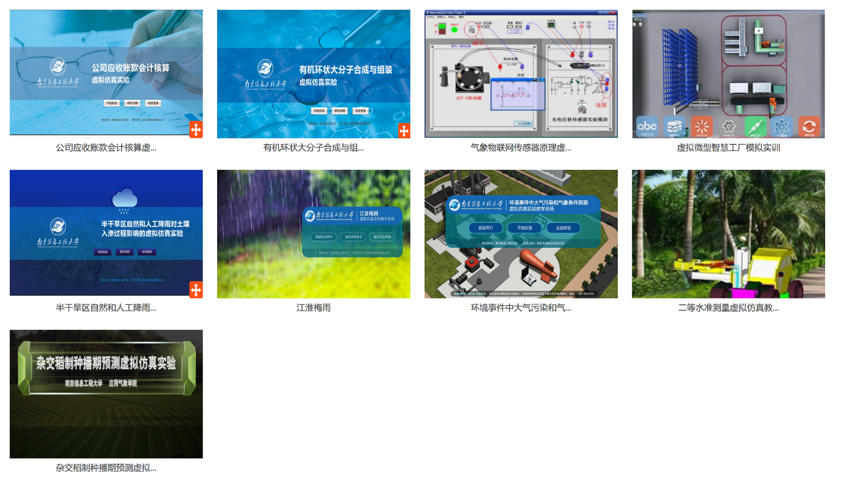
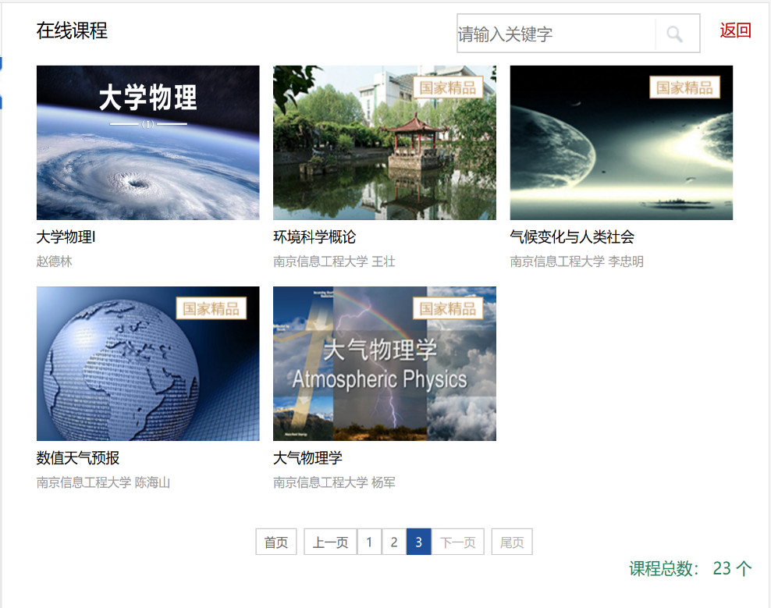
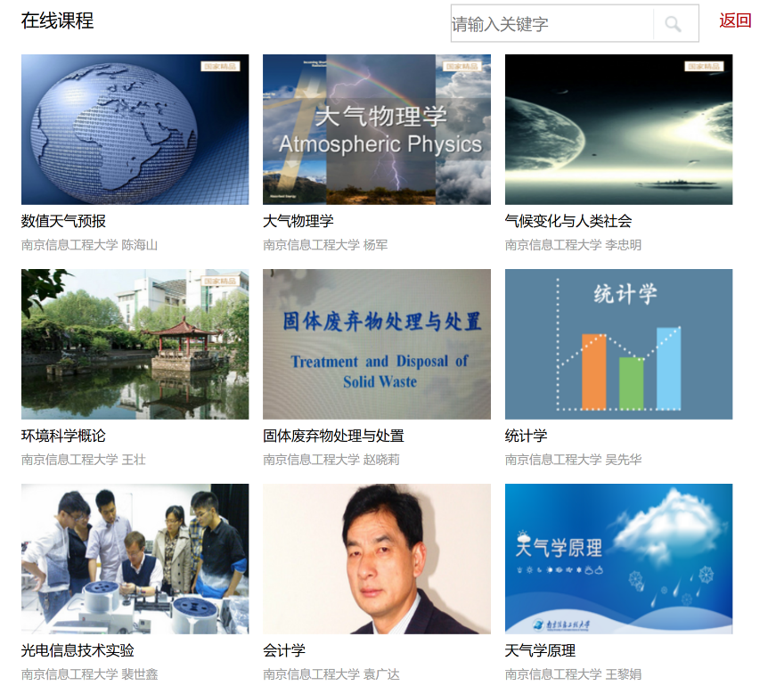
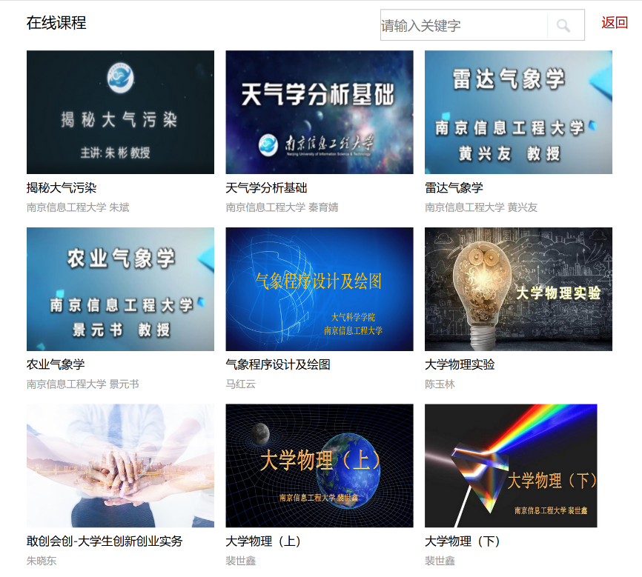
3
NUIST Propositions and the Existing Work Foundation
23 online lectures
9 virtual reality lectures
Notes:
我们有丰富的在线课程，包括23门视频课程和9门虚拟仿真课程。其中，虚拟仿真课程可让学员在电脑端实现气象观测、设备使用等实验和实习工作。这些在线课程突破了时空限制，让学员在自己方便的时间和位置中进行学习。需强调的是，我校在制作、使用和管理这些在线课程时已积累的大量的经验，这为我校为建设global campus提供了宝贵的借鉴。目前，更多的在线课程正在制作和准备当中。
We have a wide range of online courses, including 23 video courses and 9 virtual simulation courses. Among them, the virtual simulation course allows students to realize meteorological observation, equipment use and other experiments and internships on the computer side. These online courses break through time and space limits, allowing students to learn at their own convenient time and location. It is important to stress that NUIST has accumulated a wealth of experience in the production, use and management of these online courses, which provides our school with valuable lessons for building global campus. More online courses are being developed and prepared.

Slide 21








3
NUIST Propositions and the Existing Work Foundation - Operating Plan
Internet
Platform Networking
China Meteorological Press would like to distribute their whole E-book to WMO RTCs freely
Notes:
Backup two center
Country cache server

Slide 22
3
NUIST Propositions——buget
initial investment (1.21M) | iterm | unit price（M） | numbers | total fee (M) | implemented (M)
 | data server | 0.50 | 1 | 0.50 | 0.5
 | GC web | 0.05 | 1 | 0.05 | -
 | GC app | 0.05 | 1 | 0.05 | -
 | video lecture | 0.02 | 10 | 0.20 | 0.16
 | virtual reality lecture | 0.02 | 10 | 0.20 | 0.10
 | human resource fee for lecture | 0.01 | 20 | 0.20 | 0.13
 | office equipments | 0.01 | 1 | 0.01 | 0.01
M = million USD
Meteorological and Hydrological:
8 Online
5 virtual simulations
Late-stage investment (0.65M) | iterm | unit price（M/year） | number(years) | total fee (M) | implemented (M)
 | consultion fees and labor costs | 0.01 | 5 | 0.05 | -
 | international net | 0.05 | 5 | 0.25 | 0.1
 | maitainece fee for GC | 0.02 | 5 | 0.10 | -
 | utility fee | 0.01 | 5 | 0.05 | -
 | salary | 0.04 | 5 | 0.20 | 0.2
Provision of premises and manpower for permanent establishments
In 5 years，total budget is 1.86 million USD; we have implemented 1.23 million USD (66%)！
Notes:
Construction budget建设预算
The construction of the Global Campus network requires a large amount of capital investment, which mainly includes the front-end cost of the pre-construction and the back-end cost of the later year-end operation and maintenance. 建设“全球校园”网需进行大量的资金投入，这主要包含前期建设的前端费用和后期逐年运行维护产生的后端费用共两部分组成。
(1) Front-end expenses ($1.21 million)
a. Platform hardware. "Global campus" network construction, the use of various types of servers and storage hardware. Based on the Chinese market price, about 0.50 million U.S. dollars. Now, NUIST has all the hardware facilities. 平台硬件。“全球校园”网的建设，需使用各类服务器和存储等硬件。按中国市场价格，大致0.50百万美元。目前，南信大已有全部硬件设施。
b. Training website development. In addition to the general on-demand functions of the website, there will also be a study discussion area, expert question-and-answer area, examination area, for full discussion and exchange of students and teachers or experts. The website is available in both web and app versions (Android/Apple). Development at the Chinese market price is 50,000 U.S. dollar each, a total of 100,000 U.S. dollar. 培训网站开发。网站除一般的点播功能外，还将设有学习讨论区、专家答疑区、考试区，供学员与教师或专家进行充分的讨论和交流。网站有网页版和App版（安卓/苹果）。开发按中国市场价格各0.05百万美元，共0.1百万美元计。
c. Course video production. NUIST will provide 10 courses of video resources and 10 virtual simulation courses. Based on 20,000 U.S. dollar per course for each shooting and production costs, and 10,000 US dollar per course for the human resources of teachers or experts involved in video recording, it is a total of 30,000 U.S. dollar per course. For 20 courses, it is 600,000 U.S. dollar.
At present, NUIST has 8 video courses and 5 virtual simulations related to meteorology and hydrology, and will carry out translation work later. NUIST has invested 390,000 U.S. dollar。课程视频制作。南信大将提供10门课程的视频资源和10门虚拟仿真课程，按中国市场价0.02百万美元/门的拍摄和制作费、参与视频录制的教师或专家的人力资源费0.01万美元/门计算，共0.03万美元/门X 20门=0.6百万美元。目前，南信大已有与气象水文相关的8门视频课程、5门虚拟仿真，后期将进行翻译工作，已投资0.39百万美元
d. Office equipment. Purchase of necessary computers, printed copies, air conditioners, office furniture and other fixed assets for the "Global Campus" office, according to the Chinese market price, it will cost 10,000 U.S. dollars. NUIST already has necessary office equipment. 办公设备。为“全球校园”办公室购置必备的电脑、打印复印一体机、空调、办公家具等固定资产，按中国市场价格0.01百万美元计。南信大已有必须办公设备。
(2) Back-end expenses ($650,000 per year)
a. Human resources costs. The Global Campus Office will initially have two permanent staff members, each earning $20,000 per year, or $20,000 per year per person by 2 persons, in total $40,000, according to the average local salary. NUIST will implement two permanent staff members for the Global Campus Office through on-campus recruitment, without additional financial burden. In this case, $40,000 per year has been implemented. Expert consultation fees for meteorological experts who participate in the "Global Campus" online question answers and revision, and the labor costs of hiring professional network technicians and temporary office staff will be $10,000 per year. Subtotal $40,000 and $10,000, a total of $50,000. 人力资源费。“全球校园”办公室初期将设置固定工作人员2名，按照当地平均工资标准，每人每年酬薪2万美元，计2万美元/年/人X2人=4万美元。需支出的是，南信大将通过校内招聘的方式，落实“全球校园”办公室两名固定工作人员，这不额外增加财政负担。因此，已落实0.04百万美元/年。参与“全球校园”网网上试题答疑和批改的气象专家的专家咨询费，聘请专业网络技术人员和临时办公工作人员的劳务费，每年0.01百万美元。小计0.04百万美元+0.01百万美元=0.05百万美元。
b. Network bandwidth charges. To ensure the smooth operation of the Global Campus network, an application will be made to lease a 100M large bandwidth international network, and it costs $50,000 per year. At present, NUIST has a 50M international bandwidth and will be upgraded later, which will cost $20,000 per year. 网络带宽费。为保障“全球校园”网的顺畅运行，将申请租用100M大带宽国际网络，0.05百万美元/年。目前，南信大已有0.02百万美元/年的50M国际带宽，后期将升级国际带宽。
c. Hardware upgrades and maintenance for the Global Campus network costs $20,000 per year. “全球校园”网的硬件的更新和维修费，0.02百万美元/年。
d. Other costs. Reception fees for foreign experts, office supplies such as pen, paper, toner, water and electricity, and site usage, $10,000 per year. 其他费用。外来专家的接待费，办公室的笔、纸、硒鼓等耗材的办公用品费、水电气使用费、场地使用费，0.01百万美元/年。
Overall, in the next five years, NUIST has implemented $1.23 million in construction costs, occupying about 66% of the total budget $1.86 million. In the future construction, NUIST will further actively apply to the Chinese government for funding and support. In addition, NUIST and local governments also maintain long-term friendly and cooperative relations, such as the Jiangsu provincial government, Nanjing municipal government, and they have been provided various types of scholarship support for our international students education. Later we will also seek more financial and policy support from them to fully guarantee the smooth construction of the "Global Campus" network. 总之，在未来的5年中，南信大已落实1.23百万美元的建设费用，约占总预算1.86万美元的66%。在未来的建设中，南信大将进一步积极向中国政府申请资助和支持。此外，南信大与地方政府也保持着长期友好的合作关系，比如江苏省政府、南京市政府，他们一直为我校的留学生教育提供着各类奖学金支持。后期我们还将向他们寻求更多的经费和政策支持，全面保障“全球校园”网的顺利建设。

Slide 23
Thanks for your attention!

