Slide 1
ECMWF training offerings
Numerical Weather Prediction training and Copernicus Climate Change Service activities
Anna Ghelli
anna.ghelli@ecmwf.int
Thank you to many colleagues at ECMWF

Slide 2
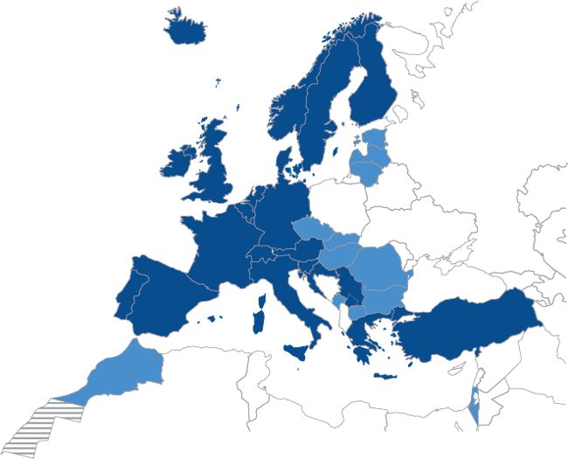
Supporting training in Europe and beyond
Our training:
Numerical Weather Prediction courses (use of products and theory)
Software and compute (mostly for ECMWF Member States)
Use of climate data for mitigation and adaptation challenges
Supporting capacity building
WMO Severe Weather Forecast (Demonstration) Projects
World Bank (Central Asia)

Slide 3
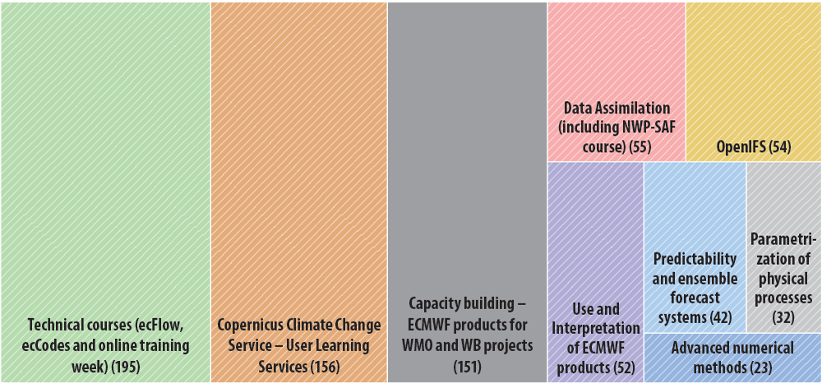
Supporting training in Europe and beyond
Our offers:
Courses are designed to enable participants to develop an understanding of advanced numerical forecasting and to use ECMWF’s services and products effectively and to use the open data offered via the Copernicus programme (Copernicus Climate Change Service and Copernicus Atmosphere Monitoring Service)
Areas
Meteorology
Software/computing
Climate
Atmosphere Monitoring
Other learning opportunities
WMO Fellowship scheme
Annual seminar
760 learners in 2019!
(September 2019)
Notes:
Non MS and CS in 2019 were about the 20% of total participants (DA NWP-SAF more popular as it is open, no priority applied)

Slide 4
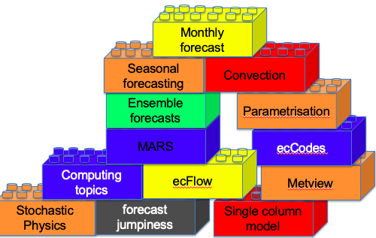
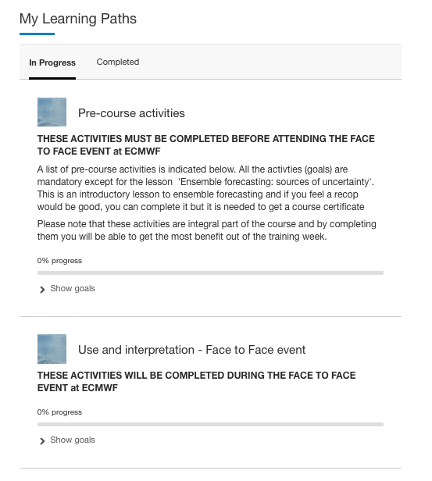
Supporting training in Europe and beyond
Blended learning
Produce bite size online learning
Staged introduction of blended learning
Case studies and practical activities (tutorial like for software and NWP and real weather events case studies)
Centralize training resources
Introduced a new Learning management system

Slide 5




User Learning Services
Climate change
Copernicus Climate Change Service
“Past, current and future climate dataset are complex and need a tailored training programme to reach out to the diverse user communities …..”
Juan Garces de Marcilla (Director of Copernicus Services at ECMWF)
The User Learning Services provide tailored blended training to those who need to use climate data to address the climate change adaptation/mitigation challenges
Wageningen University & Research is a collaboration between Wageningen University and the Wageningen Research foundation
Leader in digitalization of learning
Notes:
Climate change challenges
Budget of Copernicus programme – link to economic benefit for European citizen
Need to use open data and transform them into actionable information and ultimately in policies that will shape out future
Audience
Professionals who will use data in their activities and bring economic benefits to Europe and worldwide
Researchers whom C3S will support to foster the scientific understanding of climate impacts and climate science
Students who are the next generation of workers

Slide 6
Training method – Our blended training
Initial webinar
Introduce the learning approach
Online self learning
Build a background knowledge
Face to face event
Reinforce self learning using flipped classrooms
Guide the learners through the online resources
Focus the learning on a real case scenario
Facilitate group activities centred on real case scenarios to apply acquired knowledge
Final webinar
Present group activity
Discuss and peer review other groups' results
Learning at one's own pace: anytime and anywhere
online resources are designed for different levels of knowledge and include videos, images, text, audio to offer an engaging experience. Learners can access them with any device (computer, tablet, mobile).
In-country training
(local language)
https://uls.climate.copernicus.eu
Notes:
Need for learning activities available anytime/anywhere, but as well face to face events in local language.
online resources are designed for different levels of knowledge and include videos, images, text, audio to offer a more engaging experience to learners who can access them with any device (computer, tablet, mobile).
Webinars ahead guide the learners and provide focus, and webinars as follow up are a way to present what has been learnt (presenting case studies).
During the face to face flipped classroom activities take place to strengthen the online learning and discuss difficult concepts.
Group activities encourage learners to share experiences, create a network of people who can be approached for support or future ventures

Slide 7
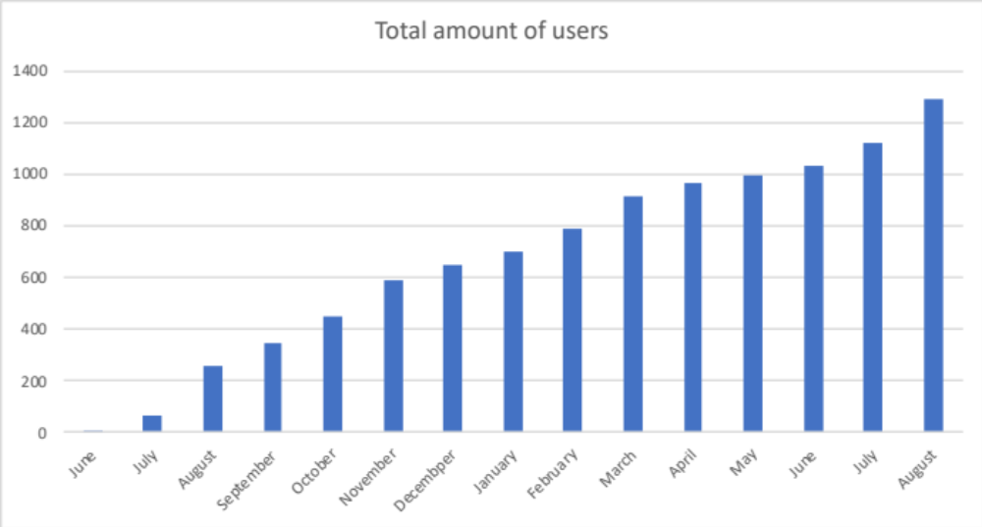
Knowledge transfer
Train the trainer
Trainers are trained in the Netherland (Wageningen) and those selected make up our pool of European trainers
Trainers co-organized and lead face to face in-country training events using the online resources
Cascading (multiplier) effect which allows to transfer knowledge rapidly
Notes:
Train the trainer approach
Use of case studies where learners have to apply their learning to an adaptation case which is usually their own case
Show the video!
Use some money stats to show the multiplication factor!! The cost to train a trainer is about 1700 Euros which compares well with the $1252 figure mentioned in the “Association for talent development’s 2016: state of industry report’
If to this figure we add an average cost of the platform (~400 Euros) and the fees for the trainer (~5000 Euros), for a group of about 40 learners, the average cost to train each learner is les s than 600 Euros
Include a comment on the increase of platform users (active), --→ this can be translated in number of learners who are acquiring knowledge

Slide 8
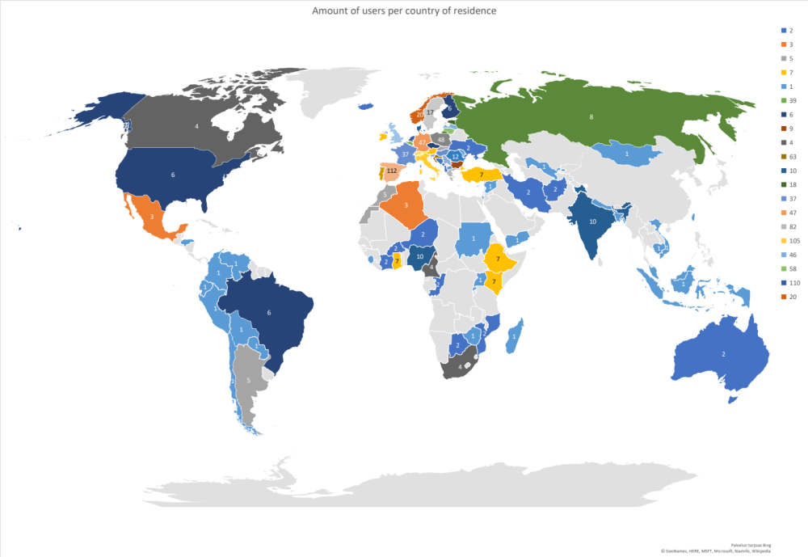
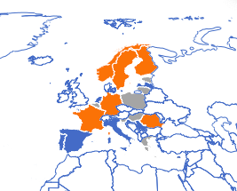
Effective and efficient training
Platform users (geographical distribution)
Face to face training events
Completed
Planned for 2019
Planned for 2020
Notes:
Geographical distribution of platform users --→ the availability of online resources has allowed us to expand the reach of our learning!!
Geographical distribution of in-country training events
Feedback from event in Italy

Slide 9


Our training- future work
Climate MOOC – Expanding the informed use of Copernicus data
Uniqueness: The MOOC shall contain unique features that link it to the activities and services of C3S
Flexible learning: The MOOC shall offer a greater flexibility in the way learners consume contents expanding the reach of training
Focus on real-life applications: The MOOC shall highlight how the information provided by the Copernicus data can help different sectors to adapt to climate change. It shall also support diverse communities and businesses to make best use of data
Our ‘ambitious’ timeline foresees the MOOC to be ready by Q1 2020.
Notes:
Highlights here:
C3S is planning a Climate MOOC
We have now appointed an externally company and will start working on the MOOC storyline before end of summer
The MOOC will be available from the C3S ULS platform (free of charge)
I have listed three high level requirements which will drive the way the MOOC is built.

Slide 10
Thank you!

