Slide 1
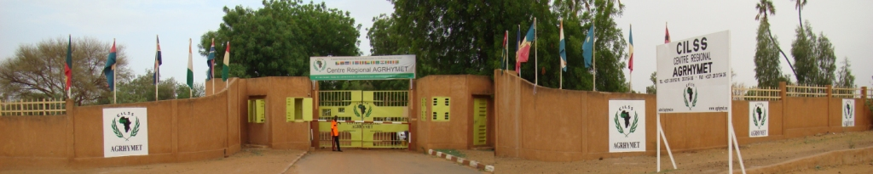
AGRHYMET REGIONAL CENTRE
WAONGO Moussa

Slide 2
Plan
  About AGRHYMET
  Training offers
  Key strengths
  examples of collaboration
  what can we offer to others RTC
  Expectation from others RTC

Slide 3
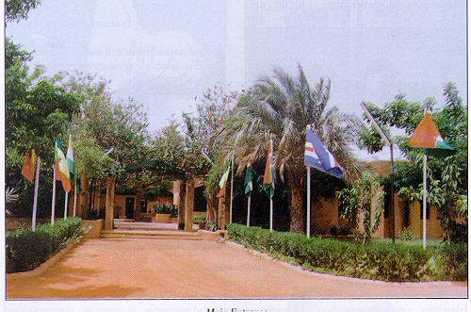
AGRHYMET, a specialized institution of CILSS
  CILSS: created in 1974 to foster actions regarding food security, drought control, water mangement and climate change
  Activities: training (graduate programs, capacities enhancement through short term training, information production,
  Beneficiaries: CILSS/ECOWAS zone and beyond ( National technical services staff, students, NGO)

Slide 4
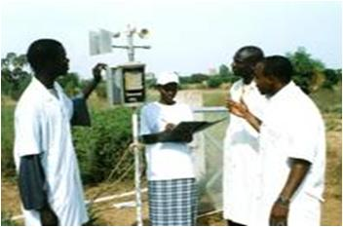
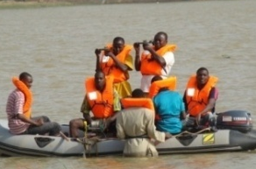
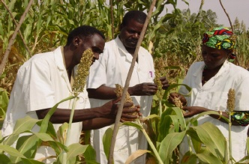
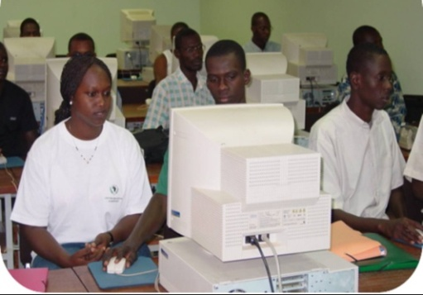
AGRHYMET = AGRrométéorologie, HYdrologie, METéorologie
TRAINING OFFERS
Graduate program
Senior technician (Bac+2 years) : agrometeorology, hydrology, maintenance and micro-informatique
Engineer (DEUG+ 3 years) : agrometeorology, hydrology, maintenance and micro-informatique
Master (Engineer or Master I + 1 year) : Climate Change and Sustainable Developemnt

Slide 5
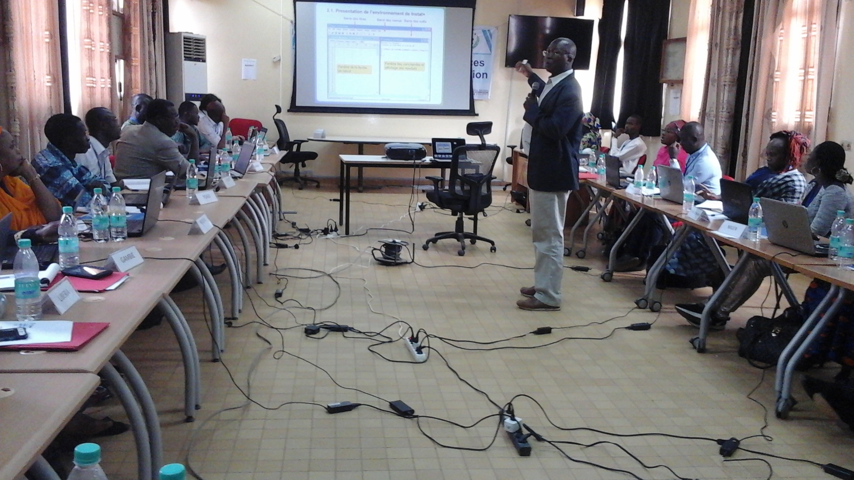
AGRHYMET = AGRrométéorologie, HYdrologie, METéorologie
TRAINING OFFERS
Short term training/ capacities enhancement
climate Data collection and analysis
Quality control and climate database management
decision making support tools (agrometeorology, hydrology, etc…)
climate information dissemination Techniques
Transfert of tools adapted to the Sahel region

Slide 6
KEY STRENGHTS
Staff: multidisciplinary team with more than 100 experts in meteorology/climate, hydrology, agronomy, crop protection, animal husbandry, GIS, computer science , etc…)
experimentation site (2ha irrigated)
2 Meteorological stations (classic and automatic)
2 Satellite Imagery reception antennas and GIS room
7 Laboratories : agrometeorology, hydrology, electronic, agricultural zoology, phytopathology, phytopharmacy and molecular biology, bio-Carbone
Amphitheatre of 120 seats
6 Classrooms, 4 computer rooms, 1 Visio conference room,
1 information and documentation Centre
Student dormitories of 130 rooms
Residence for guests of 20 rooms

Slide 7
KEY STRENGHTS
Thesis and doctoral studies support
Co-supervising of thesis
Sharing laboratories and hosting doctoral students
Internship of post doctoral students

Slide 8
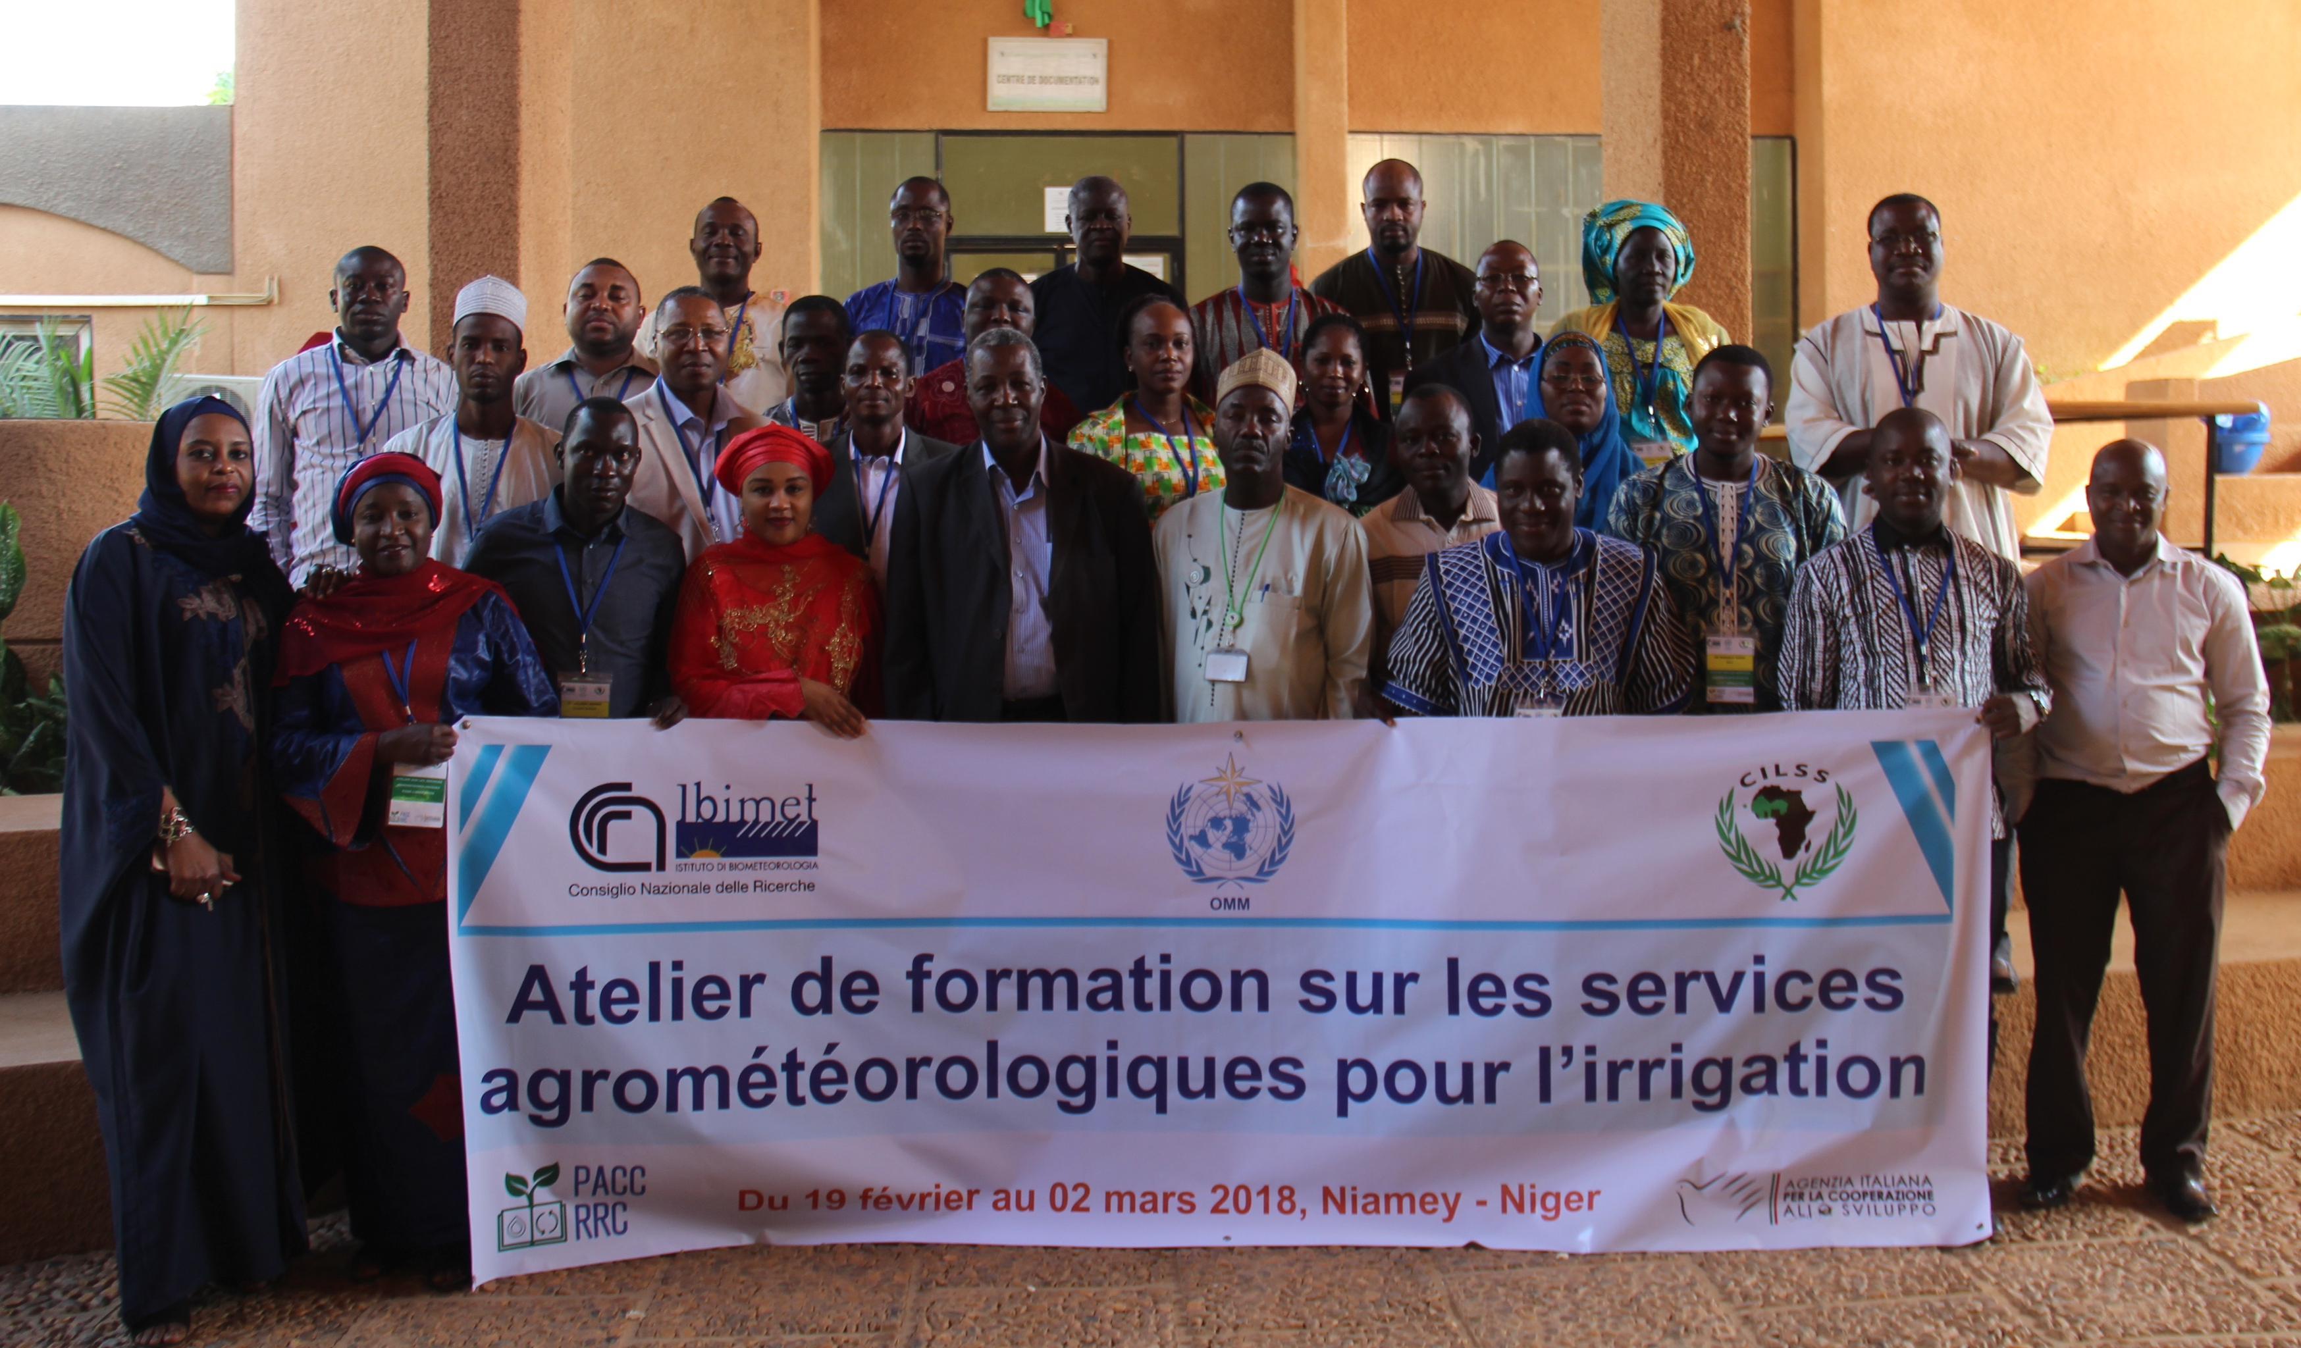
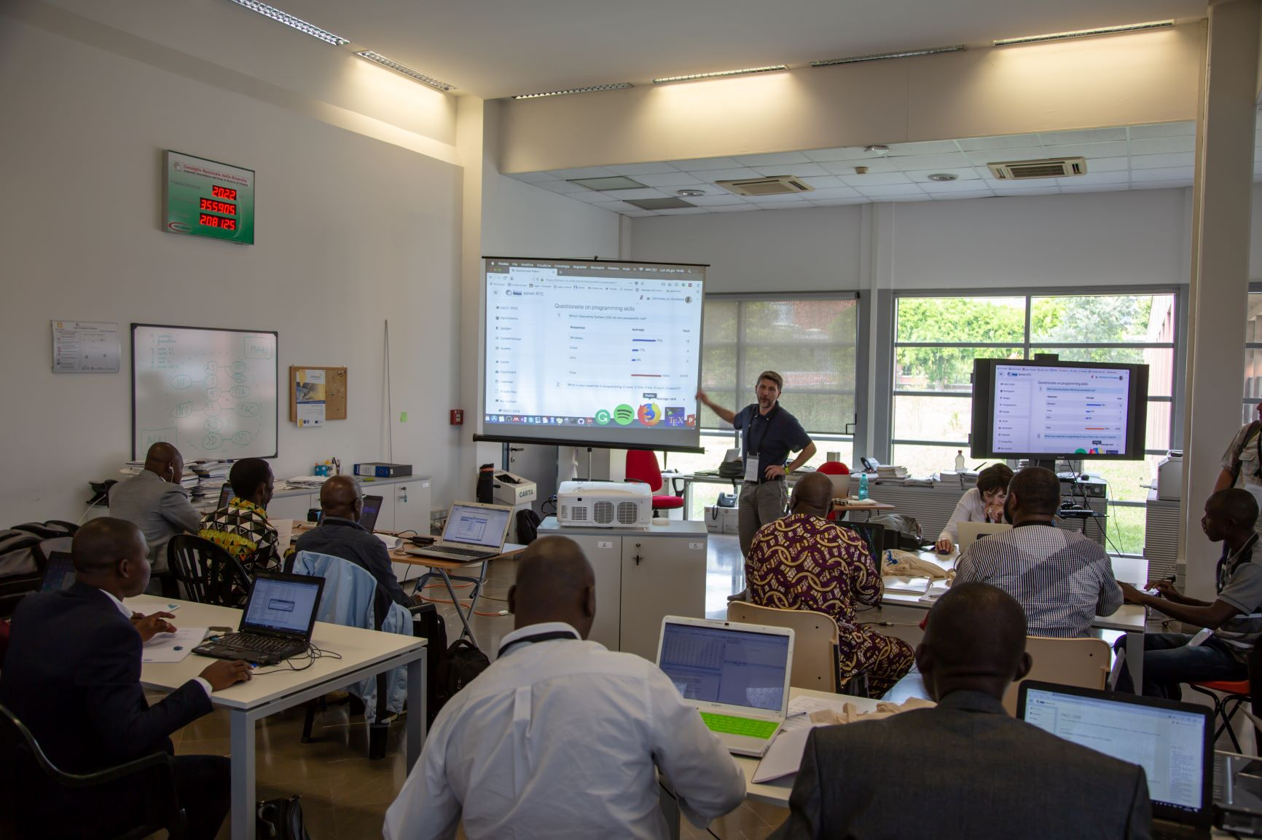
EXAMPLES OF COLABORATION
Regional integration as part of the multi-actor platforms such as “Plateforme des Institutions Régionales pour l'Environnement et la Météorologie” (PIREM) : ICRISAT, AGRHYMET, ABN, ACMAD, CRESA, EAMAC, CERMES.
MoU between AGRHYMET and AMU (NIGER), NBU (BF) in the field of training (lecture, supervision of student, member of student thesis defense)
IBIMET and AGRHYMET for the implementation of PACC-RRC

Slide 9
WHAT WE CAN OFFER TO OTHER RTCs
Sharing training experience regarding the CILSS/ECOWAS zone
Expertise in the field of agrometeorology, hydrology and maintenance and micro-informatic
Contribution to enhance the collaborative activities (training and education) for fund raising.
Willingness for collaboration to enhance the quality of training resources among RTCs

Slide 10
WHAT WE EXPECT FROM OTHER RTCs
sharing experience about training and education program
sharing experience in resource mobilization (challenges for funding education)
Experience on dealing with the huge demand on training
Support to enhance distance learning capacities
joint effort for project call targeting capacity building
Opportunities for scientific visits (enhancing trainer’s capacities)

Slide 11
THANK YOU FOR YOUR ATTENTION !

