Slide 1

Webinar #7 04.03.2019
OSCAR station class templates
-first ideas and brainstorming-

Slide 2
Agenda
Welcome
OSCAR station class templates (Luisa)
Discussion

Slide 3
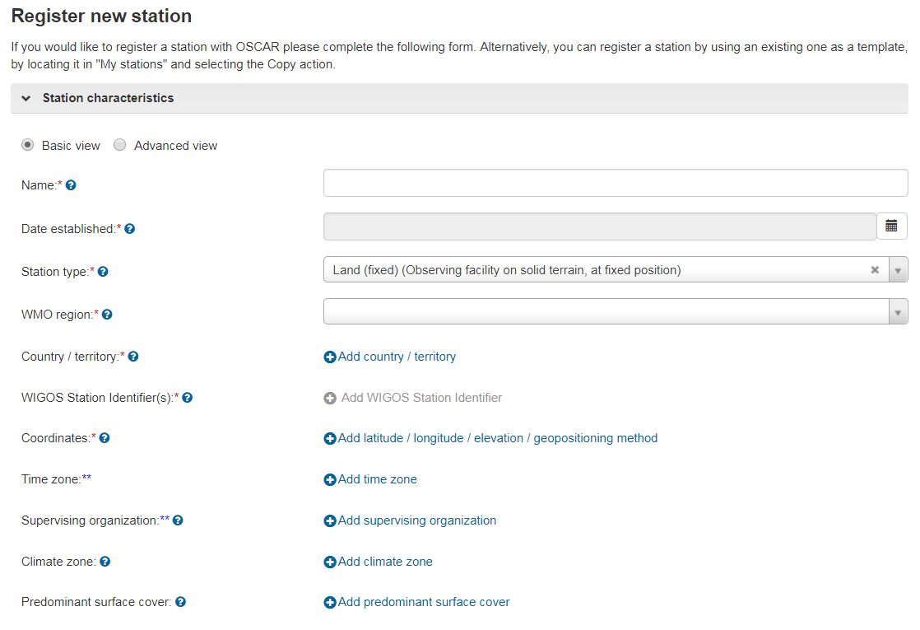
General idea
To manually register a new station takes time and depending on the station type involves repetitive steps, e.g. registration of a new Upper air/Radiosounding station

Slide 4
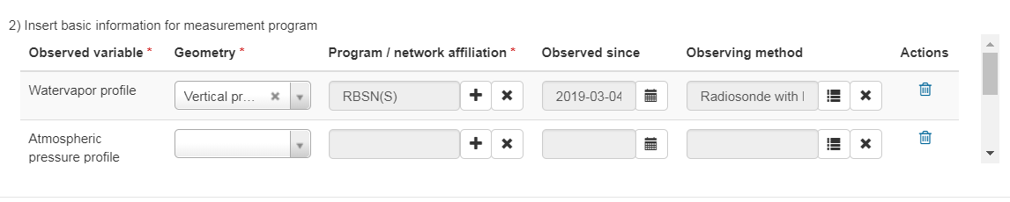
General idea
To manually register a new station takes time and depending on the station type involves repetitive steps, e.g. registration of a new Upper air/Radiosounding station

Slide 5
General idea
Easier input using templates
Register new station: select station type -> custom input form
Template depending on station class
Templates on regional, national level
Templates could be used for registration, editing(?), closing(?)

Slide 6
Concept of Templates
Presence or absence of specific WMDS fields
Predefined values for certain WMDS fields
Class specific labels describing WMDS fields (e.g. GCW template)
Correlation between WMDS fields (time schedule and deployments defined once and propagated for all observations)
, as well as how fields relate to the WMDS, preferable in an XML representation

Slide 7
New station class templates
Surface land meteorological station (synop)
Automatic Weather Station (AWS)
Upper-air station/Radiosonde station
Upper-air station/Pilot station
Radar wind profiler station
Global Cryosphere Watch Station

Slide 8
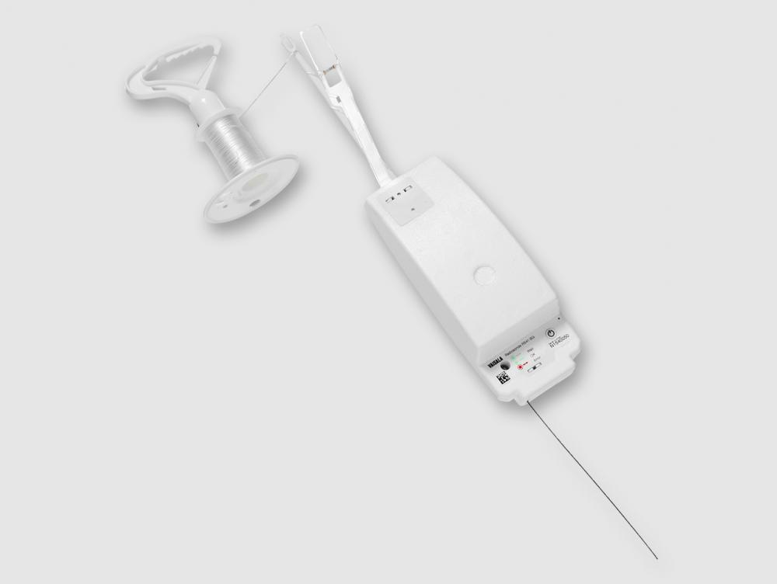
Example station class: Upper air/Radiosonde – Template
Vaisala.com

Slide 9
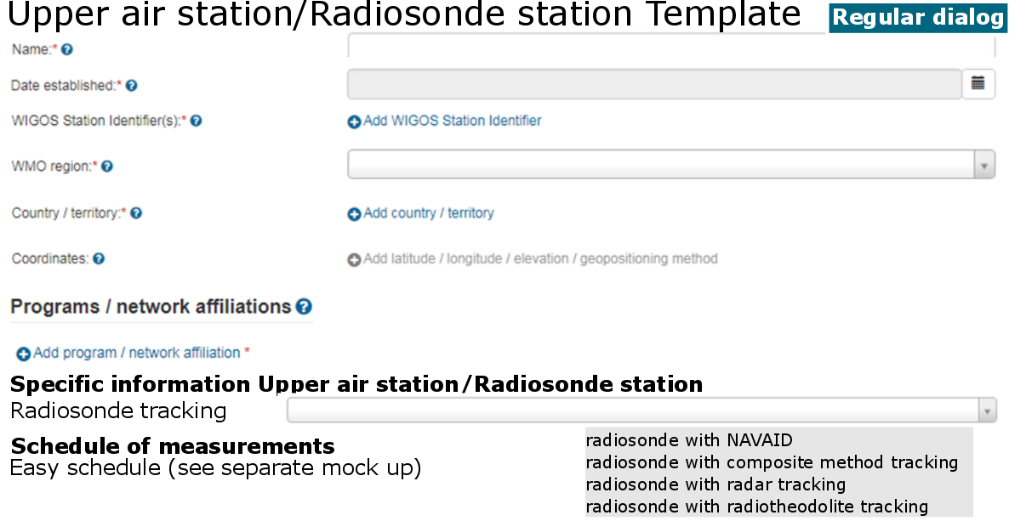
Example station class: Upper air/Radiosonde – Template Mock up

Slide 10
Example station class: Upper air/Radiosonde – Template
Necessary input:
Station basics (station name, WIGOS-ID, date established, coordinates, country, WMO-region)
Program/network
Deployment date
Observing method: Radiosonde tracking information

Slide 11
Example station class: Upper air/Radiosonde – Template
Pre-defined:
Station type: land (fixed)
Variables:
  humidity > watervapor profile
  pressure > atmospheric pressure profile
  temperature > temperature profile
  wind > upper wind (X,Y components, horizontal)
Geometry (for all variables): vertical profile
Deployments (for all variables): Instrument characteristics: Observing method: radiosonde (tracking has to be specified)

Slide 12
Open Questions
Which templates are useful?
  Planned:
  Surface land meteorological station (synop)
  Automatic Weather Station (AWS)
  Upper-air station/Radiosonde station
  Upper-air station/Pilot station
  Radar wind profiler station
  Global Cryosphere Watch Station
Would it be good to be able to create national/regional templates?

Slide 13
Open Questions
What would you like to mostly use templates for?
  Registration of stations?
  Editing of station classes?
  Closing of station classes?
How should a template based editing of a station look like?
How should closing look like/what should it do?

Slide 14

Thank you
Merci

Slide 15
New station classes (template)
Surface land meteorological station (synop)
Surface marine meteorological station (synop)
Automatic Weather Station (AWS)
Climatological station
Radiation station
Upper-air/Radiosonde station
Upper-air/Pilot station
Radar wind profiler station
Aircraft meteorological station
Sea profiling station
Weather radar station
Precipitation station
Agricultural meteorological station
Cryosphere Station (template: Global Cryosphere Watch Station)

Slide 16
[LI1]Is that always this tracking type? Check!
[LI1]Is that always this tracking type? Check!
Station class | Characteristics of this station class which will be reflected in the template
Surface land meteorological station (synop) | Predefined fields: Station type: land (fixed) Variables: humidity -> humidity (at specified distance from reference surface), pressure -> atmospheric pressure, temperature -> air temperature (at specified distance from reference surface), wind -> horizontal wind direction at specified distance from reference surface, wind -> horizontal wind speed at specified distance from reference surface

Slide 17
[LI1]Is that always this tracking type? Check!
[LI1]Is that always this tracking type? Check!
Station class | Characteristics of this station class which will be reflected in the template
Automatic station (AWS) | Predefined fields: Station type: land (fixed) Variables: humidity -> humidity (at specified distance from reference surface), pressure -> atmospheric pressure, temperature -> air temperature (at specified distance from reference surface), wind -> horizontal wind direction at specified distance from reference surface, wind -> horizontal wind speed at specified distance from reference surface Default options: source of observation -> instrumental automatic reading (automatically produced measurement result) for at least one of the above mentioned variables

Slide 18
[LI1]Is that always this tracking type? Check!
[LI1]Is that always this tracking type? Check!
Station class | Characteristics of this station class which will be reflected in the template
Upper-air/Radiosonde station | Predefined fields: Station type: land (fixed) Variables: humidity > watervapor profile, pressure > atmospheric pressure profile, temperature > temperature profile, wind > upper wind (X,Y components, horizontal) Geometry (for all variables): vertical profile Deployments (for all variables): General information: Source of observation: Instrumental automatic reading Deployments (for all variables): Instrument characteristics: Observing method: radiosonde (tracking has to be specified) Default options: Radiosonde tracking information

Slide 19
[LI1]Is that always this tracking type? Check!
[LI1]Is that always this tracking type? Check!
Station class | Characteristics of this station class which will be reflected in the template
Upper-air/Pilot station | Predefined fields: Station type: land (fixed) Variables: wind > upper wind (X,Y components, horizontal) Geometry: vertical profile Deployments: General information: Source of observation: Instrumental automatic reading Deployments: Instrument characteristics: Observing method: radiosonde with composite method tracking

Slide 20
[LI1]Is that always this tracking type? Check!
[LI1]Is that always this tracking type? Check!
Station class | Characteristics of this station class which will be reflected in the template
Radar wind profiler station | Predefined fields: Station type: land (fixed) Program: GOS -> GOS Other elements -> Wind Profilers Default options: Variables: Upper wind (X, Y components, horizontal) and/or Horizontal wind direction at specified distance from reference surface and/or Horizontal wind speed at specified distance from reference surface

Slide 21
[LI1]Is that always this tracking type? Check!
[LI1]Is that always this tracking type? Check!
Station class | Characteristics of this station class which will be reflected in the template
Global Cryosphere Watch station | Predefined fields: Program: GCW Default options: Variables: Ocean (sea ice cover, sea ice elevation, sea ice motion, sea ice surface characteristics, sea ice surface temperature, sea ice thickness, sea ice type), Terrestrial (Lake: ice thickness, River: ice thickness, Land surface: glacier cover, glacier motion, glacier topography, ice sheet topography, permafrost, depth of fresh snowfall, snow cover, snow depth, snow status, snow water equivalent)

Slide 22
Example station class: Upper air/Radiosonde – Template JSON file
{
“templatename”:”radiosonde”,
“user input fields": ["name", "dateEstablished", "wigosIds", "territoryName", "wmoRaName", "stationPrograms", {"locations":["latitude", "longitude", "elevation" ]}, “deplSince”,{“ObservingMethod”:[”radiosonde with NAVAID”, “radiosonde with composite method tracking“, “radiosonde with radar tracking”, “radiosonde with radiotheodolite tracking”]}]
"predefined": [{"typeName": "Land (fixed) "}, {"observations": [{"variableName": "Atmospheric pressure profile"}, {"geometryName": "Vertical profile"}, {"variableName": "Temperature profile"}, {"geometryName": "Vertical profile"}, {"variableName": "Upper wind (X, Y components, horizontal) "}, {"geometryName": "Vertical profile" }, {"variableName": "Watervapor profile"}, {"geometryName": "Vertical profile"}]}]
"populate": ["observations": [{"variablelist", "programs": [{"program": "stationPrograms"}]], "observations": [{"variablelist", "deployments": [{"deplSince": "dateEstablished"}]], "observations": [{"variablelist", "deployments": [{"sourceOfObservation": "InstrumentalAutomaticReading"}]], "observations": [{"variablelist”, "deployments": [{"ObservingMethod": "radiosondeTracking"}]], "observations": [{"variablelist", "deployments": [{"Schedule": "obsfreq"}]]]
}

