Slide 1

OSCAR/Surface Development – Task Team
2019 Outlook
Simon Gilbert / Thinesh Sornalingam
Co-chairs TT-OD

Slide 2
Agenda
OSCAR/Surface Development Task Team (TT-OD)
Recommendations to ICG WIGOS
2019 outlook
Work in progress
  Station templates
  Usability assessment

Slide 3
Task Team for OSCAR Development (TT-OD)
Created August 2018
Represents the OSCAR users
Works on new features
Oversees training
Works with WIGOS Metadata team, WMO OSCAR team and WMO Governance

Slide 4
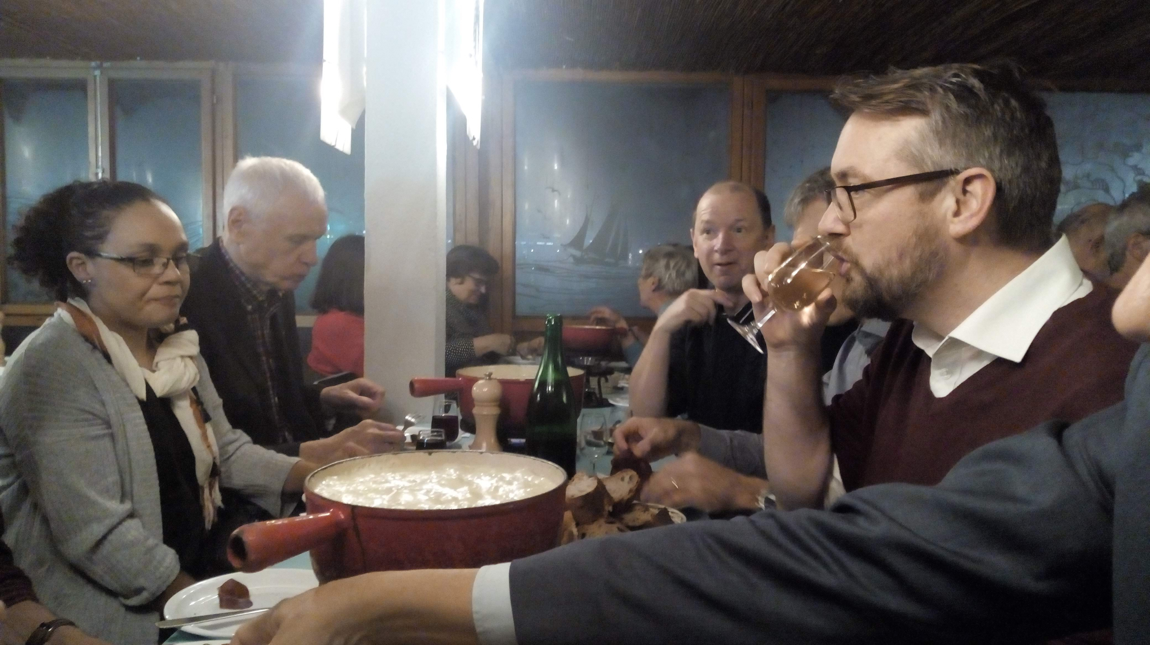
TT-OD at work

Slide 5
2019 development plan
Implement templating system to ease metadata input
Improve search interface: new station classes and reporting status, produce historic reports
Batch operations (change contact, close station..)
Aircraft Borne Observing System module
Interface with WIGOS Data Quality Monitoring
Implement better statistics
  Quality and completeness of station metadata
  Track uptake of OSCAR/Surface by Members

Slide 6
Main findings: usability
Metadata input Templates
  Create easy-to-use templates for specific communities (e.g GCW)
Batch operations for common tasks (e.g Close station, change schedules, change contact)
Metrics
  Usability and functionality assessment
  Metadata quality and completeness
  User behaviour

Slide 7
Main findings: WDQMS
Develop interface to include reporting status, obtained by WDQMS
Add qualitative and timeliness indicators later and through the same interface once the indicators are developed

Slide 8
2019 Functionality review and community feedback
Review OSCAR functionality
Reach out to community

Slide 9
OSCAR community survey
Seek feedback from community on OSCAR/Surface current feature set and their usability
  Functionality assessment is the evaluation of a tool’s feature set for it’s effectiveness in achieving the intended goals of the tool.
  Usability assessment is the evaluation of how efficiently can a user use the functions of the tool to accomplish the desired outcome.
Tools:
  Survey
  Remote usability testing
  Google analytics

Slide 10

Thank you
www.wmo.int/wigos

