Slide 1

OSCAR/Surface: Advanced API & AWS
OSCAR/Surface Webinar
14 January 2019
Online recording
OSCASR/Surface Webinar
14 January 2019

Slide 2
The OSCAR/Surface webinar
Monthly webinar with varying topic
Audience are OSCAR/Surface Focal Points and Users
Every first Monday of the month 11 UTC
Hosted in the WMO Webex
Please suggest topics

Slide 3
Outline
The OSCAR/Surface webinar
OSCAR/Surface API (M2M)
  XML interface
  JSON interface
How to connect to the API
API documentation
Interactive : create & modify a station with XML
Automatic Weather Station vs. Manual observations in OSCAR
Q&A

Slide 4
The OSCAR/Surface API
Send and retrieve information
from/to OSCAR/Surface in
JSON/XML
For example
  - Search stations
  - Download WMD XML representation of station
  - Upload station
OSCAR DB
API
External system

Slide 5
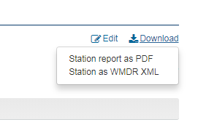
Donwload/upload XML
Download XML
  Via station report
  Via API
Upload XML to make changes
  For testing, use «XML submission»
  For production, use «OSCAR token»

Slide 6
The OSCAR/Surface API
Usage
Obtain access token to OSCAR/Surface API
Encode station fully or partly in WMD XML
Send WMD XML file (and token) to the API endpoint
  XML is first validated, only valid XML files are proccessed
  New station is created if station does not exist yet (WIGOS ID!)
  Station is updated if already existing
    Add information if it does not exist already (gml id)
    Correct information if it exists already (gml id)
Process status code to know if update succeeded

Slide 7
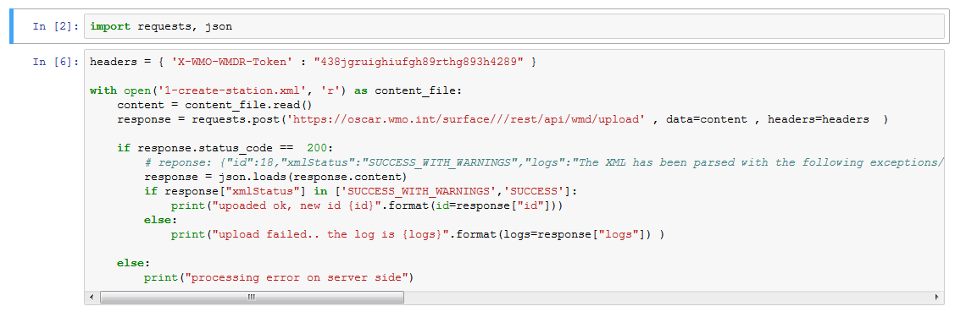
How to obtain & use an access token
Login as OSCAR national focal point
Access “manage machine access” in the “management” menu
Use token in header of HTTP request «“X-WMO-WMDR-Token”

Slide 8
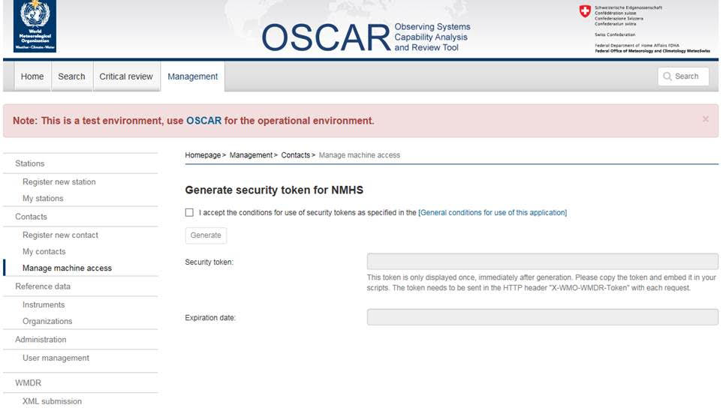

Slide 9
API documentation
Full documentation in OSCAR/Surface User Manual
Important endpoints
  XML download
    https://oscar.wmo.int/surface//rest/api/wmd/download/#WIGOS-ID# (replace WIGOS ID)
  XML upload
  https://oscar.wmo.int/surface//rest/api/wmd/upload (add header «X-WMO-WMDR-Token»)
  III. Search:
  https://oscar.wmo.int/surface//rest/api/search/station?
    Parameters: facilityType, stationClassprogramAffiliation, wmoRegion, territoryName, organization, variable, climateZone, latitudeMin,
    latitudeMax, longitudeMin,longitudeMax, elevationMin, elevationMax
    (see codelist on next slide for codelist values)

Slide 10
Reference documents
WIGOS Metadata Standard
  https://library.wmo.int/opac/doc_num.php?explnum_id=3653
WIGOS Metadata Schema
  schemas.wmo.int/wmdr/
WIGOS Guide
  http://www.wmo.int/pages/prog/www/wigos/WGM.html
WMDS Code Lists
  http://test.wmocodes.info/wmdr/
  (will be pushed to http://codes.wmo.int/)
  https://drive.google.com/open?id=1rbCY6IfCcp2-Djt4548TPt__1eZJwpEj2A3w0f7Vi94
  (more code lists for approval)

Slide 11
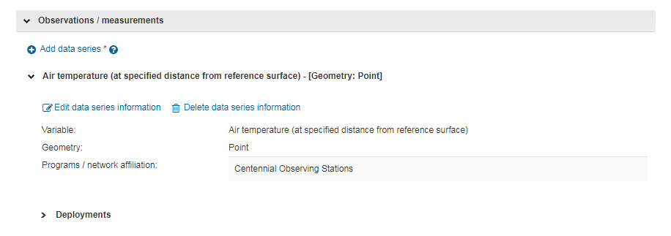
Manual vs. Automatic station in OSCAR
Specified in Deployment of an observation:

Slide 12
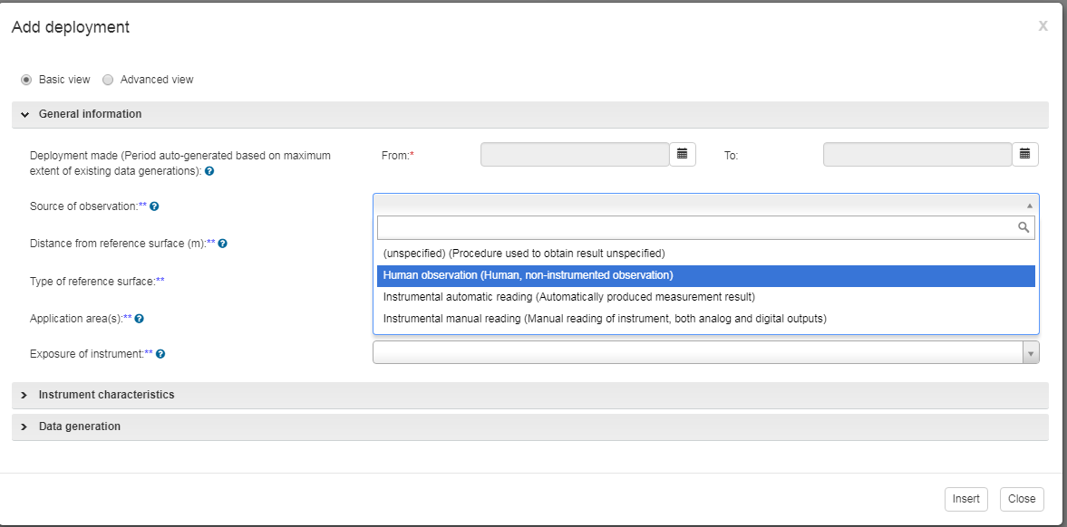
Manual vs. Automatic station in OSCAR
Manual
Automatic

Slide 13
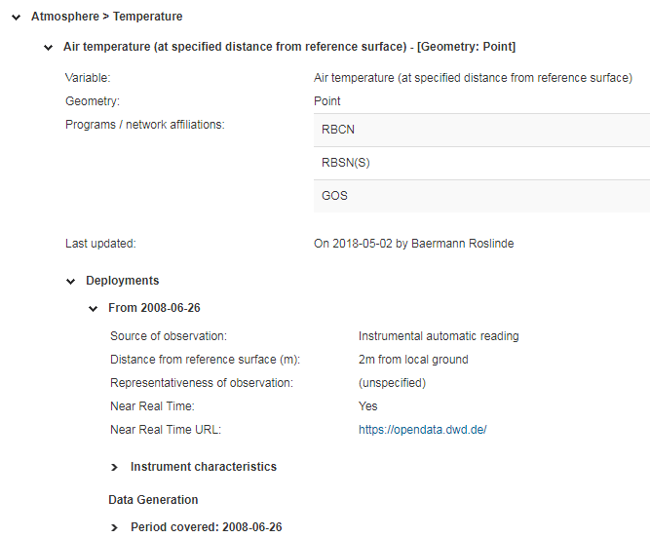
Example deployment automatic observation

Slide 14
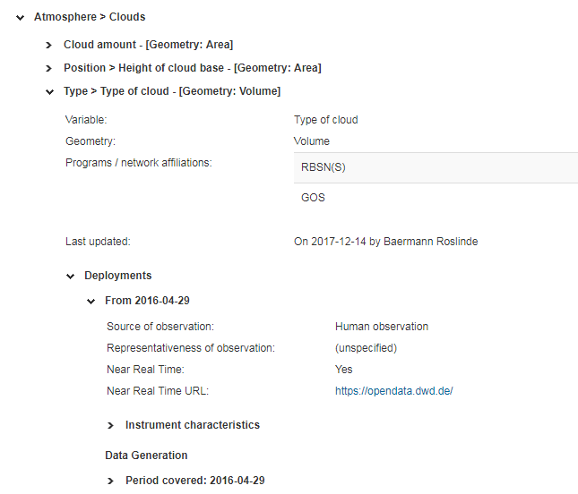
Example deployment manual observation

Slide 15
Other relevant fields
Instrument type
Observation type

Slide 16

Thank you
Questions?

