Slide 1
Role of RTC, India in the capacity development in operational Weather and Climate services in the Region
Somenath Dutta

Slide 2
Lay out of presentation
Background
Operational importance of Training Activities in IMD
Commitments
Present training activities
Brief details of the BIP-M/MT courses offered at RTC,IMD, India.
Future plan for contribution towards WMO GC

Slide 3
Background
IMD is the NM&HS of India and the principal Govt. of India agency in all matters relating to Operational Meteorology (weather forecasting), Climatology and allied subjects.
Formal training in General Meteorology started at IMD, Pune in 1943 and that in Meteorological Instrumentation & Telecommunication started in mid-seventies at IMD, New Delhi.
IMD Training facilities at Pune and New Delhi has been recognized as a Regional Meteorological Training Centre (presently known as Regional Training Centre) by the World Meteorological Organization in 1986.
Since 1988, the training centres of India Meteorological Department (IMD) at Pune and New Delhi are functioning as WMO RTC in the fields of General Meteorology, Climate/Climatology, Agricultural Meteorology, Aviation Meteorology, Seismology and Meteorological instruments & telecommunication.

Slide 4
Commitments
Capacity building in different aspects of Operational Meteorology, Climatology and Instruments & Telecommunication of the Meteorological personnel of IMD at different level.
Capacity building of the personnel of other Govt. of India organisations, who are directly or indirectly involved in above fields.
Capacity building in the above fields, of the personnel of NM&HS of neighbouring countries in the RA-II & V regions.
To enhance the knowledge, skill and attitude (for maintaining and enhancing job competencies) of the personnel, engaged directly or indirectly in the above fields, time to time.

Slide 5
Present Activities
Ab-initio training courses for fresh recruited Meteorologist Gr-II (Group A Scientific officers of IMD) & for fresh recruited scientific staffs.
Career progression courses for existing departmental scientific personnel.
Orientation training courses for existing departmental support staffs.
Training courses for International participants (BIP-M and BIP-MT) from the National Meteorological services of neighboring countries in Afro-SE Asian regions and for National participants from other Govt. of India organizations.
Tailor made customized short term refresher courses for all above personnel to keep pace with the latest development in the science and technology of Operational Meteorology and Climatology.
Periodic revision of the training curricula.

Slide 6
…Present activities
Ab-initio training program:
  Meteorologist Gr-II Training course of 1 year duration for fresh recruited Trainee Meteorologist Gr-II.
  Integrated Meteorological Training Course (IMTC) of 4 months duration for fresh recruited Scientific Assistants. This course meets the WMO BIP-MT requirements.
Career progression training program:
  Intermediate training course of 4 months duration, for all existing Scientific Assistants, for their next promotion to Meteorologist-A & B (from Group-B non-gazetted to Group-B gazetted).
  Forecasters Training course in General Meteorology/Advanced training in Instruments, Communication & Information System of 6 months duration for all Meteorologist-A & B , for their next promotion to Group-A level.

Slide 7
….Present activities
Orientation training program: Modular Training course of 2 months duration for support staffs for enabling them to do the observational work & other technical work.
International/Non-departmental training program: Advanced Meteorological Training Course of 1 year duration for the personnel from the NM&HS of neighboring countries in Afro-SE Asian regions and for the personnel from other Govt. of India organizations.
Refresher training program: Besides above long term regular training courses, short term tailor made customized training courses on specialized topics are designed and conducted to upgrade knowledge & skill.

Slide 8
….Present activities
All these training courses are open to Global participants with no course fees and provision of subsidized food & accommodation. However they must be nominated by respective PRs with WMO or through WMO.
Detail information of regular training courses are being updated in the WMO calendar enabling global participants to reach these courses, as a contribution to WMO GC.
Govt of India has already approved providing scholarships to 10 overseas participants per year for long term courses at RTC, enabling to meet their DSA for food & accommodation. However to make it effective for identifying potential international participants and for their travel assistance, WMO support is essential.

Slide 9
Brief details of the BIP-M/MT courses offered at RTC,IMD, India.
Meteorologist Gr-II Training course/AMTC.
  This course meets the BIP-M requirements.
  Streams
    General Meteorology (Consisting of Aviation also)
    Instruments & Meteorological telecommunication
    Agricultural Meteorology
    Geophysics/Seismology
  Structure
    2 semesters system.
    Semester I is mandatory for all disciplines and Semester II is for specialized streams.
Training Syllabus http://www.imdpune.gov.in/training/index.html.
DBM & GI S

Slide 10
Brief details of the BIP-M/MT courses offered at RTC,IMD, India.
Integrated Meteorological Training course/Intermediate Training Course.
  Both the courses meet the BIP-MT requirements.
  Disciplines
    General Meteorology
    Instruments & Meteorological telecommunication
Forecasters Training Course/Advanced Training in Instruments & Meteorological telecommunication.
  Completion of this course after any one of above two BIP-MT courses, meets BIP-M requirements.
  Disciplines
    General Meteorology
    Instruments & Meteorological telecommunication

Slide 11
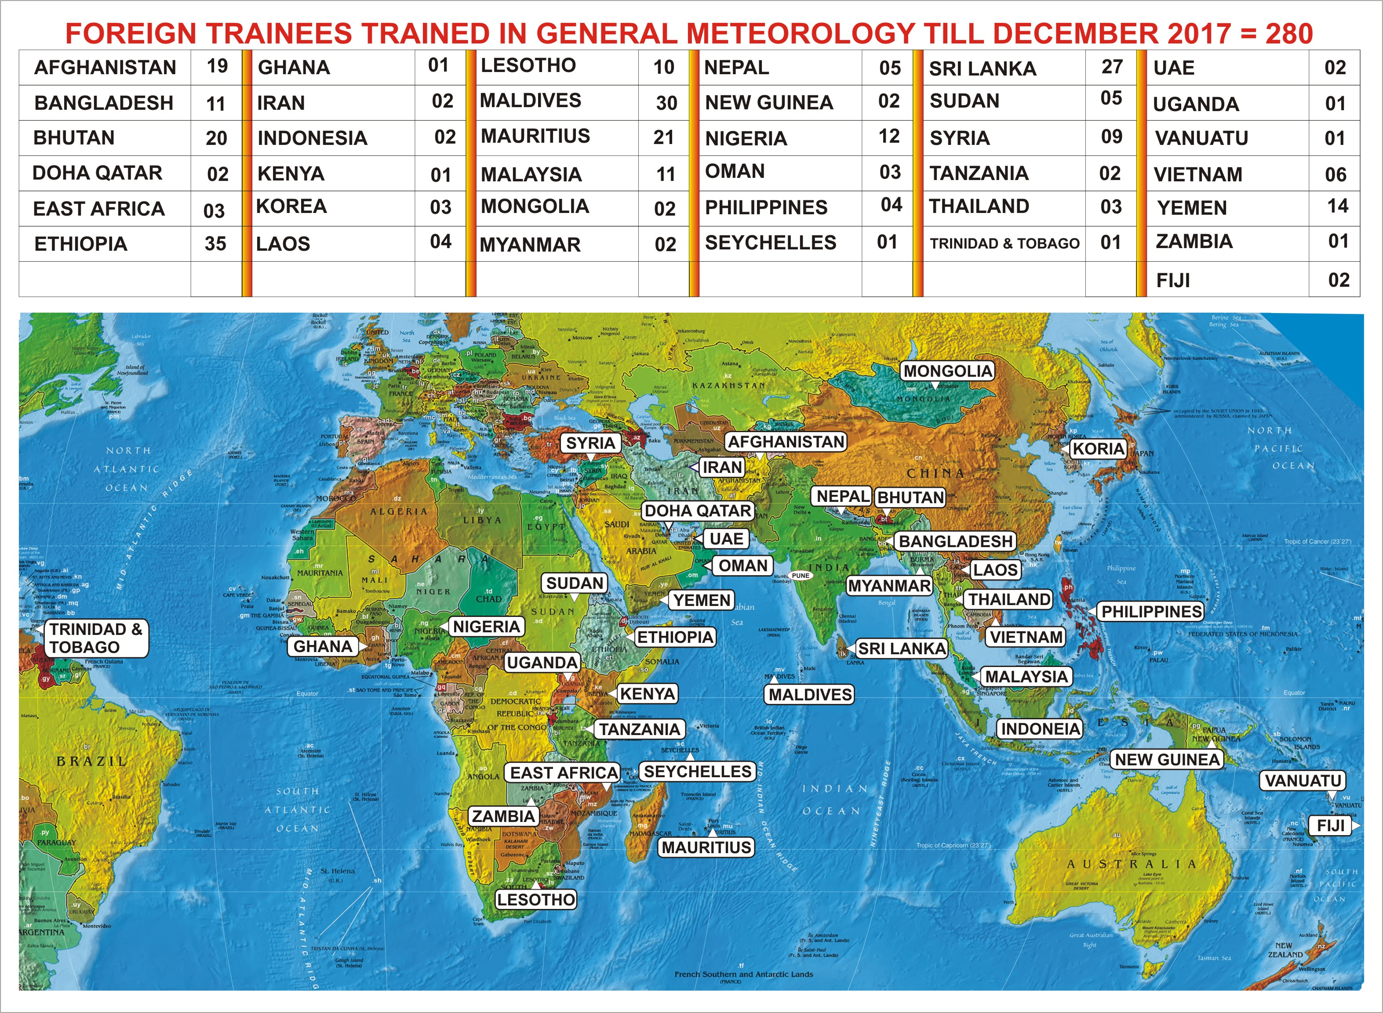

Slide 12
Short term ADVANCED REFRESHER COURSES CONDUCTED SO FAR
11 | June 1970 | Stratospheric Meteorology
2. | March 1971 | Numerical Weather Prediction
3. | May 1972 | Hydrometeorology
4. | March 1974 | Agricultural Meteorology
5. | Feb. 1975 | Satellite Meteorology
6. | Oct. 1975 | Aeronautical Meteorology
7. | Feb. 1976 | Tropical Cyclones
8. | Dec. 1976 | Numerical Weather Prediction
9. | Feb. 1977 | Agricultural Meteorology
10. | Dec. 1977 | Atmospheric Waves
11. | Feb. 1984 | Synoptic Analysis in Tropics with special reference in Aeronautical Meteorology
12. | April 1989 | Short Range Weather Prediction including use of Numerical Weather Prediction products
13. | Jan. 1991 | Cyclone Warning
14. | Sept. 1991 | Aviation Meteorology
15. | Sept. 1992 | Cyclone Warning (Emphasizing operational aspects and use of PCs in operational work)
16. | Dec. 1993 | Aviation Meteorology (SAARC Seminar cum Training Workshop)
17. | Sept. 1994 | Satellite and Radar inputs for Cyclone Warning ( Conducted at New Delhi )
18. | May 1995 | Operational Numerical Weather Prediction models
19. | Dec. 1995 | SAARC Seminar cum Workshop on Tropical Cyclones and Forecasting (Conducted at Calcutta)
20. | Jan. 1996 | LRF and Climate Change
21. | April 1996 | Mesoscale systems and circulation with special emphasis on Tropical cyclones
22. | Nov. 1996 | Aviation Meteorology
23. | Sept. 1996 | SAARC Training Workshop on Long Range Weather Forecasting and Climate Change
24. | May 2002 | Aviation Meteorology
25. | Sept. 2002 | Special Refresher Course on General Meteorology for Naval Officers
26. | Dec. 2002 | Special Refresher Course on General Meteorology for Salt Commission Personals & salt manufacturers
27 | April 2004 | Numerical Weather Prediction
28 | May 2004 | Environmental Meteorology
29 | May 2004 | 1st National Workshop for Port Meteorological Officer’s
30 | June 2004 | Special Refresher Course on General Meteorology for Naval Officers
31 | April 2005 | 1st Batch of Aviation Refresher course for SO & SA’s
32 | Sept. 2005 | 2nd Batch of Aviation Refresher course for SO & SA’s
33 | Sept. 2006 | Multi-stake holder consultation workshop cum seminar on Communicating Meteorology
34 | Feb. 2007 | Special Refresher Course on General Meteorology for Salt Commission Personals & salt manufacturers
35 | May 2007 | Met. Training course for observers of Army/SASE, (Conducted at MMC Srinagar) under project PARWAT
36 | July 2007 | Direct Trainer skills course conducted jointly by MoES & IMD at CTI, Pune
37 | Sept. 2007 | Met Training course for observers of Army/SASE, (Conducted at MMC Srinagar) under project PARWAT
38 | Sept. 2007 | Direct Trainer skills course conducted jointly by MoES & IMD at Goa.
39 | Dec 2007 | First Advanced course on Astronomy
40 | May 2008 | Met. Training course for observers of Army/SASE, (Conducted at MMC Srinagar) under project PARWAT.
41 | May 2008 | Refresher Course on Hydrometeorology for staff working at FMO.
42 | May 2008 | Met. Training course for observers of Army/SASE, (Conducted at MMC Srinagar) under project PARWAT.
43 | July 2009 | Mid level update Course for Naval met. officers
44 | Nov. 2009 | Aviation Meteorology.
45 | March 2010 | Workshop for Journalists under Outreach Programme
46 | March 2010 | Workshop for Teachers under Outreach Programme
47 | Sept. 2010 | WMO CLIPS Workshop on Urban Climatology
48 | Sept. 2011 | Aviation Refresher Course
49 | Nov. 2011 | Mid level update Course for Naval met. Officers
50 | Nov. 2012 | Application of DWR Products in NWP
51 | Dec. 2013 | Short term Training course in General Meteorology
52 | Nov. 2014 | WMO Group Training Course “Instrument Maintenance & Calibration”
53 | Aug. 2015 | Operational Climate Services
54 | Dec. 2016 | WMO Group Training Course “Instrument Maintenance & Calibration”
55 | March 2017 | Aviation Meteorology
56 | February | Application and interpretation of NWP products
57 | Marrch 2018 | Diagnostic/Synoptic Meteorology

Slide 13
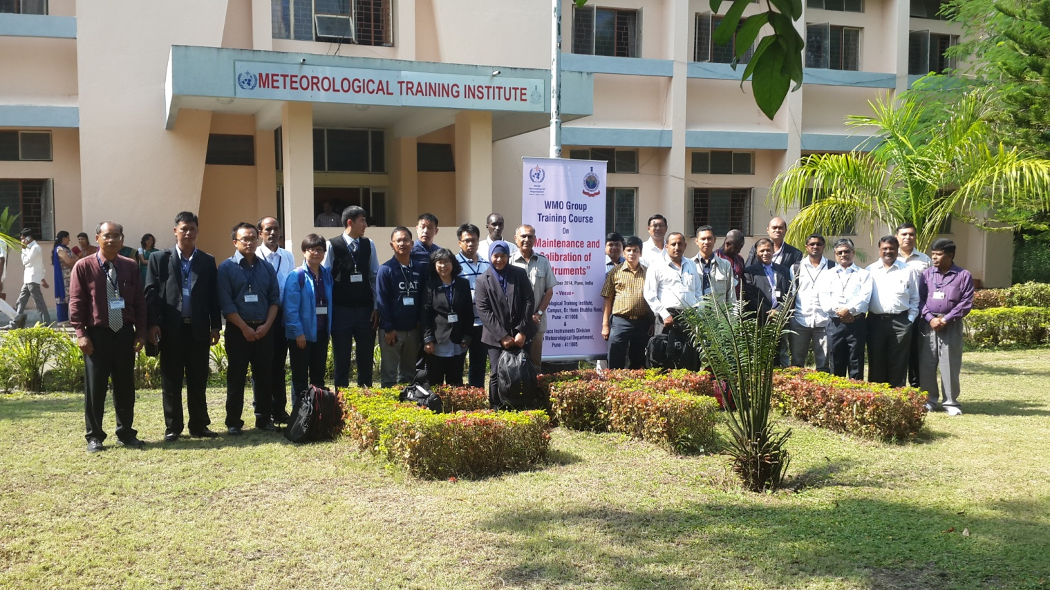
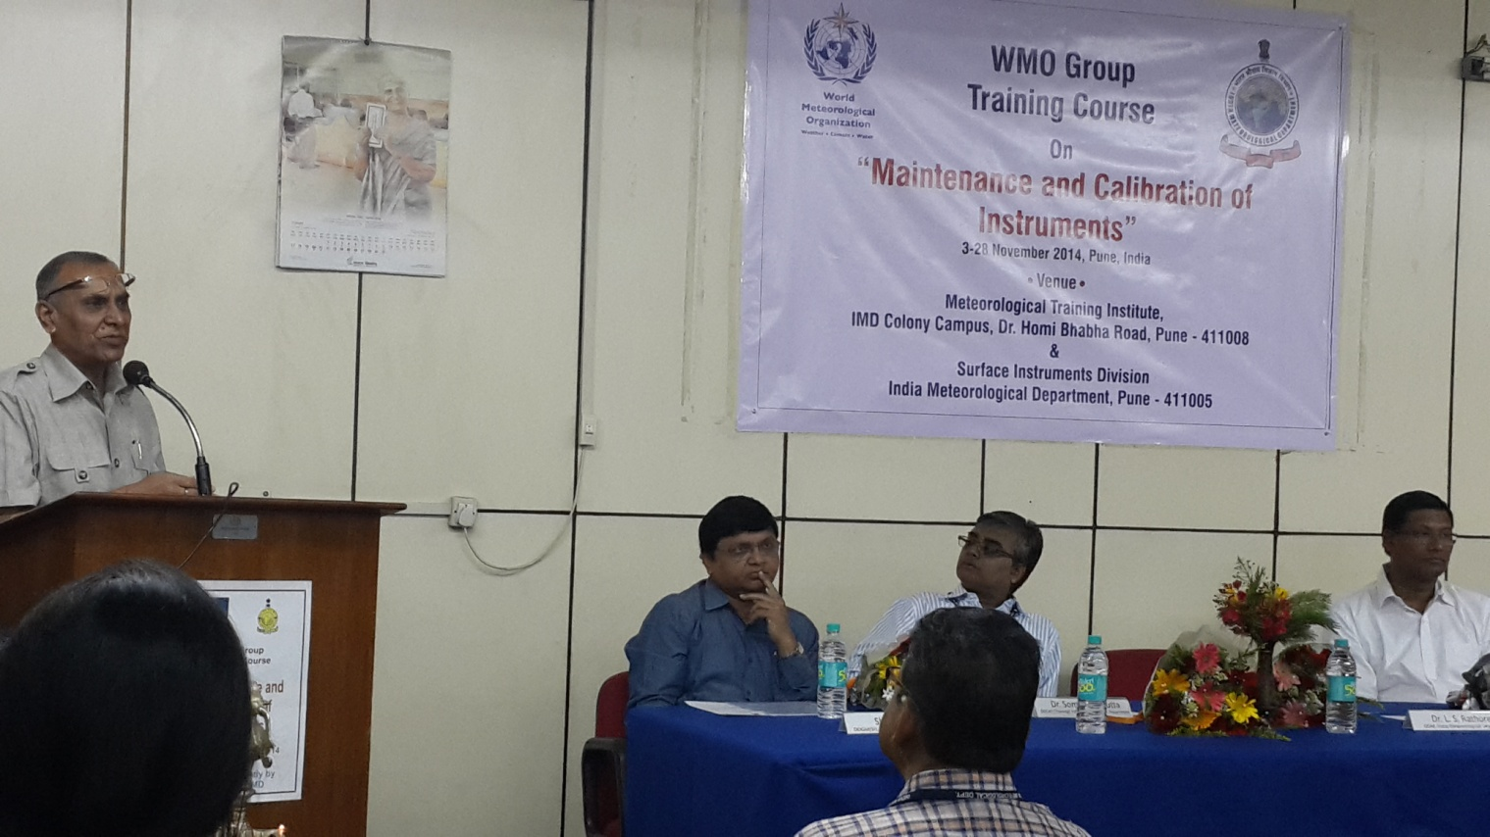
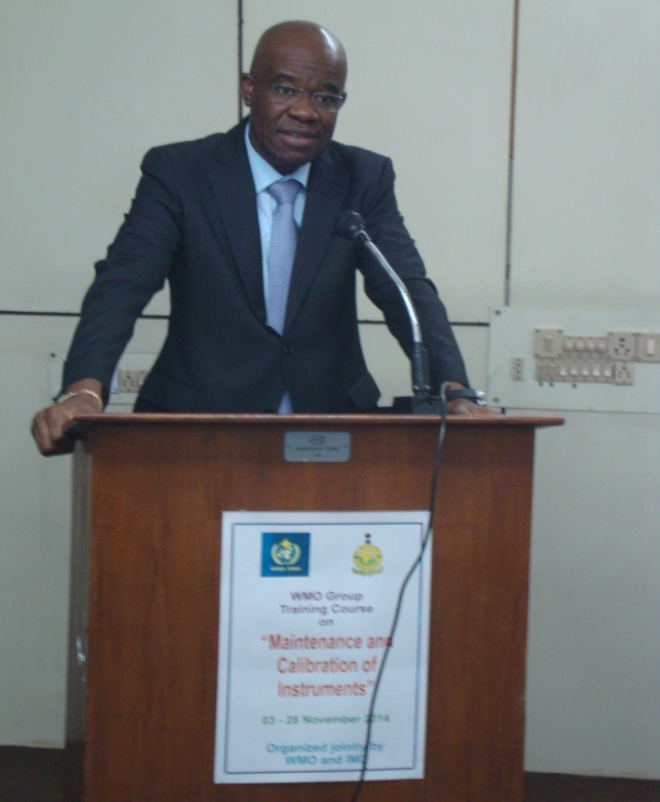
WMO group training on “Maintenance and Calibration of instruments”

Slide 14
Future plans towards contributions to WMO GC
Distance learning through virtual class room facilities.
Training web portal integrating virtual class room-enabling global participants to register and join RTC’s training program remotely.
Uploading training resource material in the RTC’s website and providing the link to WMO library.
Co-ordination with Universities, providing Met & Climate courses, urging them to provide contribute to WMO GC.
Conduction of advanced level training program in operational Climate Services.
To enable RTC, India to make foreign scholarship program of GoI effective, entering into an MoU with WMO.

Slide 15
Thanks for kind patience and hearing

