Slide 1

WMO Regional Training Centre in the Russian Federation as the System of Lifelong Professional Training in Hydrology & Meteorology
Dr Anna Timofeeva
Rector
Roshydromet Advanced Training Institute
WMO RTC in Russia

Slide 2

WMO RTC in Russia
Professional Development & Job Retraining
ATI
BIP-M + BIP-MT
Academic Education / Degree
RSHU
BIP-M
.
Vocational Education
MGMTech
BIP-MT

Slide 3
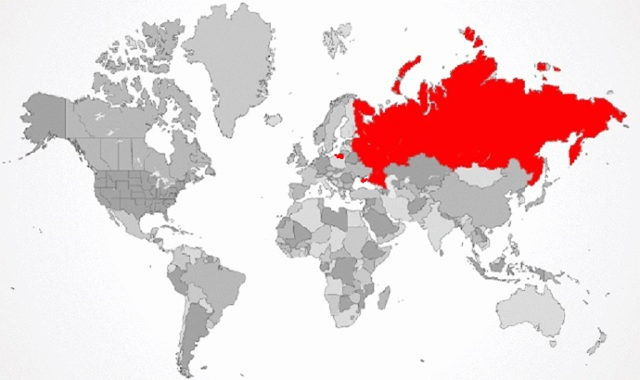
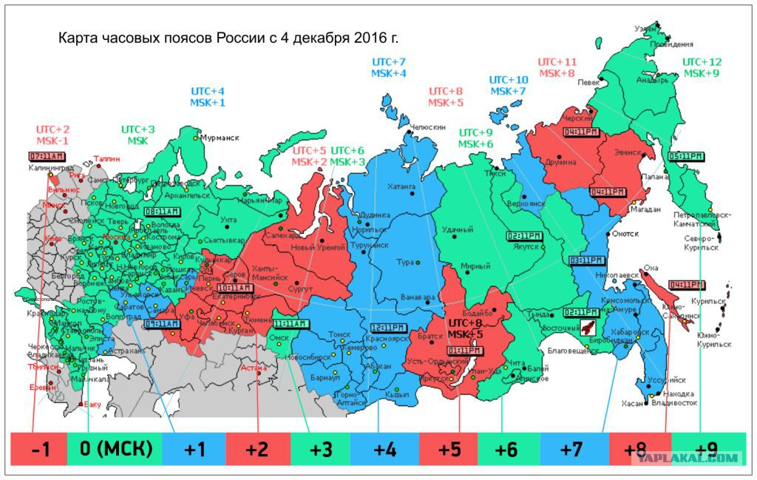
Russian weather service
employs ca. 35,000 specialists
Of them, about 17,000
Specialists have their BIP
level confirmed
Under current legislation, specialists are required to take professional development courses every five years.
Every year, up to 3,000 people study at Roshydromet ATI

Slide 4
BIP-M and BIP-MT
Example of competency standards (Aeronautical Meteorological Forecaster):
Analyse and monitor continually the weather situation
Forecast aeronautical meteorological phenomena and parameters
Warn of hazardous phenomena
Ensure the quality of meteorological information and services
Communicate meteorological information to internal and external users
Sectoral professional competencies
Background knowledge BIP-M & BIP-MT standards

Slide 5
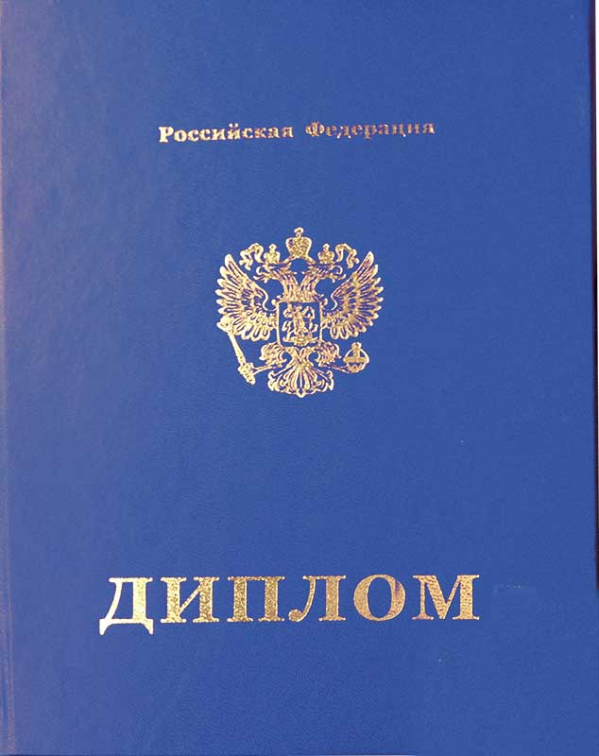
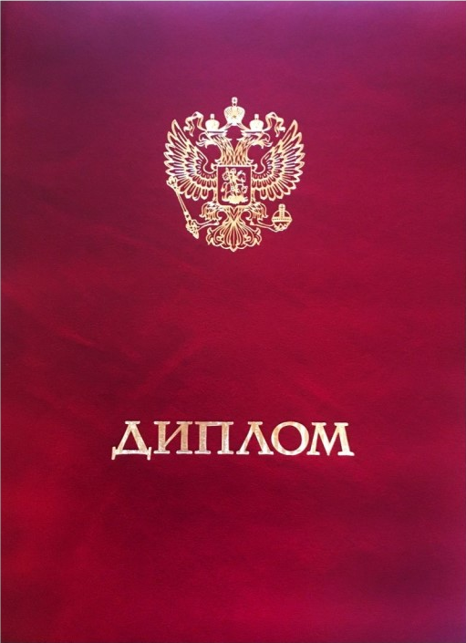

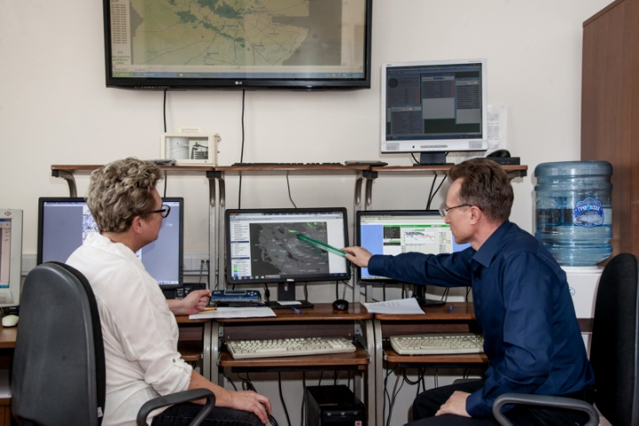
Study programs at universities comply with the BIP-M standards
In accordance with ICAO requirements, the Russian and CIS universities confirmed the compliance of their undergraduate program in hydrometeorology to the BIP-M standard, but this does not guarantee the competence of a specialist.

Slide 6
Meteorological Technicians
Meteorologists
Condensed BIP-MT:
Certificate or diploma of post-school meteorological education
Condensed BIP-M:
Postgraduate education or master degree in meteorology
Full BIP-MT:
Certificate of technical or vocational technical education
Full BIP-M:
Higher education (usually four-year) in meteorology
Certificate of secondary education from schools with science or technical majors (or equivalent)
University (undergraduate) degree in one of the scientific or technical disciplines. For example math, physics, chemistry or engineering
Knowledge of mathematics, physics and chemistry required to enter technical schools
Knowledge of mathematics, physics or chemistry required to enter the faculty of physical science

Slide 7
The BIP-M and BIP-MT retraining courses developed at Roshydromet ATI consist of 2 modules:
1 module
Essentials
2 module
forecaster
2 module
aeronautical meteorological personnel
2 module
agricultural meteorologist

Slide 8


ATI Courses for Aeronautical Meteorological Personnel following the WMO standards
Retraining
Professional Development
BIP-M
BIP-MT
BIP-M
BIP-MT
The solution
Courses have been developed for meteorological personnel engaged in civil aviation services;
the content of the courses is selected in accordance with the BIP-M program and WMO competency standards for Aeronautical Meteorological Personnel;
the option of on-the-job training using modern information technologies is available;
assessment is carried out through tests, results are communicated to the employer;
communication between developers and users is established to identify problem points, with the aim of further improving the quality of training.

Slide 9
Number of trainees at professional development and retraining programs following BIP-M and BIP-MT standards in 2016-2018
BIP-M professional development course
BIP-MT professional development course
BIP-M retraining course
BIP-MT retraining course

Slide 10
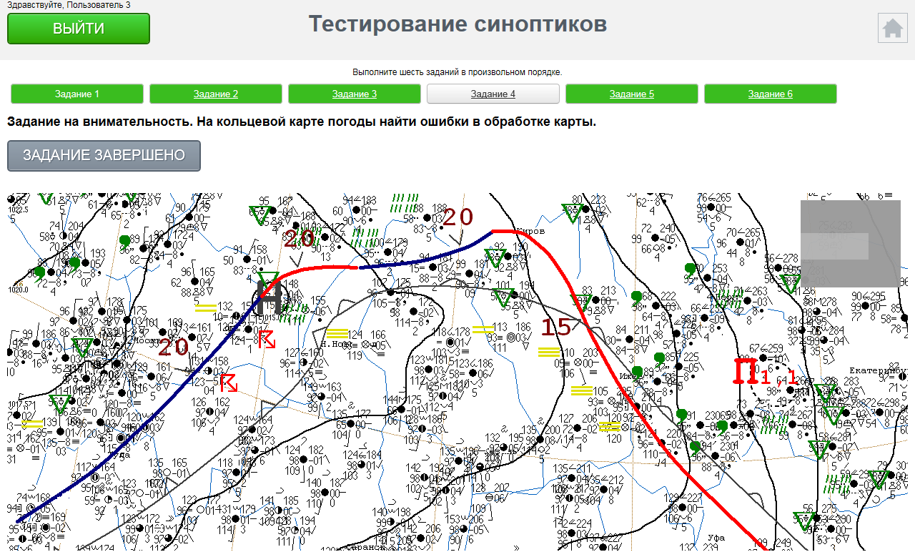
Forecasters assessment

Slide 11
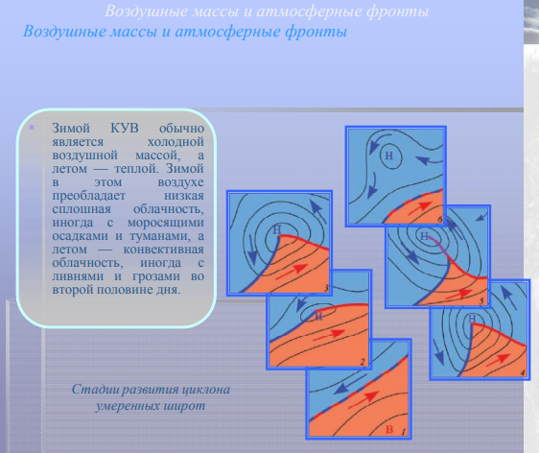
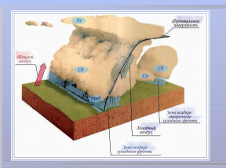
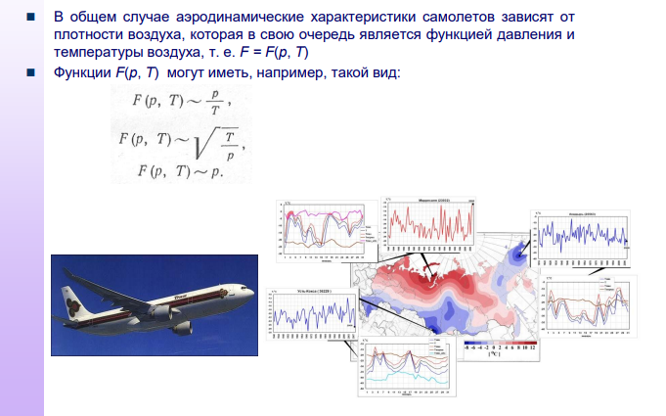
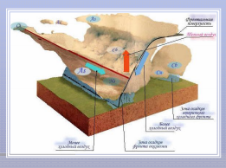

Slide 12
Assessment tools
Internal testing tools at LMS
However, the legislation of the Russian Federation leaves the methods and forms of knowledge assessment at the responsibility of universities and we do not consider it necessary to introduce a standard assessment mechanism into the BIP M / MT

Slide 13
Conclusions (BIP-M)
The compliance of aviation personnel to the BIP-M level is mandatory in the Russian Federation. Higher education institutions of the Russian Federation that provide meteorological education confirmed the compliance of their undergraduate programs in hydrometeorology to the BIP-M standard
For staff who do not have a university degree, ATI offers retraining courses in accordance with the BIP-M standard (250 academic hours/3 months)
In accordance with the Russian legislation, it is the responsibility of educational institution to choose the assessment mechanism, thus we do not support introduction of a model assessment into the standard.
Special competencies in aeronautical meteorology, PWS, agrometeorology, etc. are provided by ATI in professional development courses, the latter being mandatory for all staff at least once in 5 years. It is not advisable to include them in the BIP-M to keep the basic standard concise. However, individual specializations may be included in the package as optional ones.
Competencies defined by the WMO documents should be supplemented with those related to customer communications, impact forecasts, etc.

Slide 14
Conclusions (BIP-MT)
The compliance of aviation technical personnel to the BIP-MT level is mandatory in the Russian Federation. This is not the case with other meteorological technician roles, but BIP-MT is used in the training of meteorological technicians, due to lack of a national standard.
The BIP-MT standard is overloaded with general technical disciplines such as mathematics & physics
At the same time, it does not include basic knowledge in the field of IT and communications which with the proliferation of automated equipment becomes more and more relevant.
Model assessment tools do not seem to be appropriate in the standard
In the Russian Federation, a 2-class system of meteorological technician and meteorologist is used and it fully meets the needs of the NHMS. Allocation of a special class meteorologist-researcher is not needed

Slide 15
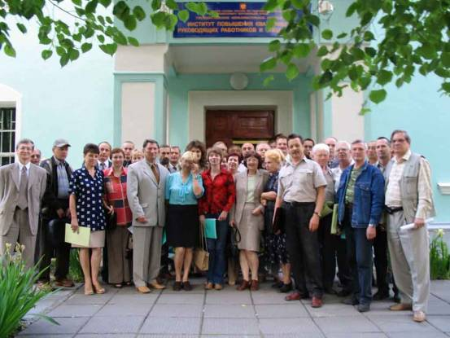

Thank you for your attention!
ipkmeteorector@gmail.com
Special thanks to:
Prof Alexander Kislov, Head of Meteorology Dept, Moscow State Uni
Dr Anna Fokicheva, Dean of Meteorological Faculty, RSHU
Dr Natalia Tolmacheva, Head of Industrial Meteorology Dept, ATI
Dr Murat Nakhaev, Senior scientist, Hydrometcentre of the Russian Federation
Ms Svetlana Zadora, Chief specialist, Aviamettelecom
Mr Eduard Podgaiskii, Chief specialist, ATI / Senior teacher, RSHU

