Slide 1

OSCAR/Surface: Closing a station
OSCAR/Surface Webinar
1 October 2018
Online recording
OSCASR/Surface Webinar
1 Oct 2018

Slide 2
The OSCAR/Surface webinar
Monthly webinar with varying topic
Audience are OSCAR/Surface Focal Points and Users
Every first Monday of the month 11 UTC
Hosted in the WMO Webex
Please suggest topics

Slide 3
Outline
The OSCAR/Surface webinar
Stations in OSCAR/Surface
  Affiliations and network status
  Data-series and deployments
  Historization
How to close a station
Advanced: close a station with XML
Q&A

Slide 4
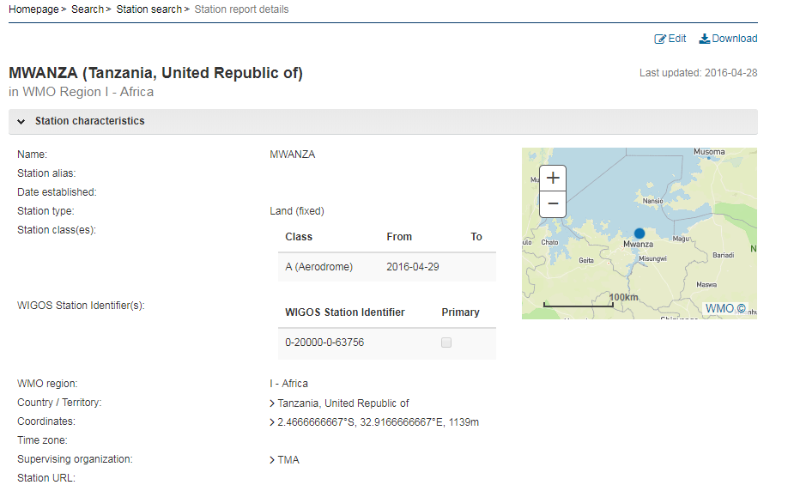
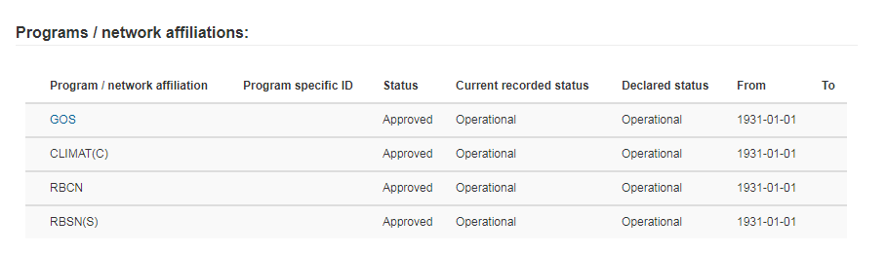
Stations in OSCAR/Surface

Slide 5
Stations OSCAR/Surface API
The OSCAR/Surface data model
  Based on the WIGOS metadata standard
  «Historizes» information
Relevant elements for station closure
  Program / network affiliation
  Deployment (Observations-> Data Series)
  Data-generation ( Observations -> Data Series - > Deployment )

Slide 6
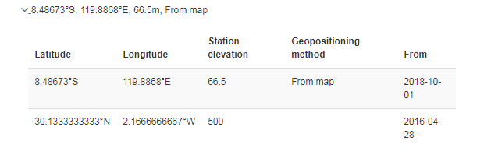
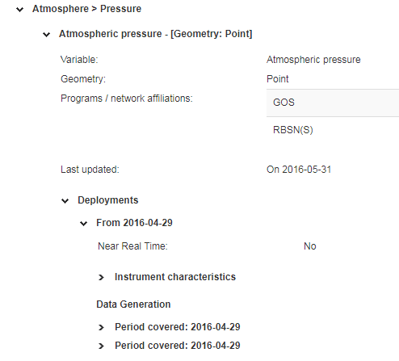
OSCAR/Surface Historization
Implizit historization
  Location
  Country
  ..
Explizit historization
  Data Series
  Deployment
  ..

Slide 7
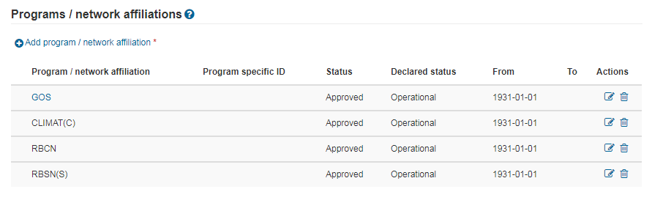
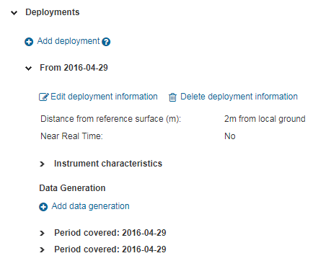
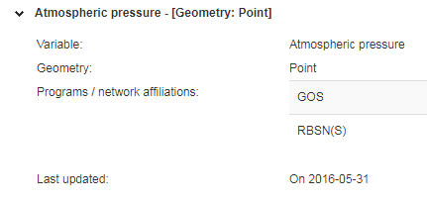
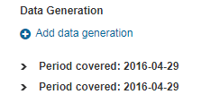
OSCAR/Surface - Elements
Program / network affiliation
Deployment / Data generation

Slide 8
Closing a station
Full closure
  Close all Data Series
  Close program / network affiliations
Closure of one or more program / network affiliation(s)
  Close associated Data Series
  Close program / network affiliation(s)
One-button click station closure will be implemented in one of the next releases

Slide 9
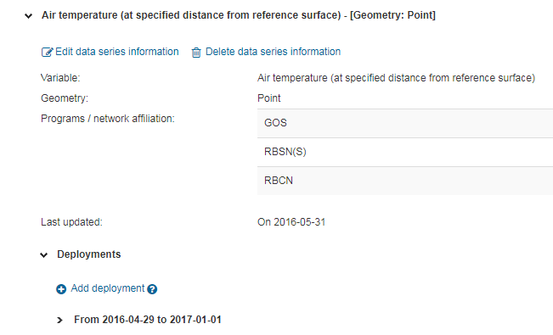
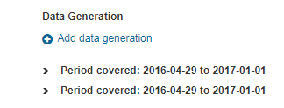
Close a Data Series
Close Data Series: Put End-Date on all Deployments under the Data-Series
Put Deployment End-Date: Set End-Date on Data-Generations under the Deployment (deployment End-date will be set automatically)

Slide 10
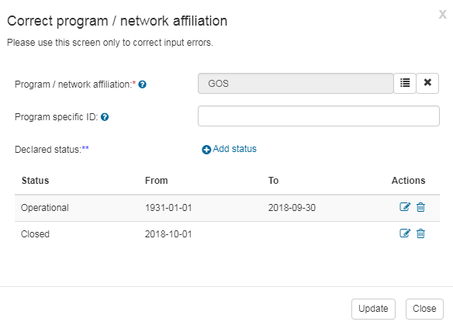
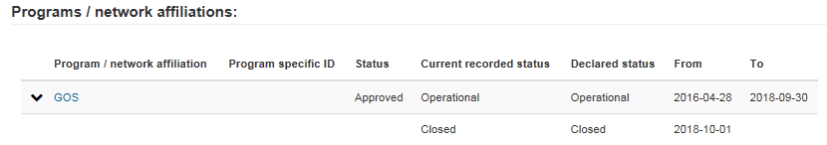
Update states of program / network affiliation
Update program / network affiliation
  Correct «To» date of
  current «operational»
  reporting status
  Insert new status
  with status «closed»
  reporting status
  Hint: insering a new status
  with status closed automatically
  updates the previous status

Slide 11
Advanced: how to close a station with the API
Craft a suitable XML file
Submit the file to the OSCAR/Surface API

Slide 12
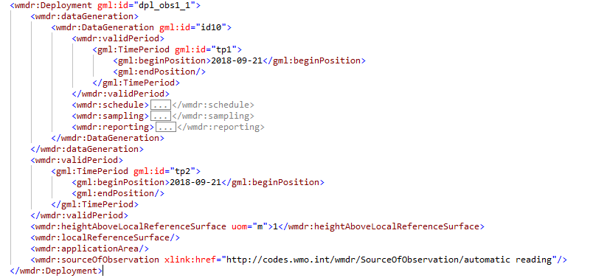
Advanced: how to close a station with the API
Insert new reporting status into programme affiliation element with reporting-status closed and start-date of closure date
  <wmdr:programAffiliation>
  <wmdr:reportingStatus
<wmdr:validPeriod>
<gml:TimePeriod gml:id="pa_cl_1">
<gml:beginPosition>2018-10-1</gml:beginPosition>
<gml:endPosition/>
</gml:TimePeriod>
</wmdr:validPeriod>
Set end dates
of data-
generations and
deplyoments

Slide 13
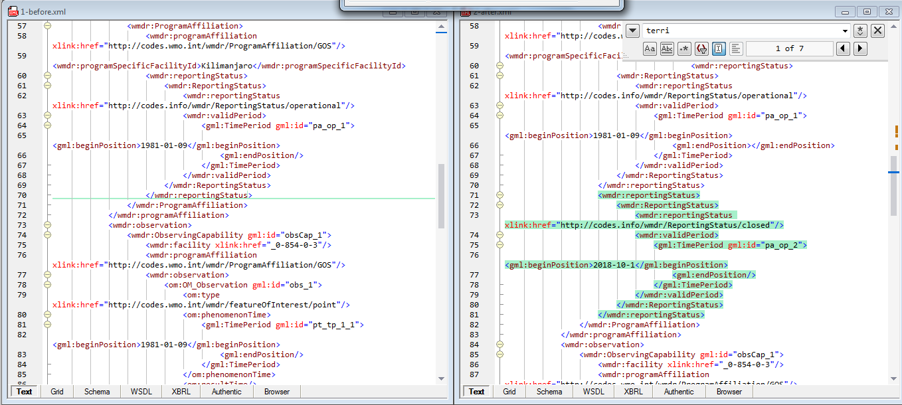
Diff view between files

Slide 14
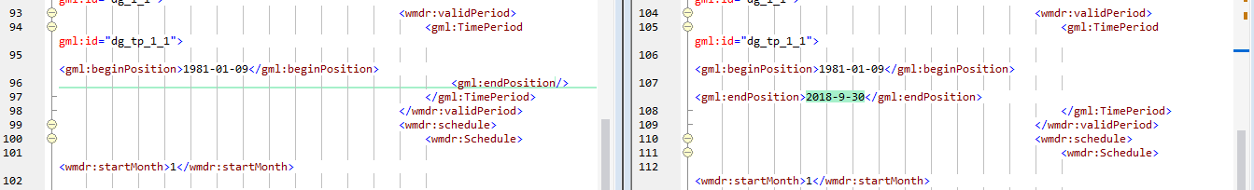
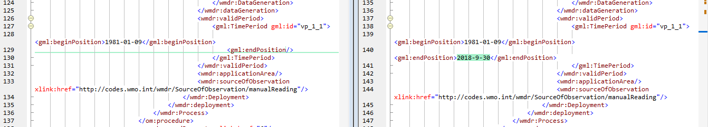
Diff view between files (2)

Slide 15
Advanced: how to close a station with the API
Demo XML files on the moodle site
API currently accessible only on http://oscardepl.wmo.int/surface
Use «management» «XML submission» menu to submit test file files
May have to adjust Territory Name to match your country’s ISO3 code

Slide 16
Reference documents
WIGOS Metadata Standard
  https://library.wmo.int/opac/doc_num.php?explnum_id=3653
WIGOS Metadata Schema
  schemas.wmo.int/wmdr/
WIGOS Guide
  http://www.wmo.int/pages/prog/www/wigos/WGM.html
WMDS Code Lists
  http://test.wmocodes.info/wmdr/
  (will be pushed to http://codes.wmo.int/)
  https://drive.google.com/open?id=1rbCY6IfCcp2-Djt4548TPt__1eZJwpEj2A3w0f7Vi94
  (more code lists for approval)

Slide 17

Thank you
Questions?

