Slide 1

The OSCAR/Surface API
OSCAR/Surface Webinar
7 Sept 2018
OSCSR/Surface Webinar
7 Sept 2018

Slide 2
Outline
The OSCAR/Surface webinar
The OSCAR/Surface API
WIGOS Metadata XML
A short demo
The OSCAR/Surface client
How you can access the API
Q&A

Slide 3
The OSCAR/Surface webinar
Monthly webinar with varying topic
Audience are OSCAR/Surface Focal Points and Users
Currently on the first Friday of the month (may change to Monday) 11 UTC
Hosted in the WMO Webex
Please suggest topics

Slide 4
The OSCAR/Surface API (I)
Send and retrieve information
from/to OSCAR/Surface in
JSON/XML/CSV
For example
  - Search stations: /rest/api/search/station
  - Download results: /rest/search/download/stationSRs
  - Download WMD XML representation of station
Today: create/modify stations
with the API
OSCAR DB
API
External system

Slide 5
The OSCAR/Surface API (II)
Status
Release 1.4.1 contained first version of API
  Manual upload only
  Based on 1.0RC8 WMD schema
Release 1.4.2 will bring additional features
  Authentication token
  Upload to propoer REST API endpoint
  XML download

Slide 6
The OSCAR/Surface API (III)
Use cases
Synchronize OSCAR/Surface with a local database
  Regular process
  For countries with existing station database
  Integrate into data warehouse workflow
Upload list of stations to OSCAR/Surface
  Initial seeding
  Import stations from Excel etc. lists
  One-time action
Interactively and semi-automatically make batch changes
  Make batch correctionss
    adding observations
    Correcting schedules
  Semi-automatic and interactive usage

Slide 7
The OSCAR/Surface API (IV)
Usage
Obtain access to OSCAR/Surface API
  NFPs can create machine user and obtain security token
  Security token needed to access API
Encode station fully or partly in WMD XML
Send WMD XML file (and token) to the API endpoint
  XML is first validated, only valid XML files are proccessed
  New station is created if station does not exist yet (WIGOS ID!)
  Station is updated if already existing
    Add information if it does not exist already (gml id)
    Correct information if it exists already (gml id)
Process status code to know if update succeeded

Slide 8
The OSCAR/Surface API (V)
WIGOS Metadata XML
XML representation of the WIGOS metadata standard
Formal model and XML schema are on http://schemas.wmo.int
  Current version: 1.0RC8 (http://schemas.wmo.int/wmdr/1.0RC8/)
Codelist entries for XML elements are important
  http://test.wmocodes.info/wmdr/
  More code lists on gdrive
Model and XML schema are complicated, need specialist knowledge and tools to edit
But WMD XML files can be generated from databases, Excel files etc.

Slide 9
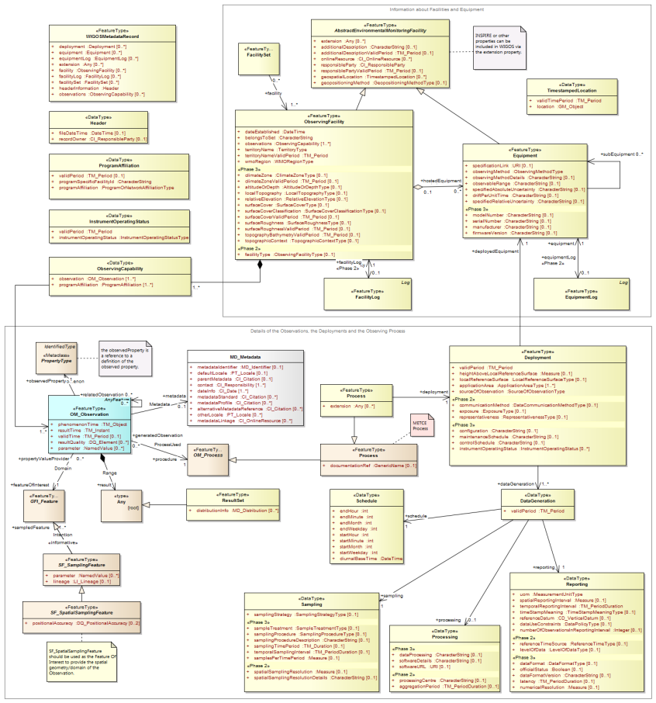
Formal WIGOS Metadata Model
Extensions
WMD Record
Observing facility
«WIS»-type
metadata
Equipment
Observation
Deployment
DataGeneration
Schedule
Sampling
Processing
Reporting

Slide 10
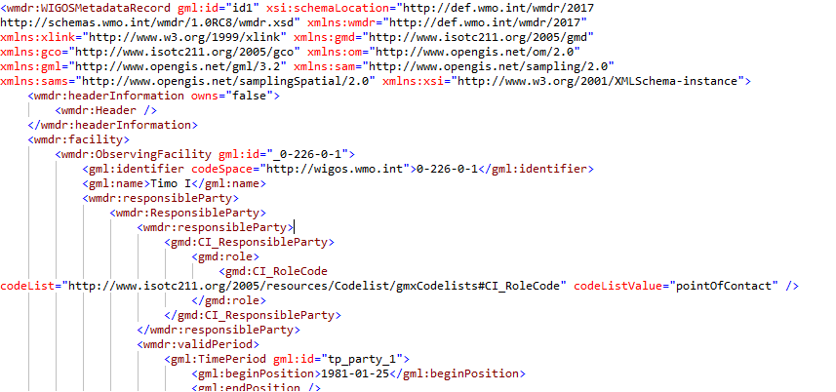
WMD XML file

Slide 11
Schort demo
Test environment for experimentation
  https://oscardepl.wmo.int/surface/
Can be accessed by all registered contacts
API is acessible to all OSCAR/Surface NFPs
Management console -> XML submission
Test environment is reset weekly

Slide 12
OSCAR/Surface client
Small application generating valid WMD XML files from an Excel list
Uses an Excel file and a Windows application
Available on GitHub after the session (https://github.com/kurt-hectic/oscar-surface-client)
Files can then be uploaded to the API

Slide 13
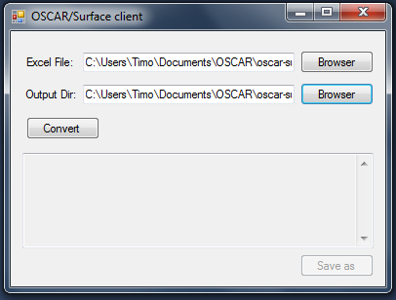
OSCAR/Surface client (II) - usage
Launch application, select Excel sheet and output folder
Transform Excel to XML
Upload XML files
1
2

Slide 14
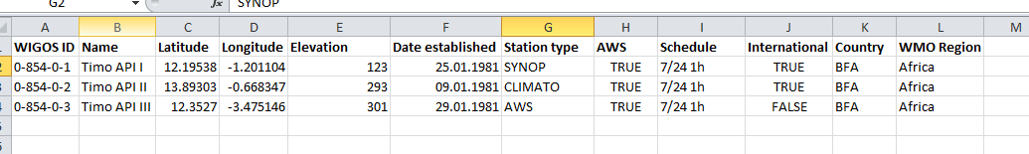
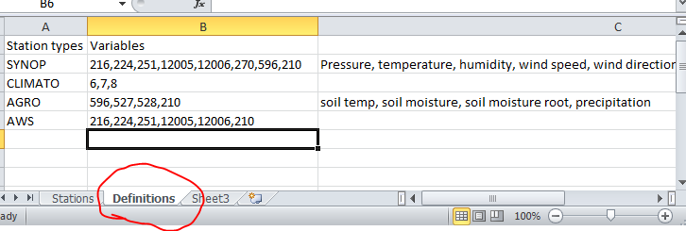
OSCAR/Surface client (III) – usage cont.
Excel file needs to have the right headers
Station type and schedule need to correspond to what is in worksheet «definitions»
Station type is linked with variables using «defitions»
worksheet

Slide 15

Thank you
Questions?

