Slide 1
How do I self-enroll in a course?

Slide 2
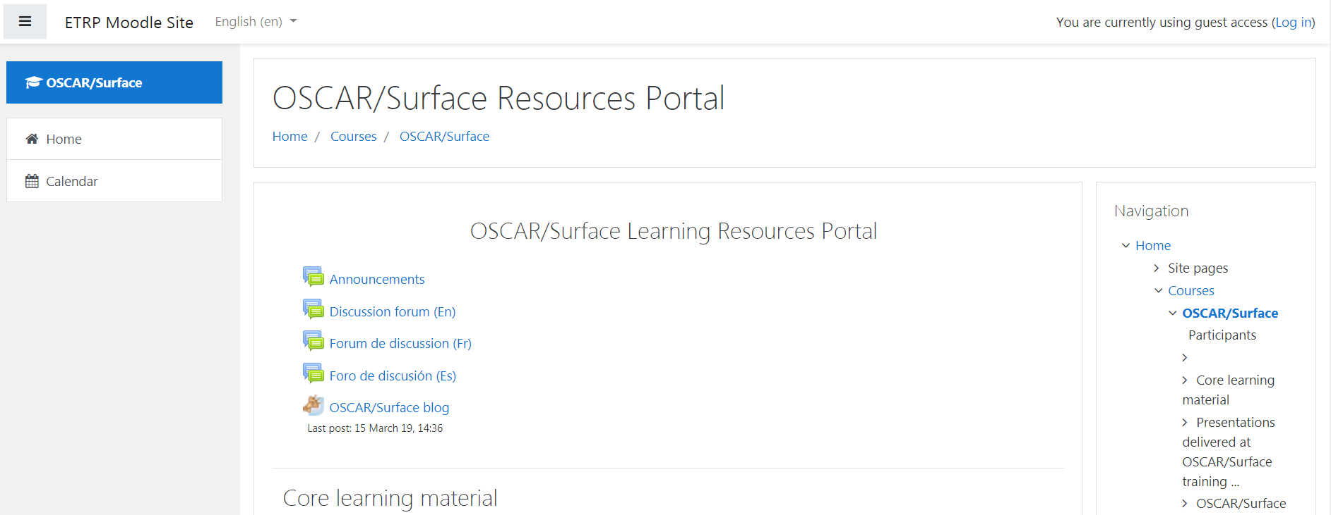
1. Make sure you are registered to the Moodle platform

Slide 3
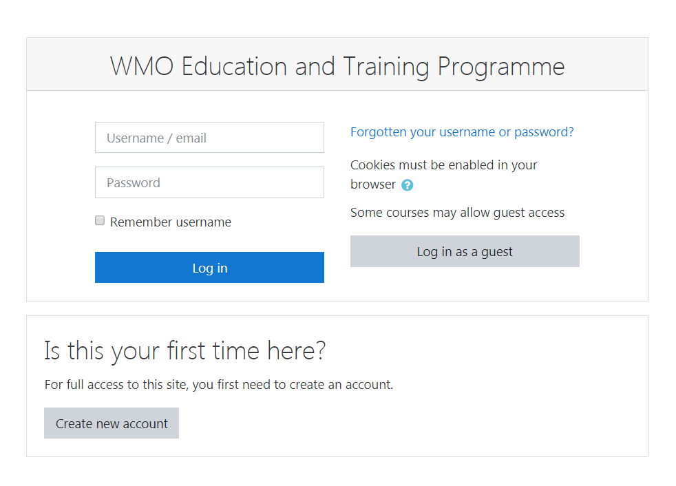
Create an account on Moodle

Slide 4
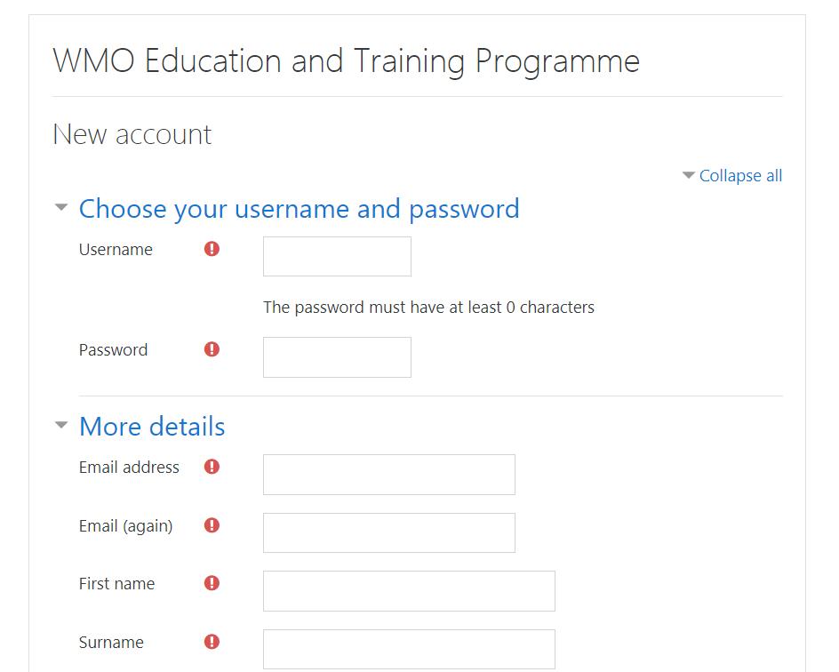

Slide 5
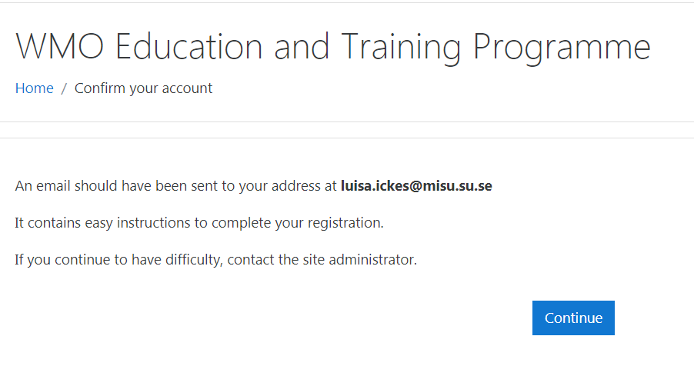
Confirm your account (e-mail)

Slide 6
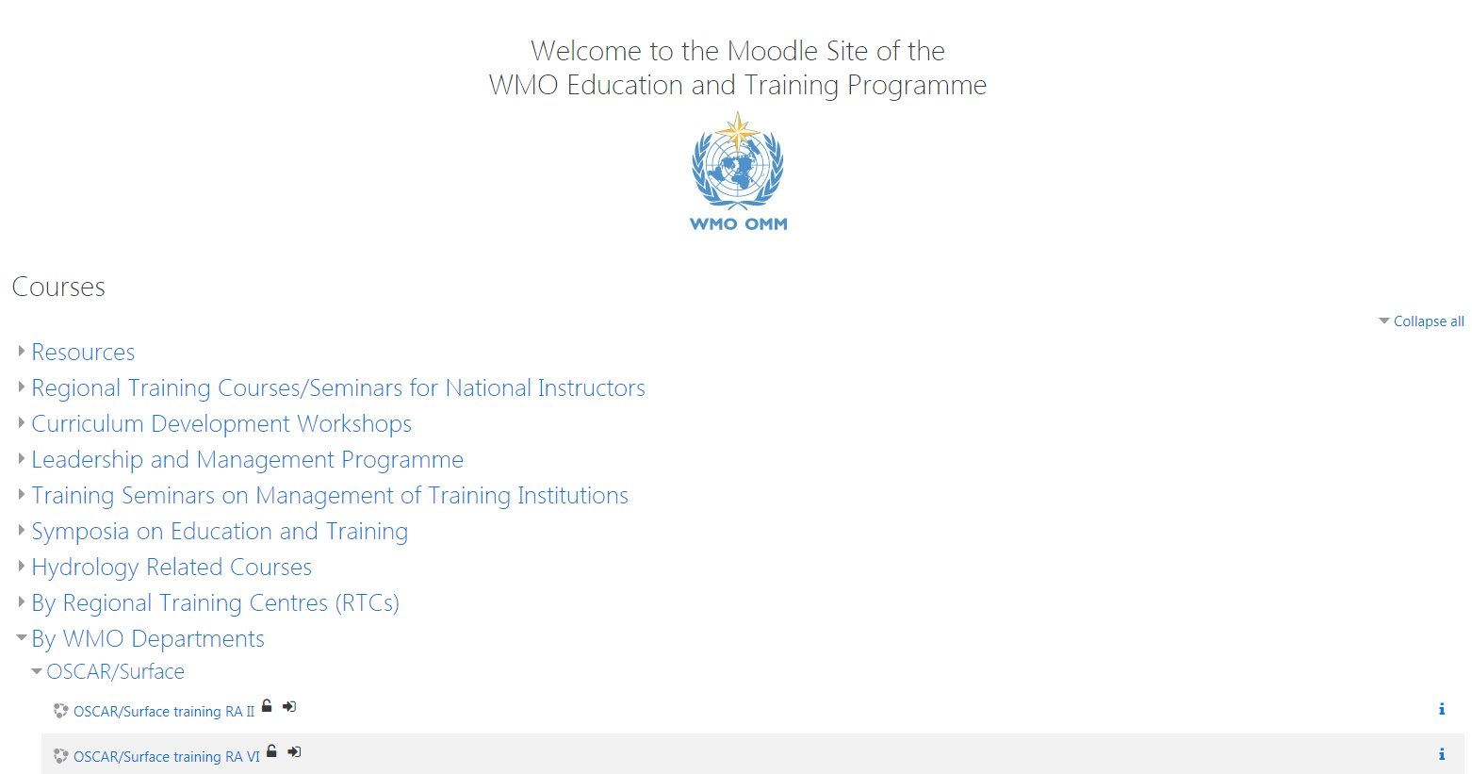
Self-enroll to the courses

Slide 7
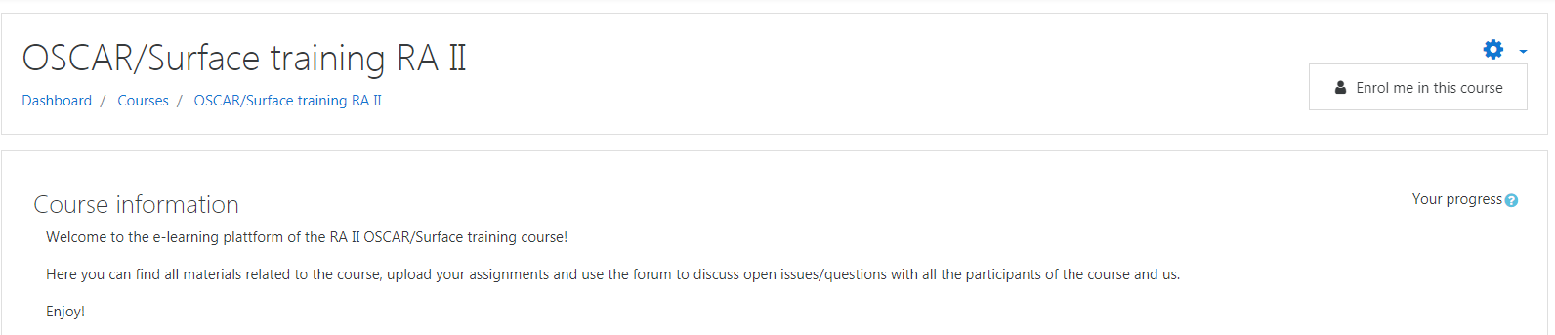
2. Self-enroll to the courses

Slide 8
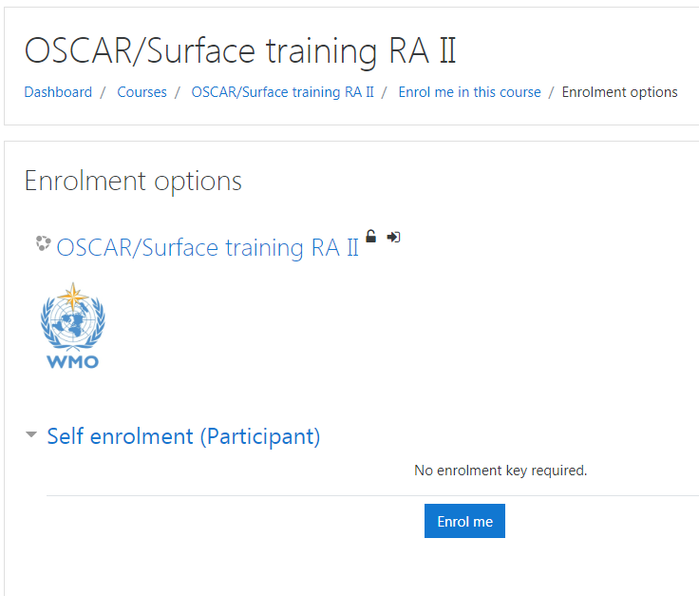
Self-enroll to the courses

Slide 9
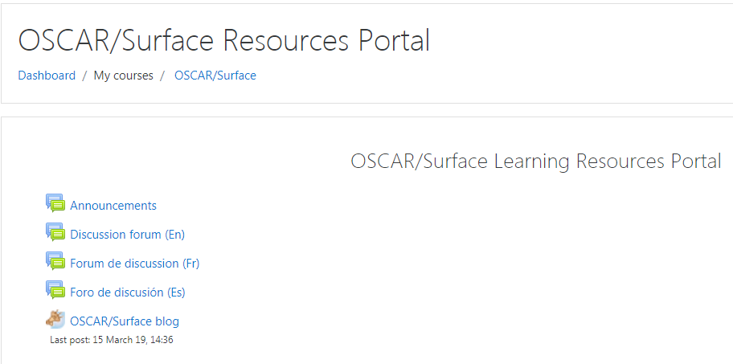
How to find the different courses you are enrolled in?

Slide 10
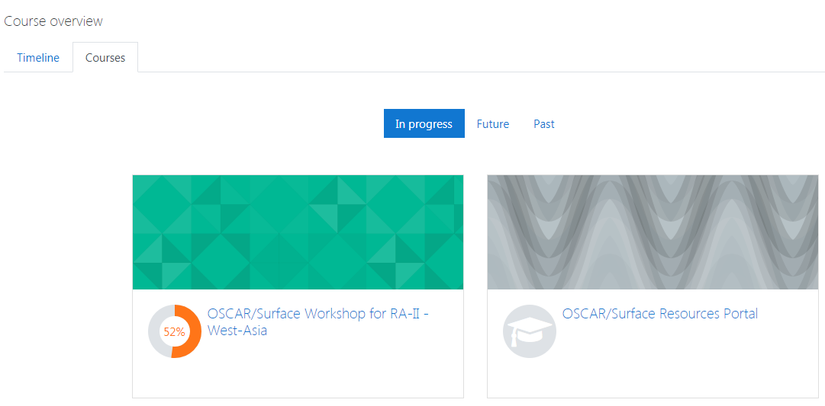
How to find the different courses you are enrolled in?

