Slide 1
Verification of Warnings

Slide 2
Warning Verification subjects
  Hits, False Alarms and Missed Alarms in balance
  Classical Warning verification against thresholds
  Impact based Warning Verification

Slide 3
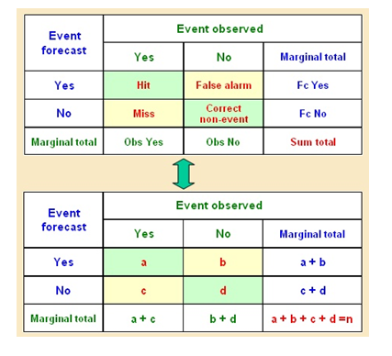
Classical Contingency scoring table

Slide 4


False Alarm Ratio (FAR)
https://www.wmo.int/pages/prog/www/.../Doc-7-Verification.doc
2.3.2 False Alarm Ratio (FAR)
The false alarm ratio is the ratio of the total false alarms (b) to the total events FORECAST (a+b). Its range is 0 to 1 and a perfect score is 0. It does not include c and therefore is not sensitive to missed events. One can improve the FAR by systematically underforecasting rare events. It also is an incomplete score and should be used in connection with the HR above.
2.3.4 Threat Score (Critical success index)
The critical success index is frequently used as a standard verification measure, for example in the U.S.A. It has a range of 0 to 1 with a value of 1 indicating a perfect score. The CSI is more complete than the HR and FAR since it is sensitive to both missed events and false alarms.

Slide 5
Hits, False and Missed Alarms in balance
You should allow your warning system to have false alarms
If you don’t allow false alarms, you will almost automatically increase the number of missed alarms
A missed alarm is the main reason for much internal and external criticism towards your NMHS.
Also too many false alarms will devaluate the credibility of your warning system
Your hit ratio especially for Orange and Red should best be between 80 to 90 %, the false alarm ratio should not be above 10 to 20%

Slide 6
Threshold based warning verification
Verification should be done by checking on:
Was the warning issuing threshold reached
Was the threshold reached within the region indicated in the warning and during the validity period of this warning
You can hopefully check this out of your observational database, synops and metars and other official national observations
At the end you could score your warning as a hit or false alarm. → Do not forget the missed alarms !
This scoring at times is to strict, so you could also score 1,2,3 by classifying it in Excellent / Good / Poor / Very poor

Slide 7
Impact based warning verification
If you issue Impact based warnings you best verify your warnings against the occurred impact
If your warning system is based on implicit impact criteria, such as return period based thresholds, or on a combination out of explicitly impact driven criteria together with return period based thresholds you better do both verification paths. So impact based verification next to classical meteorological “threshold reached” verification

Slide 8
Impact based warning verification
Recommendation on Impact based warning verification (WMO TTWarn)
Impact based warnings should contain information on:
What level of impacts to expect (+ Impact and Advisory information)
Over what period these impacts will occur
In what area those impacts will happen
So after the event the verification should focus on these 3 topics:
Level of occurred impact correctly forecasted ?
Was the time period of the predicted impact correct ?
Was the location, or region, of the affected area correct ?

Slide 9
Impact based warning verification
1. What were the impacts ?
In this part of the verification scheme it is necessary to decide whether the impacts that happened match those that were forecasted in the warning.
2. When did the impacts happen ?
Did the impacts occur during the validity period of the warning?
Was the warning issued sufficiently far ahead of the event so preparations could be made?
3. Where did the impacts occur ?
Did the impacts occur in the area indicated by the warning?

Slide 10
Impact based warning verification
In order to do 1, 2, and 3 it is important to look outside of your NMHS and use a variety of sources. These could include:
Media reports – national and local TV and radio, press reports, social media etc.
Reports and feedback from Civil Protection Agencies
Reports from other Government departments
Public reports, reports into the NMS, WOW reports
Public surveys after the event

Slide 11
Impact based warning verification
Each of these three aspects can be assessed and then the warning can be categorised into one of four categories:
Excellent – warning provided excellent guidance to the user
Good – warning provided good guidance to the user
Poor – warning provided poor guidance to the user
Very Poor– warning provided poor guidance to the user (this could include a missed warning or a false alarm)
It is worth bearing in mind that if an impact based warning is working, then the impacts that occur may be lower than they might have been if there were no warning in force as the population may have taken action to mitigate against those impacts. There will therefore always have to be a degree of pragmatism and flexibility in any verification scheme.

Slide 12
Impact based warning verification
Missed events
If at least medium impacts occur over a reasonably sized geographical area and no warning has been issued, a Met Service should also make a note of these events and mark them as missed events, so very poor guidance in any verification scheme
Ensuring robustness of a subjective verification scheme
A Met Service could consider holding a monthly meeting or teleconference to discuss the warnings that have been issued, and how they have verified. This discussion could include other forecasters, other departments within the Met Service, members of the Civil Protection community and representatives from Government Departments

Slide 13


