Slide 1
Meteoalarm

Slide 2
Meteoalarm, subjects
  How it begun in 1999
  The website philosophy and content
  The website and its functions
  Advantages to the different users
  How to join Meteoalarm

Slide 3
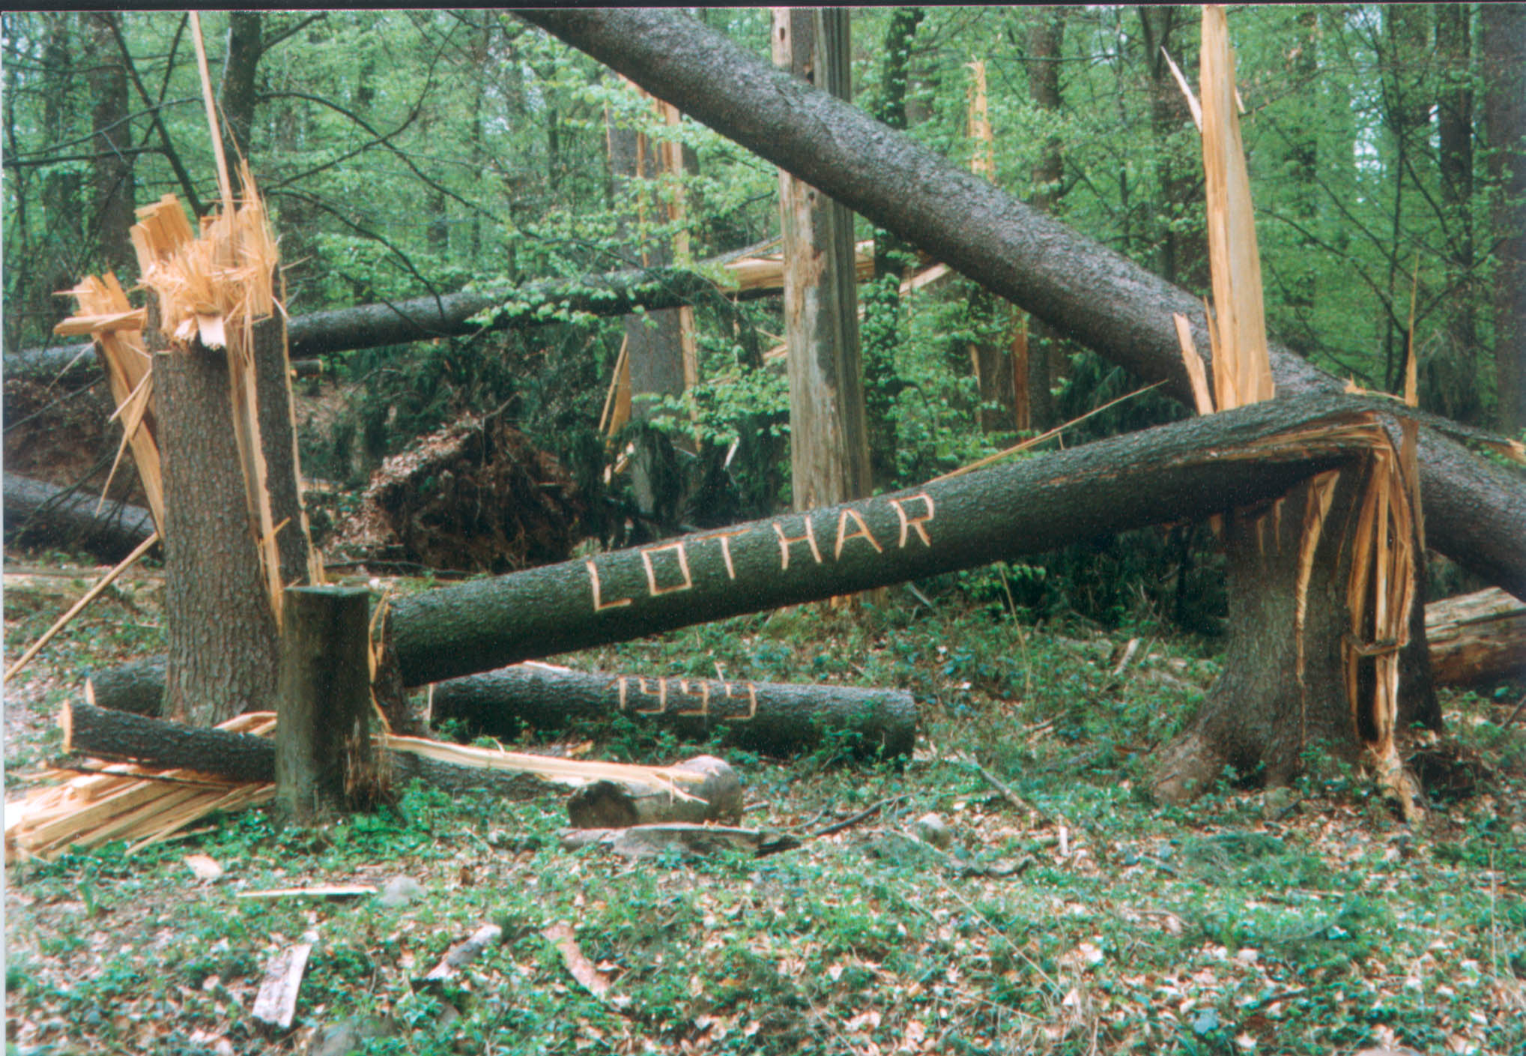

Slide 4
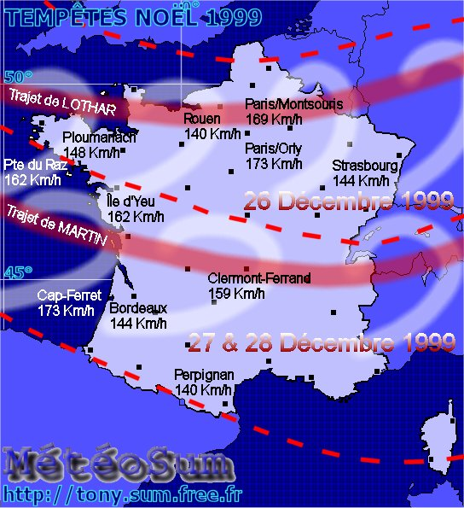

Slide 5
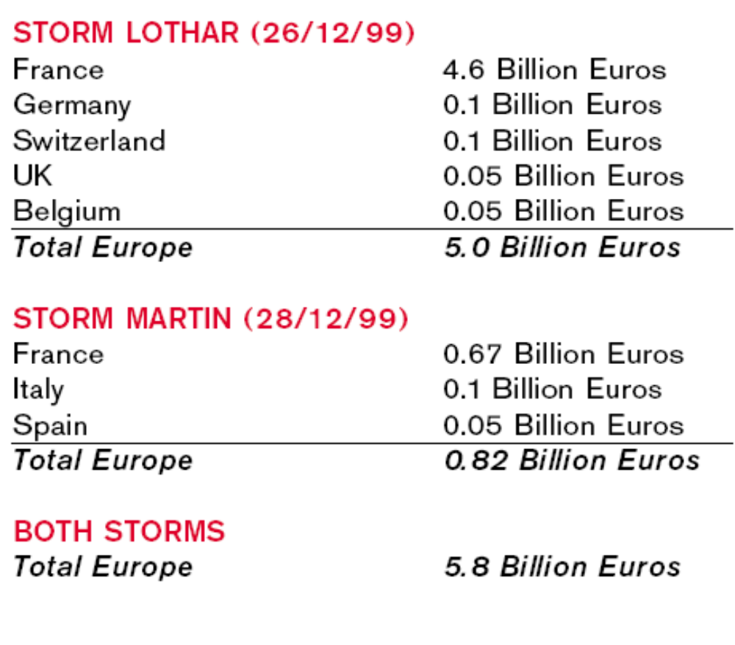

Slide 6
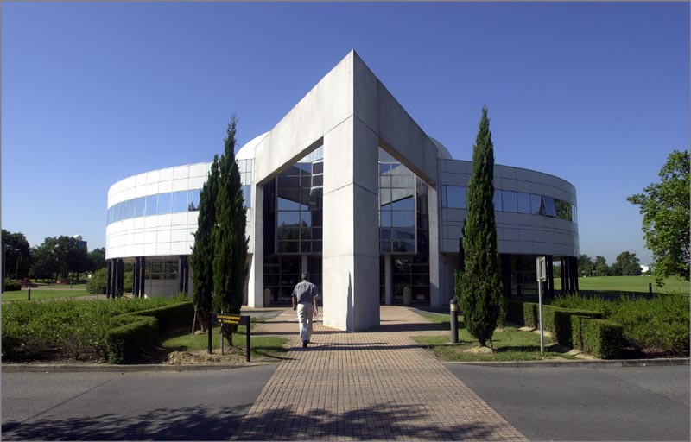
Winterstorm meeting Toulouse Oct 2000
La Meteopole, Meteo France (Toulouse)

Slide 7
Winterstormmeeting Toulouse Oct 2000
  Meteorological discussions (synoptical + dynamical)
  Discussions on warning strategies
  Vigilance system announcement by Meteo France
  Need was expressed to improve communication between NMS’s already at the onset phase of severe cross boarder events and to exchange warnings

Slide 8
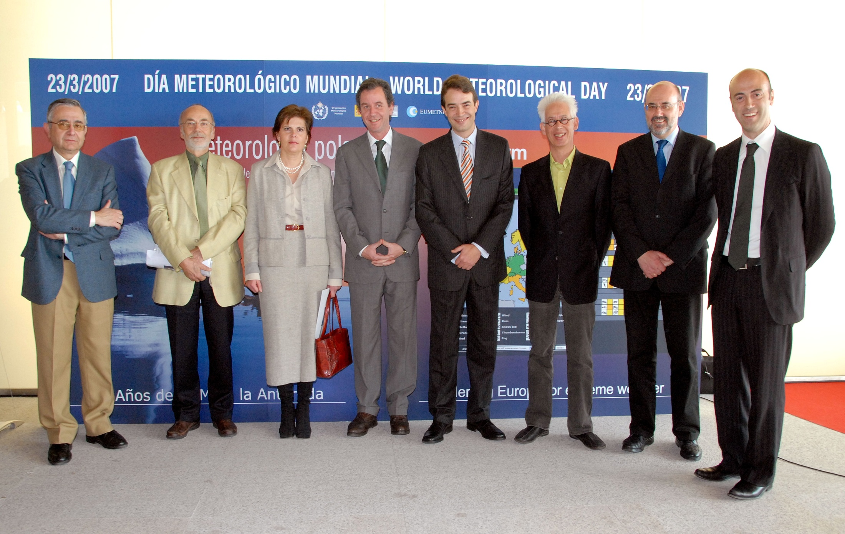
Meteoalarm a Eumetnet initiative launched 2007
Finally March 2007 Meteoalarm was launched in El Escorial during World Meteorological Day.
Meteoalarm is a Eumetnet initiative and nowadays is supported by over 30 European countries

Slide 9
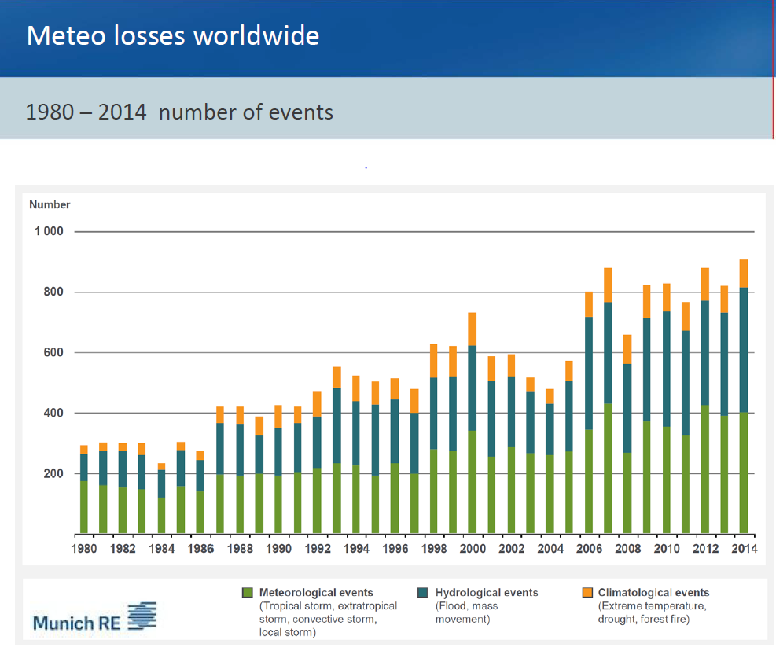

Slide 10
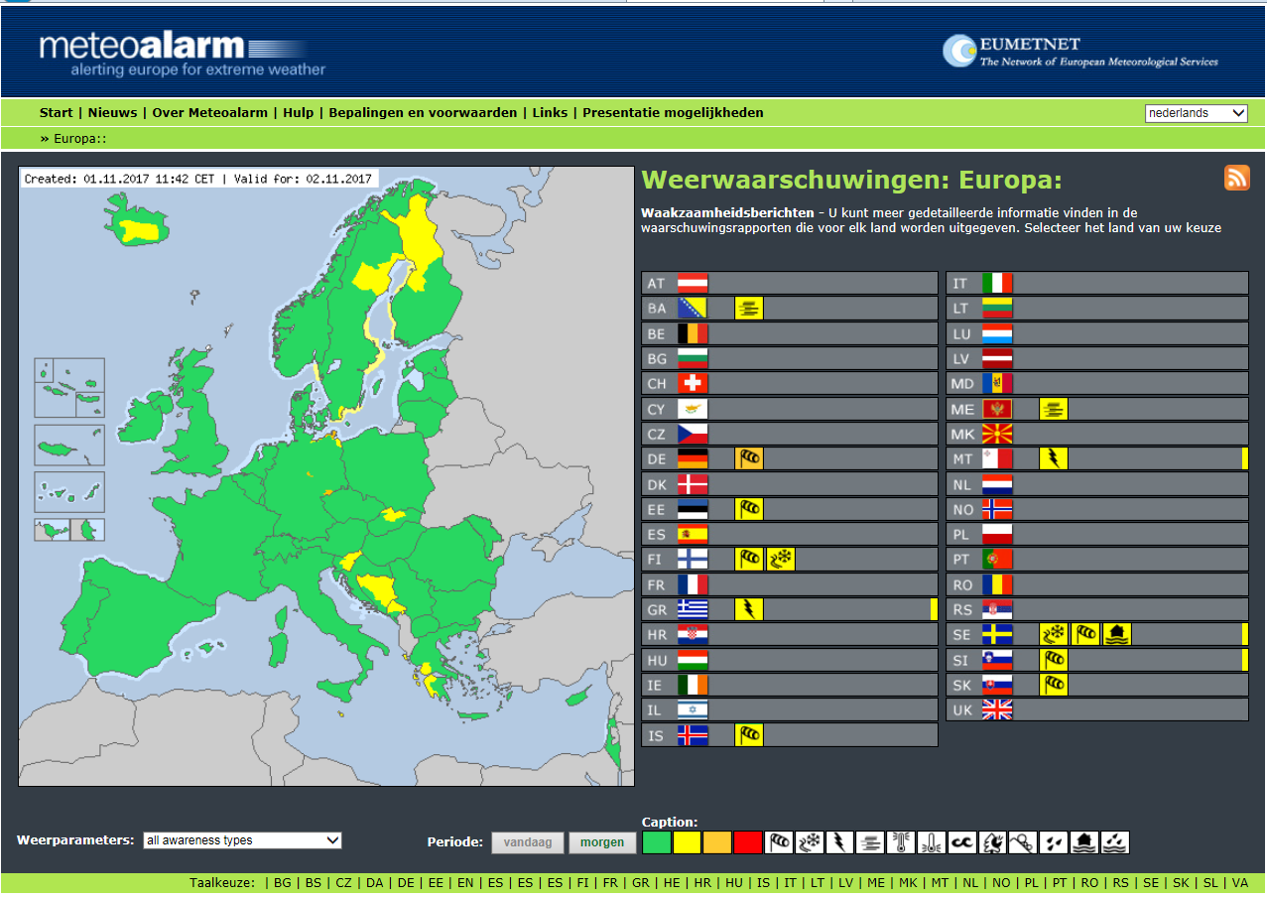

Slide 11
The Meteoalarm concept
  Simply understandable at one glance also for non experts, therefore using graphical symbols
  All warning levels (colours) should be impact and damage related
  In stead of harmonizing criteria across the Meteoalarm domain Meteoalarm harmonises colour assignment strategy across the domain
  Colours are preferably assigned according to the Radegno table adopted by the EMMA/Meteoalarm Expert members from all participating NMS’s. Your national climatological return period database should be able to help you to match the right parameter criterion with the appropriate colour
  Primarily targeted at the General Public and National CP authorities
  Also targeted to the Forecasters at the bench. The forum on the intranet allows them to have discussions during the onset phase of a severe weather event

Slide 12
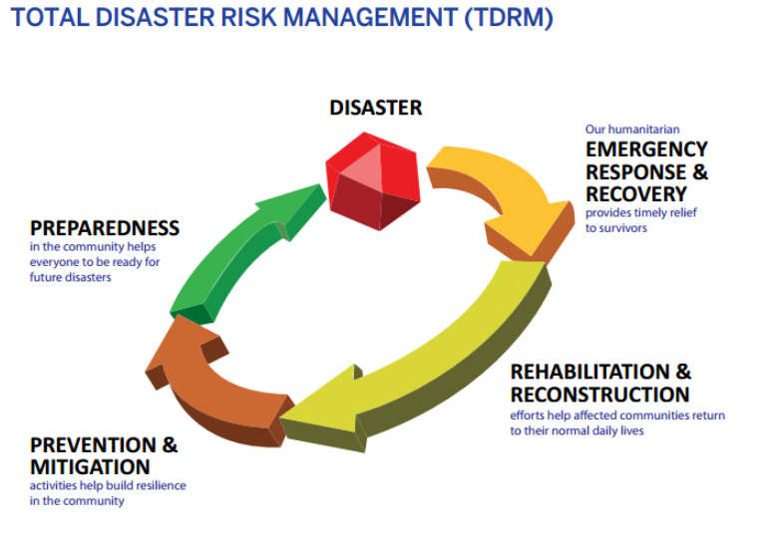
Disaster Risk Reduction Cycle

Slide 13
Color related to impact threat
Green = No threats
Yellow = Be Aware
Orange = Be Prepared
Red = Take Action

Slide 14
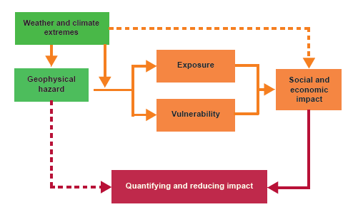
From hazard towards Impact

Slide 15
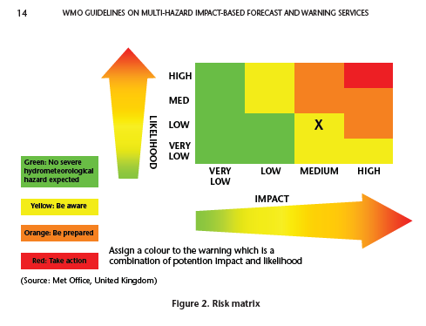
Impact description and Risk Matrix

Slide 16
The Meteoalarm Radegno warning matrix
Colour | One word | Damage / Impact | What to do? | Used how often? | Meteo Treshholds e.g. Rain (area + impact related)
Green | Weather report | - - - | usual phenomena | usual phenomena | Examples
yellow | Be aware! | exposed objects (avoidable) | caution with exposed activities | > 30 per year | > 54 mm/12h
orange | Be prepared! | general damages (not avoidable) | keep informed in detail, follow advice of authorities | 1 to 30 per year | > 80 mm/12h
red | Take action! | extreme damage and /or casualties extreme damage (mostly) on large areas, threatning life and properties (not avoidable, even in otherwise safe places) | follow order of authorities under all circumstances be prepared for extraordinary measures | less then 1 year + large (5000km2) scale phenomena | > 140 mm/12h

Slide 17
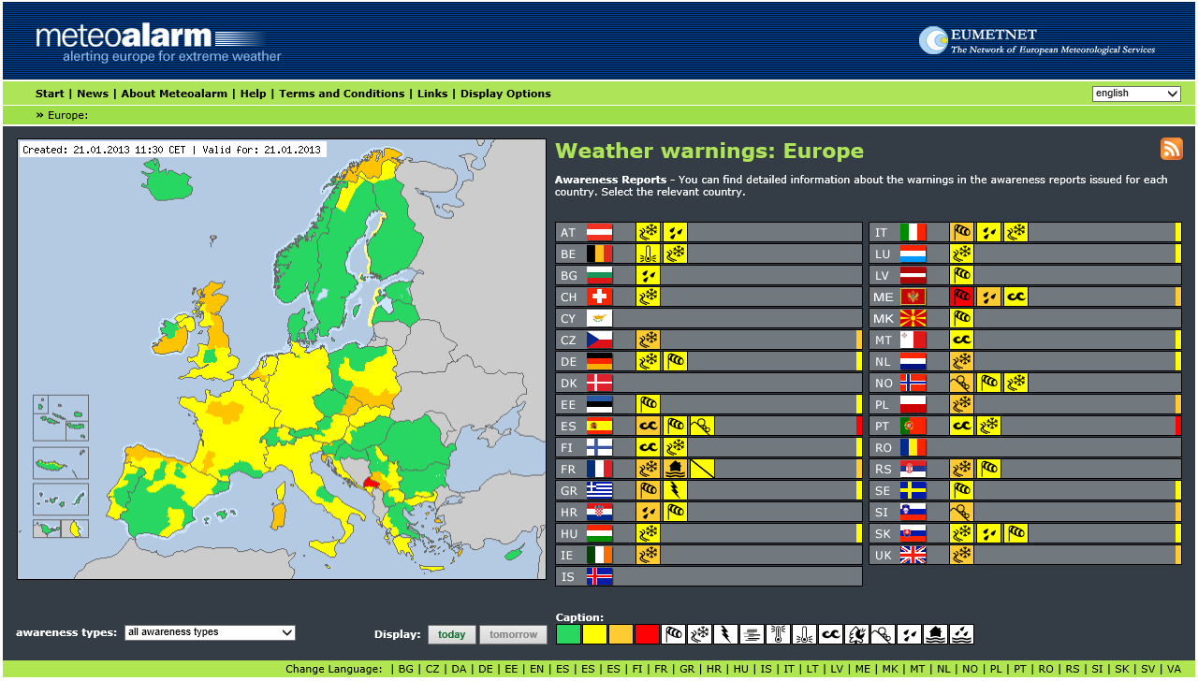

Slide 18
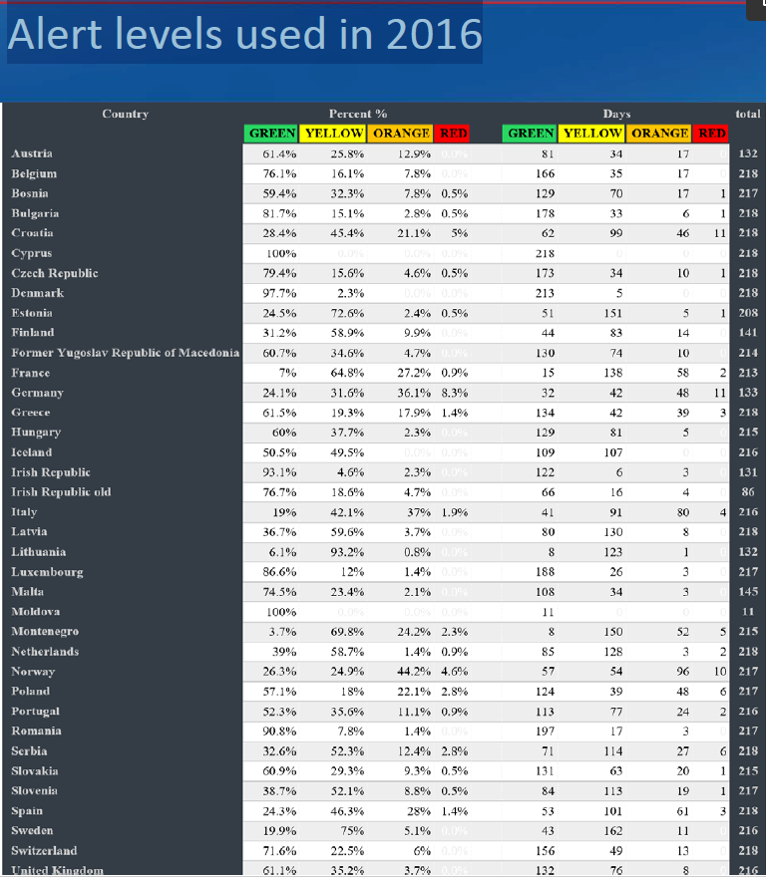

Slide 19
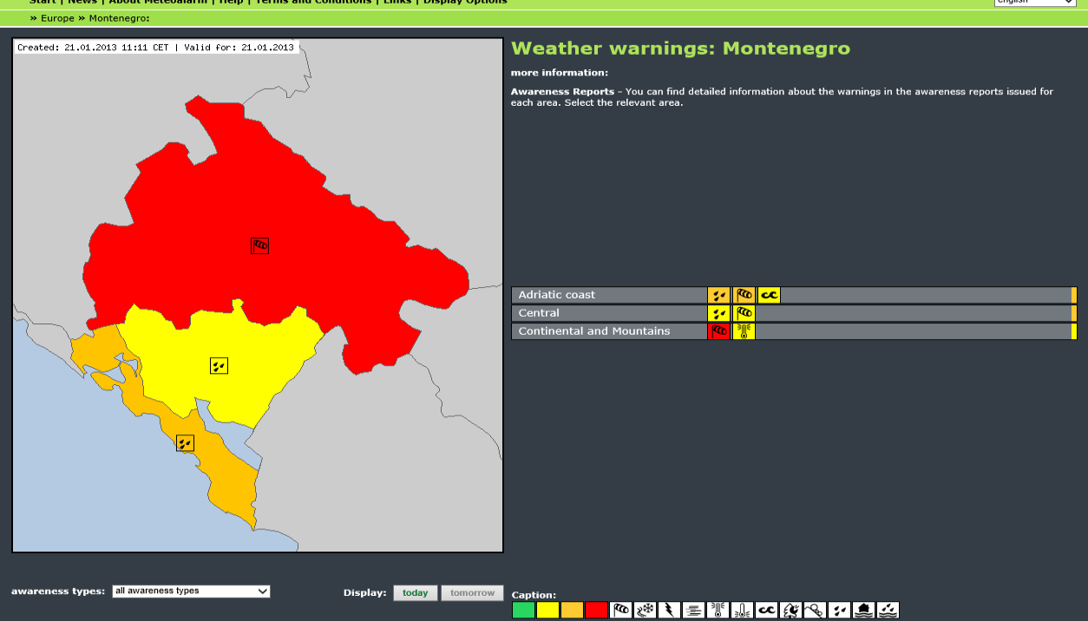

Slide 20
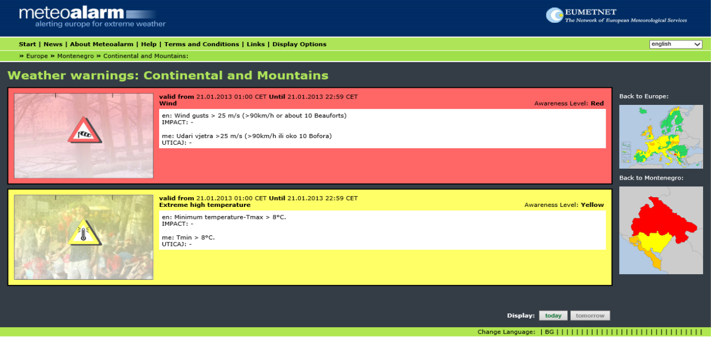

Slide 21
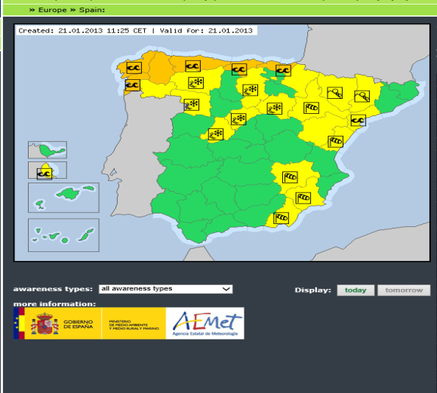

Slide 22
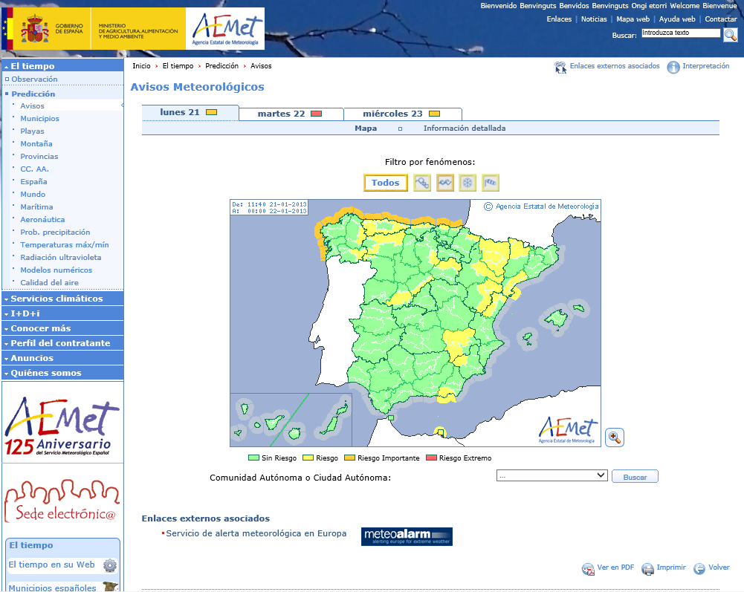

Slide 23
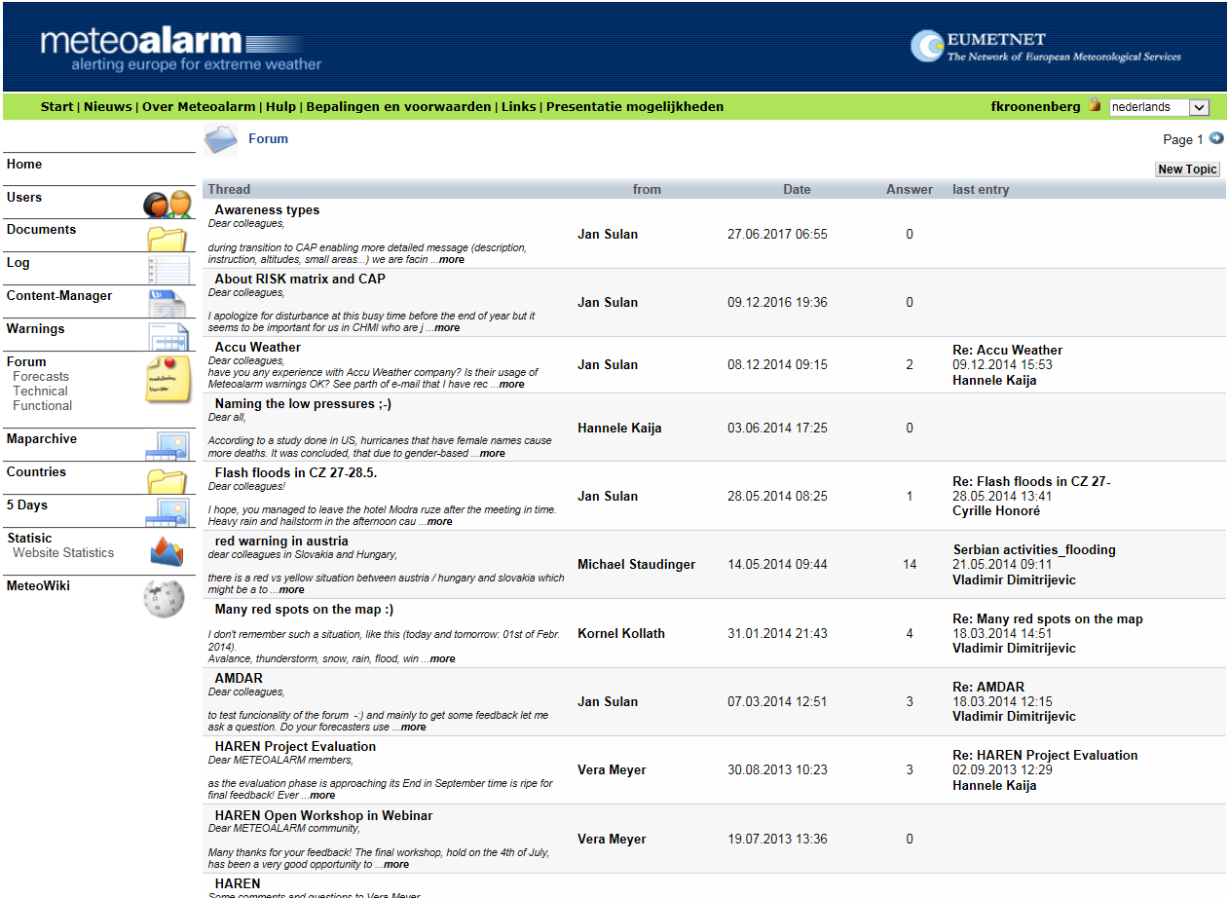

Slide 24
Meteoalarm Extended Features
Password admittance for CP services, also ERCC and NMS’s
  Day 2 to 5 warnings displayed by some countries
  A special assignment scheme available for NMS’s

Slide 25
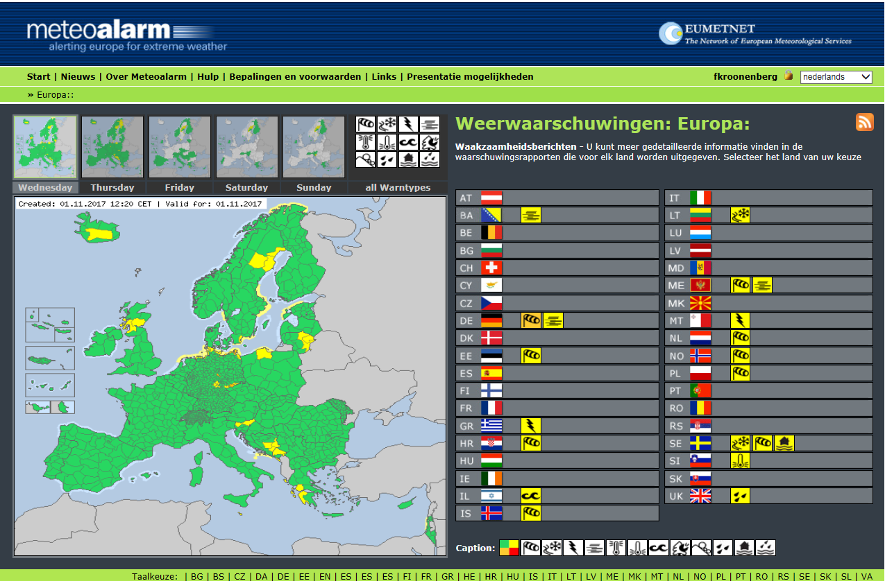

Slide 26
Meteoalarm Advantages
  Your NMS info is part of the European awareness picture
  NMS’s have to sync with international systematics but can pick national parameters and thresholds
  Meteoalarm members meet at least once a year in a Program members meeting (MPG). There exchange of best practices improves national capabilities
  NMS Website will get more traffic via Meteoalarm
  CPA’s have access to national cross boarder warning info in a semi harmonized picture, with day 2 to 5 warnings also displayed by an increasing number of countries

Slide 27
Meteoalarm Future Plans (2019 →)
New website needed for many reasons, such as: dynamic polygones and more regions per country
Responsive website and push messages towards users should be possible
Impact feedback should be visible on Meteoalarm website, from ESSL (ESWD) and also out of social media
CAP coded XML exchange → supports API’s
The one stop shop to enclose all European Multi Hazard Warning info
Targeted towards re-users and app developers

Slide 28
Related Risk Reduction activities (DRR)
EC – Aristotle Pilot Project
WMO- Global Multi Hazard Alert System (GMAS)

Slide 29


Slide 30

ARISTOTLE’S Objectives
will deliver world leading multi‐hazard capability to the Emergency Response Coordination Centre (ERCC)
has been designed to offer
  a flexible and scalable system that can provide new hazard‐ related services to the ERCC
  to create a pool of experts in the field of Meteorology and Geophysics of Europe that can support the ERCC with regard to situation assessments in crisis situations

Slide 31
Four Hazard Types
Earthquakes (with Tsunamis as secondary induced hazard)
Volcano Eruptions (ashes and volcanic gases)
Severe Weather Events (including wind storms, major heat and cold waves, and severe precipitation)
Flooding (flash floods, coastal flooding)

Slide 32


ARISTOTLE Operational & Project Governance, 24/7 monitoring
ARISTOTLE
Chair – INGV / ZAMG
External advisory board
24 * 7 Monitoring
24 * 7 Monitoring
IMO
UKMO
MH Op. Board
Chair – INGV / ZAMG
Volcano’s
Severe
Weather
24*7 expert Advice & Analysis for ERCC
Project Management Board
24 * 7 Monitoring
24 * 7 Monitoring
ERCC
Earthquake
(Tsunami)
Flooding
JRC
Chair – INGV / ZAMG
SHMI
INGV
Steering Committee
National Monitoring & Analysis Centres
European Monitoring & Reporting (EFAS, GTIMS, Meteoalarm etc.)

Slide 33
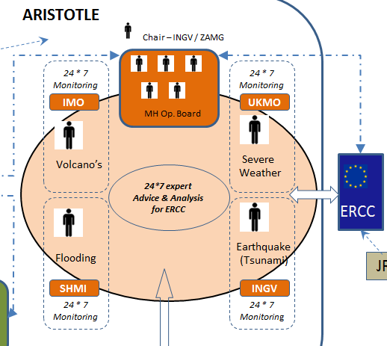

Slide 34
GMAS
WMO Global Multi Hazard Alerting System
Resolution 10 – Sendai Framework for DRR 2015 -2030 and WMO participation in International Network for Multi-hazard Early Warning System
Might become a virtual platform with alert information out of many already existing warning systems
Giving the authoritative source of impact-based warning information on hazards, giving “The single tone of voice on warnings in each country”
Enhance visibility of NMHSs as THE source of warnings at global, regional and national level
As a global aggregator of warnings mainly to support UN humanitarian activities (perhaps in future also for the general public worldwide)

Slide 35
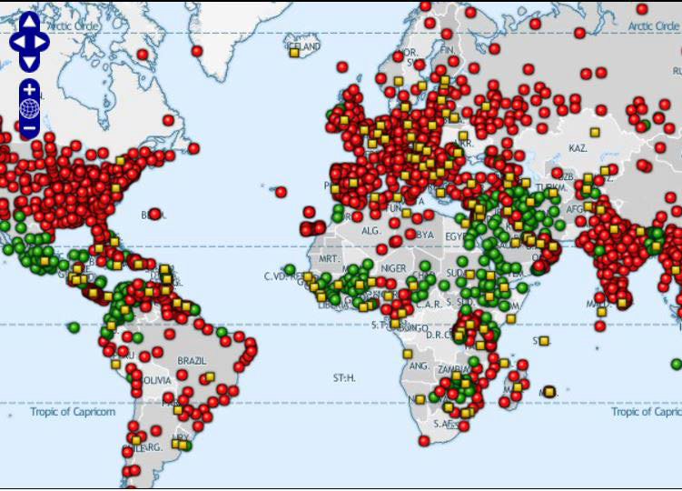
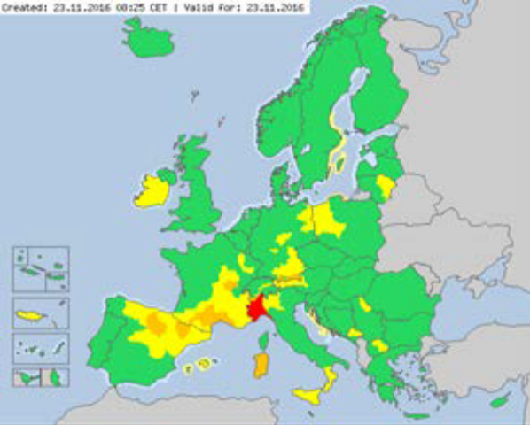
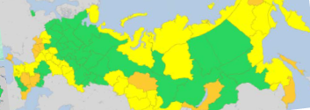
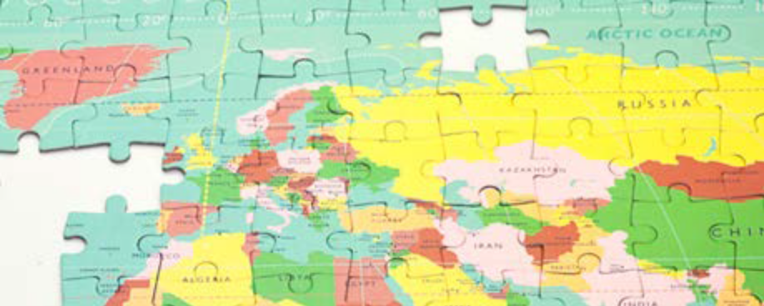
GMAS – concept under construction

Slide 36
How to set and update your warning system
Which (weather, hydro, climate) events cause impact. Score events in probability/severity diagram (You have to link with your CPA)

Slide 37
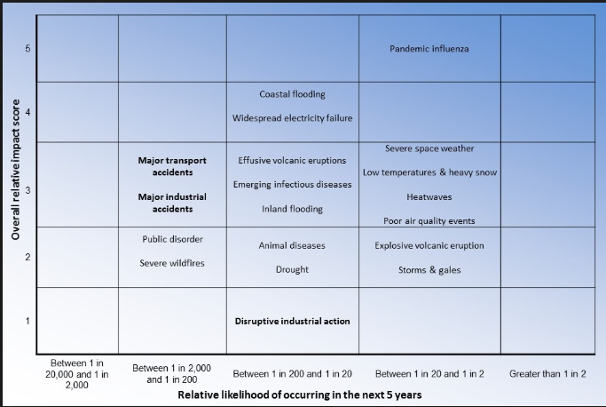
National or regional risk matrix(prob vs impact)

Slide 38
How to set and update your warning system
Which (weather, hydro, climate) events cause impact. Score events in probability/severity diagram (You have to link with your CPA)
Upgrade your forecasting ability (models and methodology) for these events/parameters
Optimize observing capacity for these parameters (synop, radar, sat, others)
Model rapid update cycles to improve observations assimilation within the NWP

Slide 39
Thresholds for each parameter & colour
Purely Meteorological driven thresholds
Thresholds based on return period (Radegno recommendation)
Thresholds based on return period and impact experience from the past (CPA linking)
Virtual thresholds purely impact based. Where Impact is the result out of exposure and vulnerability. And vulnerability is dynamical of origin

Slide 40
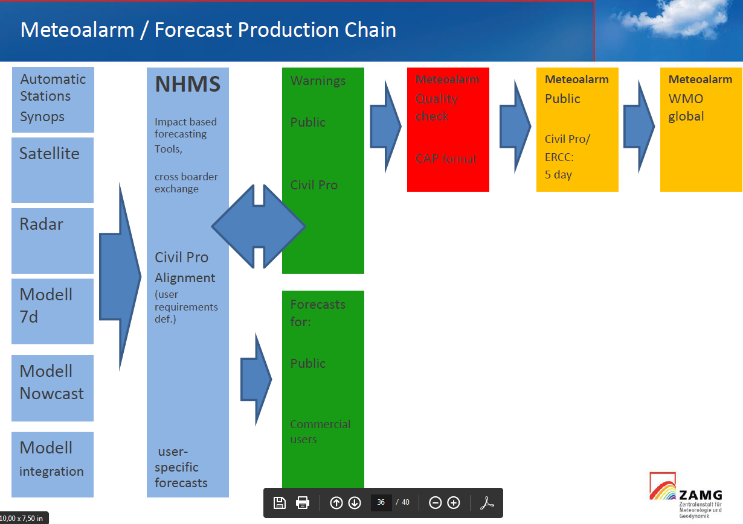

Slide 41
Communication of warnings
“Good communicating of your warning makes your warning twice as effective” so:
Warning texts should consist out of event description, impact description and advisory on what to do
Linking with public and social media, in general a clear communication strategy, is needed when issuing your warning messages
Linking with your Civil Protection Agencies is essential from a political, a strategical point of view. This also for reasons of feedback and verification and making the quality control circle complete and closed

Slide 42
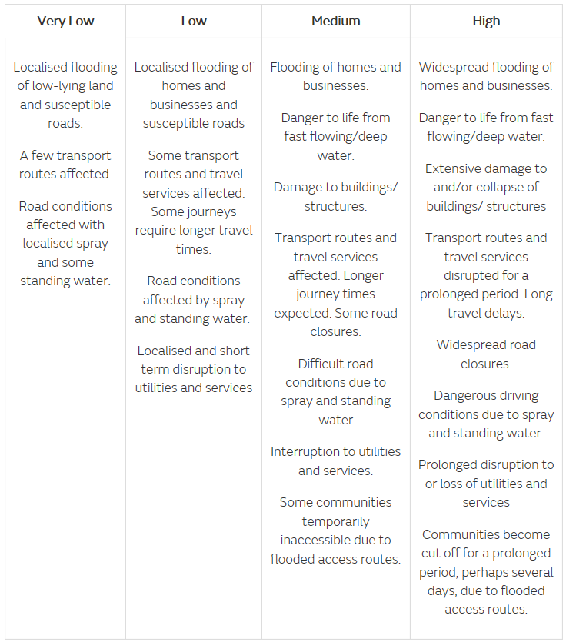
Rain Impact description
(from UK-Metoffice)

Slide 43
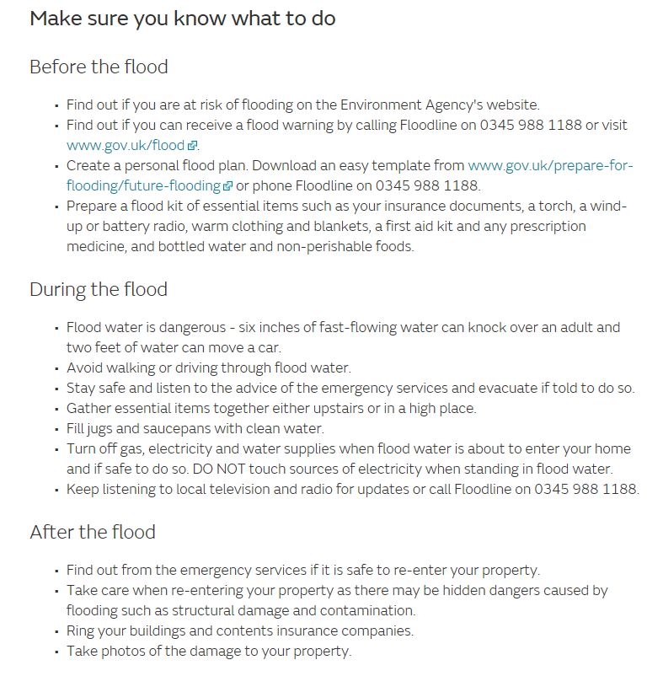
Rain Impact advisories
(from UK-Metoffice)

Slide 44
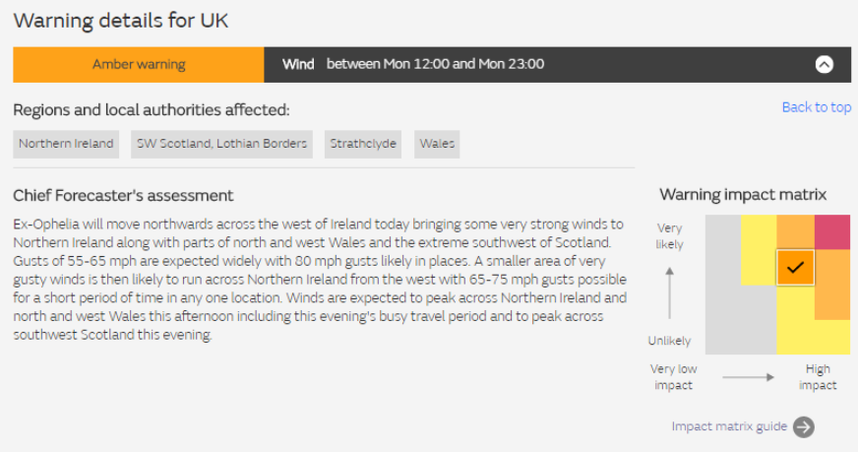
Additional info (from UK-Metoffice)

Slide 45
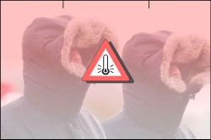

Slide 46


