Slide 1





4th International
Distance Learning Program
in Basic Hydrological Sciences
for Indian Professionals
16th October to 30th November 2017
Organized by
National Water Academy, Pune

Slide 2
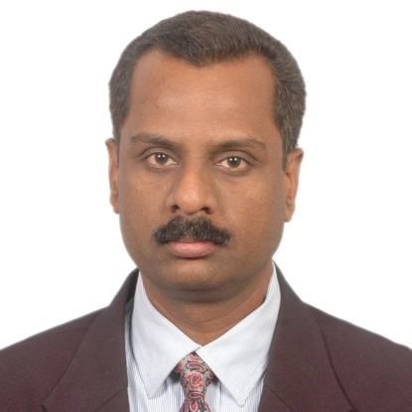
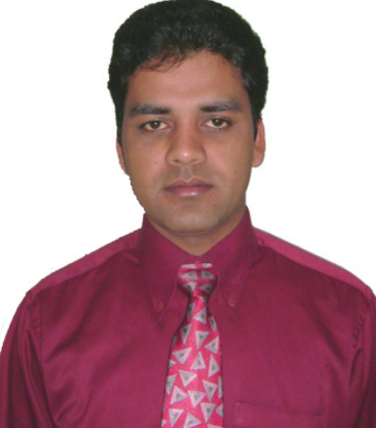
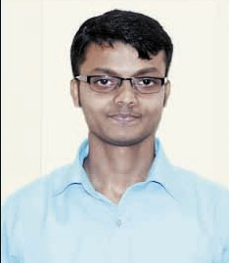
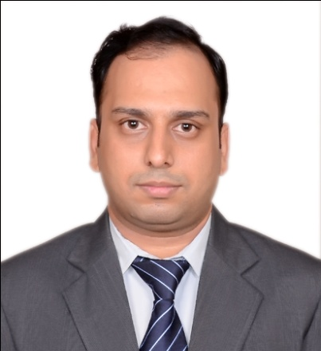
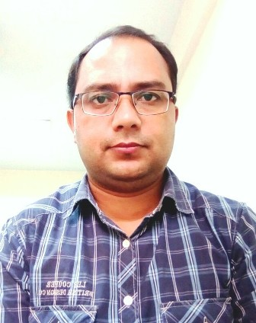
Course Instructors from NWA
Dattakumar Chaskar
Director
Sunil Kumar
Director
Sidhartha Mitra
Director
Manish Rathore
Deputy Director
Deepak Bhatt
Deputy Director

Slide 3






Course Facilitators from
WMO & COMET
Mustafa Adiguzel
WMO
Matt Kelsch
COMET
Claudio Capponi
WMO
Dr. Patrick Parrish
WMO
Nirina Ravalitera
WMO
Bruce Muller
COMET

Slide 4
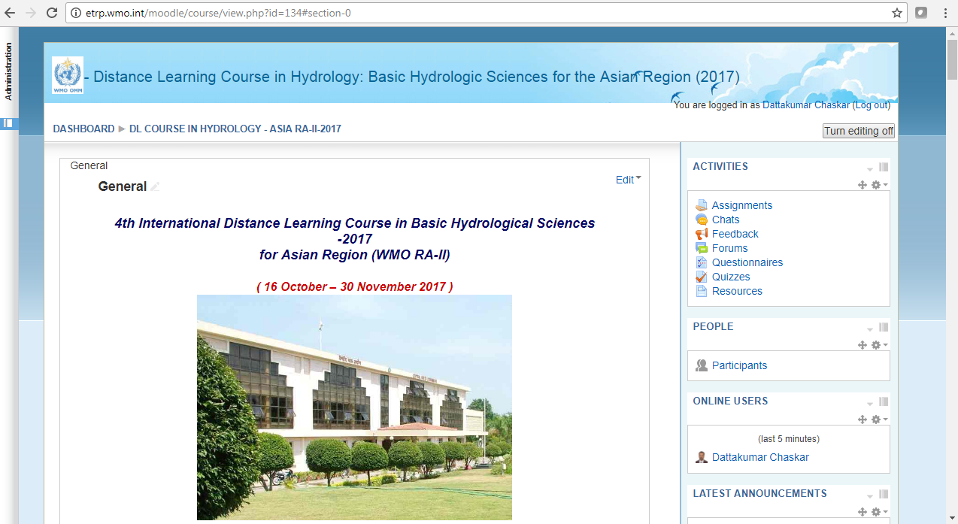
Course Website
http://etrp.wmo.int/moodle/course/view.php?id=134

Slide 5
The Course
The course is designed to meet the needs of hydrological forecasters who work with hydrologic data, particularly in flood forecasting and design flood analysis.
The course is intended to provide an understanding of ground, surface, and atmospheric forms of water and will prepare the participant for its application & further study in hydrologic methods and forecasting.

Slide 6
Goal of the Course
Upon completion of this course, participants will be able to:
Understand the elements of the hydrologic cycle
Explain the rainfall runoff processes
Learn River Discharge measurement technique; & Discharge computation by velocity area method
Describe the process of stream flow routing
Derive & use a unit Hydrograph
Apply various hydrologic modeling methods
Apply various methods to assess flood risks

Slide 7
Technical Notes
Access modules from the Course Website
(http://etrp.wmo.int/moodle/course/view.php?id=134)
Most of the modules & quizzes thereon reside on MetED website
( https://www.meted.ucar.edu )
You’ll need to register on the MetEd Website (free)
Few modules developed by NWA & quizzes thereon reside on the course website itself.
See instructions in the Technical Requirements/Instructions document

Slide 8
Course Components
Set up your profile (Pre-course Activity)
Complete the module on “Understanding Hydrolgoical Cycle”
( Pre-Course Activity)
Live Orientation Webinar on 16 October at 1100 hrs IST
17 Distance Learning Modules and Quizzes
  8 modules are mandatory
  1 module optional
  Your choice for an additional 2 out of 8 options
Live Closing Session (1500 Hrs IST, 4 December 2017)
Participate on the Course forum – at least twice weekly
A short final writing assignment
Completing all of these will earn you a Certificate of Completion for the course

Slide 9


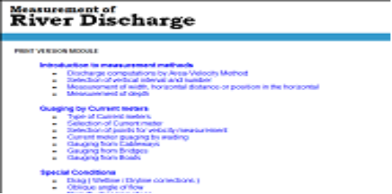
Required Modules
Pre-Course Activity
Week 1
NWA

Slide 10

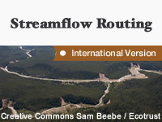
Required Modules
Week 2
Optional Module for this week
NWA:
Derivation of Unit Hydrograph

Slide 11
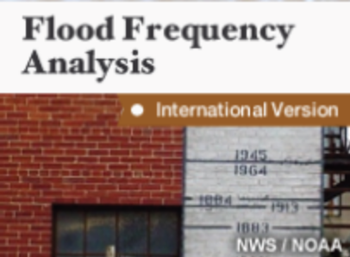


Required Modules
Week 3

Slide 12


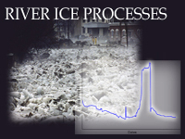

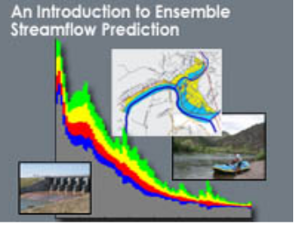
Elective Modules
Week 4
Any two electives out of 8 modules
NWA :
Flood frequency Analysis-Part-II
NWA:
Flood forecasting Techniques
Dam failure Concepts & Modelling

Slide 13
Week 5
Completing all the required & optional modules
&
Starting with Final writing Assignment

Slide 14
Required Modules
Week 6 & 7
Submission of Final writing Assignment
Course Evaluation Survey
Concluding Webinar

Slide 15
Final Writing Assignment
Choose one topic area:
Option A: Discuss the work responsibilities of your office.
Option B: Report about your local hydrological conditions.
Option C: Outline the strengths and weaknesses of your local hydrologic forecasting system.

Slide 16
Participation Guidelines
Complete the modules for each week to avoid falling behind schedule
Post your questions and comments for the instructors and other students in the Course Forum each week
Allow at least 8 hours per week for taking modules, completing quizzes and the final writing assignment

Slide 17
Participation Guidelines
DON’T forget to take the online quiz associated with each of the modules!
  You must pass each quiz with at least 70 % marks to receive credit for the module.
  You may re-take a quiz as many times as it takes to succeed

Slide 18
Final Webinar Session
Scheduled for 1500 hrs IST, 4 December 2017
Review main themes covered in written assignments
Discuss major questions/topics/issues from the discussion forums
Answer any final questions (you may post these in advance in the course forum)

Slide 19
Thank You

