Slide 1


CALMet XIV Conference
FUTURE SEAFARERS TRAINING IN MARINE METEOROLOGY:
IN-CLASS/ ONLINE AND OUT-OF-CLASS/ ONBOARD
Brindusa Cristina CHIOTOROIU
Associate Prof. PhD
Constanta Maritime University, Romania

Slide 2
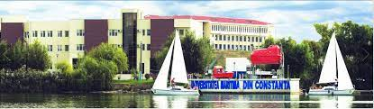
The presentation refers to :
• the types of training in Marine Meteorology of nautical students from Constanta Maritime University, Romania
(mandatory topic, 2 semesters, 100-200 students enrolled each year in Navigation)
• how the International Maritime Organization training outcomes can be achieved during the pandemic
(lectures and laboratories/seminars cover the minimum standards of competence for officers in charge of a navigational watch STCW*)
*The International Convention on Standards of Training, Certification and Watchkeeping for Seafarers
• students' opinions on their training before and during the Covid-19 pandemic

Slide 3
Types of training with nautical students
 | Before the pandemic | During the pandemic
Required by the IMO | in-class training measurements with instruments (in-class and outdoor) | on-line training on the university e-campus platform (Moodle) on-line documentation (Moodle) assignments (Moodle)
Extracurricular training activities (not required by the IMO) | on-line documentation on the university e-campus platform outdoor weather measurements at the Regional Forecast Center onboard a ship practical training
Notes:
.
in 2019, when the opportunity arose to take students onboard the Greenpeace flag ship the Rainbow Warrior. The ship was in the port of Constanta, during its campaign around Europe to promote renewable energy sources and has meteorological equipment, being a part of the VOS system.

Slide 4
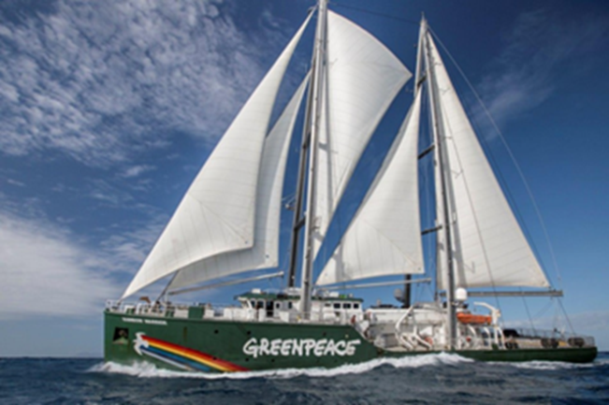
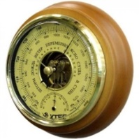
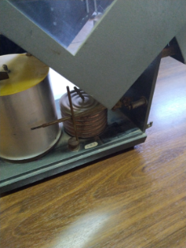
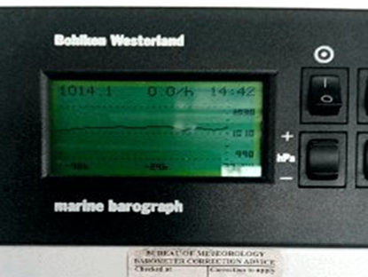
Training on meteorological instruments: the example of the barometer/ barograph
IMO required performances : knowledge of the instrument, description of the basic principle/ function
In-class: Presentation, conversation
Topics: Construction, function and operating principle of the metal chamber, reading barometers/ barographs.
On-line:
Power-point presentation
Example of reading the barometer display and the barogram (photos of), conversions
Moodle assignments
Out-of-class/ Onboard the Rainbow Warrior
Presentation of a
marine barographer
by the 1st deck officer
Readings of the
barograph
Students noticed the
difference from the
metallic barometer
-the electronic
pressure-sensing element
-the 48 hour pressure curve;
current air pressure and tendency
(1 h/ 3h); the time; the temperature
- the internal memory (256 KBits),
it can store pressure data of the last 28 days, with a time resolution of 5 min.
- a sudden drop in air pressure exceeding -1,4 hPa produces a short ‘beep’ tone every 5 min.
Notes:
Acc to IMO: required performances = knowledge of the instrument, description of the basic principle/function of the barometer
in 2019, when the opportunity arose to take students onboard the Greenpeace flag ship the Rainbow Warrior. The ship was in the port of Constanta, during its campaign around Europe to promote renewable energy sources and has meteorological equipment, being a part of the VOS system.

Slide 5
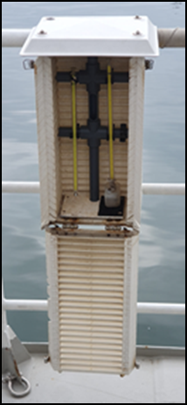
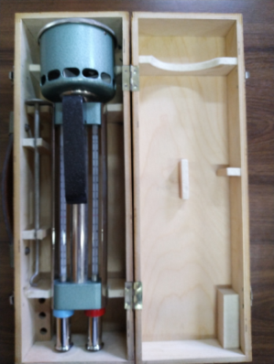
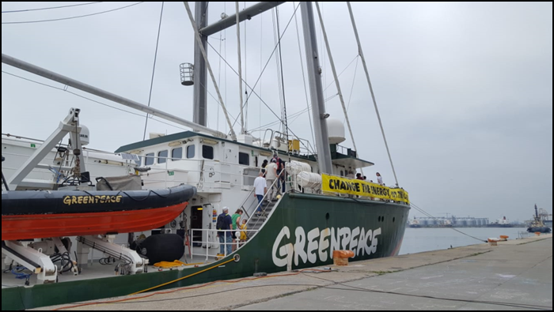
Training on meteorological instruments: the example of the psychrometer
IMO required performances: knowledge of the instrument, description of the basic principle/ function
In-class: Presentation , conversation
Topics: Air humidity measurement methods Construction, function and operating principle of the psychrometer, calculation of vapour pressure
Practical session : Reading the 2 thermometers of the aspiration (field) psychrometer, calculation of vapour pressure
On-line: Power-point presentation (same topics); calculations (Moodle assignments)
Out-of-class/ Onboard the Rainbow Warrior
Presentation of the psychrometer installed on the Port side of the ship by the 1st deck officer
Readings of the 2 thermometers

Slide 6
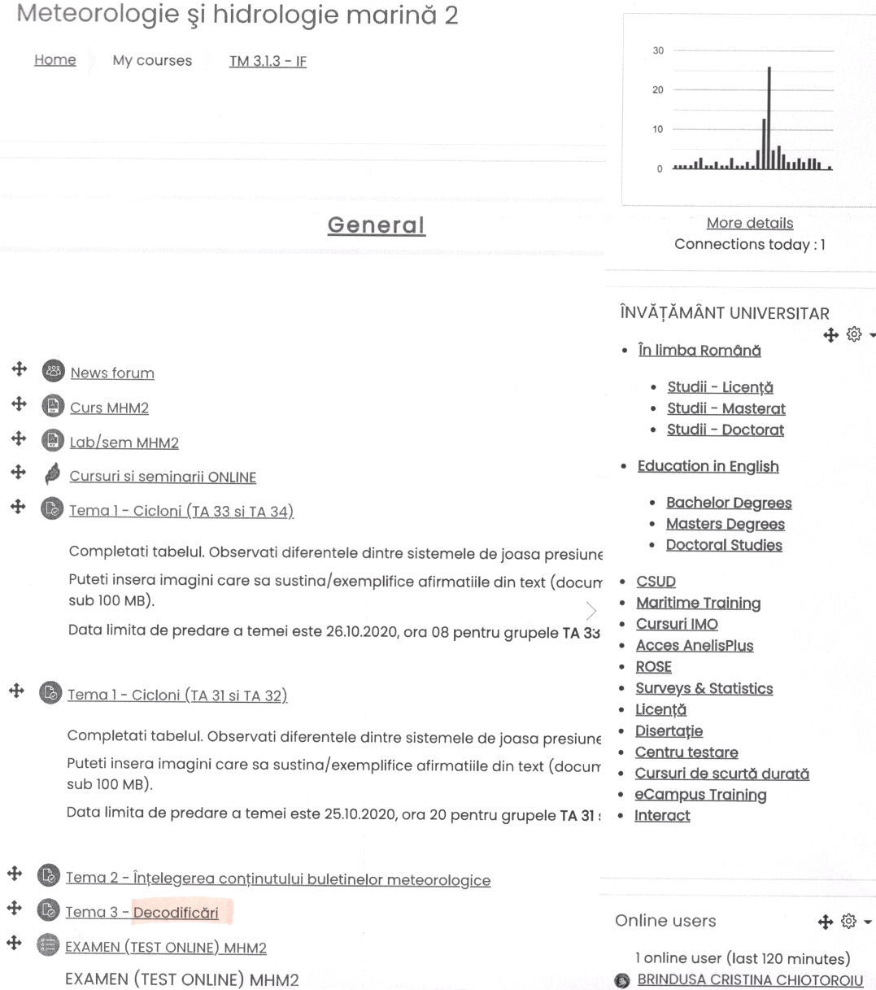
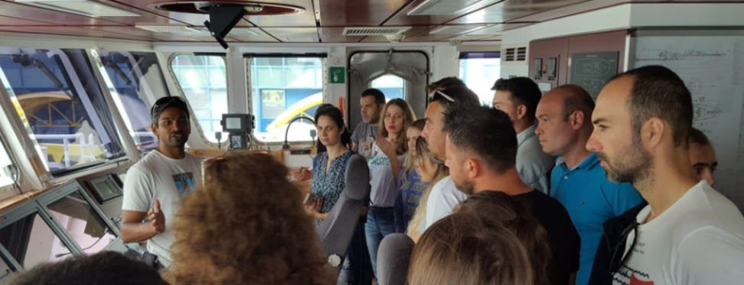
Training on recording and reporting weather observations
IMO required performances: use of the SHIP code to code/decode a ship/shore station
In-class: Presentation , conversation
Topic: the SHIP synoptic code format
Practical sessions: 1.decoding a SHIP message
and writing a text, 2. transposition of data (already recorded) in the SHIP format
Out-of class/ Onboard the Rainbow Warrior
Q&A session with the 1st deck officer about the computer display, the soft for recording in a SHIP format of the weather data from shipborne instruments, the transmission system.
On-line:
same topics/applications
Moodle assignments

Slide 7
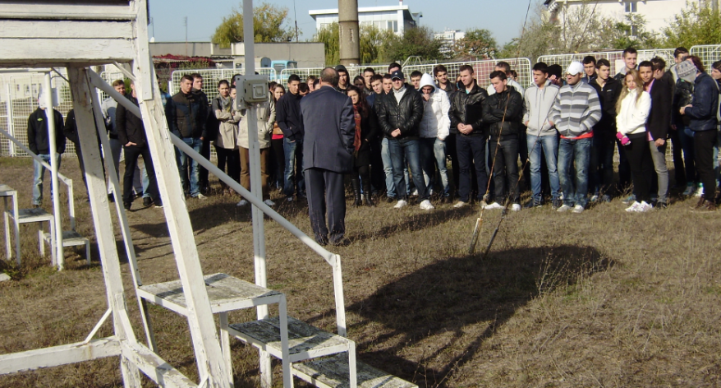
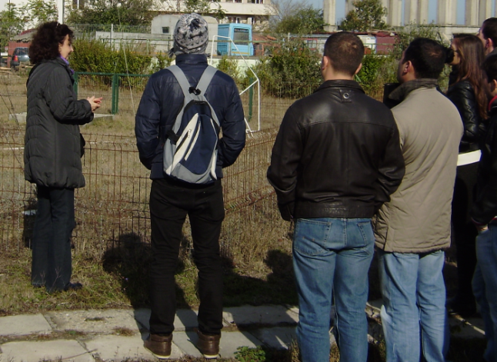
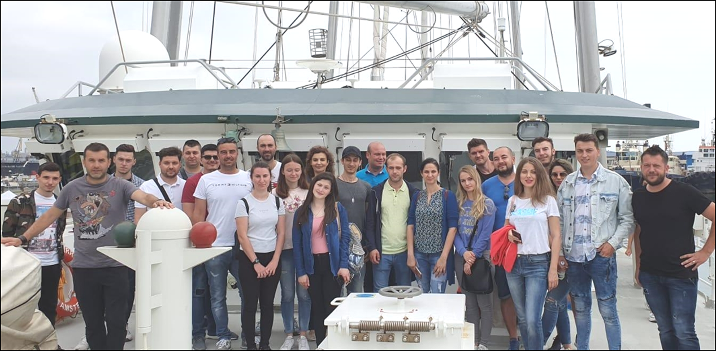
Students opinions on the extracurricular outdoor training (Regional Forecast Center and onboard the Rainbow Warrior):
real and useful hands-on experiences
an opportunity to see the work of the port meteorological officer (forecast, drafting the meteorological bulletin, information flow between the ships and the meteorological office)
an opportunity to speak with the 1st deck officer who shared his experience with making weather observations and transmitting them and with other duties onboard.
Acknowledgments
We would like to thank the former director of the Regional Forecast Center in Constanta, Romania, Mr. Vasile TORICĂ and the Rainbow Warrior 1st deck officer, Mr. Amrit BAKSHI for the extremely useful informations offered to the students.
The assistance provided by Mr. Marian MÂNDRU (Greenpeace Romania) was greatly appreciated.

Slide 8
Students opinions on the different types of training in Marine Meteorology
Before the pandemic
the in-class training : useful for acquiring theoretical knowledge.
the out-of-class training : “exciting and different experience”, “a deeper understanding of the way of handling, making, recording and transmitting meteorological observations”.
Students’ opinion: the 2 visits/ trainings at the Forecast Center and onboard a ship to be included in their laboratory activities.
During the pandemic - the on-line training
access to the online course (Jitsi conference room): easy
access to the course material : students could read it at their own pace.
assignments : students had enough time to prepare their homeworks
Students’ opinion: would choose blended learning.
----------------------------------------------------------------------------------------------------------------------
The challenges I had to face as a the teacher:
to create a comfortable learning environment
to adapt in a short time the lectures to the online system and to the students’ age (interactive lectures)
to monitor course attendance
to prepare and evaluate assignments for a large number of students
to design quizzes (final evaluation tests)

Slide 9
What would your students be willing to keep from this time on? | The access to the updated online course material and other additional materials because they could read them at their own pace. The individual feed-back they received for their homework/assignments.
What the students found difficult or unpleasant? | To stay focused online for 90 minutes (duration of a lecture) To talk to their teacher and colleagues only online
What did I find difficult as a teacher? | Familiarization with a learning management system (Moodle) in a short time Assignments correction and individual feed-back
What do you think can be improved? | The online sessions with small groups (already done during f2f training when it proved to be very useful)
What were the positive points? | We learned about learning management systems A better structured course material

