Slide 1





Title of innovation
From Research to Training: Improving Hands-on Approach to Learning at the RTC in Nigeria
WMO Regional Training Centre (RTC), Lagos, Nigeria
Popoola T.I., Aryee J., Parker D., Sholademi M., Williams A., Parrish P., Odjugo P.A.O., Roberts A., Amekudzi L.

Slide 2
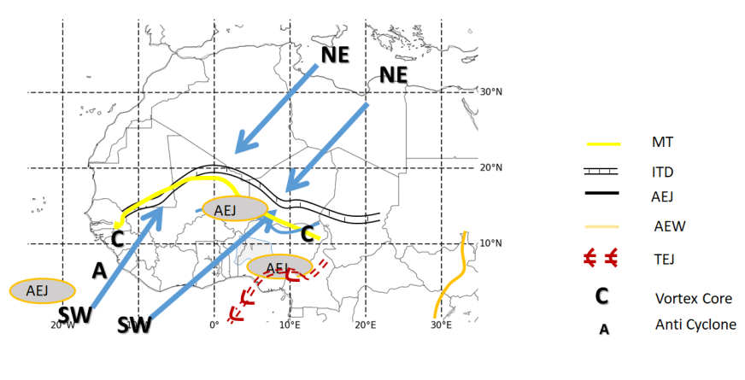
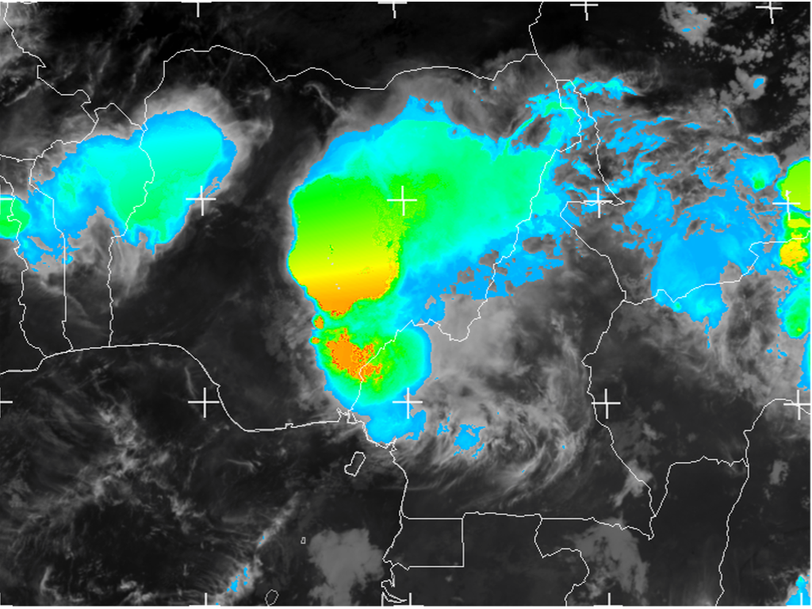
Introduction
Recognized Need/Gap
In recent times, reading, writing, and alternate-to-practical are becoming the traditional way for students to learn. However, studies have revealed that the best way to learn and build capabilities is to adopt hands-on learning strategies which are project-based and case-based [1] [2] [3] [4] [5].
Therefore, to help trainees’ (forecasters’) with limited practical experience, case studies with a range of complexities have been developed.
Cases were developed from the research output from the Global Challenges Research Fund African SWIFT (Science for Weather Information and Forecasting Techniques) project led by the National Centre for Atmospheric Science (NCAS) based at the University of Leeds, UK.
A workbook (for online use) containing guidelines, activities and exercises on the "diagnosis of West African Synthetic Analysis (WASA) features is currently being developed. (first of its kind at RTC, Nigeria)
WASA features are dynamic synoptic weather features (such as heat low, ITD, African Easterly Jets, or Monsoon troughs) over West Africa.
Feedback from the workplace shows that more than 70% of the students finds it difficult to integrate themselves quickly into operational tasks and duties at the forecast offices in Nigeria.
The way practical is currently being conducted at RTC Nigeria is somewhat traditional and tends to limit trainees' (forecasters') ability to build practical skill sets necessary for the workplace. This is believed to be responsible for the gap.
Traditional, in this instance refers to the daily hand-analysis of weather charts which is believed to be rigorous, time-consuming, and does not make full use of the available NWP.
Hence, the need for an improved, hands-on learning approach. This study offers a case-based learning approach.
Description of Innovation
Figure 1.0 WASA Features courtesy SWIFT
Figure 1.1 EUMETSAT

Slide 3
Greatest benefits of the innovation
The innovation improved pedagogical approach used to develop trainees' competencies and capabilities in the workplace.
It also encourages collaboration in research and education & training, as it is currently playing out with RTC/NiMet, FUTA, KNUST (training centres and Universities), SWIFT & WMO.
Collaboration
Greatest Challenge
WMO – World Meteorological Organization
  Provides leadership and oversight.
NiMet – Nigerian Meteorological Agency
    provides leadership.
    Initiates innovation.
GCRF African SWIFT (UoL, KNUST)
  Involves in the development of case studies.
  Involves in the development of workbook module.
  Provides funding for secondment opportunity to further advance innovation at KNUST, and for publication.
GCRF – Global Challenges Research Fund.
SWIFT - Science for Weather Information and Forecasting Techniques.
UoL – University of Leeds
KNUST – Kwame Nkrumah University of Science & Technology
RTC – Regional Training Centre
FUTA – Federal University of Technology Akure
Inconsistent internet facility to support robust synchronous training.
Development of Asynchronous learning approach is currently on-going.
Short-term Solution

Slide 4
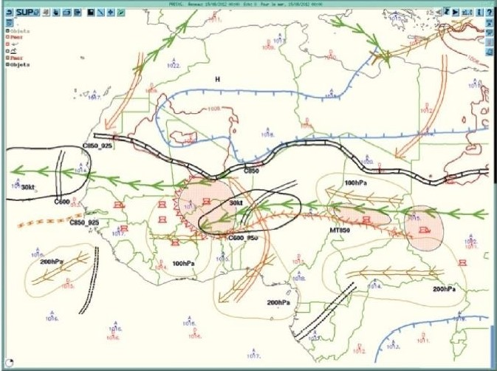
Principles and Theories of West African Synthetic Analysis / Forecast
Parker and Diop-Kane (2017) described synthetic analysis and teleconnections of synoptic features in West Africa as a diagnostic approach that consists of drawing single synthetic maps that summarize all the key features of the West African monsoon analyzed at a given time.
These synthetic maps are named West African synthetic analysis (WASA).
WASA provides a unique and common framework within which forecasters in different West African countries can discuss the current weather situations.
It helps Aeronautical Meteorological Forecasters (AMFs) to capture the main characteristics of the weather situation, and forecast the occurrence of deep convection, dust and the weather over West Africa.
WASA features include – Inter-tropical discontinuity (ITD), Heat low (HL), Mid-level dry air intrusion (MLDI), Sub-tropical jet (STJ), African easterly jet (AEJ), Tropical easterly jet (TEJ), African Easterly Waves (AEW), Monsoon trough (MT) etc.
Figure 1.2 Illustration of the different key features figuring on a WASA/F, for 15 August 2012
at 0000 UTC. [Source: West African Synthetic Analysis and Forecast: WASA/F
(chapter 11)-(Jean Philippe Lafore et al, 2017)].
Drawing rules for identifying WASA features
Lafore et al. (2017, ch 11), explicitly described the rules guiding the drawing of WASA features.
The MARTIN Software is used for easy generation of WASA features from GFS range of products.
MARTIN software was developed as part of the SWIFT project.
Tool for drawing WASA features

Slide 5
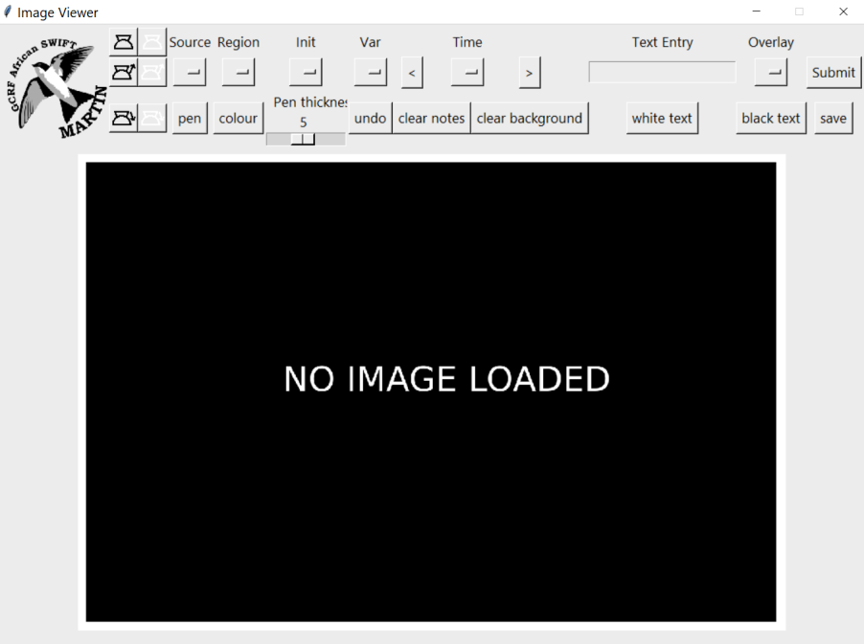
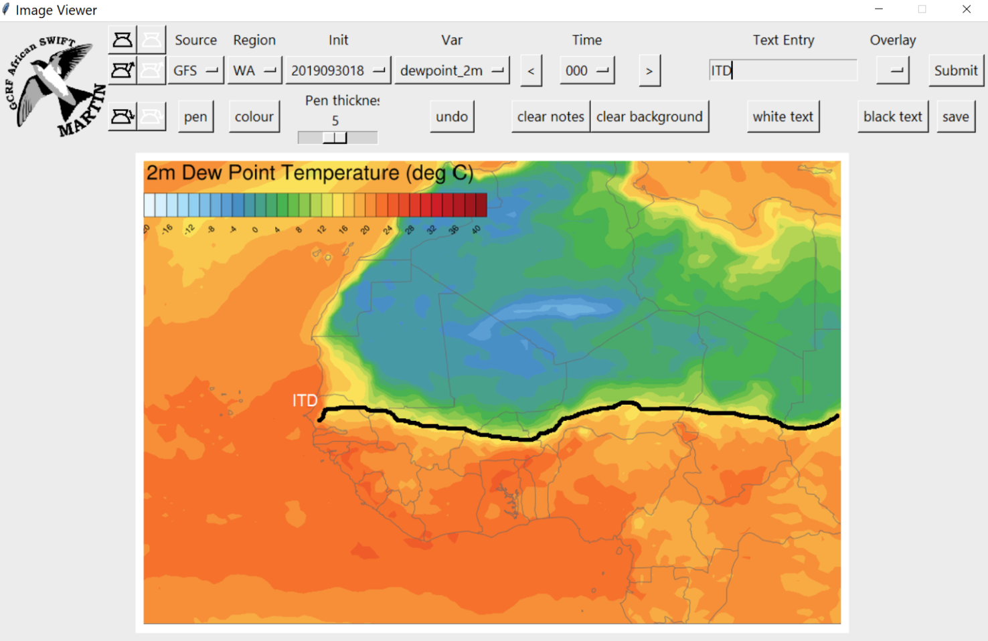
WASA/F Demo on MARTIN
MARTIN Software
(https://github.com/earajr/MARTIN)
Image loaded on MARTIN
ITD identified on MARTIN

Slide 6
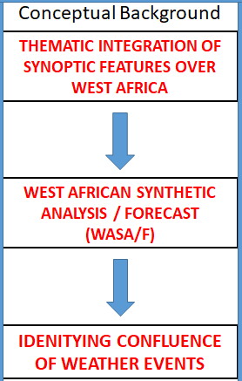
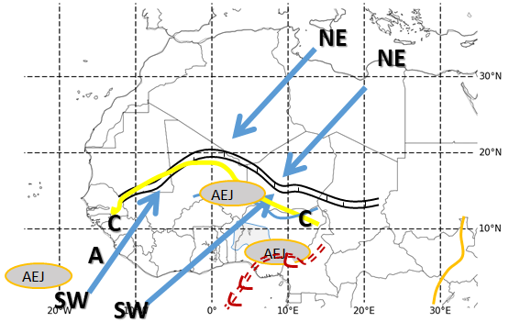
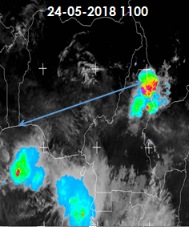


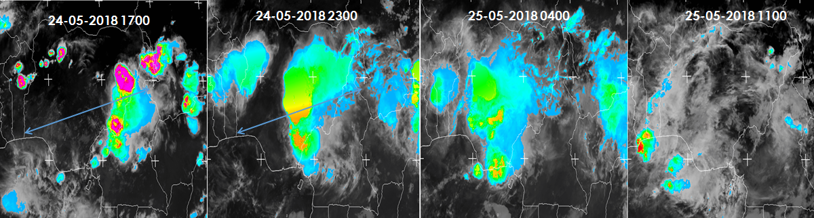
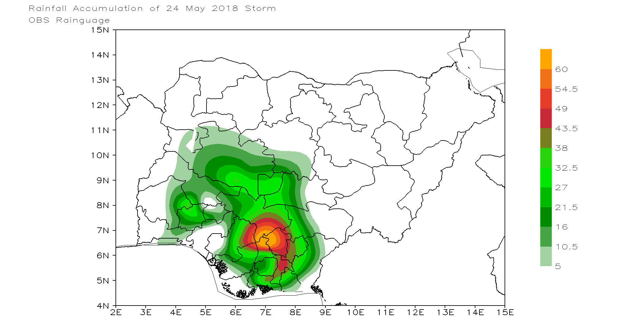
Example
24-05-2018 @1100Z
Clear sky over Nigeria
@1100Z
Eastern Nigeria hit by storm @1700Z
Storm moves towards west, with a southerly component
Storm still ravaging the west and south of Nigeria
Storm cleared 24Hr later
Total precipitation for the entire period
Comment
Clear sky over Nigeria as at the time of observation @1100.
Storms observed at both the entrance and exit of the jet.
Confluence of WASA features – AEJ, MT, AEW, SW, and cyclonic (vortex) suggesting high probability of weather activities (thunderstorms).
Images sourced from GCRF African SWIFT case studies

Slide 7
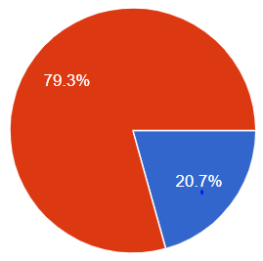

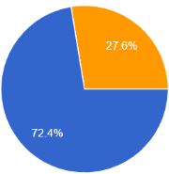

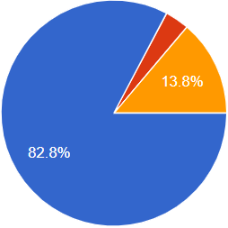

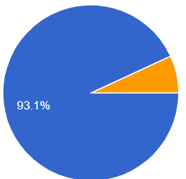

Feedback Analysis
Summary
Data were collected from 50 trainees
New hands-on practical training activities have been developed.
It combines NWP fields with analysis of synoptic structures using simple software.
79% of the trainee forecasters who have successfully completed the course and filled our evaluation form prefers case-based learning approach to traditional approach. Of these, 72% are from Nigeria, while others are from The Gambia.
82% out of the 79% strongly agreed that case studies show how the understanding of the synoptic drivers aids in the forecasting of high impact weather and prepare them better for the task of an Aeronautical Meteorological Forecaster (AMF).
Overall, 93% recommended the continuation of a case-based learning approach.
Link to evaluation form
https://forms.gle/trfkumKxh3jz2eVq7
Figure 2.0 Percentage of trainee forecasters who preferred case-based learning approach to traditional approach.
Figure 2.1 Percentage of trainee forecasters who agreed that case-based approach prepared them for the task of an AMF.
Figure 2.2 Percentage of trainee forecasters who recommended the continuation of case-based learning approach.

Slide 8
Bibliography
[1] WMO (2013). Guidelines for Trainers in Meteorological, Hydrological and Climate Services 1114: 32 – 39.
[2] Joseph, S. K. and Phyllis, C. B. (2006). 19 Project-based learning: The Cambridge Handbook of the Learning Sciences. R. Keith Sawyer (Ed), Cambridge University Press.
[3] Stephanie B. (2010). Project-Based Learning for the 21st Century: Skills for the Future, The Clearing House: A Journal of Educational Strategies, Issues and Ideas, 83:2, 39-43, DOI: 10.1080/00098650903505415
[4] WMO resources for trainers (2019). Learning strategies, Version 1.0
[5] WMO resources for trainers (2019). Selecting learning strategies, Version 1.1
Lafore JP, Chapelon N, Beucher F, Diop-Kane M, Gaymard A, Kassimou A, Lepape S, Mumba Z, Orji B, Osika D, Parker DJ, Poan E, Razafindrakoto LG, Vincendon JC. 2017. West African Synthetic Analysis and Forecast: WASA/F. In: Parker DJ; Diop-Kane M (eds.) Meteorology of Tropical West Africa: The Forecasters' Handbook. Chichester, UK: John Wiley & Sons, Ltd, pp. 423-451. https://doi.org/10.1002/9781118391297.ch11
Parker DJ; Diop-Kane M (eds.) 2017. Meteorology of Tropical West Africa: The Forecasters' Handbook. Chichester, UK: John Wiley & Sons, Ltd. DOI:10.1002/9781118391297

Slide 9
THANK YOU FOR LISTENING

