Slide 1
Leadership and Management Workshop for Senior Management of
RA III and IV Caribbean Members
Fundamentals of negotiation
Dr. Arlene Laing and Rodney Martinez
Port of Spain, Trinidad and Tobago
1-5 December 2025

Slide 2

Fundamentals of Negotiation
Key principles for effective communication and agreement
Notes:
---

Slide 3
Introduction to Negotiation
Notes:
What is Negotiation?, Key Principles of Negotiation

Slide 4

What is Negotiation?
Definition of Negotiation
  Negotiation is a strategic dialogue aimed at reaching mutually acceptable agreements through communication and compromise.
Scope and Importance
  Negotiation is essential beyond business, playing a vital role in everyday conflict resolution and relationship building.
Key Elements
  Successful negotiation requires preparation, clear goals, adaptability, trust, and collaboration between parties.
Benefits of Negotiation
  Effective negotiation enhances influence, protects interests, and contributes to positive, sustainable outcomes for all.
Notes:
Negotiation is a strategic dialogue between two or more parties aimed at reaching a mutually acceptable agreement. It involves communication, compromise, and problem-solving to resolve differences and achieve objectives. Negotiation is not limited to business transactions; it plays a vital role in everyday life, from resolving conflicts at home to securing deals in professional settings. Understanding negotiation helps individuals build stronger relationships, avoid unnecessary disputes, and create value for all parties involved. It is a process that requires preparation, clarity of goals, and adaptability to changing circumstances. Effective negotiation fosters trust and collaboration, ensuring that agreements are sustainable and beneficial for everyone. By mastering negotiation fundamentals, individuals can enhance their influence, protect their interests, and contribute to positive outcomes in diverse scenarios.

Slide 5
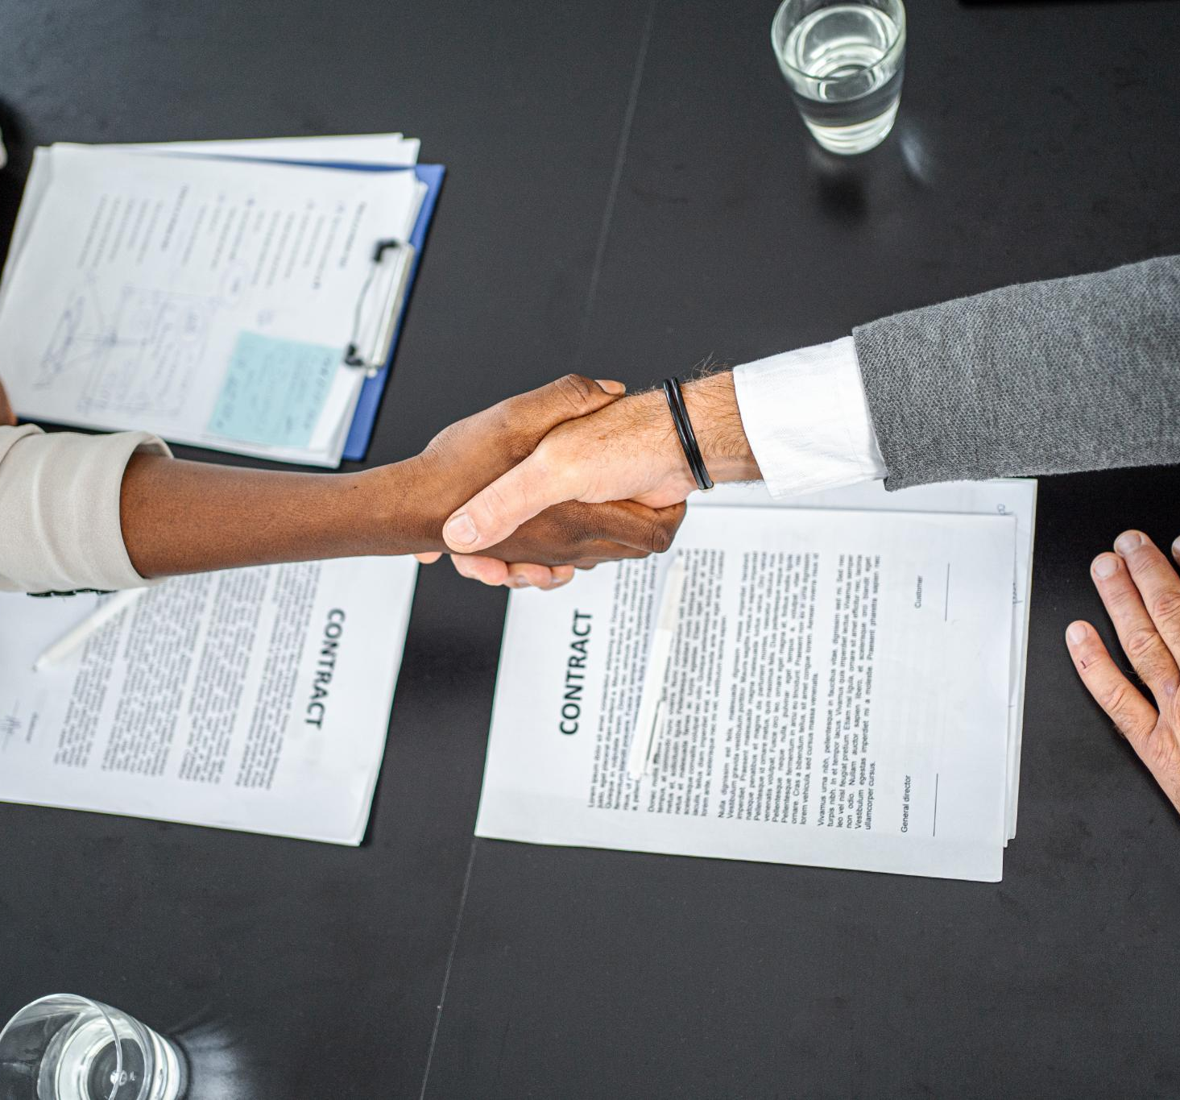
Key Principles of Negotiation
Win-Win Mindset
  A win-win approach focuses on solutions that satisfy mutual interests, creating value for both parties.
Communication and Trust
  Transparency and honesty build trust, encouraging cooperation throughout the negotiation process.
Flexibility and Creativity
  Being open to alternative solutions and creative problem-solving enhances negotiation outcomes.
Preparation and Ethics
  Understanding objectives, anticipating challenges, and maintaining integrity ensures successful negotiations.
Notes:
The core principles of negotiation revolve around creating value and maintaining relationships. A win-win mindset is essential, where both parties seek solutions that satisfy mutual interests rather than focusing on zero-sum outcomes. Communication and trust form the foundation of successful negotiations, as transparency and honesty encourage cooperation. Another principle is flexibility—being open to alternative solutions and creative problem-solving. Negotiators should also prioritize interests over positions, meaning they should understand the underlying needs rather than rigid demands. Ethical behavior is critical, as integrity ensures long-term credibility and prevents conflicts. Finally, preparation is a guiding principle: knowing your objectives, understanding the other party’s perspective, and anticipating challenges can significantly improve negotiation outcomes.

Slide 6
Types and Processes of Negotiation
Notes:
Types of Negotiation, The Negotiation Process

Slide 7

Types of Negotiation
Distributive Negotiation
  Distributive negotiation involves dividing fixed resources, resulting in one party's gain and another's loss, common in competitive bidding.
Integrative Negotiation
  Integrative negotiation focuses on collaboration to create value and achieve win-win outcomes through shared interests and creative solutions.
Choosing Strategies
  Understanding negotiation types helps select appropriate strategies based on goals, context, and relationship nature.
Notes:
Negotiation can be categorized into two primary types: distributive and integrative. Distributive negotiation, often called win-lose, involves dividing a fixed amount of resources, where one party’s gain is another’s loss. This approach is common in price bargaining or competitive bidding. Integrative negotiation, on the other hand, focuses on collaboration and creating value for all parties. It seeks win-win outcomes by exploring shared interests and generating creative solutions. Integrative negotiations often involve long-term relationships and emphasize trust and cooperation. Understanding these types helps negotiators choose appropriate strategies based on context, goals, and the nature of the relationship between parties.

Slide 8

The Negotiation Process
Five Key Stages
  Negotiation involves preparation, discussion, bargaining, closing, and implementation stages.
Preparation & Discussion
  Preparation includes researching and setting goals; discussion focuses on exchanging information and building rapport.
Bargaining & Closing
  Bargaining entails proposals and compromises; closing ensures agreement clarity and mutual understanding.
Implementation & Success
  Implementation monitors commitment fulfillment, increasing chances of successful negotiation outcomes.
Notes:
The negotiation process typically follows five stages: preparation, discussion, bargaining, closing, and implementation. Preparation involves researching, setting objectives, and identifying priorities. Discussion is the stage where parties exchange information, clarify interests, and establish rapport. Bargaining is the core phase where proposals are made, concessions are considered, and compromises are reached. Closing formalizes the agreement, ensuring clarity and mutual understanding. Finally, implementation ensures that commitments are honored and monitored. Each stage requires specific skills, such as active listening during discussion and strategic thinking during bargaining. A structured approach to these stages increases the likelihood of successful outcomes and minimizes misunderstandings.

Slide 9
Strategies and Skills for Effective Negotiation
Notes:
Preparation Strategies, Communication Skills

Slide 10

Preparation Strategies
Thorough Research
  Effective negotiation starts with deep research on the subject, parties involved, and alternatives available.
Clear Objectives and BATNA (which stands for "Best Alternative to a Negotiated Agreement)," is your backup plan—the most favorable option you can pursue if a current negotiation fails. Setting clear goals and defining your BATNA builds confidence and leverage during negotiation.
Understanding Positions vs Interests
  Recognizing the difference between stated demands and underlying needs helps tailor negotiation approach.
Anticipating Objections and Logistics
  Planning responses to objections and managing timing and setting reduces surprises and uncertainty.
Notes:
Preparation is the cornerstone of effective negotiation. It begins with thorough research about the subject matter, the other party’s interests, and potential alternatives. Setting clear objectives and defining your BATNA (Best Alternative to a Negotiated Agreement) provides leverage and confidence during discussions. Understanding the difference between positions and interests is crucial; positions are stated demands, while interests reflect underlying needs. Anticipating objections and planning responses can prevent surprises and strengthen your stance. Preparation also includes logistical considerations, such as choosing the right time and setting for the negotiation. A well-prepared negotiator demonstrates professionalism, reduces uncertainty, and increases the chances of achieving favorable outcomes.

Slide 11

Communication Skills
Active Listening
  Active listening helps understand perspectives and builds trust in negotiations.
Open-Ended Questions
  Asking open-ended questions encourages dialogue and reveals valuable insights.
Non-Verbal Cues
  Body language and tone convey confidence or empathy, shaping negotiation atmosphere.
Emotional Intelligence
  Emotional intelligence helps manage stress and respond calmly during challenges.
Notes:
Communication is the lifeblood of negotiation. Active listening ensures that you understand the other party’s perspective and build trust. Asking open-ended questions encourages dialogue and reveals valuable information. Non-verbal cues, such as body language and tone, can convey confidence or empathy, influencing the negotiation atmosphere. Clear and concise articulation of your points prevents misunderstandings and demonstrates credibility. Emotional intelligence plays a vital role in managing stress and responding calmly to challenges. Effective communicators also know when to pause, allowing space for reflection and reducing tension. Mastering these skills creates a collaborative environment and facilitates agreements that satisfy all parties.

Slide 12
Tactics, Challenges, and Key Takeaways
Notes:
Common Tactics and Overcoming Challenges, Summary and Key Takeaways

Slide 13
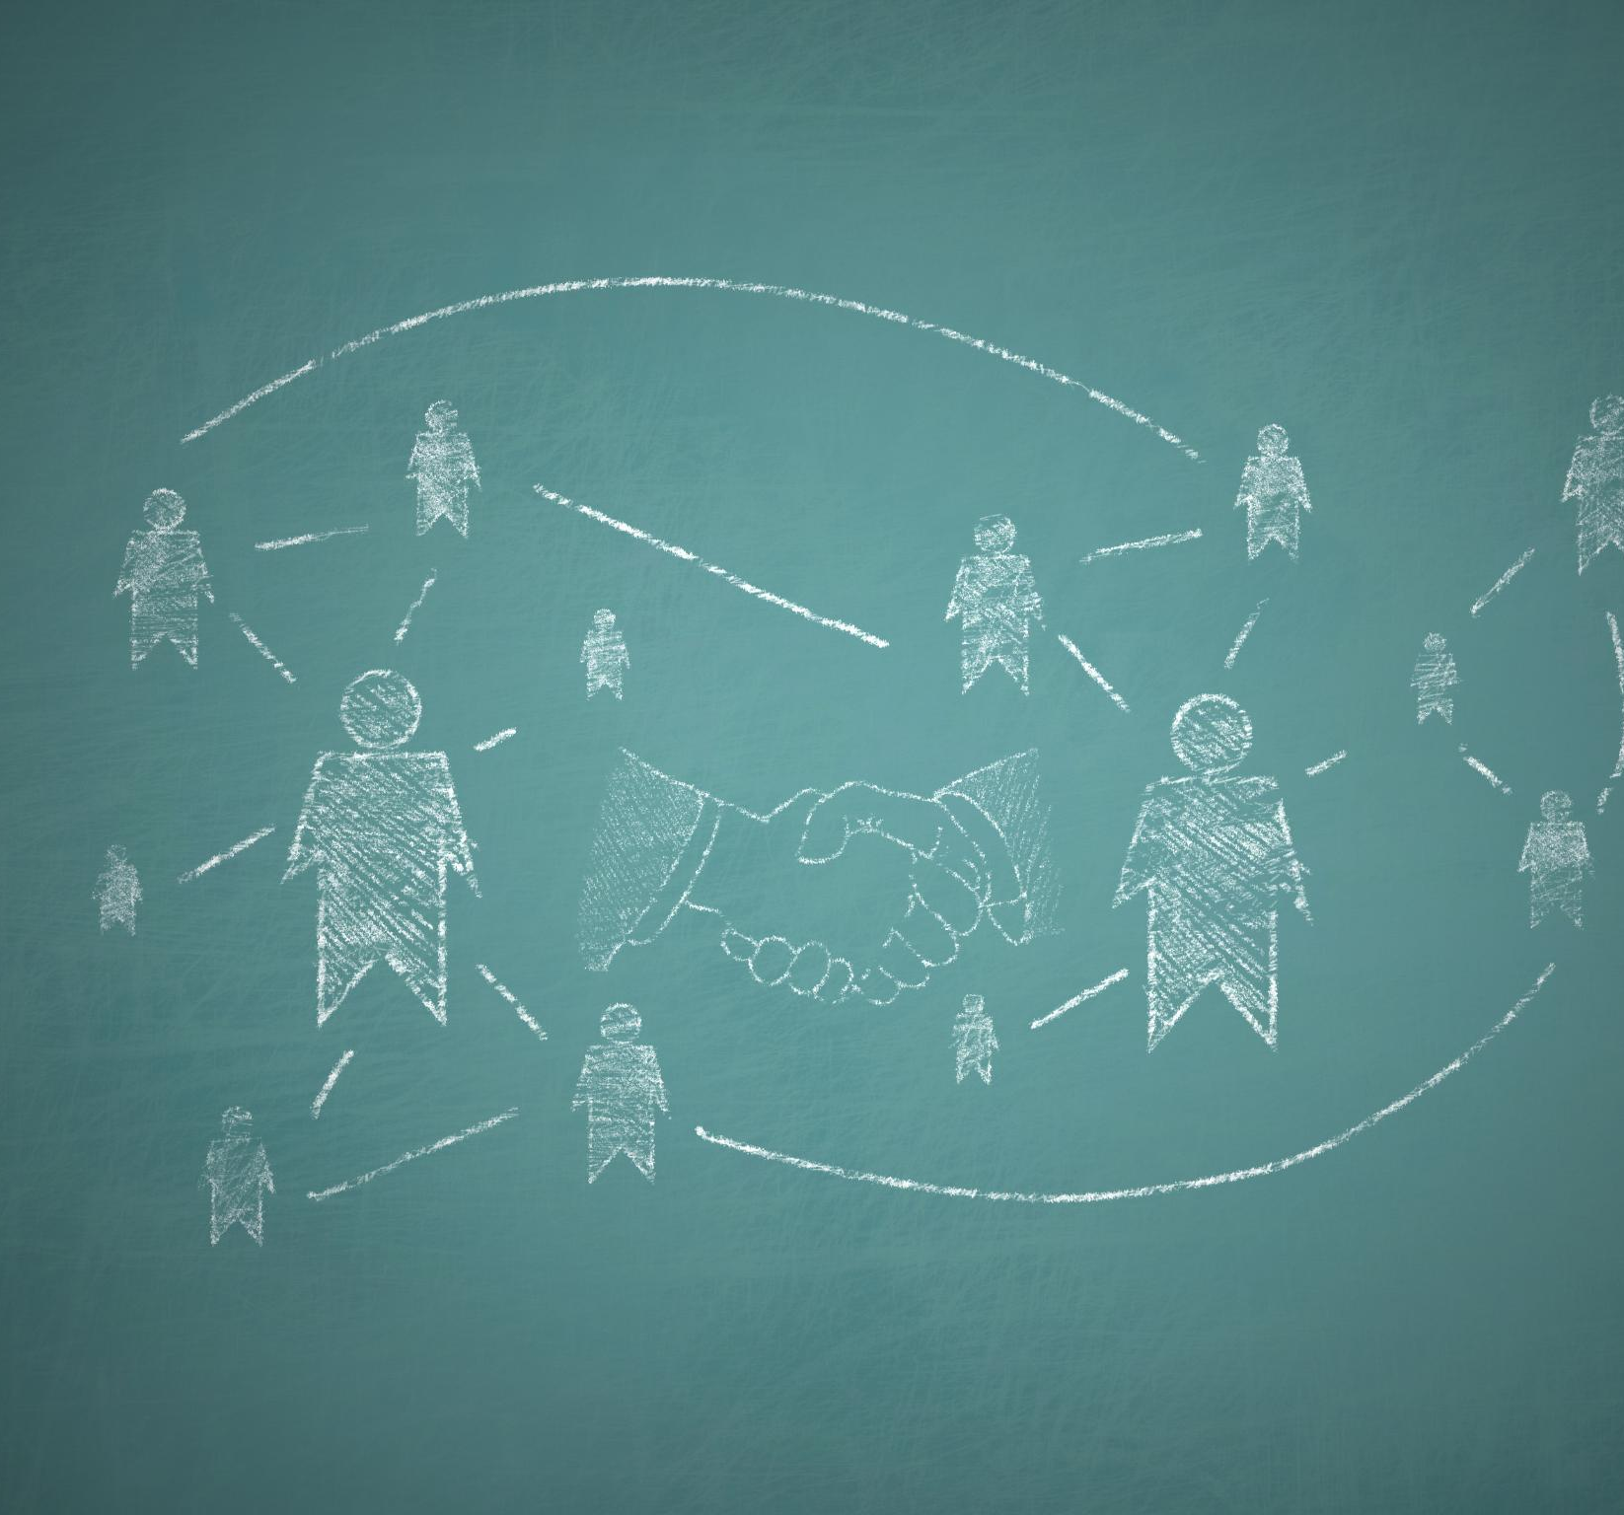
Common Tactics and Overcoming Challenges
Negotiation Tactics
  Common tactics include anchoring offers, leveraging BATNA, and making strategic concessions to build goodwill.
Handling Conflict
  Managing conflict requires patience, empathy, and reframing issues to focus on shared interests, not positions.
Managing Emotions
  Emotional management demands self-awareness and professionalism to maintain control under negotiation pressure.
Cultural Sensitivity
  Awareness of cultural differences and communication styles is essential for effective and respectful negotiations.
Notes:
Negotiators often use tactics such as anchoring, where an initial offer sets the tone for subsequent discussions, and leveraging BATNA to strengthen their position. Concessions are another tactic, where small compromises are made strategically to build goodwill or achieve larger goals. However, challenges such as conflict, emotional reactions, and cultural differences can derail negotiations. Handling conflict requires patience, empathy, and reframing issues to focus on interests rather than positions. Managing emotions involves self-awareness and maintaining professionalism under pressure. Cultural considerations demand sensitivity to different norms and communication styles. Overcoming these challenges ensures that negotiations remain constructive and lead to sustainable agreements.

Slide 14

Summary and Key Takeaways
Core Negotiation Skills
  Negotiation blends strategy, communication, and adaptability to achieve successful outcomes.
Preparation and Trust
  Effective preparation and fostering trust are vital for reaching win-win agreements.
Communication Techniques
  Active listening and clear articulation build rapport and resolve conflicts in negotiation.
Ethics and Flexibility
  Ethical practices and flexibility help negotiators find balanced solutions for all parties.
Notes:
Negotiation is a critical skill that combines strategy, communication, and adaptability. Key takeaways include the importance of preparation, understanding interests, and fostering trust. Effective negotiators aim for win-win outcomes, use ethical practices, and remain flexible in finding solutions. Communication skills, such as active listening and clear articulation, are essential for building rapport and resolving conflicts. Recognizing common tactics and preparing for challenges enhances confidence and success. Ultimately, negotiation is not about winning at all costs but about creating agreements that satisfy all parties and strengthen relationships. Continuous learning and practice ensure that these skills evolve and remain relevant in diverse contexts.

Slide 15
Thank you!

