Slide 1
Leadership and Management Workshop for Senior Management of
RA III and IV Caribbean Members
Leveraging WMO, UN and Cooperation Framework
Laura Paterson and Rodney Martinez
Port of Spain, Trinidad and Tobago
1-5 December 2025

Slide 2

How UNSDCF Supports SDGs and How UNCT Implements It
Collaborative frameworks advancing global sustainable development goals
Notes:
---

Slide 3

UN SUSTAINABLE DEVELOPMENT COOPERATION FRAMEWORK
(UNSDCF)
What Is the UNSDCF?
The UN’s primary planning and partnership framework for development cooperation at country level
Fully aligned with the 2030 Agenda and Sustainable Development Goals
Co-created with government and rooted in national priorities
Guides the collective work of all UN agencies in the country.
Often includes identified financiers
Notes:
1. Power is dispersing — not just shifting
The U.S.-led unipolar moment is over, but we’re not in a simple U.S.–China bipolar world either.
Instead, we have a “multiplex” world, with several consequential powers:
China (global economic + regional military power)
India (demographic + economic rise)
EU (regulatory + economic power, fragmented politically)
Middle powers (Turkey, Saudi Arabia, UAE, Brazil, South Africa, Indonesia) acting more independently
Non-state actors (tech giants, cyber groups) influencing global outcomes
This dispersal of power is itself a kind of reset.
2. Alliances and blocs are being reconfigured
Traditional alliances (NATO, U.S.–Japan, U.S.–Korea) are strengthening, but many regions are realigning:
Russia and China are closer than at any point since the 1950s.
Gulf states are pursuing “strategic hedging,” balancing U.S., China, and Russia.
Africa is seeing a recompetition between the West, China, Russia, and increasingly Gulf states.
Countries no longer fit neatly into “aligned” or “non-aligned.” They are acting transactionally.
3. Economic globalization has fractured into blocs
We are entering an era of geo-economic fragmentation:
Supply chains are being re-shored or “friend-shored.”
The U.S. and China are decoupling in critical sectors: chips, AI, rare earths, green tech.
The dollar’s dominance is challenged — not replaced — but diversified around the edges.
This is a reset from “globalization as default” to “globalization if secure.”
4. Technology is now a geopolitical battlefield
AI, semiconductors, biotech, quantum, and space systems are the new strategic territory.
For the first time, tech companies, not states, own much of the critical infrastructure that defines national power.
The AI race is altering alliances, trade, and military planning simultaneously.
5. Conflict is returning to major-power politics
We see simultaneous, interlinked conflicts — something unusual in the post-Cold-War era:
Ukraine
Middle East
The Red Sea and maritime chokepoints
South China Sea
Nagorno-Karabakh, Sudan, Sahel states
Taiwan tension steadily rising
None is isolated; each interacts with great-power competition.
6. The global governance system is struggling
UN, WTO, IMF, and World Bank structures reflect the power balance of 1945–1990, not 2025.
Reform has stalled, so parallel systems have emerged:
BRICS+
Belt and Road Initiative
Regional development banks
Alternative payments systems
This is another sign of systemic reset.
war: 1594
minister: 270
climate: 689
development: 1200
rights: 682
security: 1288
environment: 203

Slide 4

Foundational Principles
Leave No One Behind
  Prioritize marginalized and vulnerable groups to ensure inclusiveness in all interventions and programs.
Human Rights-Based Approach
  Programs uphold international human rights standards promoting equality and justice for all people.
Gender Equality and Empowerment
  Integrate gender equality and women’s empowerment as critical factors for sustainable development success.
Resilience and Sustainability
  Ensure development gains are protected from shocks like climate change and economic crises.
Notes:
---
This slide references information from the following file: https://eu-prod.asyncgw.teams.microsoft.com/v1/objects/0-neu-d5-2a4b4a495e18d06a3efe247918df5aad/views/original/roadmap_workflow.pptx,https://eu-prod.asyncgw.teams.microsoft.com/v1/objects/0-neu-d9-ca8a1d0662e5e96f668c8fe416da7ac1/views/original/roadmap_meteorological_service.pptx
The UNSDCF is guided by several foundational principles that ensure its effectiveness and inclusivity. The principle of Leave No One Behind (LNOB) is central, requiring that all interventions prioritize the most marginalized and vulnerable populations. A human rights-based approach ensures that programs uphold international human rights standards and promote equality and justice. Gender equality and women’s empowerment are integrated throughout the framework, recognizing their critical role in achieving sustainable development. Additionally, the UNSDCF emphasizes resilience and sustainability, ensuring that development gains are protected against shocks such as climate change and economic crises. These principles are operationalized through participatory processes, where governments, civil society, and other stakeholders are actively engaged in designing and implementing programs. By embedding these principles, the UNSDCF ensures that UN support is not only effective but also equitable and transformative.

Slide 5
Why the UNSDCF Matters?
Ensures coherence of the entire UN System
Strengthens alignment with national development plans
Focuses on long-term, measurable development outcomes
Helps mobilize partnerships and financing
Promotes accountability and transparency

Slide 6
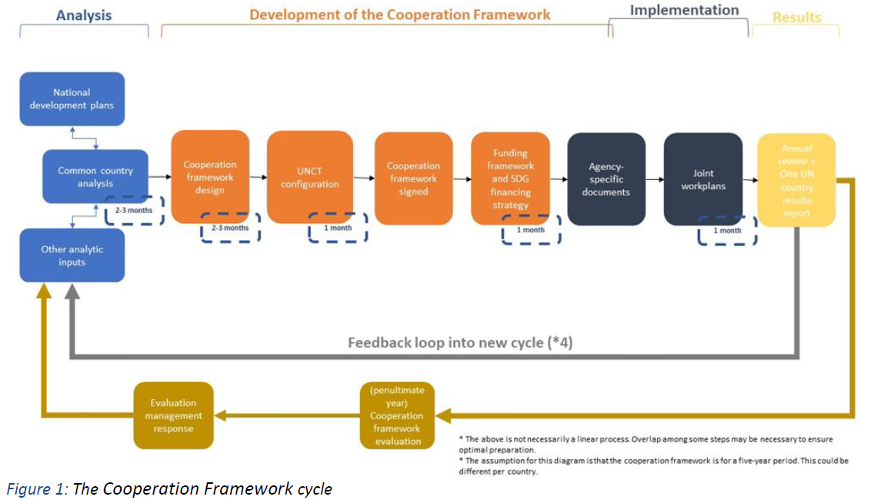
UNSDCF Development Process
Common Country Analysis (CCA): Evidence-based assessment conducted by UN, consulted with Government.
UNSDCF designed with Government. Strategic Priorities agreed with Government
Theory of Change: How UN support leads to national outcomes
Validation & Signature: With Government and UN leadership

Slide 7
The Common Country Analysis (CCA)
Created by the UN, consulted with the government
Examines:
Development challenges & gaps
Inequalities & vulnerabilities
Root causes and structural barriers
SDG progress & data landscape
Basis for prioritization in the UNSDCF

Slide 8
Financing the UNSDCF
Integrated financing approach
Sources include:
  Government budgets
  UN Agency core resources
  Multi-partner trust funds
  Bilateral donors
  International financial institutions
  Private sector & philanthropic actors
Links to national financing strategies

Slide 9
Key considerations for NMHS
NMHSs need to be fully involved in the UNSDCF development process.
It is highly recommended that PRs keep a proactive interaction with the UN Resident Coordinator.
Since NMHSs contribute to several SDGs, is critical that NMHSs needs are well reflected in CCA and the prioritization leaded by the Government.
The timely and adequate inclusion of NMHSs in UNSDCF, increase the possibility of resources mobilization and active involvement in projects related to EWS, climate services to support adaptation and climate resilience

Slide 10
Resident Coordinators in the Caribbean
UNCT | Resident Coordinator | Counties of responsibility
Barbados (Multi-Country Office) | Simon Springett BIO ANNOUNCEMENT | Also covers Anguilla, Antigua & Barbuda, British Virgin Islands, Dominica, Grenada, Montserrat, St Kitts & Nevis, St Lucia, St. Vincent & the Grenadines
El Salvador (Multi-Country Office) | Raul Salazar BIO ANNOUNCEMENT | Also covers Belize
Guyana | Jean Njeri Kamau - BIO ANNOUNCEMENT
Jamaica (Multi-Country Office) | Dennis Zulu BIO. ANNOUNCEMENT | Also covers Bahamas, Bermuda, Cayman Islands, and Turks and Caicos
Trinidad & Tobago (Multi-Country Office) | Joanna Kazana-Wisniowiecki BIO ANNOUNCEMENT | Also covers Aruba, Curacao, Suriname and St Maarten

Slide 11
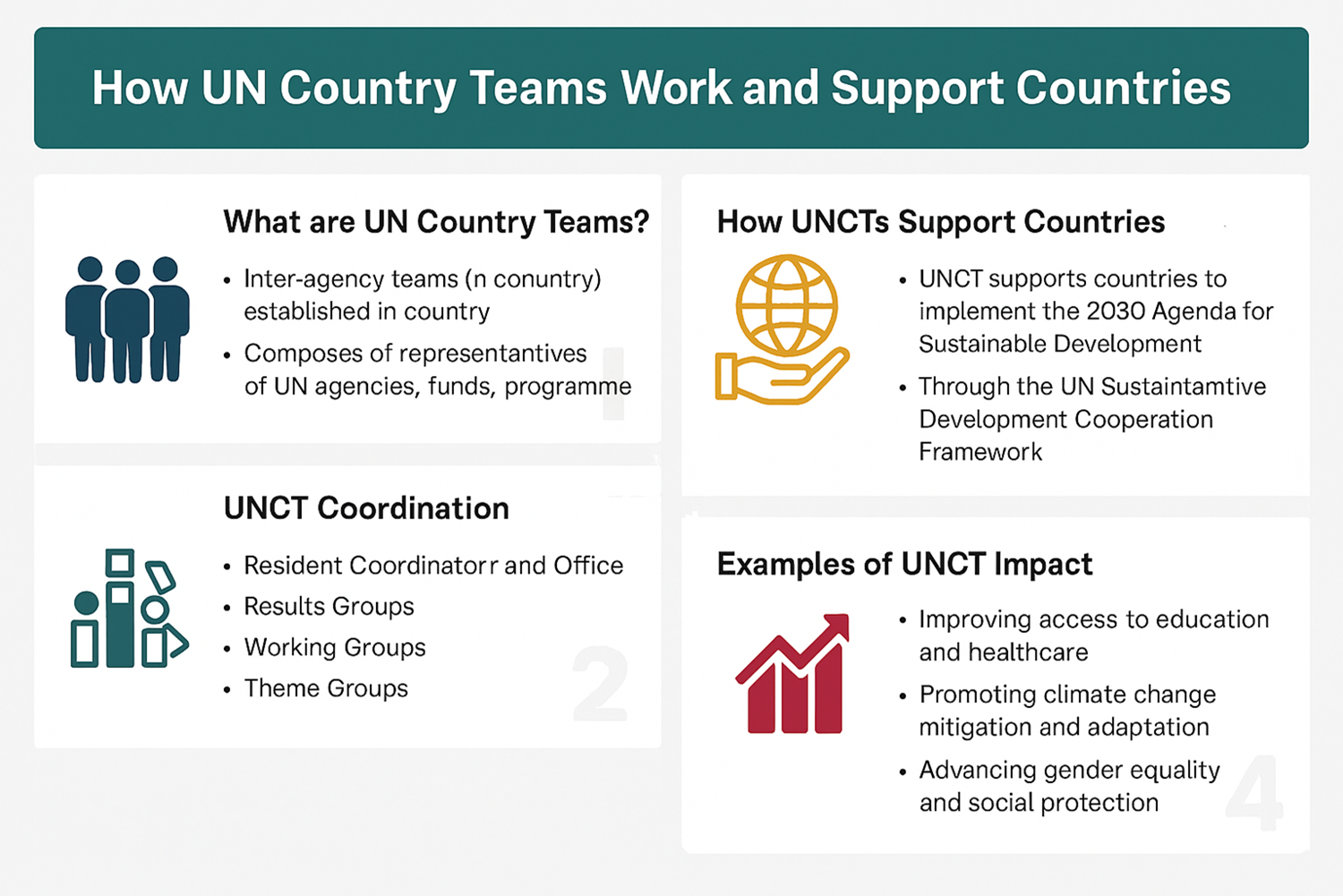

Slide 12
UN Country Team (UNCT) Configuration
UN Agencies, Funds & Programmes supporting outcomes
Each agency contributes based on comparative advantage
Coordination through:
Resident Coordinator
Results Groups
Programme Management Team
UNCT operates as One UN

Slide 13
Recognised Challenges and UN80
System-wide evaluation on progress towards a new generation of United Nations Country Teams Report (2025)
Recognised challenges for ‘non-resident agencies’
UN80 includes work packages to help address this
  Expertise-on-demand
  Thematic hubs
  Regional reset
To be considered in our own regional reform

Slide 14

Antigua and Barbuda Agenda for SIDS (ABAS)
  10-year plan of Action to catalyze Sustainable Development in SIDS, adopted unanimously 30 May 2024 in St John’s.
  It represents another major agreement on what is needed to achieve sustainable development, and includes items relevant for NMHSs.
  It is important to highlight these connections when engaging politically and mobilizing resources
Strengthen Health Systems by
    c) Enhance prevention, preparedness and response to better cope with health emergencies, epidemics, pandemics and climate change-related health impacts through capacity building, upgrading of surveillance and early warning systems and adapting sustainable infrastructure and equipment so that it is climate-resilient, low greenhouse gas emission and sustainable;
Mainstream Disaster Risk Reduction by
    c) Strengthening disaster preparedness, including multi-hazard early warning systems and capacity to take early action, through initiatives such as the Early Warnings for All (EW4ALL) and the Climate Risk Early Warning Systems (CREWS), timely evacuation planning, planning for relocation of communities, and developing post-disaster needs assessments;

Slide 15
Summary
  UNSD Cooperation Framework is an important document, where the country and the UN, jointly agree on priority areas for development
  Informed by the UN Common Country Analysis, which the UN conducts, in consultation with the country.
  Drives financing priorities for development at the national level.
  The UN Resident Coordinator (RC) and their team, lead and oversees this process.
  It is vital RC’s understand the critical role of your NMHS in supporting the full spectrum of sustainable development, including DRR, climate adaptation, ABAS, and EW4All.

Slide 16
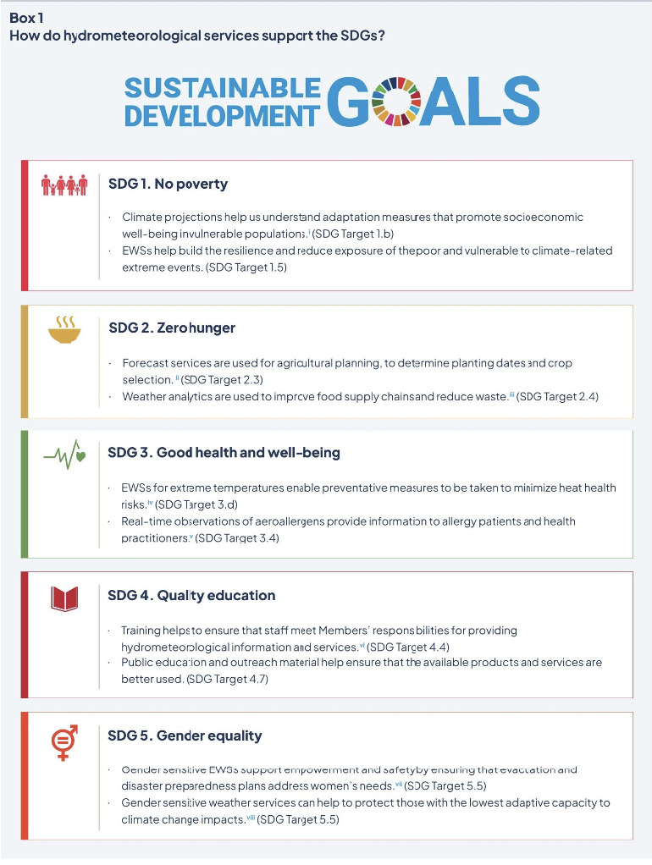
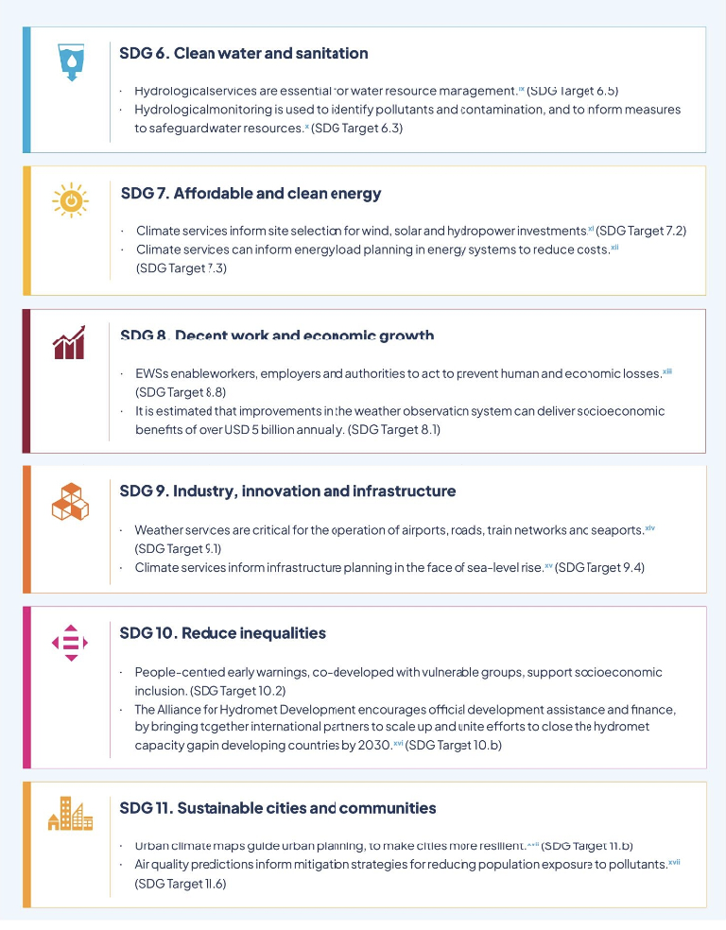
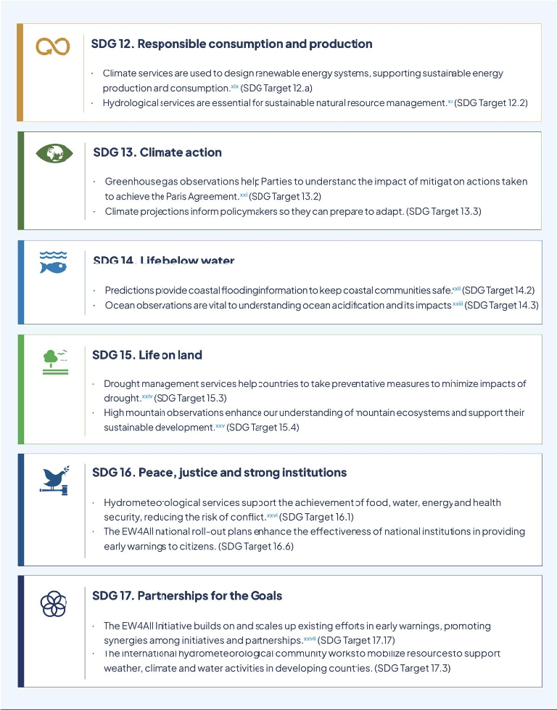
Useful resource: Hydromet Gap Report 2024

Slide 17
Thank you!

