Slide 1
Leadership and Management Workshop for Senior Management of
RA III and IV Caribbean Members
Successful Approaches to Assure Political Support and Sustainable Investment in NMHS
Kenneth Kerr
Port of Spain, Trinidad and Tobago
1-5 December 2025
Notes:
Good morning/afternoon, distinguished delegates and colleagues.
Today, I will be speaking about successful approaches to securing political support and long-term, sustainable investment in National Meteorological and Hydrological Services.
This is not easily done nor straight forward. Not all of us are comfortable to approach a Minister, but there are tools and devices that you can used to bridge the gap, that may have some value for you
What I will speak to , will explore practical strategies that have proven to be effective in moving the needle in correct direction towards strengthening political buy-in in the environment that we operate in
It is absolutely important to understand what resonates within your political enterprise, not only with politicians, but your political enterprise, which is where there is organized effort—aimed at influencing political decisions, shaping public policy, or gaining and maintaining political power, this could even be the media. So lets go.

Slide 2
NMHS Chapeau
Exposure to extreme weather and climate risks makes our NMHSs essential to national security, public safety, disaster readiness, economic stability, and long-term climate planning
To secure political commitment and sustained investment, NMHSs must:
Align — Make sure the NMHS’s work matches the country’s priorities
Prove — Show real value through partnerships and results
Enable — Position the NMHS as essential for climate adaptation, resilience, disaster readiness, and economic stability
HOW DO WE DO THIS?
Notes:
This is your Chapeau, or should be your Chapeau, and entry point to the political support arena that we need.
"exposure to extreme weather and climate risks makes your National Meteorological Services core elements of national security, public safety, governments disaster counter-measures, economic stability, and climate preparedness".
Therefore securing political support and long-term investment requires clearly aligning your NMHSs capabilities with national priorities, YES YES, we said this many times between yesterday and today, so you repeat it until it is believable and become the truth.
You also need to prove your value through sectoral partnerships to position your NMHS as foundational enablers of climate adaptation, climate resilience, disaster preparedness and economic growth.
How do you do this?

Slide 3
1. Position the NMHS as a National Resilience Asset
Key Approaches to Secure
Political Support & Sustainable Investment
Frame the NMHSs work around high-risk climate economy and national goals:
Safeguarding critical infrastructure
Support climate adaptation
Strengthening National Security
Protecting economic sectors (agriculture, water , aviation, maritime)
Have a key message:
We are a frontline defence against climate risk and extreme weather????
Notes:
Based on my experience, to secure long-term support, as Directors, you must position your NMHS a as a national resilience asset, as a core pillar of national resilience—not simply a forecasting and warning provider.
What do I mean by this?
You need to fully embed your NMHS in national climate adaptation strategies, disaster risk reduction frameworks, disaster risk management planning, and national security arrangements.
This seems like a lot of work. Doesn't it.
But because your aim is to move your NMHS from being seen as a technical service to being understood as essential national infrastructure—as critical input for key GDP sectors,
You really need to Frame the NMHSs work around national risks and national goals, such as:
Safeguarding critical infrastructure,
Enabling water security and effective flood management,
Supporting climate adaptation, Strengthening National Security
And Protecting economic sectors
And always have a tag line, that can stand the test of time for example:
We are a frontline defence against climate risk and extreme weather????

Slide 4
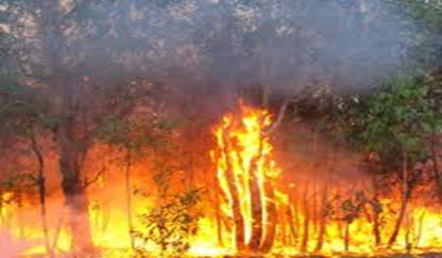
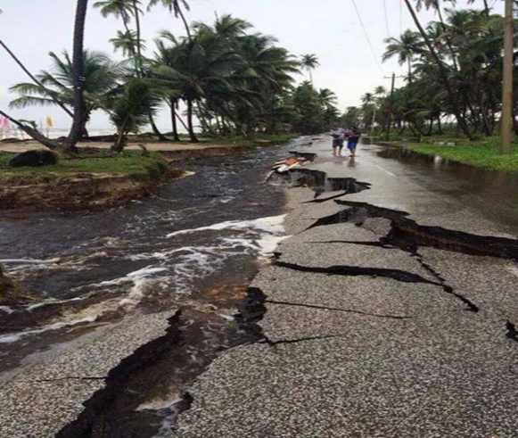
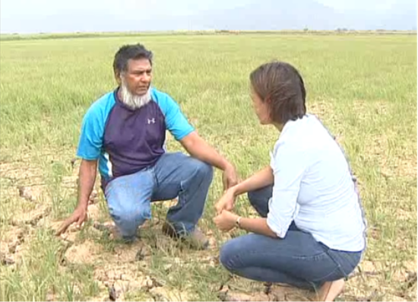
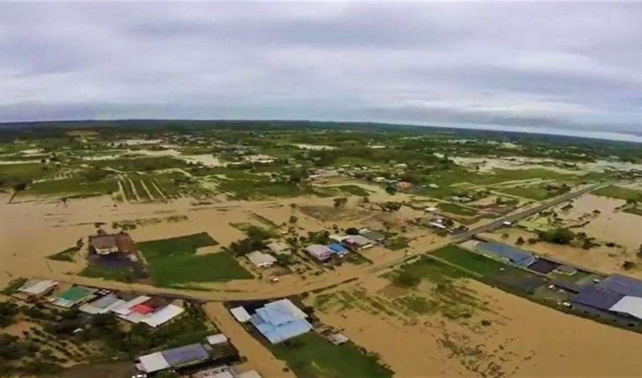
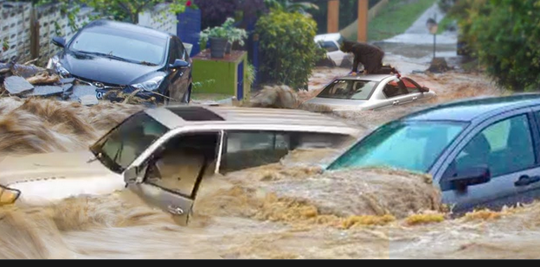
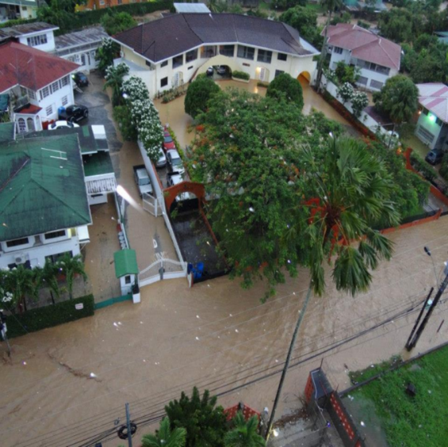
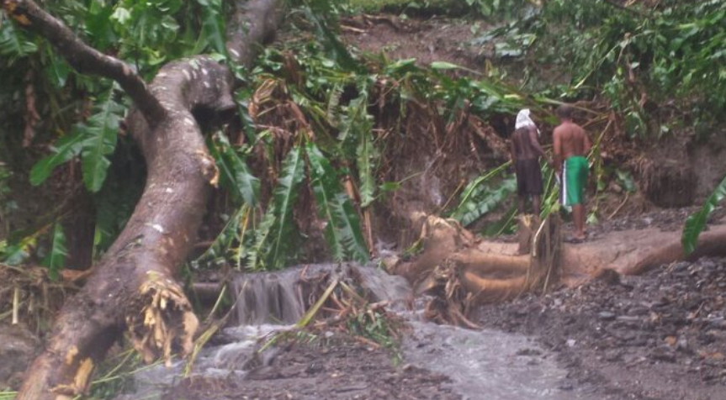
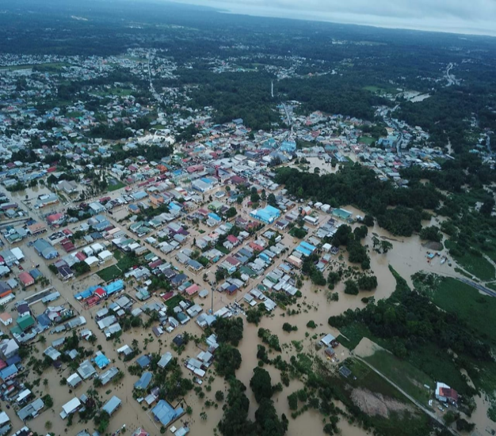
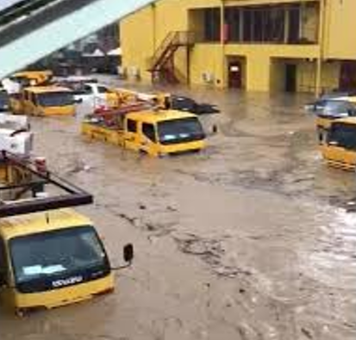

NMHSs Operational Environment
People, Communities, Sectors Face
A CLIMATE CRISIS!
Notes:
But to do that, you First need to demonstrate that your NMHSs is operating in a climate hot spot where impacts driven by climate change across a suite of climate hazards, places your country in a perennial climate crisis.
You need to show that your NMHS operational space is an environment, in which the average cost of climate related disasters and impacts are high in terms of direct economic losses to individuals, general public and government infrastructure
You need to show that vulnerable communities, people housing stocks and climate sensitive sectors including major foreign exchange earners., things that the Prime Minister, Ministers and Politicians care about and pay attention to, are linked to your daily work.

Slide 5
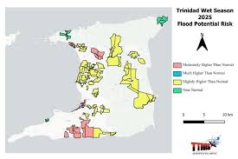


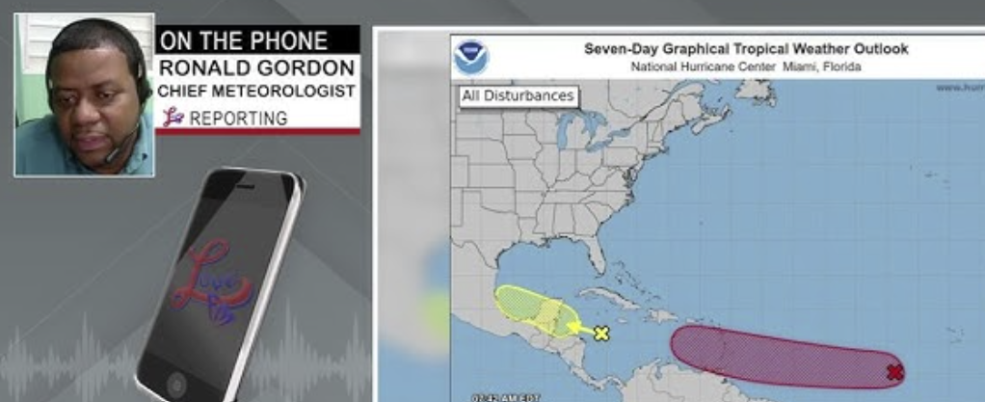
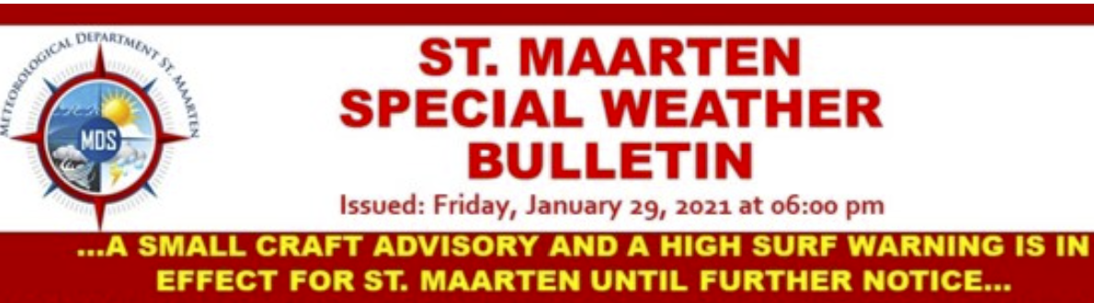
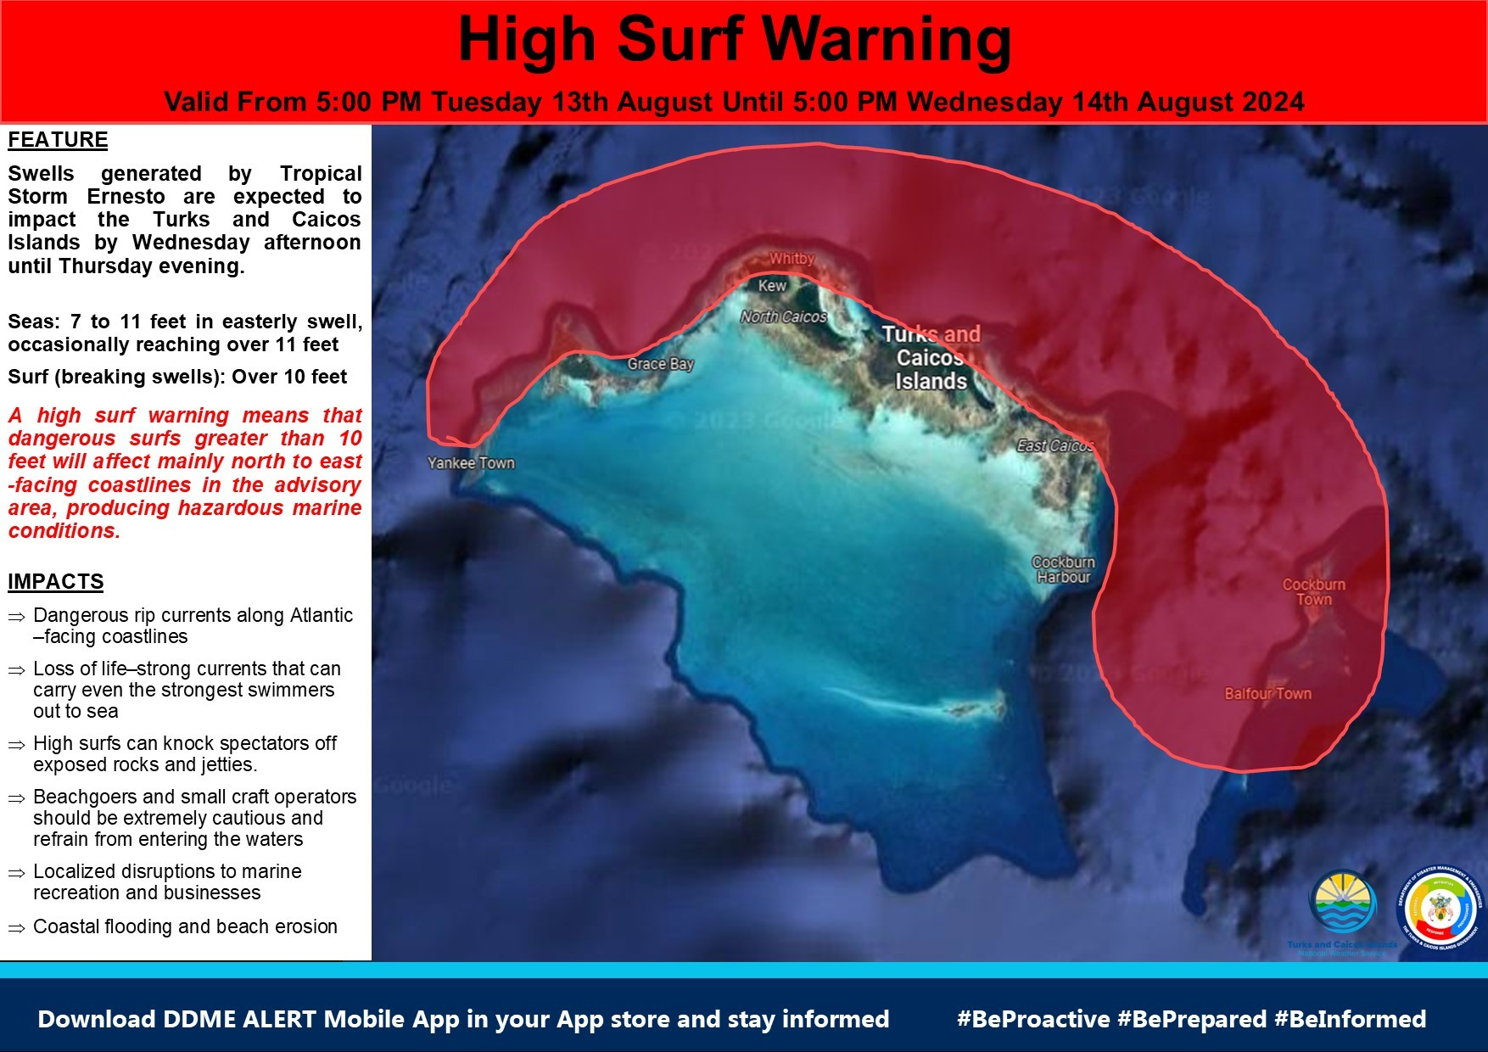
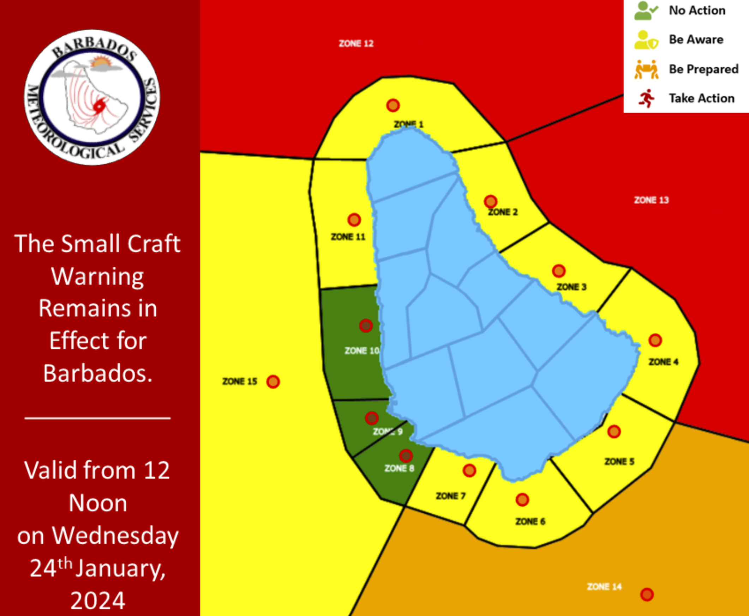
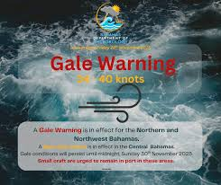
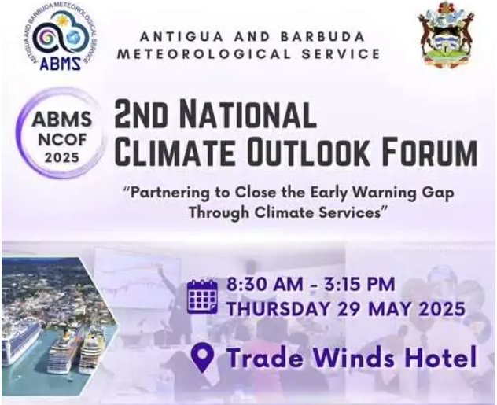
NMHS is Country's First Line of Defence
Your NMHS works at the frontline of these risks. Provide strong evidence that
EWS & climate intelligence reduce economic losses and save lives
Notes:
You need to demonstrate that in this environment, Your NMHS is the country’s first line of defense, as the trigger for early preparedness action, as the trigger for anticipatory action, and the authoritative voice on all things weather, climate and water.
You already know this. Does your Minister or Ministry knows this. Does your PS knows this?
What I am saying is that you need to position or show that Your NMHSs operate like a defensive wall around these hazards, literally as demonstrated on screen, making sure that without you, the losses and damages would be ten-fold.
Provide strong evidence that early warnings and climate intelligence reduce economic losses and save lives
Let me give you an example, one Minister with responsibility public utilities including the Met Office, after 3 to 4years on the job said to us, that he was at a water tank upgrade and opening ceremony on a Saturday and he received a call that flights could not land and that his help was needed.
And he asked why were they calling him, why not call the transport ministry.
He said he was told that it was the Met Office, and he asked what they had to do with this…….then he found out the role the Met Office in the operations of the airport and the safety of aviation operations.
So do not take it for granted that every one knows what you do or where your tentacles connect with their daily jobs or daily activities.

Slide 6
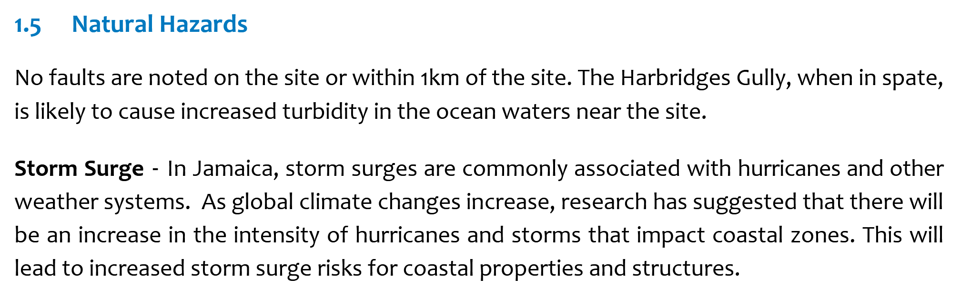
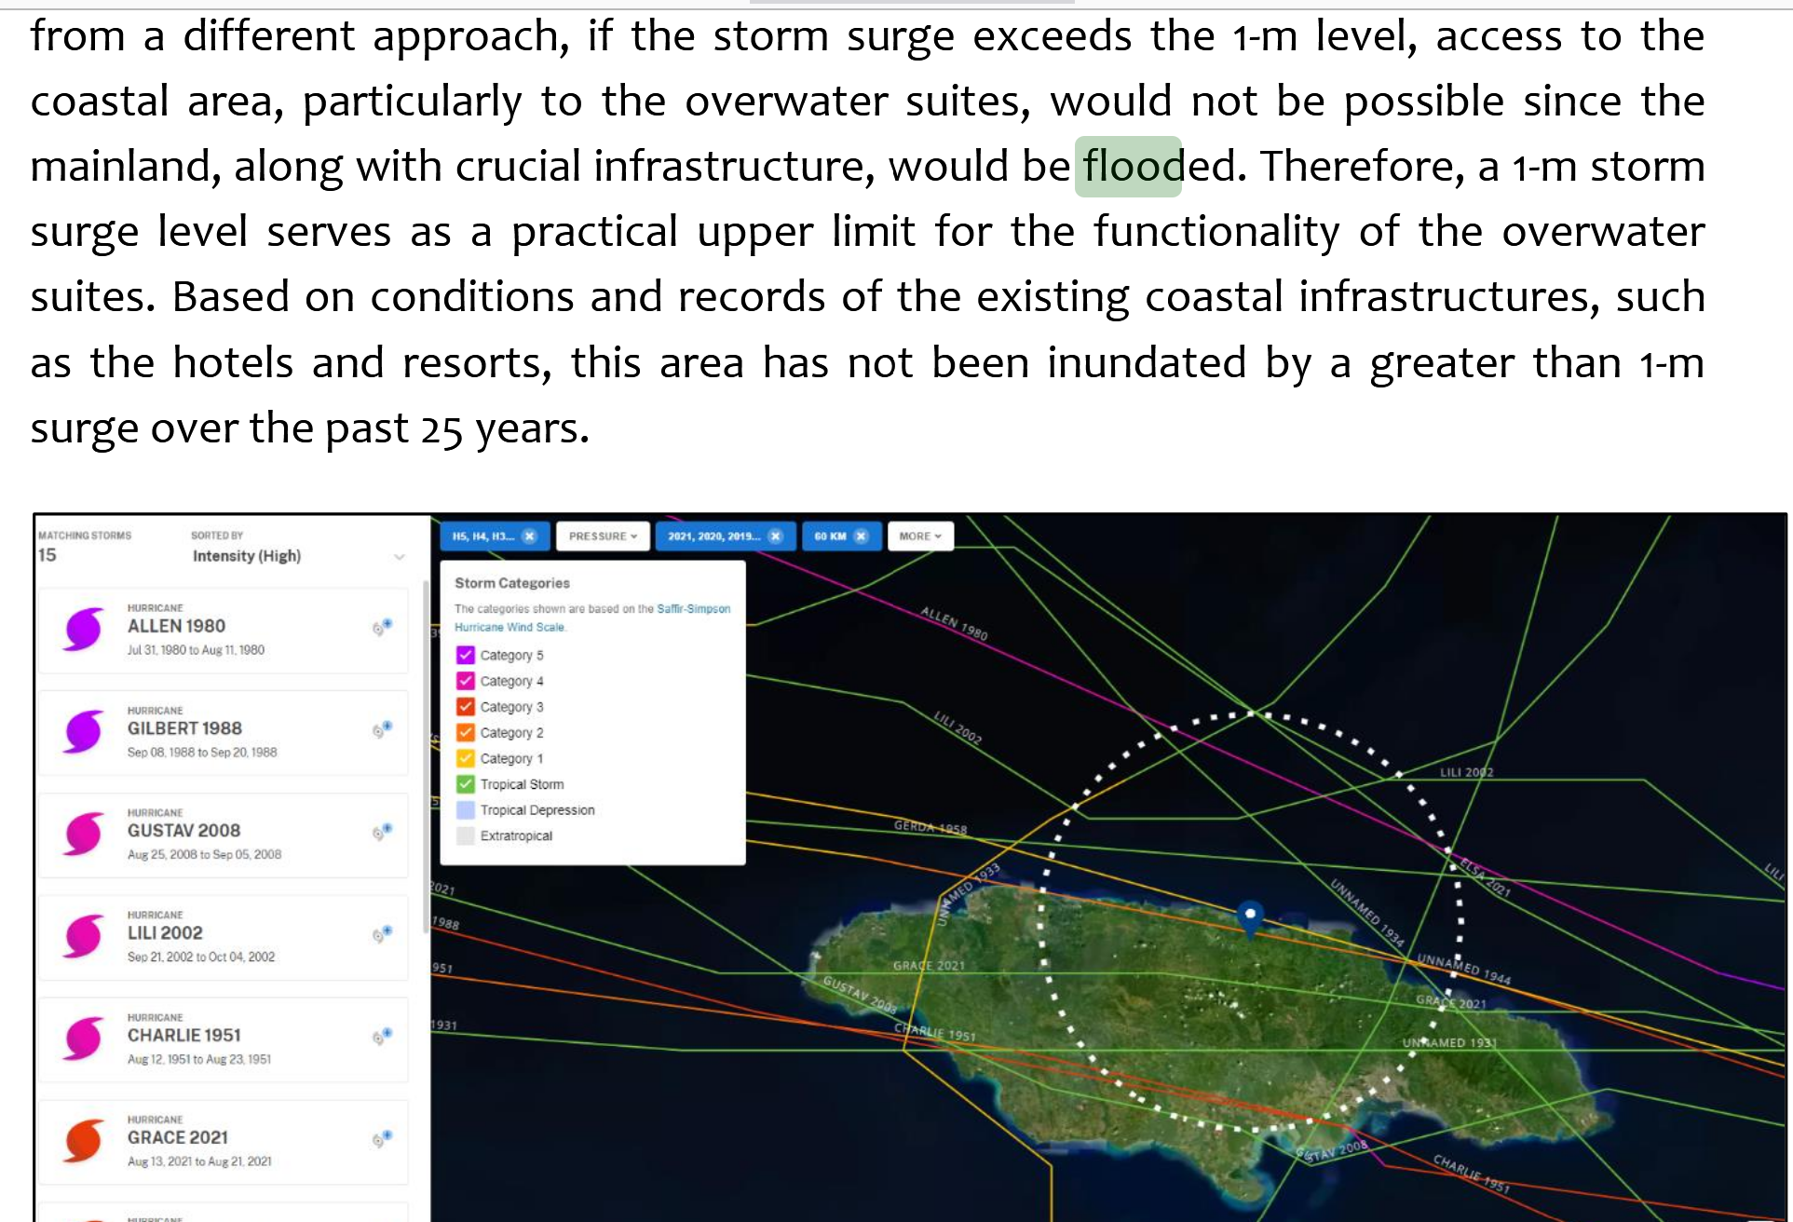
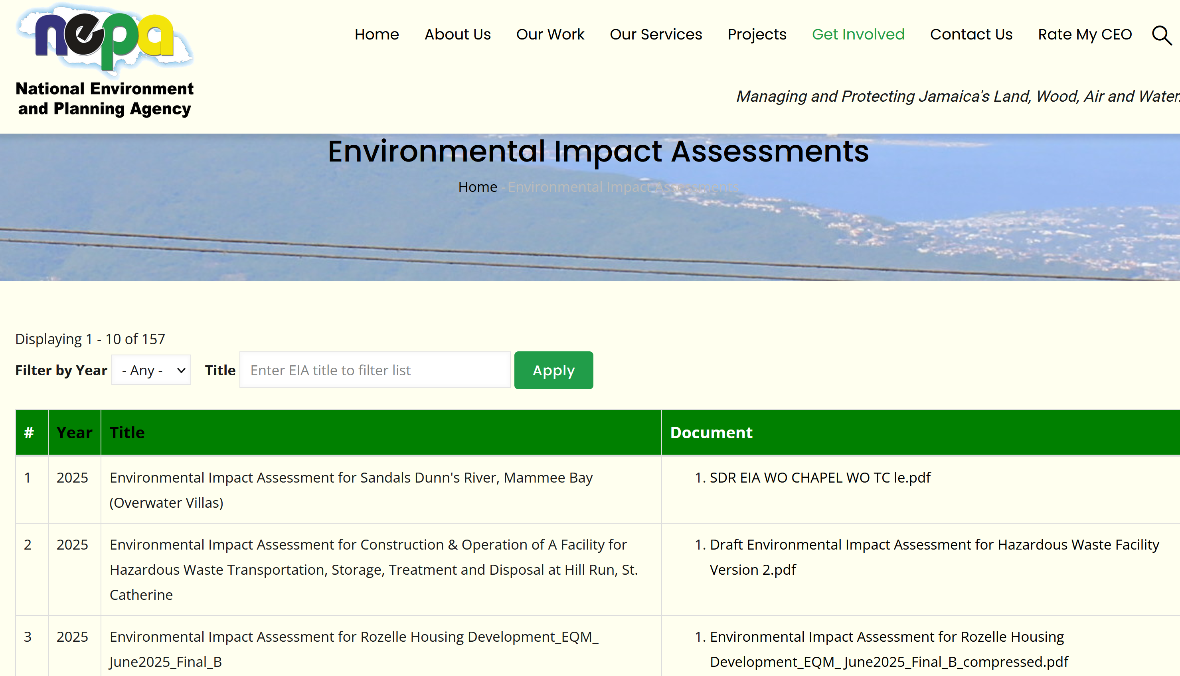
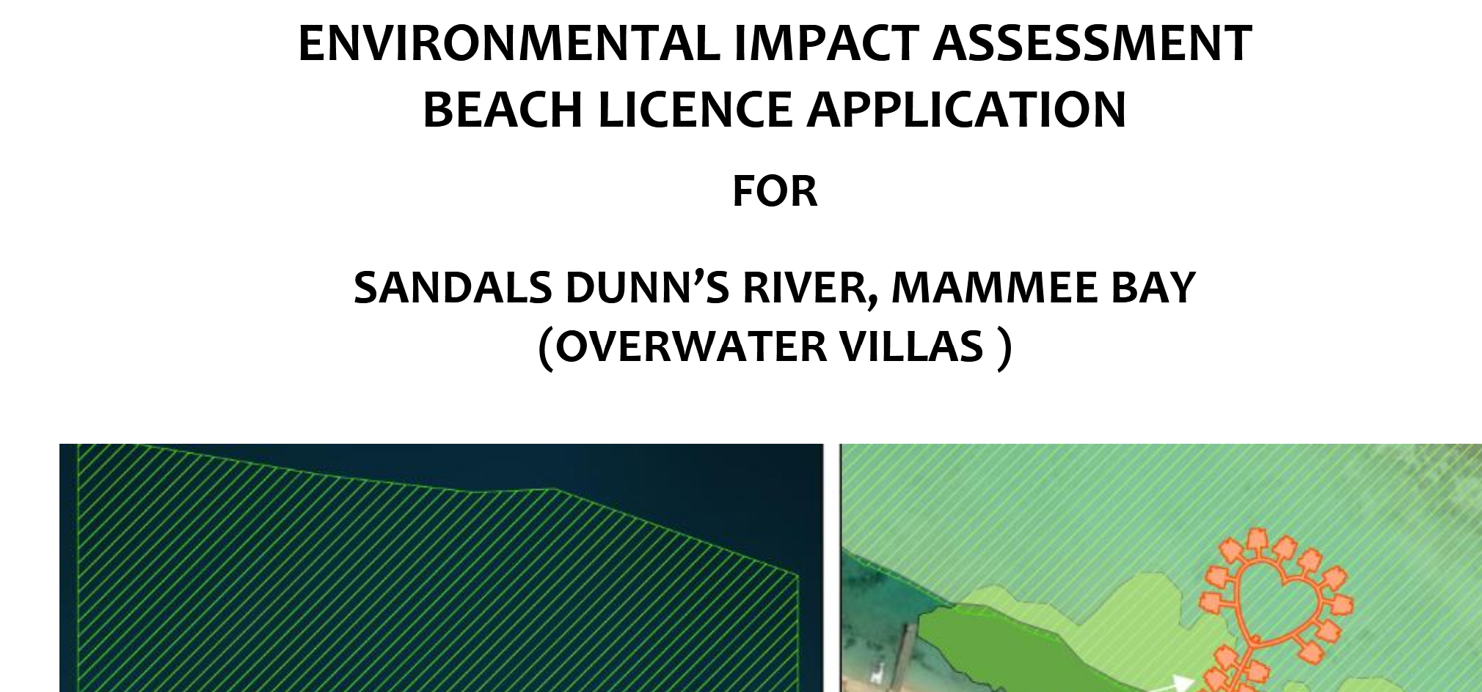
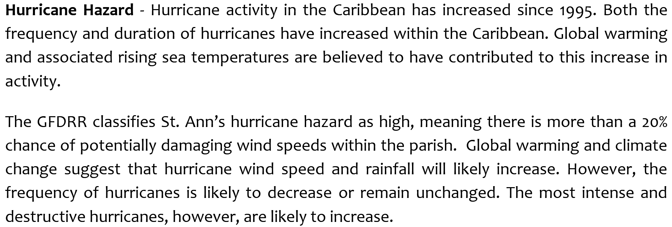
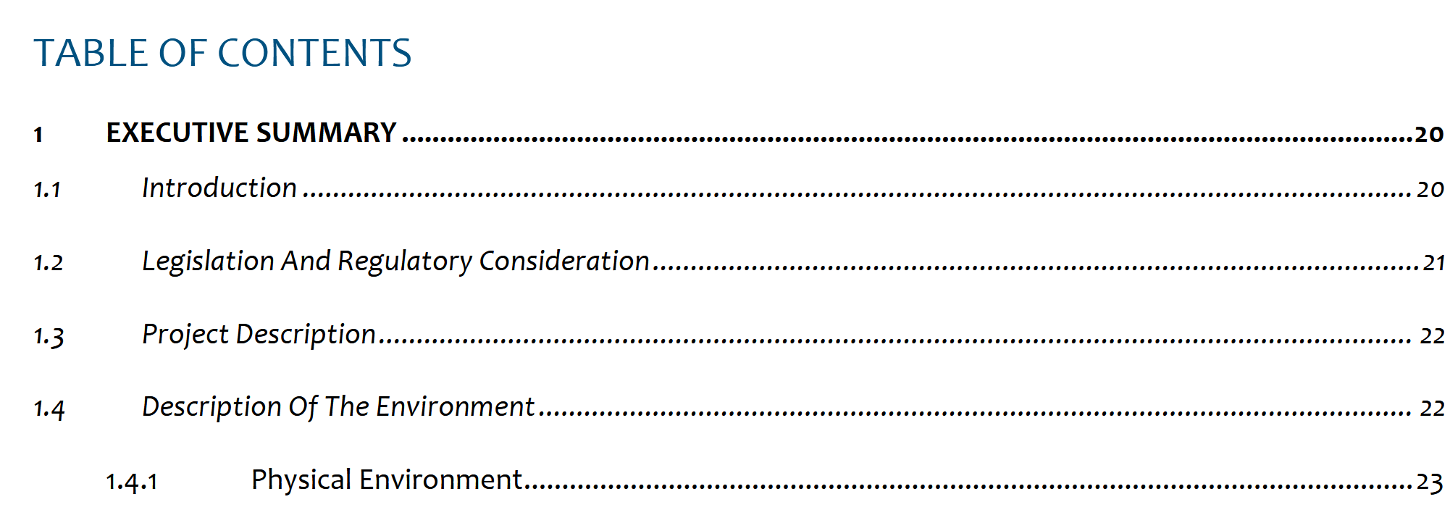
Embed NMHS in National Resilience Frameworks
Integrate NMHS into planning, governance, and operations that shape:
Infrastructural development National security and disaster resilience
National disaster risk reduction strategy
National climate risk assessments
National emergency management and hazard readiness plans
Critical infrastructure protection
Notes:
So you need to embed your NMHSs in national resilience frameworks.
Your NMHS plays a foundational role in disaster risk reduction. Your early warnings, hazard maps, climate trends, and impact-based forecasts underpin national risk-reduction decisions.
To strengthen national resilience, it is essential that as NMSHs you are fully integrated into the planning, governance, and operational frameworks that drive infrastructural development, and climate adaptation.
“You data, hazard projections, and climate intelligence directly inform major infrastructure decisions—from road and bridge construction to housing, drainage, energy systems, and water security projects. And therefore, your NMHS is expected to play a foundational role in disaster risk reduction.
Similarly, Your early warnings, hazard maps, climate trends, and impact-based forecasts underpin national risk-reduction decisions.
If you agree with this, then you need to ensure that your NMHS science and knowledge and expertise is integrated into planning approvals and investment frameworks, to help ensure that infrastructure is climate-ready, future-proof, and capable of withstanding more extreme events. Do not for one minute say this is not your mandate. It is.
This reduces long-term public expenditure on repairs and protects communities and enable governments gets value for more.
But not many of you are involved in the process, even though the Acts speak toy you.
Click
Here is an example from Jamaica. Tell me what are your thoughts.:
This is project for a Sandals Development, which requires an Environmental Impact Assessment to be done.
Look at what are some of what the Assessment contain.
Clikc, clikc, click…. Is this your business. Who is the expert in this regards on behalf of government.
More importantly contributing to socio-economic development, one of your mandates and Most of you have Environmental agencies with an Act requiring environmental assessments for infrastructural development projects .
So Evan, what are thoughts on this and others what are your thoughts.

Slide 7
Strengthen High-Visibility, High-Impact Partnerships
Strengthen your Whole-of-Government Value by Deepening partnerships and strengthening your visibility
Demonstrate that many critical systems depend on the NMHS:
Disaster Management
National Security
Health (heatwaves)
Transport (aviation/maritime safety)
Energy and electricity
Water management and agriculture
Formal Agreements in the form of MOUs to Demonstrate operational value
These will reinforce the NMHS value at Cabinet level
Notes:
Now, To reinforce your NMHS importance, your Service, your department needs to be woven into the core operations of key sectors to Strengthen your Whole-of-Government Value by Deepen partnerships and strengthening your visibility.
Disaster services rely on you , but so do National Security, the health system, the energy grid, aviation, shipping, agriculture, and water authorities.
If you do not have formal agreements in the form of MoUs with these sectors, think about having these to demonstrate your operational value and ensure that agencies advocate for you at senior levels, because MoUs are signed by senior management and they usually read these MoU before putting their signatures.
So get an MoU with the tourism Ministry, Health, Finance, Energy, Water, agriculture etc. These will reinforce the NMHS value at Cabinet level
The stronger your cross-government, whole-government integration, the stronger the political support across the various Ministerial portfolios
and

Slide 8
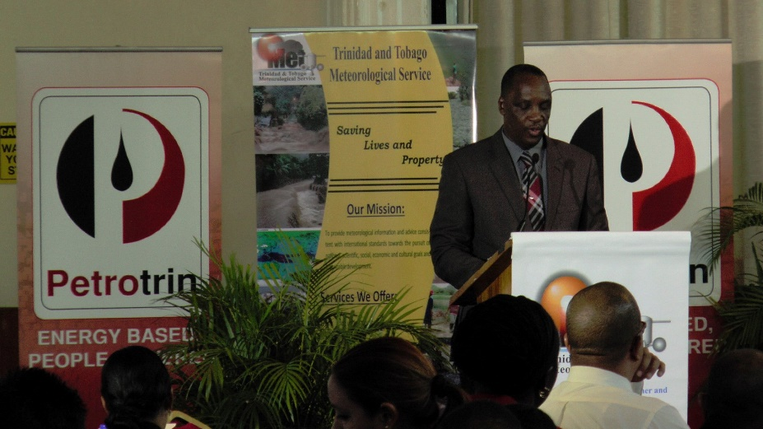
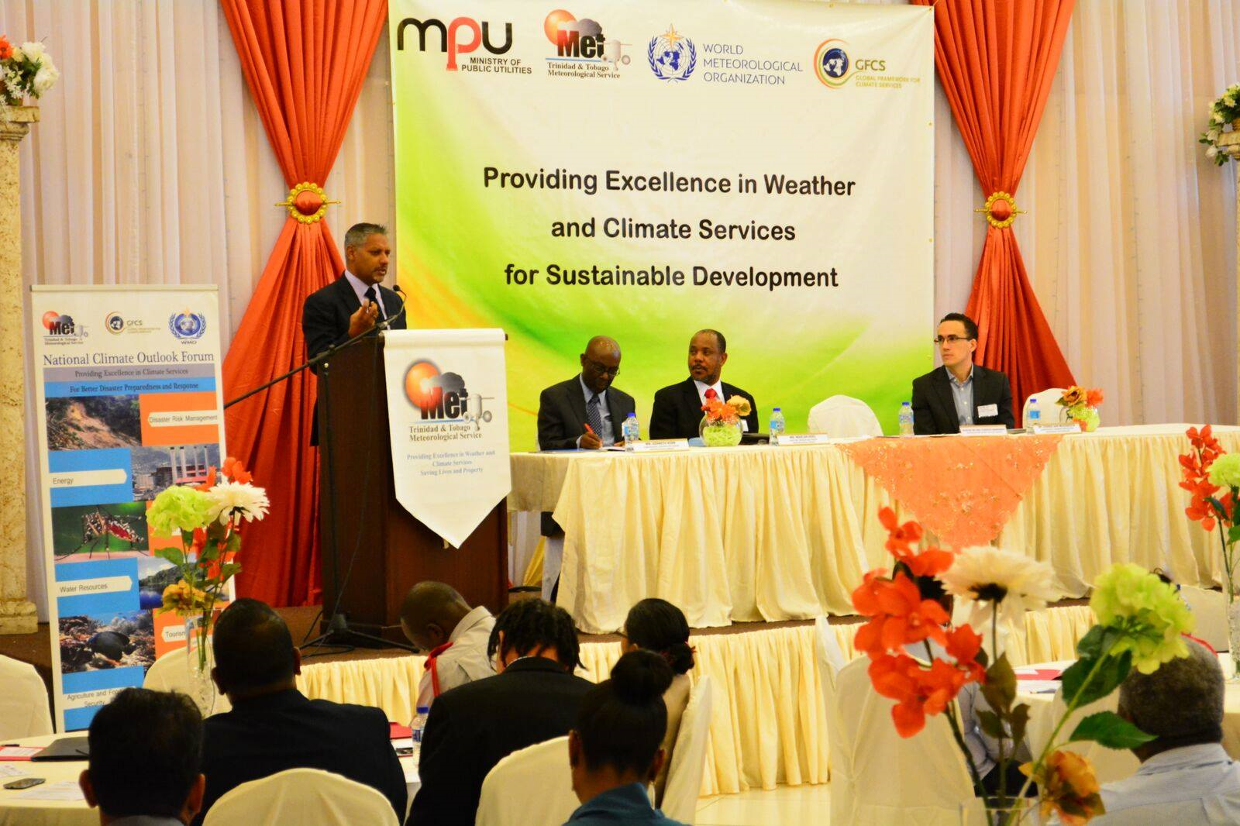
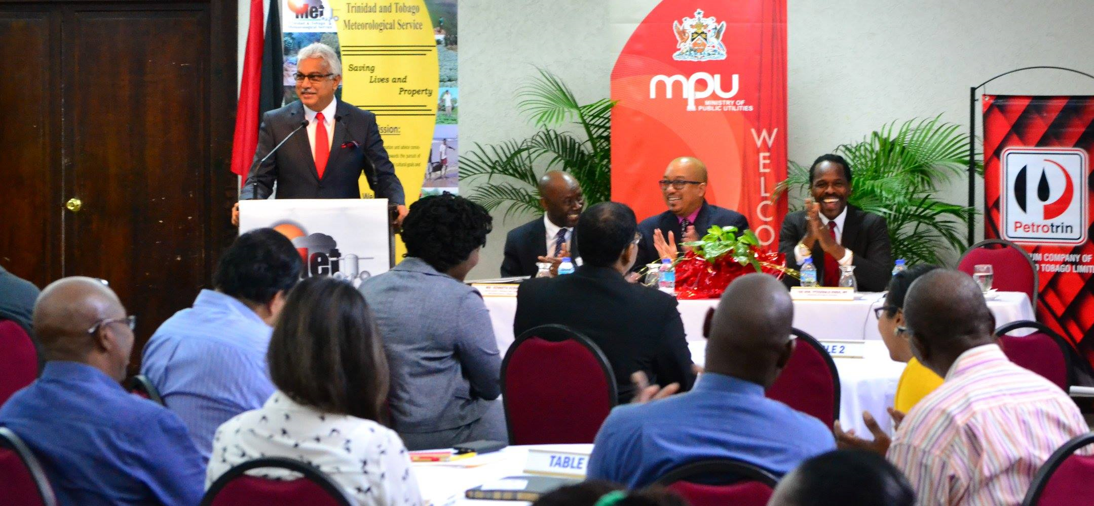
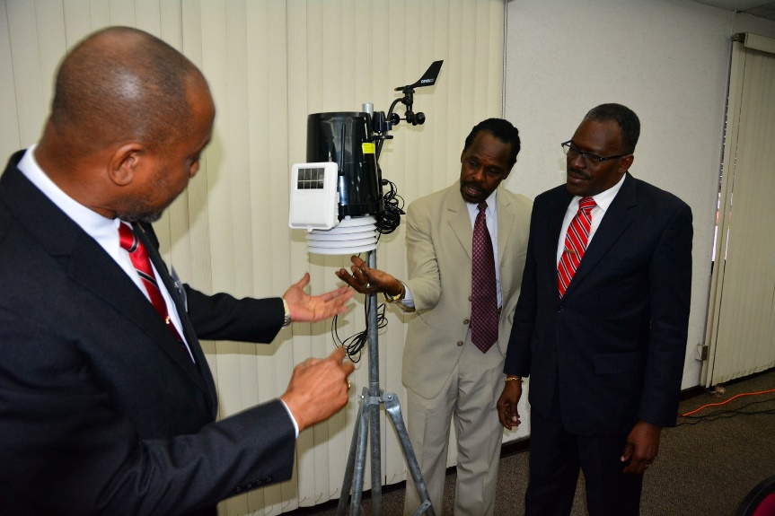
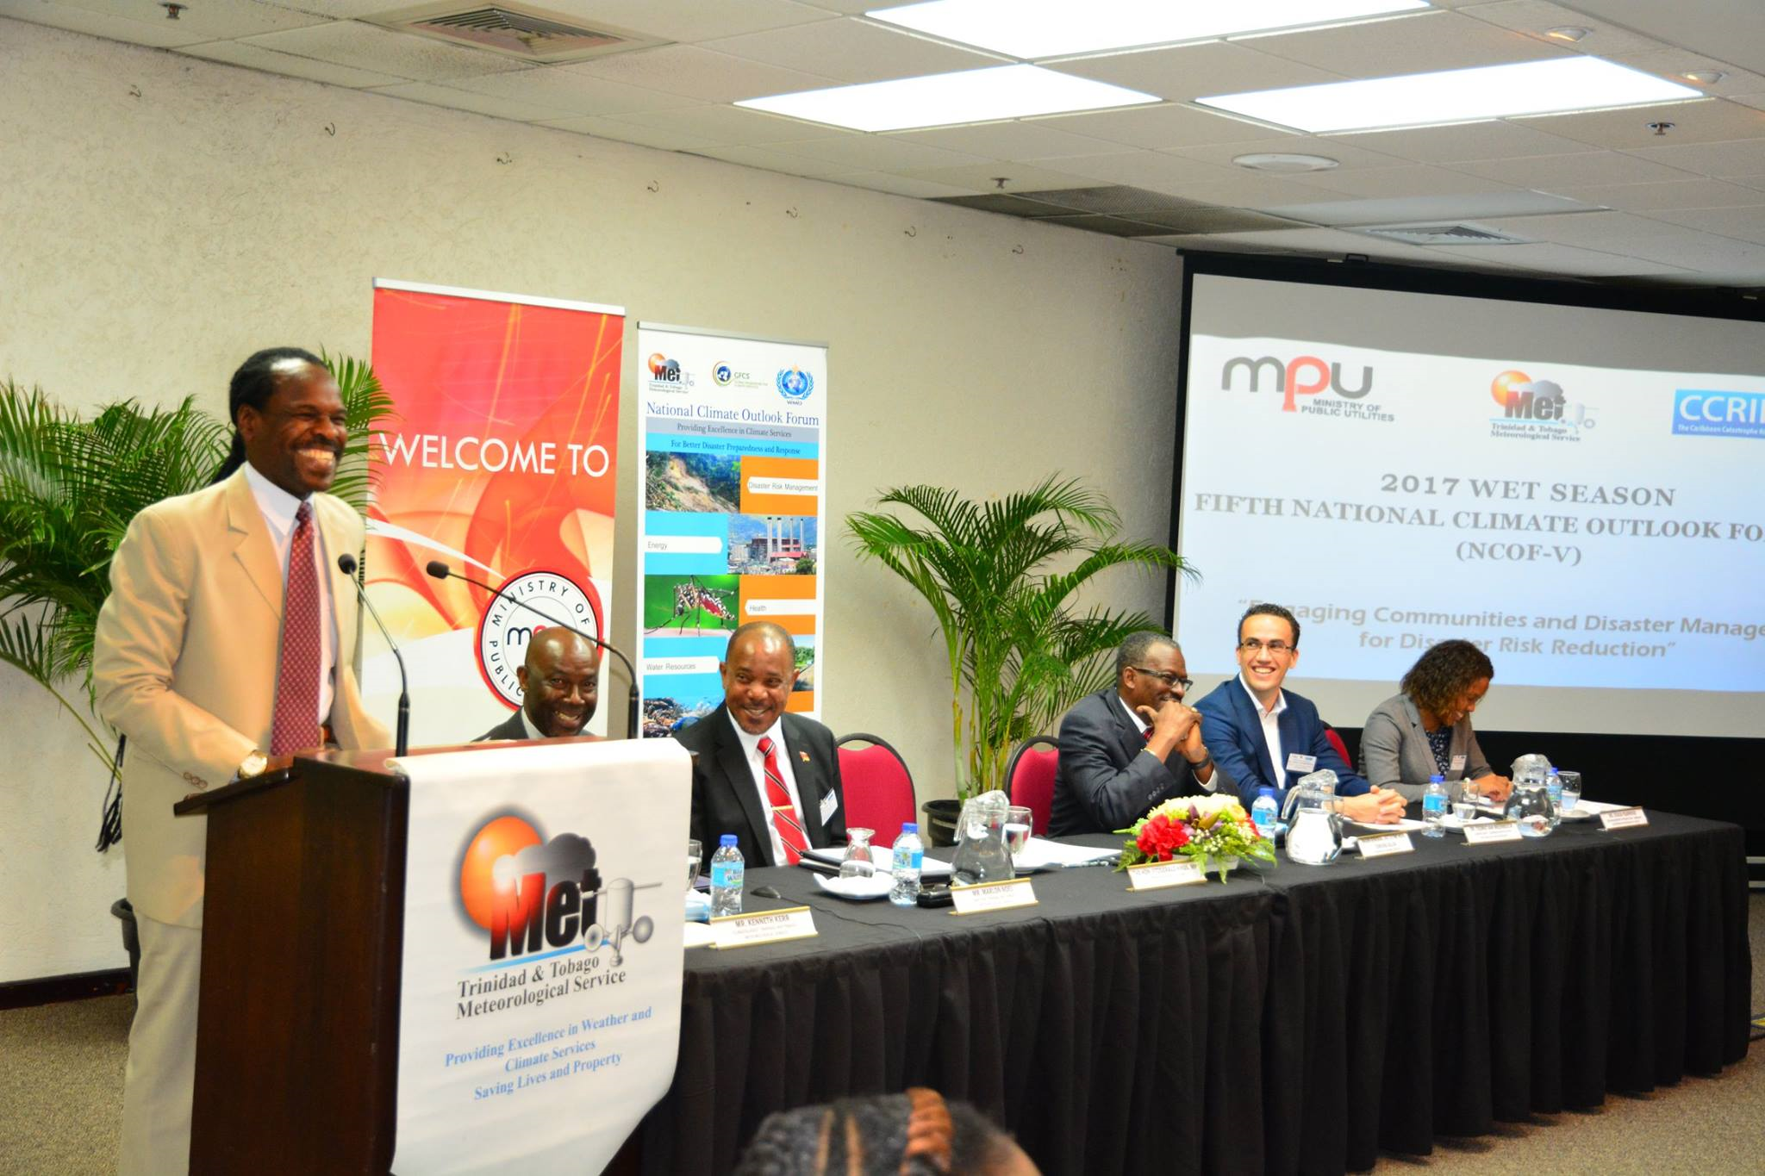
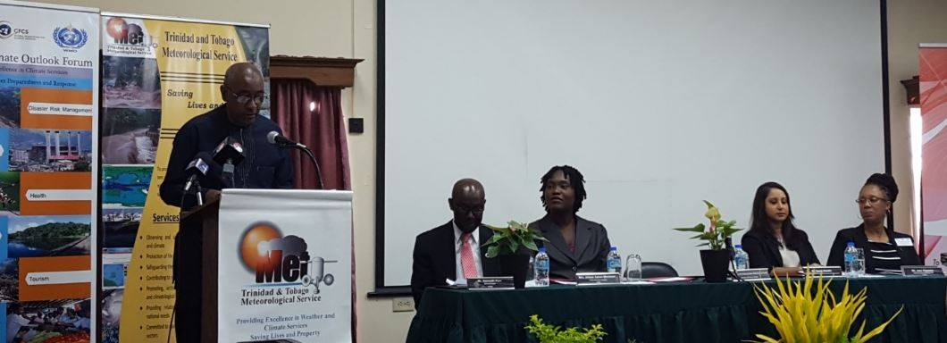
Use Political Pipelines to Strengthen Visibility & High-Impact Partnerships
Minister
of Health
Minister
of Utilities
Minister of Public Utilities
(Water, Electricity, Meteorology)
Minister of Agriculture
Another
Minister of Public Utilities
(Water, Electricity, Meteorology)
Minister’s Utilities &
National Security
Minister’s Utilities &
National Security
Notes:
Another strong practice for strengthening high-visibility, high-impact partnerships is to institutionalize and operationalize platforms and devices as National Climate Outlook Forums (NCOFs) and use established political channels to elevate their visibility at senior government and Cabinet levels.
Brand the NCOFs with clear logos, messaging, and visual identity so that each event is recognizably a NMS-led initiative. This ensures that NMS messages stand out prominently in all communication products, media coverage, and stakeholder interactions.
Host the NCOF, targeting a specific sector and engage your parent Ministry strategically—by requesting that your Minister invite the other key sector Minister to attend. The Minister is a human with jealous eyes that would like his colleague to at a Met event and he is not.
So Provide your Minister with a concept note, talking points, and a press package in advance so their office understands the event’s importance and the opportunity it presents to amplify their message.
This approach greatly increases the likelihood that more than one Ministers will participate in your public events, thus strengthening your political visibility, as you can see on screen. At all of these NCOF we had a Minister or 2 in attendance.
This is important because when Government Ministers sit at the head table with you or speak at the podium, cameras and media attention naturally follow.
By ensuring strong NMS branding and clear value messages throughout the event, the National Met Service benefits from high-voltage visibility—but with Ministers carrying the message on your behalf.
This represents the critical top-down component of your political support strategy .
All other aspects of the NCOF—including technical content, stakeholder engagement, and sector collaboration—should be built through a bottom-up approach, ensuring strong ownership and practical value across the national climate and sectoral user community. So you gain political support from above and below.

Slide 9
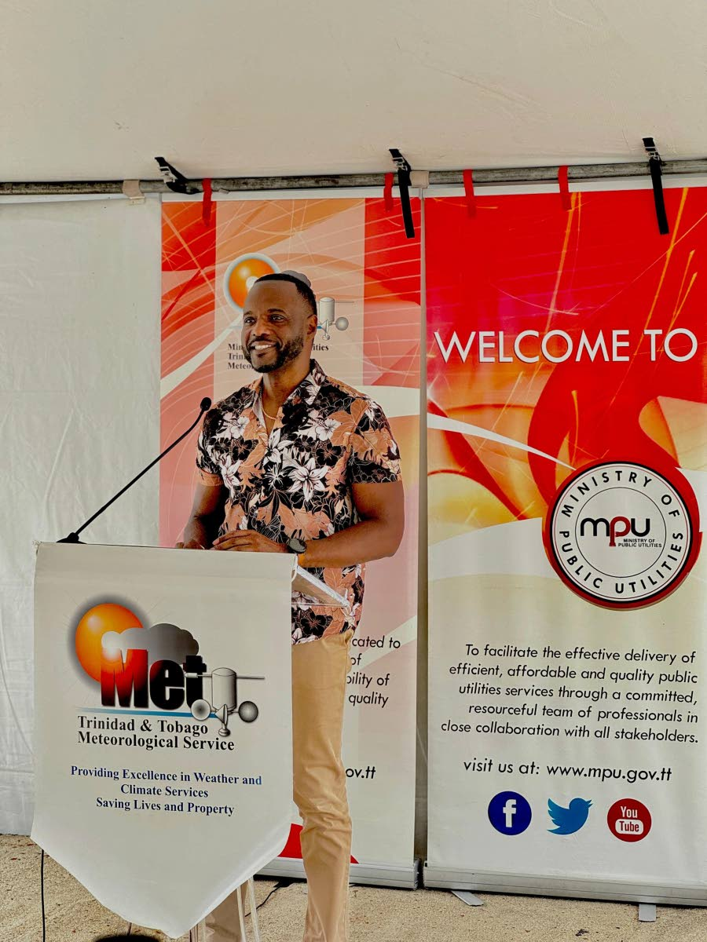
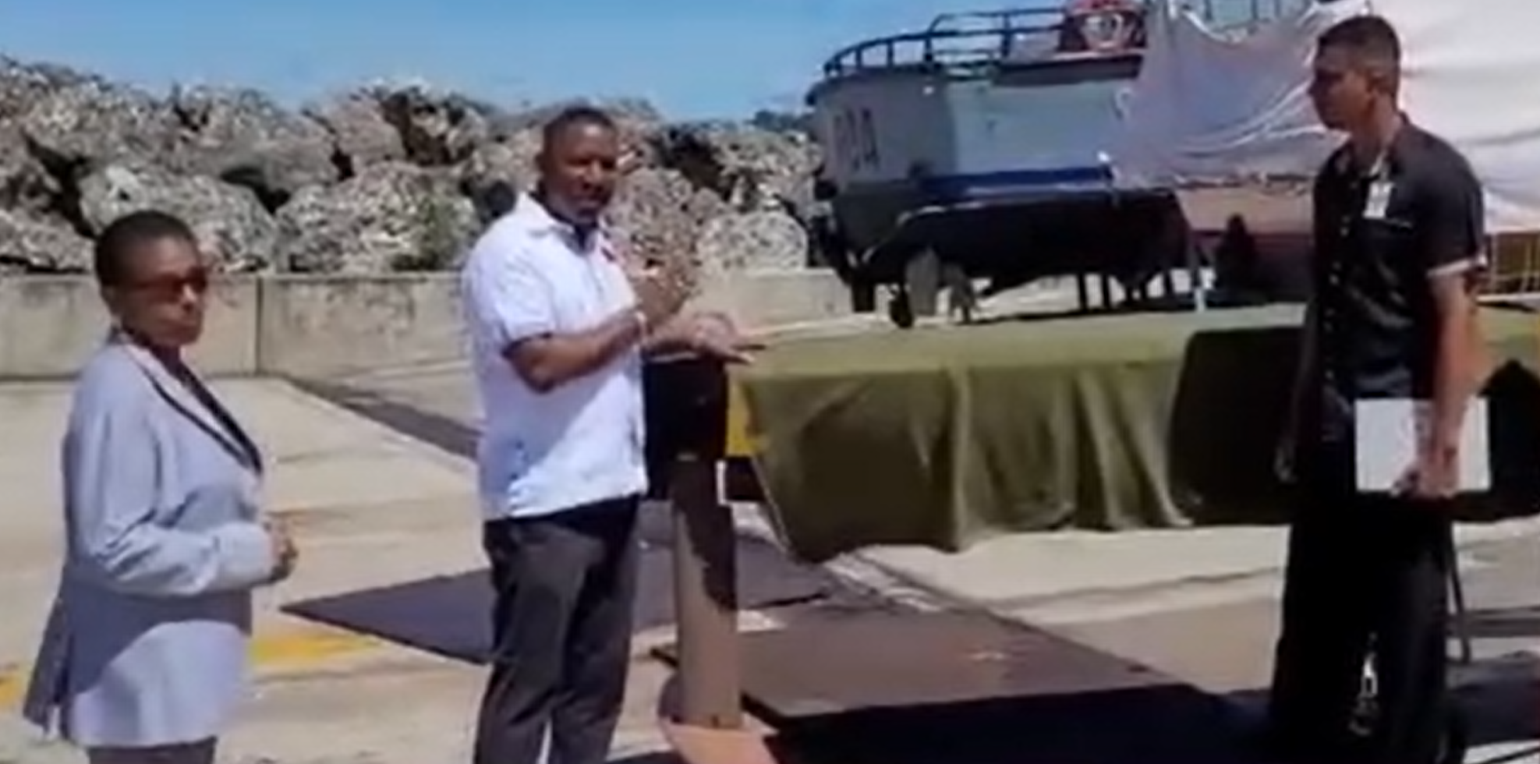
Use Champions and Storytelling
Identify and empower political allies as NMS natural champions
Tell human-centered stories about NMS impact
Invite Ministers or MPs to field visits
Use media and public platforms
When champions feel informed and supported, they become powerful advocates for funding and policy reform
Champions matter:
A single influential minister can unlock years of funding. But they must feel confident speaking on your behalf. Give them the evidence, the talking points, and the success stories they need to argue for you inside & outside Cabinet
Notes:
“Actively scan the political landscape and the media to identify Ministers, Members of Parliament (MPs), or senior civil servants or media house or personnel who already value climate resilience, disaster management, agriculture, or infrastructure protection.
These individuals are natural champions for the National Meteorological Service.
Engage them with tailored briefings, exclusive insights, and clear evidence of how improved forecasting supports their portfolios.
You do not have to always speak to the Minister, but you want to get his senior advisor attention, phone contact and email , you want to get the same for his speech write . You want to write briefs and send it to the advisors and speech writers and communicators.
When champions feel informed and supported, they become powerful advocates for funding and policy reform.
Click
Champions matter. A single influential minister can unlock years of funding. But they must feel confident speaking on your behalf. Give them the evidence, the talking points, and the success stories they need to argue for you inside Cabinet.”

Slide 10
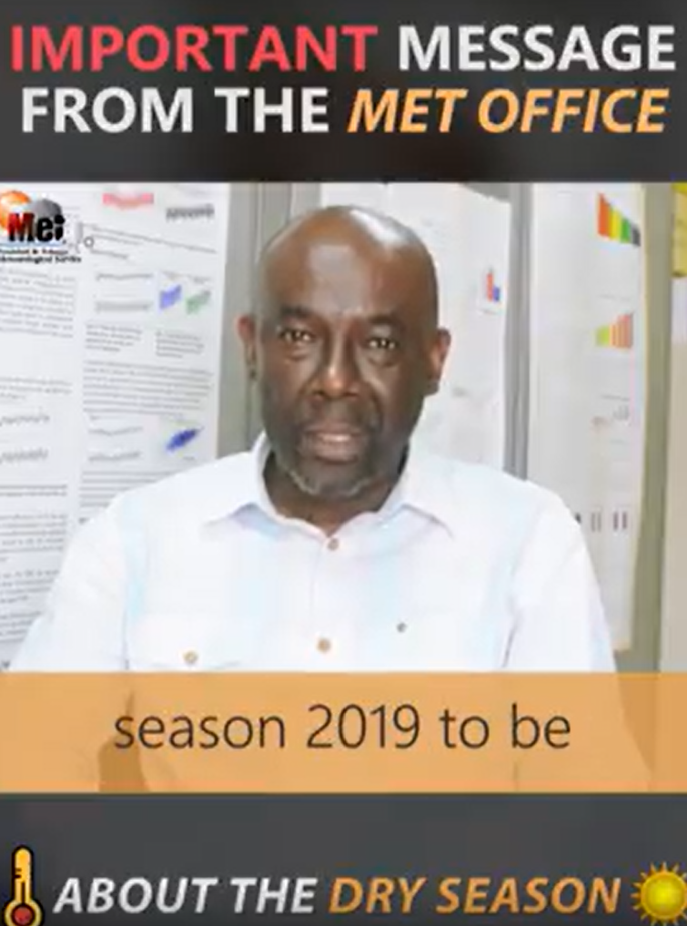
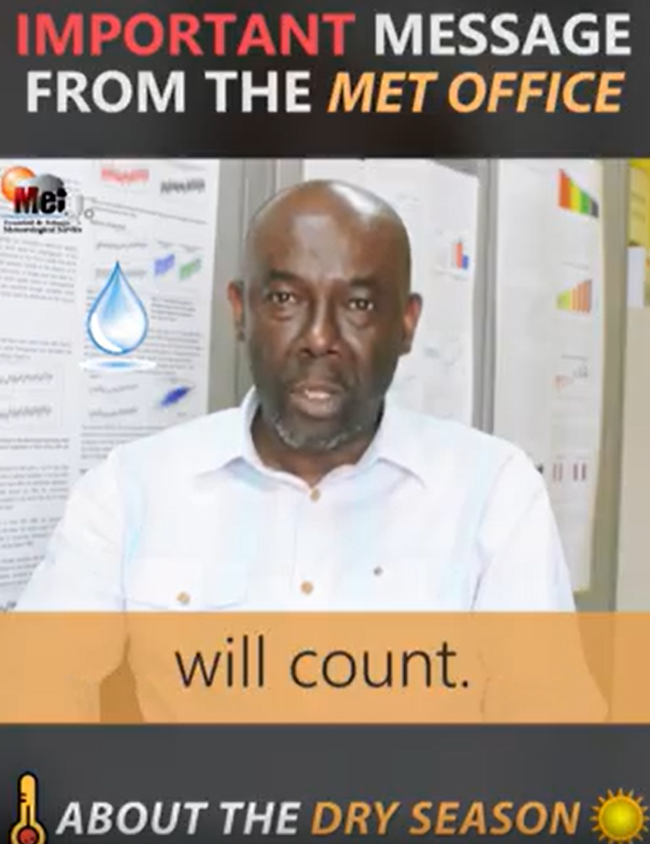
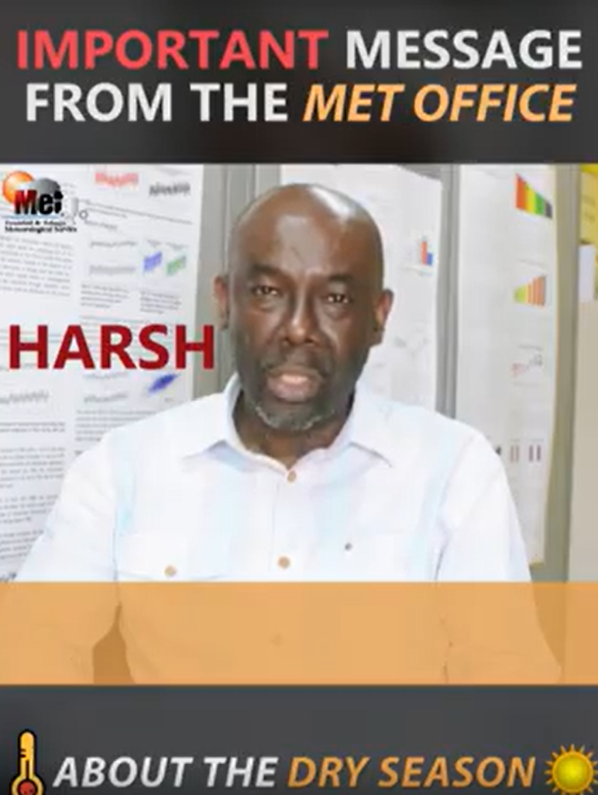

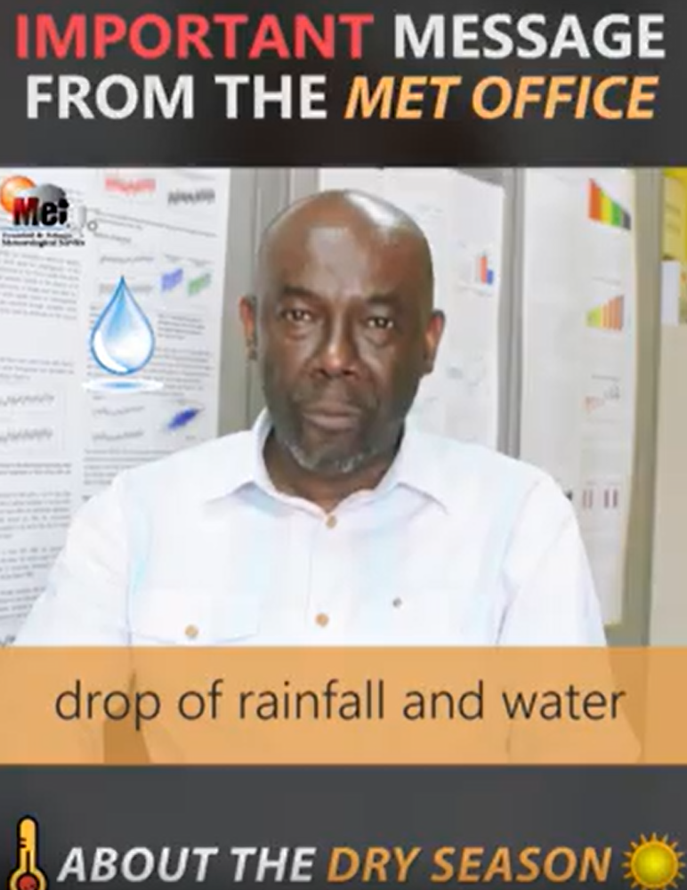
Storytelling is Critical
It is Political Visibility
Season 2016 to be
Public Trust Becomes Political Capital
When People Publicly State They Rely on NMHS Guidance to Stay Safe
Political Leaders Pay Attention
Notes:
Storytelling is a critical tool and could be a potent political tool to gain visibility and support. Here is an example of a compelling story telling, where it was said 3 months ahead that the 2019 dry season was going to be a HARSH one, and a season when every drop of rainfall and water will count.
Provide the politicians with compelling data, compelling but truthful visuals, and success stories they can use in parliamentary debates or Cabinet discussions or tag lines for media interviews
When the weather and climate turns on us, people look for a voice they can trust—and that voice must be the NMS.
Every TV briefing, every radio update, every community session or social media post isn’t just information…
it’s visibility.
It’s proof that we’re standing with the nation when it matters most.
CLICK
And here’s the key: Public trust becomes political capital.
When people clearly rely on you —when they say, ‘I listened to Evan or Sabu from the Met Service and , and it kept my family safe’—political leaders hear that

Slide 11
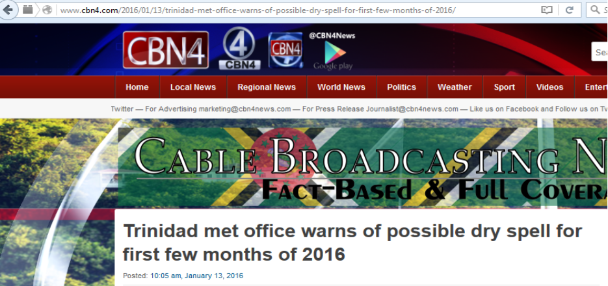
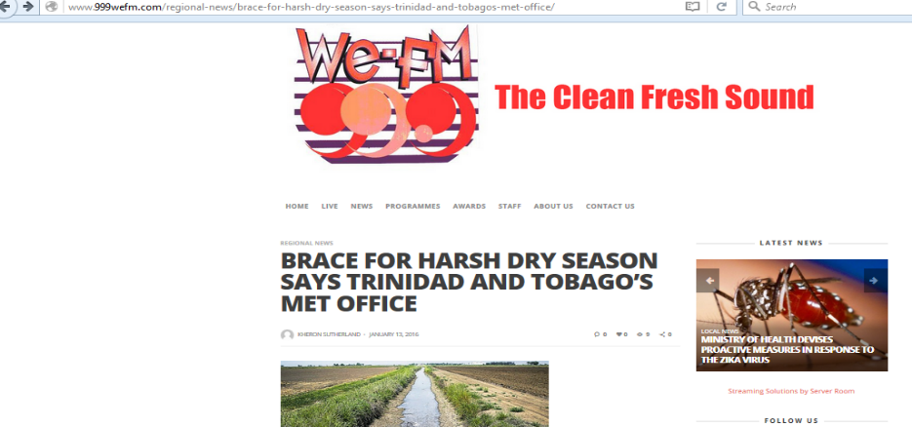
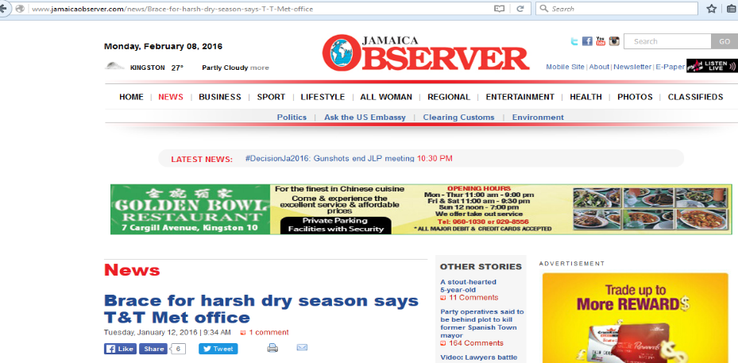
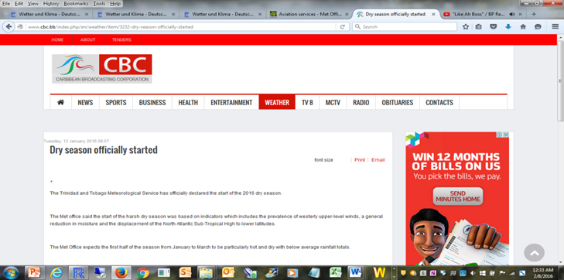
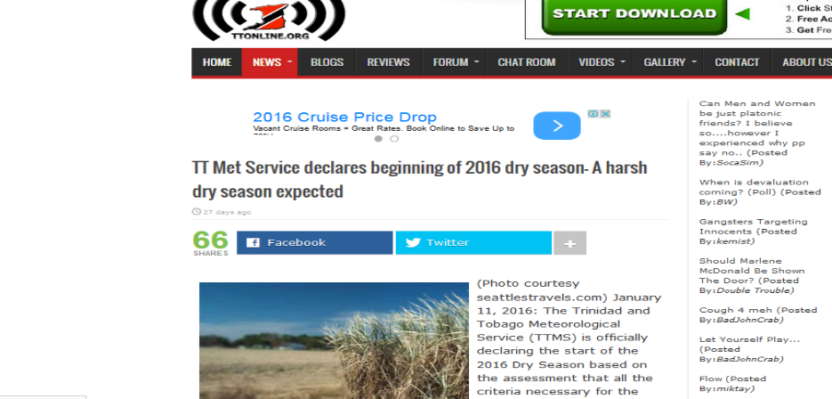
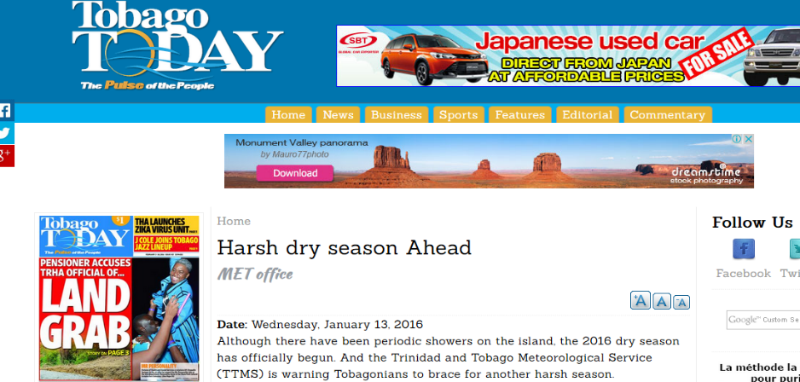

Slide 12
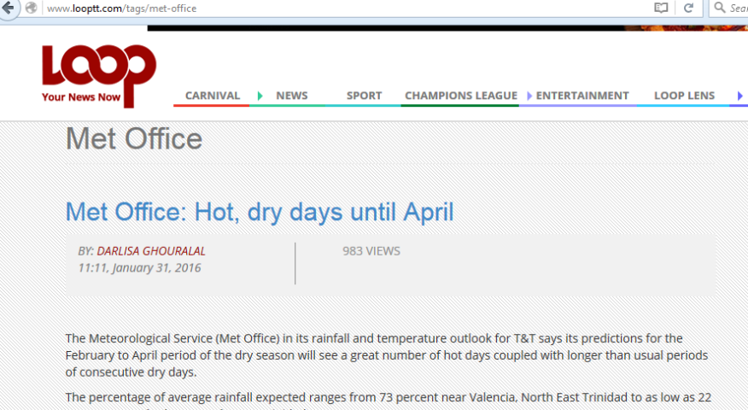
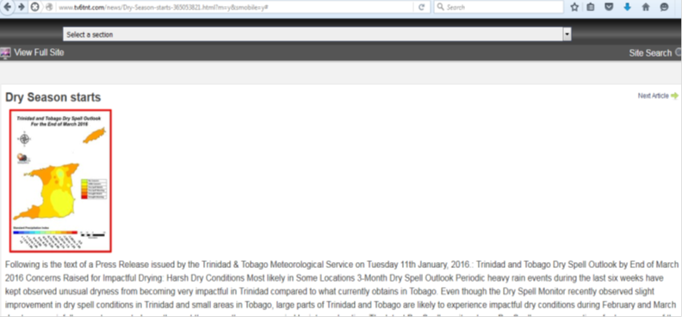
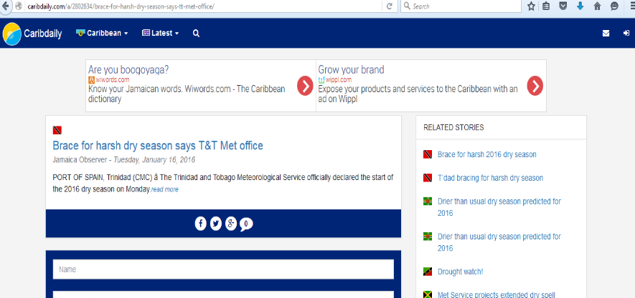
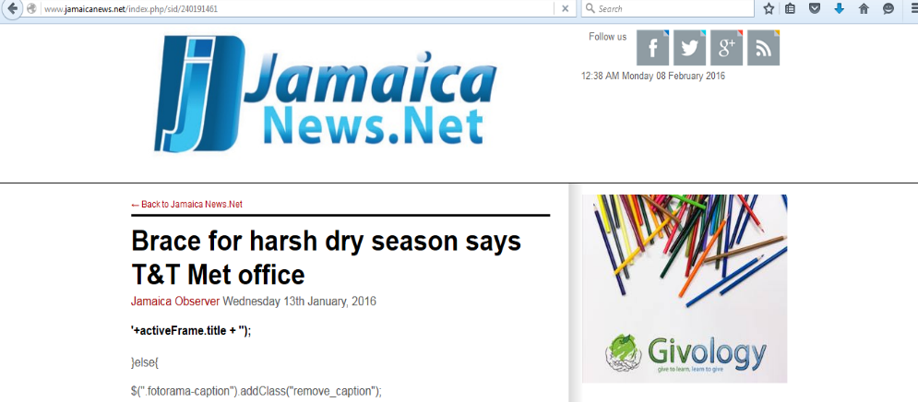
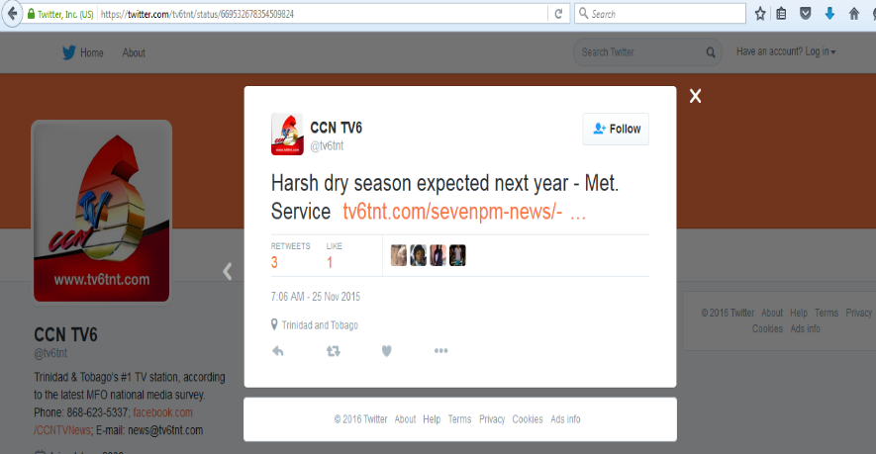
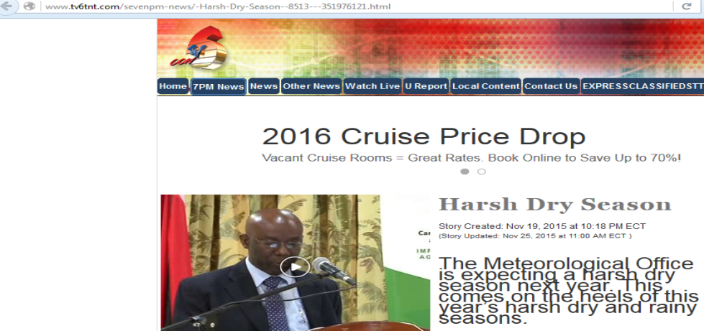

Slide 13
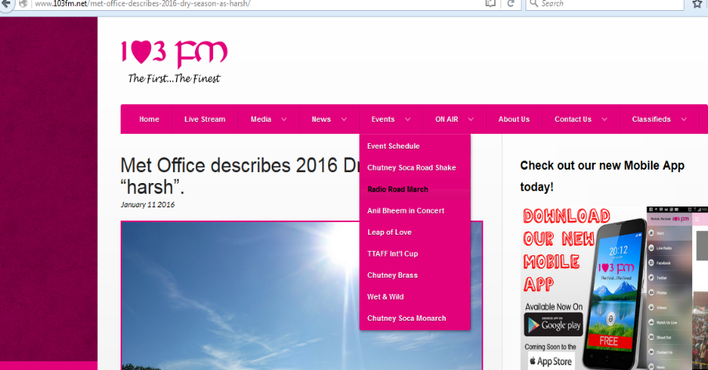
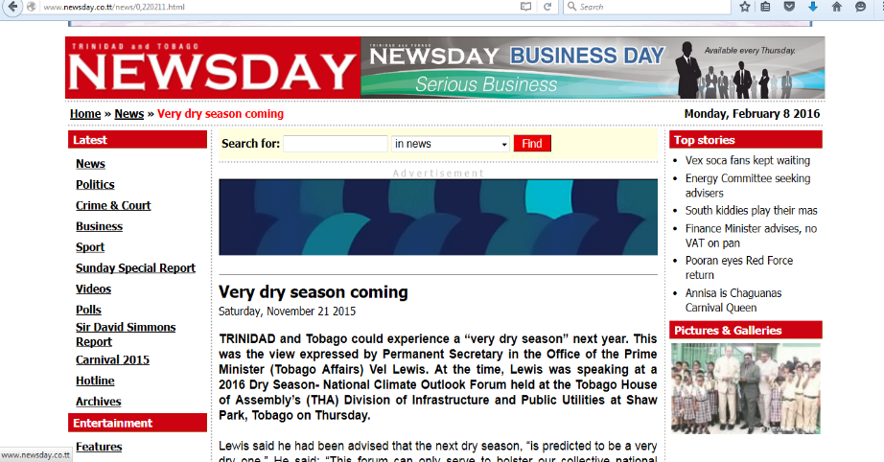
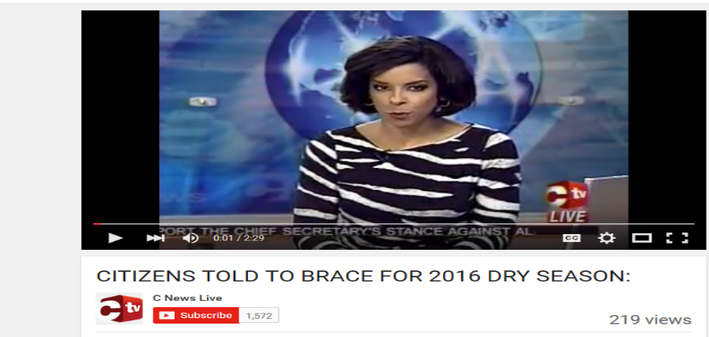
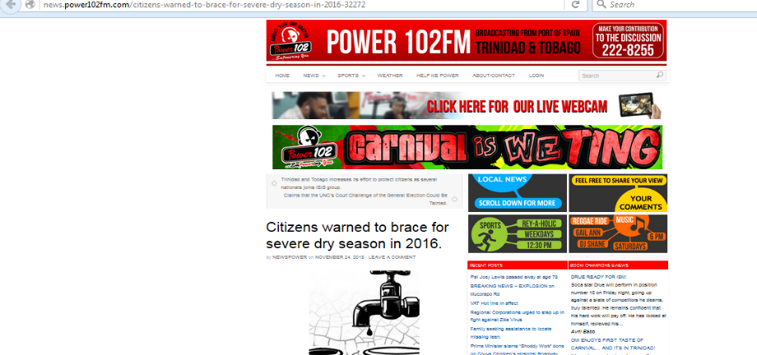



Slide 14



Demonstrate Economic Return
Demonstrate :
Productivity gains across agriculture, energy, transport
Forecast accuracy enables efficiency
Avoided and reduced losses
Case study examples of economic impact
Notes:
A good practice is demonstrating economic return.
Your services deliver measurable economic value. One of the strongest cases for investment is showing avoided losses as we discussed yesterday.
Framing your value in terms of economic efficiency, avoided losses, and lives saved creates a compelling argument that investment in the NMHS is an investment in national resilience.
Use clear examples and case studies and reports to demonstrate avoided losses during major flood events or operational savings in for investment. Send a copy to the Ministry of Planning and Ministry of Finance, and your key GDP Ministries.

Slide 15




Demonstrate Economic Return
Notes:
Your agrometeorological services provide direct, measurable economic benefits to farmers, agribusinesses, and the national economy.
If you have no agromet forecasts, create one.
Use CCRIF Interns for the case study. Staff shortage is not a problem for this one.
Prepare concise case studies and short reports and share them with the Ministry of Planning, Ministry of Finance, Ministry of Agriculture, and other GDP-critical ministries.
Here we are Demonstrating how weather and climate info is used by farmers, annual savings from use and farmers estimated cost for the services provided.
This shows savings or avoided losses, which can strengthen political support and positions agromet services as essential national assets for food security and economic stability.

Slide 16


Demonstrate Strengthened Public Trust & Visibility
Demonstrate :
Positive Public Perception
Reach
Effectiveness of the Alert System
Case study of social& economic impacts
Offer post-event policy recommendations
Notes:
Public trust is one of an NMHSs greatest assets for political support. Your communication must remain clear, consistent, and science-based—especially during high-impact events. You need to demonstrate that. Proactive media engagement and transparent reporting enhance understanding and credibility.
Every crisis is an opportunity to demonstrate value: your warnings enabled evacuations, protected vulnerable people, and guided emergency and disaster operations.
This is important because maintaining and enhancing public trust builds strong public and political support.
Offer post-event policy recommendations. After a major event. Prepare a short “After-Action Report” for Cabinet or Parliament. Include practical recommendations: strengthening radar coverage, upgrading forecasting systems, expanding community early warning programs.
This shows leadership and positions the NMS as essential to national climate resilience.

Slide 17


Demonstrate Economic & Social Return
Use High-Impact Weather Events As Evidence of the NMS’s value
Colour-coded alert messages reduced what could have been far worse impacts
Colour-coded alerts provided clear, early warning that helped people prepare
Triggered extensive media coverage and public awareness
Supported faster government and emergency response
Notes:
We need to Use High-Impact Weather Events As Evidence of the NMS’s value.
We were able to demonstrate that Although the flood caused significant losses, the Met Service’s colour-coded alert messages reduced what could have been far worse impacts.
They Provided Clear, Early Warning That Helped People Prepare. Residents received advance notice, giving them time to:move vehicles to higher ground protect household items avoid travelling during peak flooding monitor rising water levels more closely
They Prompted Immediate Attention Because They Were Easy to Understand
The colour codes (e.g., Yellow, Orange, Red):helped people instantly grasp the severity cut through information overload and encouraged urgent protective action
They Triggered Extensive Media Coverage and Public Awareness
Likely Reduced Total Losses—Even If We Cannot Quantify the Exact Savings and thus Supported Faster Government and Emergency Response

Slide 18


Demonstrate Services Excellence & Public Satisfaction
Customer satisfaction surveys :
Demonstrate excellence in service
Provide clear, credible evidence NMHS is effectively serving the public
Show public values and trusts EWS, reinforcing the NMHS’s reputation
Tangible Evidence of Impact
Transparency and accountable
Modernization is not just about technology— it is also about culture, communication, and readiness for a demanding public
Notes:
Sustaining excellence requires continuous investment in the backbone of our service and hence political support.
Demonstrating positive results from customer surveys on early warning messages can enable political support by providing clear, credible evidence that the your NMHS is effectively serving the public and protecting lives and property.
As simple as these Survey results are they show that the public values and trusts the early warnings, reinforcing the NMHS’s reputation as a reliable, essential service.
Politicians are more likely to support agencies that have strong public backing based on tangible Evidence of Impact.
Click
Quantifiable feedback—such as high satisfaction ratings demonstrates that the NMHS’s work is making a real difference in community safety and preparedness and enhances Accountability and Transparency.
By Sharing survey data publicly or with decision-makers it signals that the NMHS is transparent and accountable, boosting confidence among political leaders.
S0 Modernization is not just about technology — it is also about culture, communication, and readiness for a demanding public

Slide 19



Forecast Verification Strengthens Political Support
Shows the NMHS is Delivering on Its Core Mandate
Translates Technical Capability into Public Safety Outcomes
Strengthens Government Accountability Narratives
Builds Public Trust, Which Politicians Respond To
Notes:
Similarly, demonstrating verification of accurate public weather forecasts is one of the strongest ways to secure political support because it translates technical performance into credible, measurable proof of national value.
Forecast verification made public :
Shows the NMHS is Delivering on Its Core Mandate,. Politicians need confidence that the NMHS is doing what it is funded to do. That is providing high quality , reliable forecast
Translates Technical Capability into Public Safety Outcomes: When verification shows that forecasts were correct, ministers can confidently tell the public: “We acted on good science, and that science protected communities. ”This builds political legitimacy and reinforces the value of the NMHS as a public safety asset.
Verification results Strengthens Government Accountability Narratives: Politicians want to point to services that work. Verified forecast performance gives them a clear success story: For example “Accuracy improved 15% since the new radar upgrade and the Autonauts were purchased.
This is clean politically attractive message backed by evidence. They would love that.
Finally, verification Builds Public Trust, Which Politicians Respond To because High trust from the public creates pressure for political leaders to sustain or increase support for the service. When the public believes the forecasts are accurate, the government has strong incentive to maintain funding for a well-performing agency.

Slide 20
Protecting Your NMHSs Future
Caribbean National Meteorological Services stand at the front line of national climate adaptation and resilience
National Met Services needs political support to be resilient
Resilience is not automatic—it is built through foresight, partnership, sustained advocacy using political pipelines
Ensure that your NMHS remains relevant by using political pipelines
Notes:
Across and around the floods, heatwaves, tropical storms and hurricanes your National Met service stands at the front line of national climate adaptation and resilience.
Your science protects lives. Your services strengthen industries. Your forecasts safeguard the nation’s future.
But resilience is not automatic—it is built through foresight, partnership, and sustained advocacy .
As the climate risk grows around us, one thing remains constant, all of our countries depends on a world-class national meteorological service
.Ensure that your NMHS remains relevant by using political pipelines to sustain support and to protect the future of your NMHS.

Slide 21
What are your thoughts?
Lets have a discussion!

