Slide 1
Leadership and Management Workshop for Senior Management of
RA III and IV Caribbean Members
Business Continuity Management:
Leadership Commitment & Policy Development
Based on WMO-No. 1361
Mr Haley Anderson (WMO TT-BCM)
Port of Spain, Trinidad and Tobago
1-5 December 2025
Notes:
Today we will focus on one of the most critical components of leadership in modern meteorological operations: Business Continuity Management.
I am presenting on behalf of the WMO Task Team on BCM, which was tasked with developing training materials to support the WMO Technical Guidelines on BCM (WMO 1361).
Our objective today is simple: to help you begin building or strengthening a Business Continuity Management System that protects your essential services, especially warnings and aviation services, during any disruption.

Slide 2
Session Outline
Presentation
Core BCM concepts
Why BCM is essential for NMHS leadership
Leadership responsibilities
BCM Policy: Purpose & structure
Practical activity
Drafting a BCM Policy for your NMHS
Group reflections and presentations
Notes:
This session is divided into two parts.
The first part is a twenty minute strategic overview of BCM and the leadership responsibilities involved.
The second part is a forty minute practical exercise where you will begin drafting the BCM Policy for your NMHS.
By the end of this session, each NMHS will have the first essential building block of a BCMS.

Slide 3
Session Objective
By the end of this session, senior leaders will be able to:
Recognize risks of operating without an established BCMS
Understand how WMO’s guidelines can support NMHS BCM implementation
Identify leadership responsibilities and resource commitments
Lead and actively contribute to the development of BCM Policy within your NMHS
Notes:
Our objective is leadership focused.
By the end of this session you should clearly understand WMO’s expectations for BCM, the risks of not having a BCMS, and the leadership actions required to initiate one.
Most importantly, you will take the first operational step. You will draft the BCM Policy that gives your BCM focal point a clear mandate.

Slide 4
Rationale
An unprecedented surge in the need of a guidance for Members on how to maintain their operation and maintenance of systems overwhelmed during the COVID-19 pandemic and further highlighted during the eruption of the Hunga Tonga-Hunga Ha'apai volcano.
Examples of previous disruptions to NMHS operations
- Cyber attack
Power shortage
Natural hazards
Budget cut
Notes:
National Meteorology and Hydrology Services (NMHSs) are essential in safeguarding public safety and supporting various sectors of the economy.
Business Continuity Management (BCM) is a critical aspect of their responsibilities, involving planning for potential disruptions to their operations.
Through effective implementation of BCM, NMHSs can uphold operational continuity, fulfill their responsibilities, and bolster national resilience.

Slide 5
WMO Actions to Support the Continuity of NMHS Operations
Members share BCM good practices and lessons learned
RAs include BCM into the workplan of WMO Regional Training Centers
Explore to form a peer-to-peer assistance mechanism between Members
Hopefully list BCM into WMO QMS and competency framework
Task Team on BCM under SC-DRR drafts training materials
EC-75, SERCOM-3, EC-78
Endorse the Proposed Approaches for BCM and Guidelines for WMO Members
6 experts from 6 regions + 1 from IFRC
Power Outage/Cyber Attack/ Financial Shock
RAIV and RAV endorsed
within the SWFP context: San José designated as the primary center, with El Salvador as the backup, and Malaysia supporting Indonesia
Collaboration with WIPPS
Notes:
Encourage Regional Association to include BCM into workplan
meeting for SWFP implementation in Southeastern Asia-Oceania this year, SWFP Central America (San José with El Salvador as a back up centre)
Standing Committee on Marine will provide good practices
Connection with SC-MMO started

Slide 6
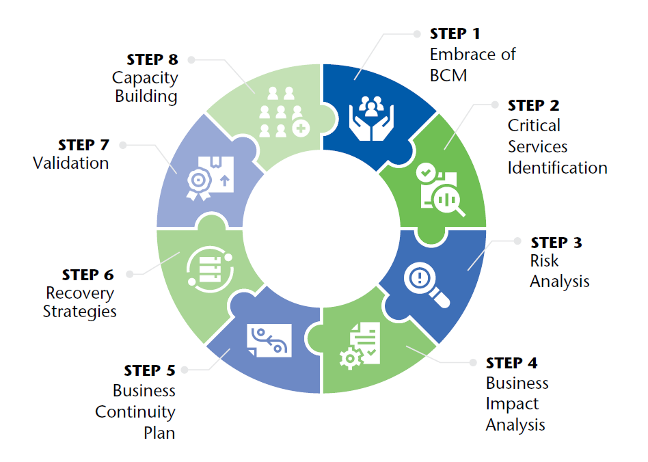
What is Business Continuity Management?
BCM is a structured, proactive system that enables an NMHS to:
Continue delivering essential services during and after a disruption
Protect life-saving functions such as warnings, aviation services, and data provision
Prioritize recovery actions using documented plans and trained staff
Strengthen resilience through regular testing and continuous improvement
A functioning BCM ensures you to “continue to serve” even under severe stress.
Notes:
BCM is not simply having backups or reacting when something fails.
It is a structured system that ensures your NMHS can continue delivering essential services such as warnings, aviation products, and real time data even if your building, IT infrastructure, or communication systems are unavailable.
For meteorological services, continuity is not optional. It is central to the mandate of protecting life and property.

Slide 7
BCM vs Ad-hoc Crisis Response
BCM: Structured & Proactive
Planned, systematic, documented
Clear roles & responsibilities
Prioritized essential services
Tested procedures & backups
Supports life-saving mandates
Ad-hoc Crisis Response: Disorganized & Reactive
Unplanned, improvised decisions
Dependent on individual judgement
Confusion about priorities
“Figure it out as we go”
High risk of failure & liability
Notes:
This slide highlights the difference between resilience and vulnerability.
Many NMHSs already manage crises but often in an informal and reactive manner.
Ad hoc responses depend on individuals and luck. They create inconsistency and high risk.
BCM is proactive, structured, tested, and reliable.
For an NMHS, this difference can determine whether a warning is issued on time or missed entirely.

Slide 8
Why BCM Matters for NMHS Leadership
A resilient NMHS ensures:
Uninterrupted warnings and aviation products
Consistency in national obligations
Protection of life and property
Maintenance of national and regional trust
Compliance with WMO guidelines and ICAO requirements
BCM is not only a good practice, it is part of
responsible leadership.
Notes:
Continuity of service is ultimately a leadership responsibility.
BCM supports your ability to meet national expectations, WMO commitments, and ICAO obligations.
We have all experienced operational outages that disrupted warnings or aviation services.
BCM ensures these services remain operational even during severe disruptions.
It protects your credibility and the public’s trust.

Slide 9
Understanding Your Operational Environment
Effective BCM begins with understanding:
Current services & operations (aviation, warnings, hydrological products, climate services)
Organizational structure & staffing
Existing backup or workaround procedures
Critical dependencies (IT systems, telecommunications, power, facilities)
Legal/regulatory requirements
Previous disruptions & lessons learned
This forms the foundation of your Business Impact Analysis and BCM Policy.
Notes:
Effective BCM begins with understanding your own operational environment.
What are your essential services. What supports them. What are the departmental and technical dependencies.
What are the risks that could interrupt these services.
This understanding is the foundation of your Business Impact Analysis and your recovery priorities.

Slide 10
Existing Good Practices You Already Have
Your NMHS may already use:
Backup generators, alternative comms, HSE protocols
Work-from-home provisions
On-call or duty meteorologist systems
Severe weather operational procedures
Quality Management Systems
HSE risk assessments
Redundant data sources or backup locations
BCM brings these existing practices into one coherent, accountable system.
Notes:
Most NMHSs already have elements of BCM in place.
These include backup power, telecommunications, severe weather procedures, HSE risk assessments, QMS processes, remote work arrangements, and duty rosters.
BCM does not replace these practices. It integrates them into one documented and systematic approach that builds consistency and reliability.

Slide 11
Risks of Not Implementing BCM
If your NMHS cannot deliver critical services:
Missed or delayed severe weather warnings
Failure to meet ICAO and WMO obligations
Reputational damage
Legal liability for loss of life or damages
National loss of trust in meteorological information
Financial consequences and operational downtime
BCM mitigates these strategic, operational, and reputational risks.
Notes:
When BCM is absent the risks are substantial.
Missing or delaying a warning can have life threatening consequences.
Interruptions to aviation services carry legal and operational risks.
Website or data outages during a storm can damage public trust.
A BCMS significantly reduces these strategic, operational, and reputational risks.

Slide 12

Your Role as a Leader
"Leadership" implies more of a role in setting the direction, developing a vision and inspiring others to develop their full potential.
NMHS leaders:
Build organizational capability and responsiveness... take action to ensure sustainability
Steers and implements change and deals with uncertainty ... defines high-level objectives and ensures translation into practical implementation strategies

Slide 13
Leadership Actions Required Now
As NMHS Senior Leadership, you should:
Make the executive decision to implement BCM
Designate a BCM Focal Point (and team, if practical)
Provide a formal mandate and necessary resources
Support the development of a BCM Policy
Champion BCM across the organization
Ensure periodic review and improvement of the BCMS
Without leadership commitment, BCM will not succeed.
Notes:
BCM succeeds only with leadership commitment.
The first leadership action is to decide to implement BCM.
Next, designate a BCM Focal Point with clear authority and responsibility.
Provide them with a mandate, access to staff, and the time needed to do the work.
Finally, communicate your support. BCM will not take root unless staff see that leadership prioritizes it.

Slide 14
BCM Policy and Business Continuity Plan
BCM Policy
“Intentions and direction of an organization, as formally expressed by its top management” (ISO 22301)
Leadership’s formal commitment to BCM
Defines scope, principles, responsibilities
Sets expectations and governance structure
Business Continuity Plan (BCP)
“Documented information that guides an organization to respond to a disruption and resume, recover andrestore the delivery of products and services consistent with its business continuity objectives” (ISO 22301)
Operational playbook for responding to disruptions
Details recovery actions, roles, and timeframes
Includes procedures, checklists, and resource needs
Policy = Direction/Commitment
BCP = Action
Notes:
The BCM Policy and the Business Continuity Plan are different.
The BCM Policy is a leadership level statement that defines expectations, scope, and responsibilities.
The BCP is operational and explains what staff must do during a disruption.
You cannot have an effective BCP without a clear BCM Policy. Today we focus on the policy.

Slide 15

Key Elements of a BCM Policy
A strong BCM Policy includes:
Purpose and scope
Leadership commitment & BCM principles
Roles and responsibilities
Critical functions (initial list)
Linkages to legal/regulatory requirements
Minimum recovery objectives
Resources for BCM implementation
Policy review and update cycle
Notes:
A strong BCM Policy includes a clear purpose and scope, a statement of leadership commitment, defined responsibilities, an initial list of critical functions, recovery expectations, and a review cycle.
It does not need to be long. A concise and clear policy is more effective than a detailed document that no one reads.

Slide 16
Leadership Commitment and Support for BCM
The BCM Focal Point will:
Draft the BCM Policy
Coordinate BCMS development
Lead risk assessment and business impact analysis
Engage staff and managers to identify critical services
Facilitate the development of Business Continuity Plans
Report regularly to senior leadership
Support training, testing, and exercises
The focal point needs leadership support to be effective.
Notes:
The BCM Focal Point is your internal coordinator and champion.
They lead the development of the BCMS including the risk assessment, the Business Impact Analysis, the coordination of continuity plans, and the organization of drills.
They need access to leadership and the authority to coordinate across departments.
When a focal point is empowered, BCM progresses rapidly.

Slide 17
Policy Development: How to Begin
The BCM Focal Point should:
Review WMO BCM Guidelines (WMO-No. 1361)
Review the example BCM Policies
Draft a short, high-level policy tailored to your NMHS
Share with senior leadership for refinement and approval
Communicate the approved policy to all staff
A short, well-defined policy is better than a long, unused one.
Notes:
The BCM Focal Point begins by reviewing the WMO guidelines and examining sample policies.
They then prepare a short draft BCM Policy tailored to your NMHS.
That policy becomes the foundation of your BCMS and frames future BCM activities.
Remember that clarity and leadership approval are more important than length.

Slide 18
Leadership Role in Policy Approval
As Senior Leadership, you must:
Review and approve the draft BCM Policy
Issue the policy formally to the organization
Communicate expectations to staff
Ensure cross-departmental participation in BCM
Monitor early implementation steps
Leadership endorsement signals:
“This matters. We are doing this.”
Notes:
Once the BCM Policy is drafted, leadership must review and approve it.
However approval is not enough. Leadership must also issue the policy formally, communicate expectations to staff, and ensure that BCM is recognized as an organizational priority.
This endorsement gives credibility and momentum to the BCMS.

Slide 19
Practical Activity
Each NMHS delegation will draft a workable, 1–2 page BCM Policy that includes:
Policy Statement (Leadership Commitment)
Purpose & Scope
Preliminary List of Critical Functions
Roles & Responsibilities (Focal Point + Leadership)
Notes:
This is NOT a full BCMS nor a full policy, just the leadership foundation.
The aim is to leave the room with a real BCM Policy draft that leaders can refine and sign later.
The policy sets direction; it is not a detailed Business Continuity Plan.
Reinforce: “Without a policy, BCM cannot move forward. Today, you start that process.”

Slide 20
Policy Statement
Policy Statement (Leadership Commitment)
Why is BCM important for your NMHS?
What commitment does leadership make?
What outcomes do you expect (e.g., resilience, continuity of warnings)?
Prompt:
"The NMHS commits to establishing and maintaining a Business Continuity Management System (BCMS) to ensure uninterrupted delivery of essential services…"

Slide 21
Purpose & Scope
Answer the following questions:
What does the policy apply to? What disruptions are covered? (facility outages, IT failures, cyberattacks, natural hazards, staffing issues, etc.)
Which services must ALWAYS remain operational? –
  CRITICAL FUNCTIONS

Slide 22
Initial List of Critical Functions
List essential services, for example:
Severe weather warnings
Aviation meteorological services
Telecommunications/website data dissemination
ICT systems supporting real-time data
Observing systems (minimum viable coverage)
Answer:
Which services cannot be interrupted under any circumstances?
Which services can tolerate some delay?
Notes:
This prepares the NMHSs for a future Business Impact Analysis.

Slide 23
Roles & Responsibilities
Identify:
Leadership (who approves, resources, communicates BCM)
BCM Focal Point (who coordinates the BCMS)
Departments/Units (identify critical services & dependencies)
State who has ultimate accountability (usually the Director/Head).

Slide 24
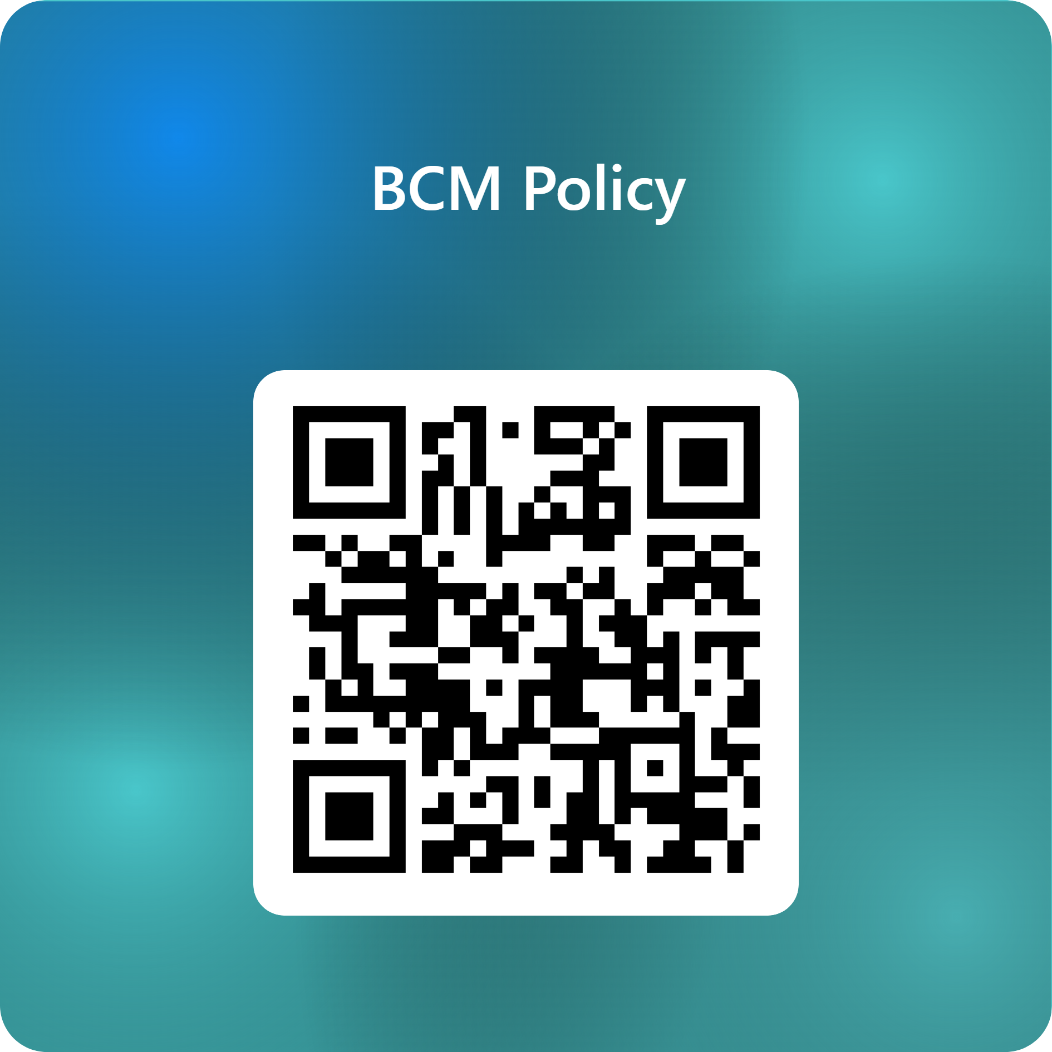

Slide 25
Volunteer Presentations
2-3 randomly selected volunteers to share:
Policy Statement
Purpose & Scope of BCM Policy
Critical Functions
Roles & Responsibilities clarity

Slide 26
Debrief
What was the most difficult part to define?
What can you commit to doing after this workshop?
E.g. I will designate a BCM focal point in one month
How will your policy be communicated?

Slide 27
Closing
For further support:
WMO Technical Guidelines on BCM (WMO-No. 1361)
WMO Task Team on Business Continuity Management

Slide 28
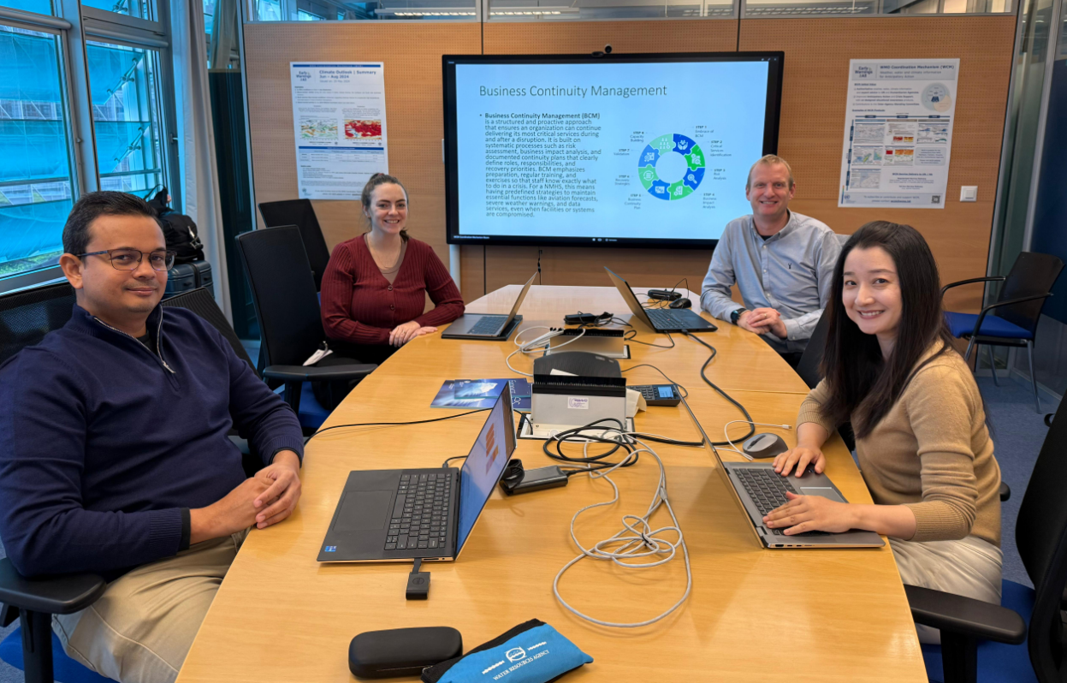
Special Thanks
Xiao Zhou – TT-BCM Focal Point, WMO
Brendan Butler – WMO TT-BCM Member
Rita Ewing – WMO TT-BCM Member

Slide 29
Thank you!

