Slide 1
Leadership and Management Workshop for Senior Management of
RA III and IV Caribbean Members
Good Practices in Leveraging Technological Advances, Empowering Youth, and International Mutual Learning
Mr.Sabu Best (Director BMS)
Port of Spain, Trinidad and Tobago
1-5 December 2025
Notes:
Good morning, distinguished colleagues, partners, and friends,
It is a privilege to join you today at this important WMO–CMO Leadership and Management Workshop. I want to extend my appreciation to the organizers for convening us here in Port of Spain to reflect on how we, as senior leaders of National Meteorological and Hydrological Services in the Caribbean, can strengthen our institutions for the future.

Slide 2

verview
Leveraging technological advances,
Empowering the youth
Supporting intergenerational mutual learning
Notes:
Today’s session focuses on three themes that are critical not only to our operational success, but to the long-term sustainability of our NMHSs:
leveraging technological advances,
empowering the youth, and
supporting intergenerational mutual learning.
These themes speak to where we are as a region — and where we must go.
Across the Caribbean, our institutions face rising expectations. Our societies demand earlier warnings, clearer information, and more precise forecasting. At the same time, climate extremes are intensifying, and public reliance on our services has never been higher. To meet these evolving needs, we must simultaneously modernize technology, invest in people, and build organizational cultures that are agile, innovative, and resilient.
In Barbados, these three pillars have guided much of our recent transformation, and I hope the experiences I share today will resonate with your own national journeys.

Slide 3
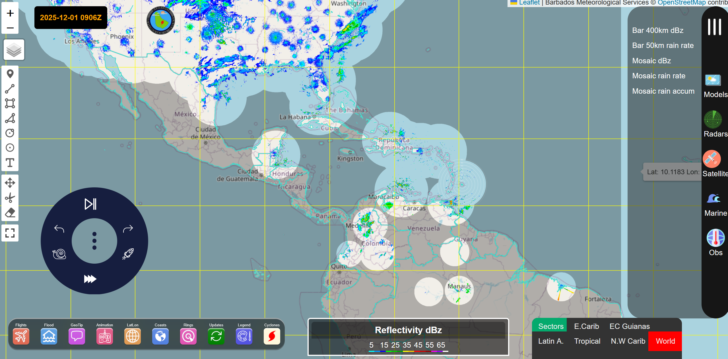
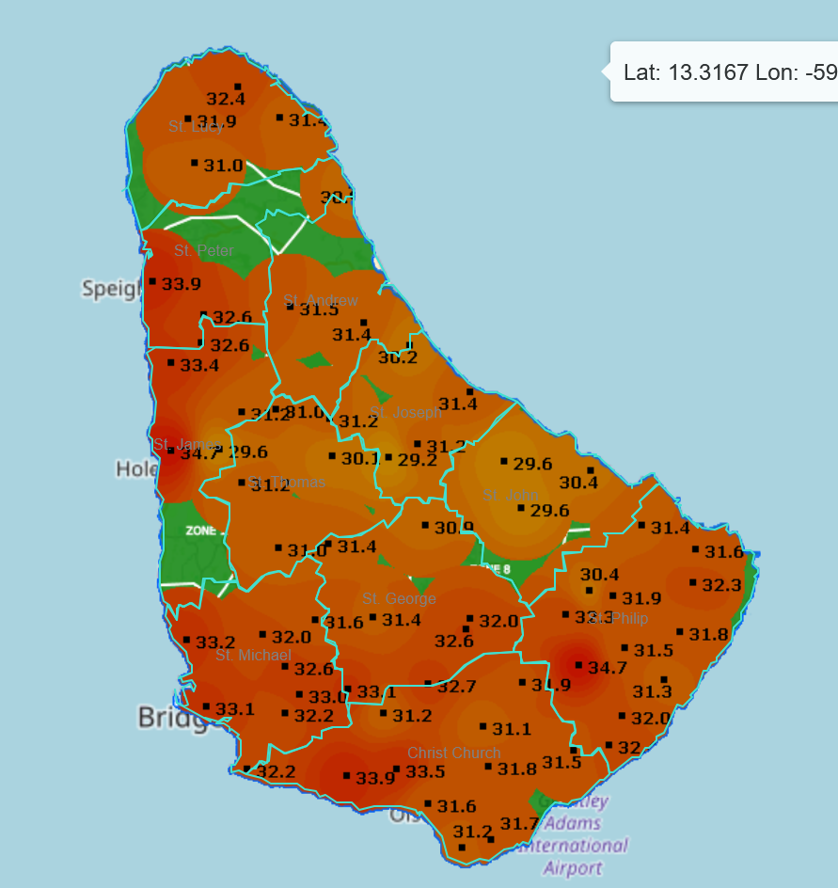
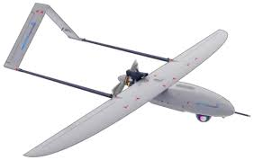
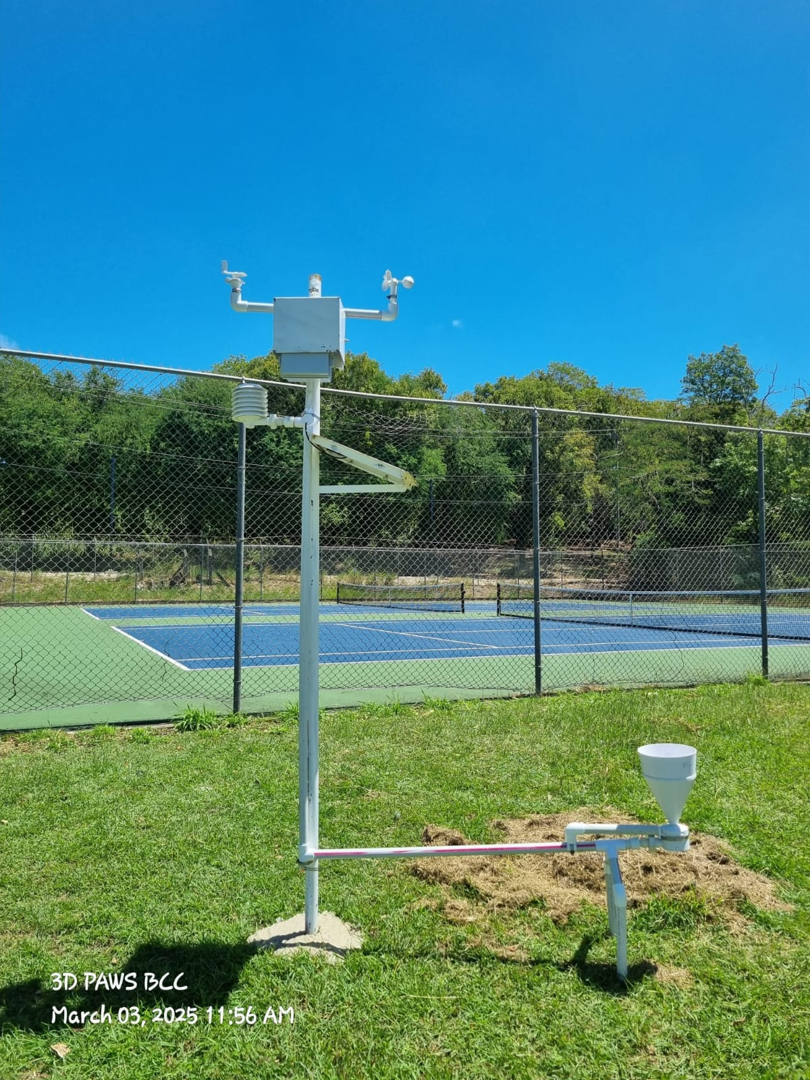
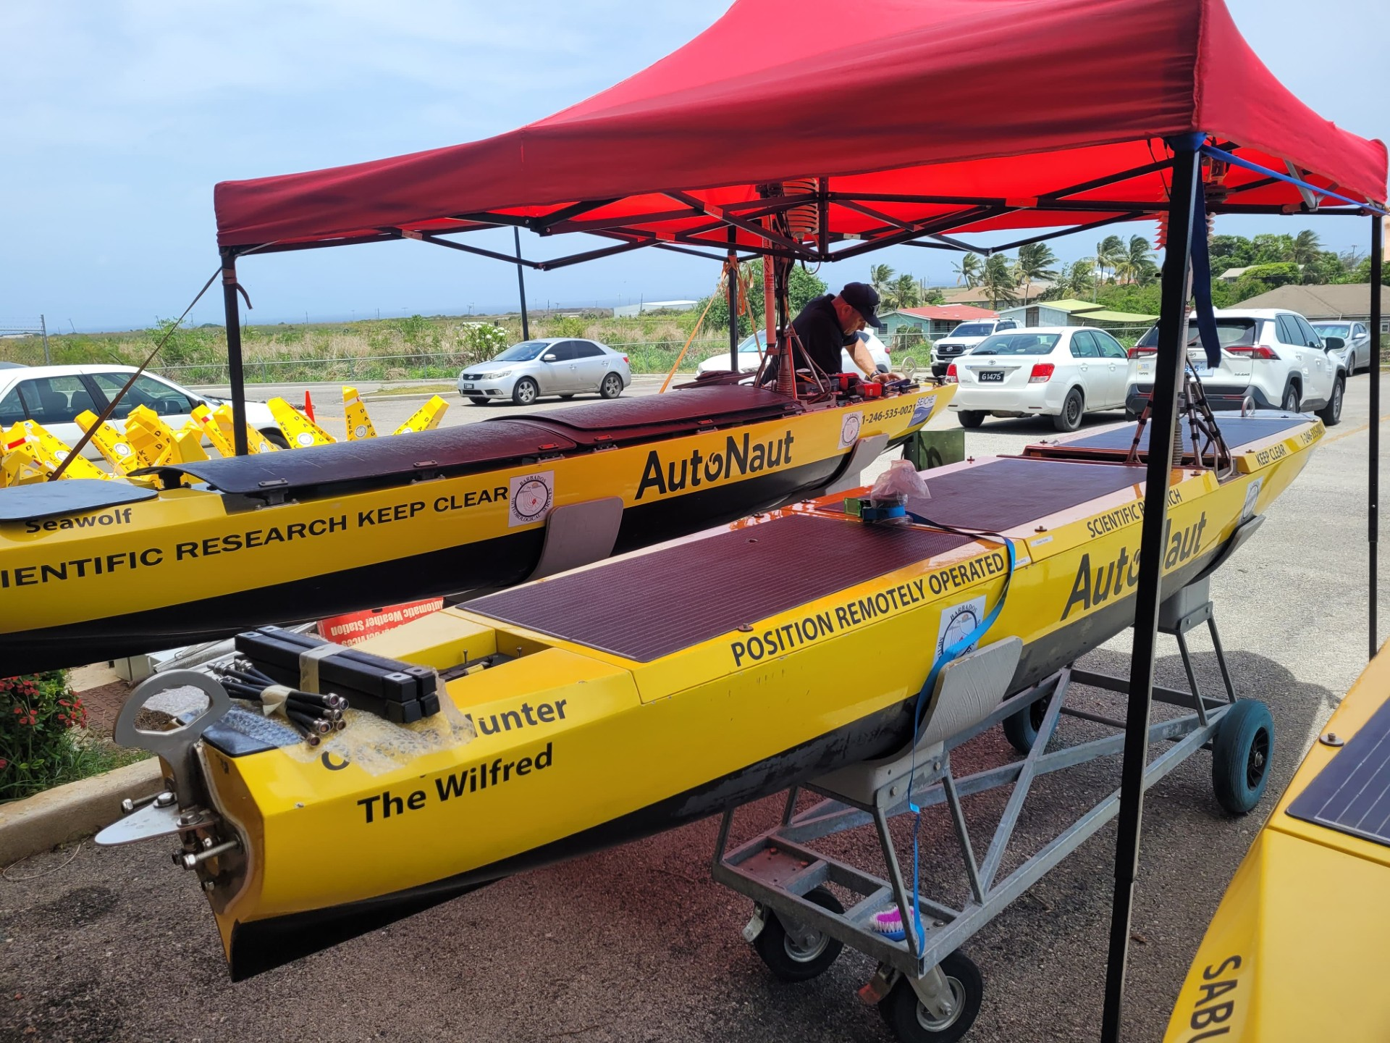
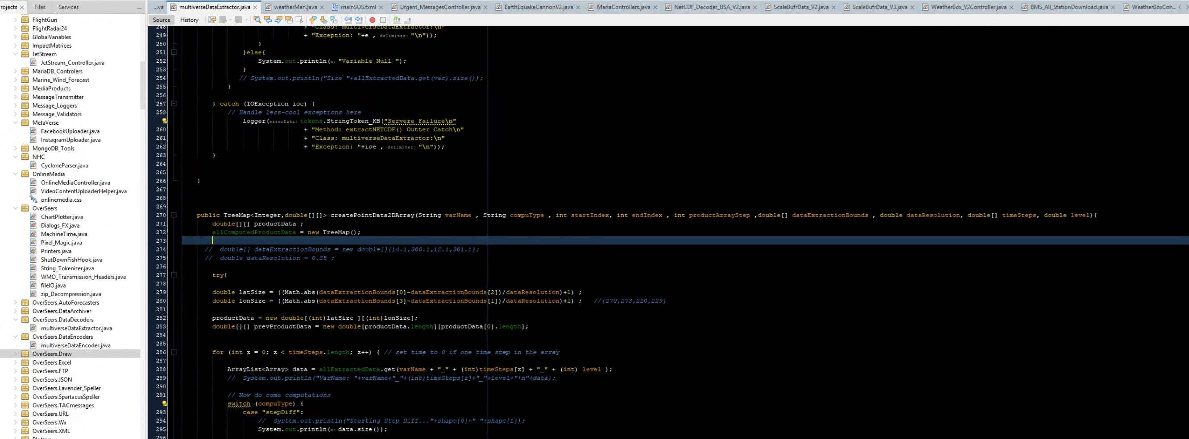
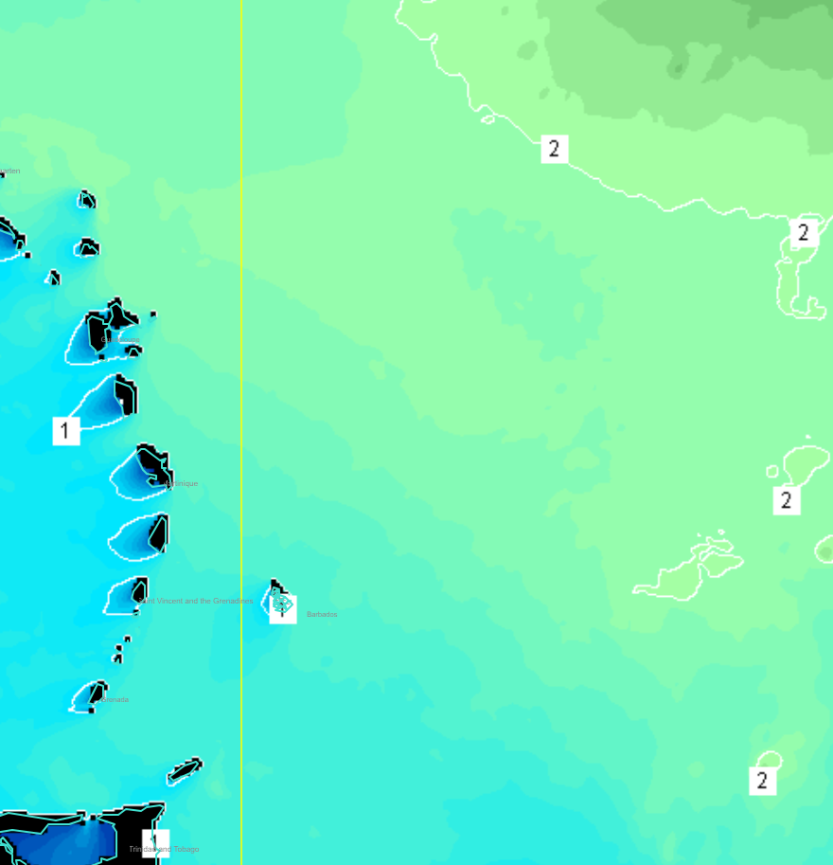
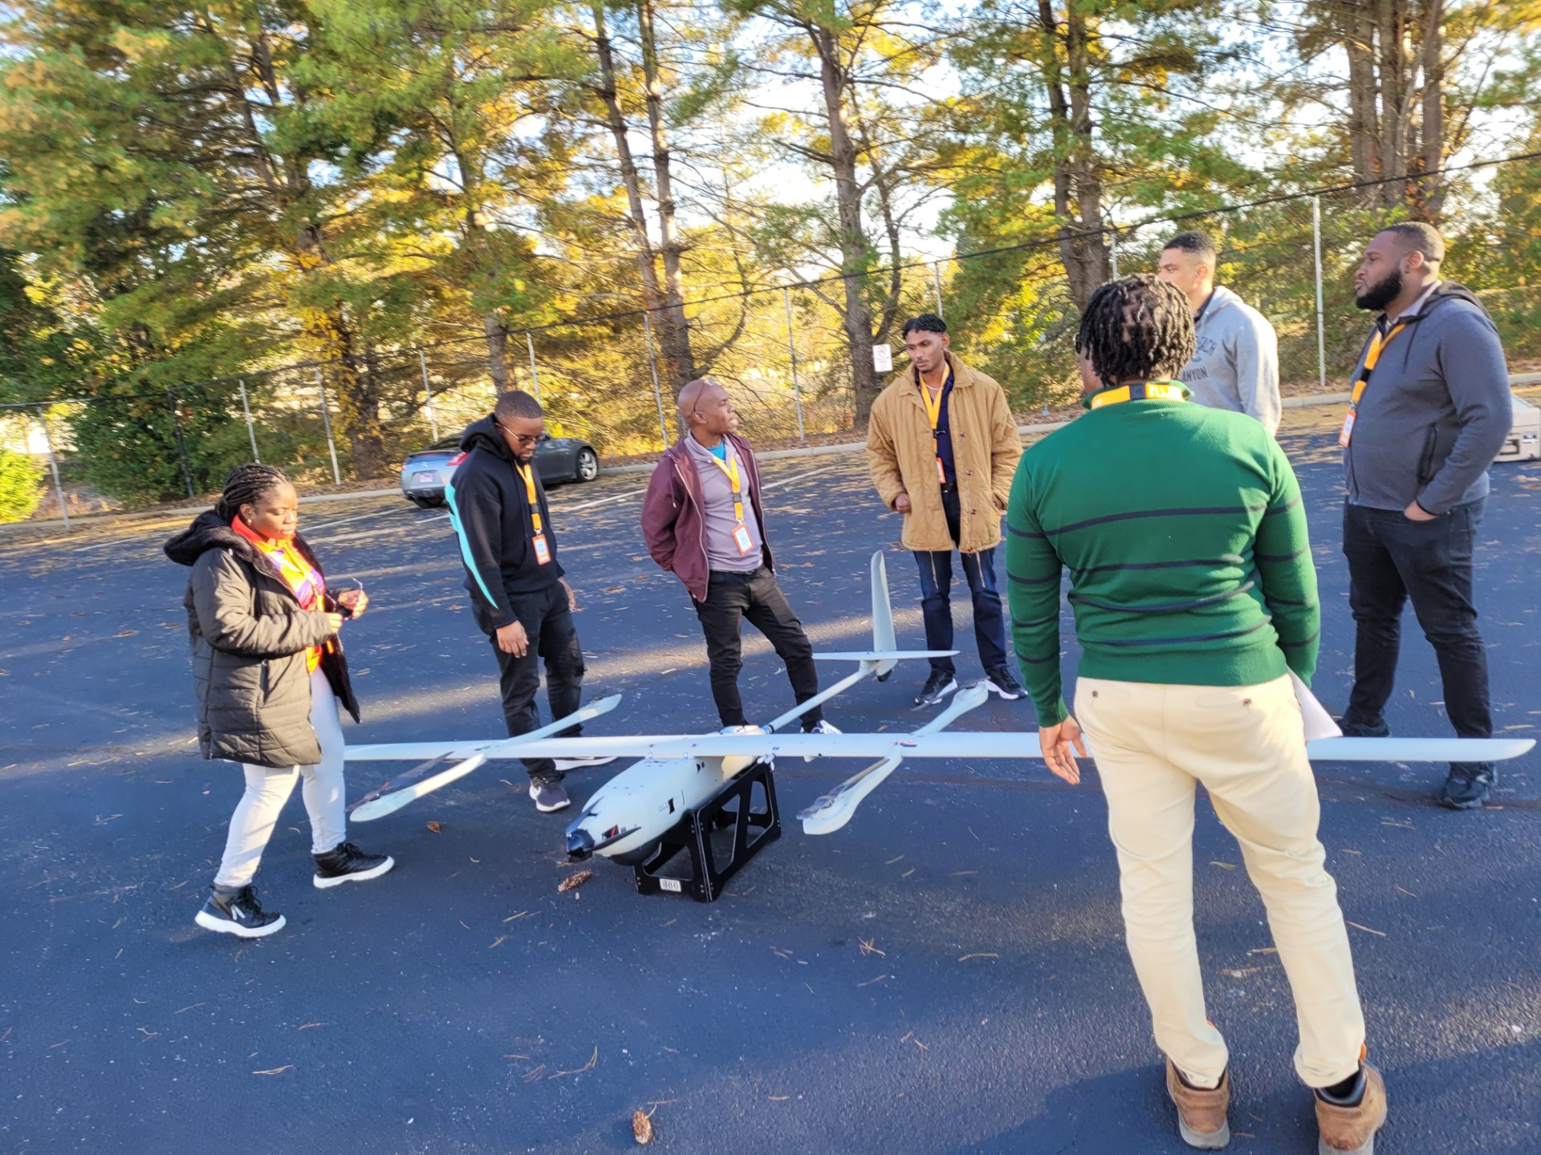
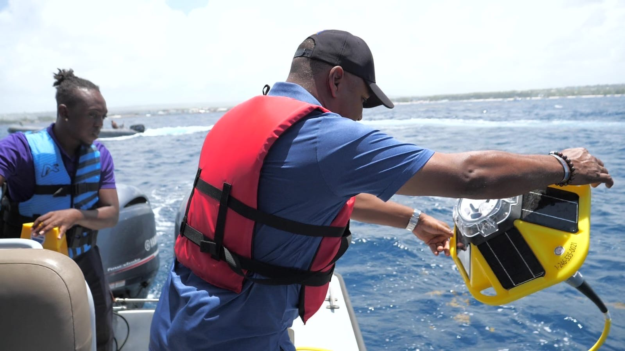
Leveraging Technological Advances
Integration
Sustainability
Multi-Purposes
Notes:
Technology has been transforming meteorology for decades, but the past five years have been especially significant for the BMS. As a region of small island developing states, we are often the first to feel the impacts of a changing climate, yet the last to receive the resources needed to fully prepare for them. This makes modernization not a luxury, but a necessity.
At the Barbados Meteorological Services, our approach to technological advancement has been guided by three principles:
Integration, sustainability, and Multi-Purposes

Slide 4

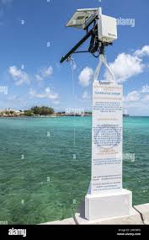
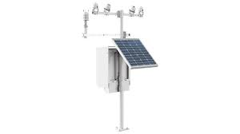
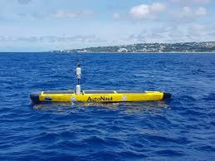
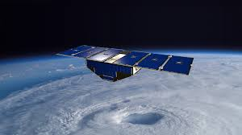
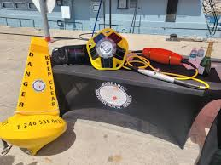
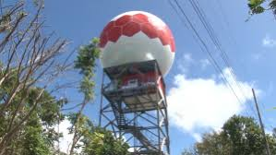
Integration
Platforms
Software
Manage
Ideas
People
Value Chains
Notes:
Integration
We have expanded our observational network with automatic weather stations and improved data acquisition from radar and satellite sources. But more importantly, we have worked to integrate these tools into a unified operational picture. Real-time situational awareness is no longer a desire; it is a requirement.

Slide 5
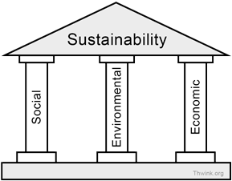


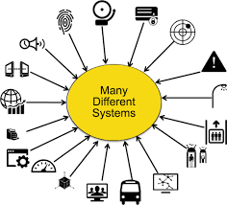
Technological Sustainability
Social Adjustments
Internal
External
Economic:
The Buy in
Full value chain
Impact on eco-system(s)
Notes:
Sustainability
This is often overlooked in modernization projects. Equipment requires maintenance. Systems must be updated. Staff need continuous training. Sustainability planning is now a core part of our modernization strategy.

Slide 6


The Multi-Purpose
Object Oriented
Reusable
Portable
Notes:
Purpose
Our goal has never been modernization for its own sake. Every tool, every software upgrade, every system enhancement must contribute directly to better services, clearer warnings, stronger decision-making support, and better public understanding of risk.

Slide 7
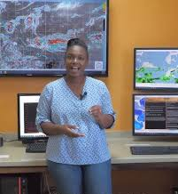
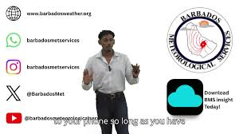
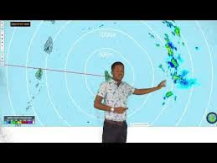
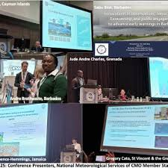
Youth Empowerment
Exposure
Junior Management
New Staff
Interns
Notes:
If technology gives us capability, youth give us capacity.
Across our NMHSs, a new generation of professionals is stepping forward, young people who are digitally fluent, globally connected, and eager to innovate. They bring fresh energy and new ways of thinking.
But they need space, opportunity, and mentorship.
At the Barbados Meteorological Services, we have taken deliberate steps to integrate young professionals into:
forecasting operations,
radar and satellite analysis,
ICT and systems maintenance,
climate data management, and
public communication and media engagement.
We no longer keep young staff on the periphery. We bring them into the heart of operations, where they can learn, contribute, and lead.
One of the most striking impacts of youth involvement has been in our public communication efforts. Young officers have led improvements to our digital outreach, enhancing our social media presence, creating visual products, and strengthening real-time communication during hazardous events. Their contributions have made our messages clearer and more accessible to the public, who increasingly rely on digital platforms.
Creating Leadership Pathways
Youth empowerment must go beyond operational tasks. It must include leadership development.
We encourage young staff to:
participate in WMO workshops,
pursue professional certification,
take ownership of projects,
and sit at the table during strategic discussions.
This builds confidence and fosters a sense of belonging; a crucial factor in staff retention.
The Leadership Role
As senior managers, it is our responsibility to nurture this generation. They are not simply the future of our NMHSs; they are the present. And their success depends on the environment we create for them today.

Slide 8


Intergenerational Learning
Across all generations
Notes:
3. Intergenerational Mutual Learning
While youth bring innovation, our senior staff carry something equally valuable: institutional memory. They know the history of our systems, the lessons from past storms, and the realities of working with limited resources.
In meteorology, experience is not just useful, it is essential.
But the old paradigm of “senior teaches junior” is no longer sufficient. Today’s environment demands mutual learning, a two-way exchange where each generation benefits from the strengths of the other.
At the Barbados Meteorological Services, this approach has produced several positive outcomes:
Knowledge Retention and Succession Planning
Meteorologists, Technicians, and Electronic Officers now work closely with younger staff on real-time operations. This pairing strengthens succession planning and reduces the risk of losing institutional knowledge.
Improved Technical Innovation
Younger officers introduce automation tools, coding skills, and analytical methods that enhance efficiency. Meanwhile, senior staff provide operational context and practical caution that keeps innovation grounded and relevant.
Enhanced Team Culture
When staff feel seen, valued, and respected, regardless of age, organizational morale improves. Teams become more cohesive, more resilient, and more committed to the mission.
Intergenerational mutual learning is not only a best practice; it is a strategic leadership tool.

Slide 9
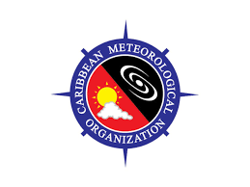

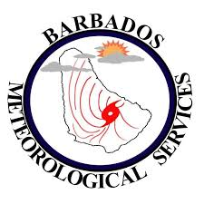

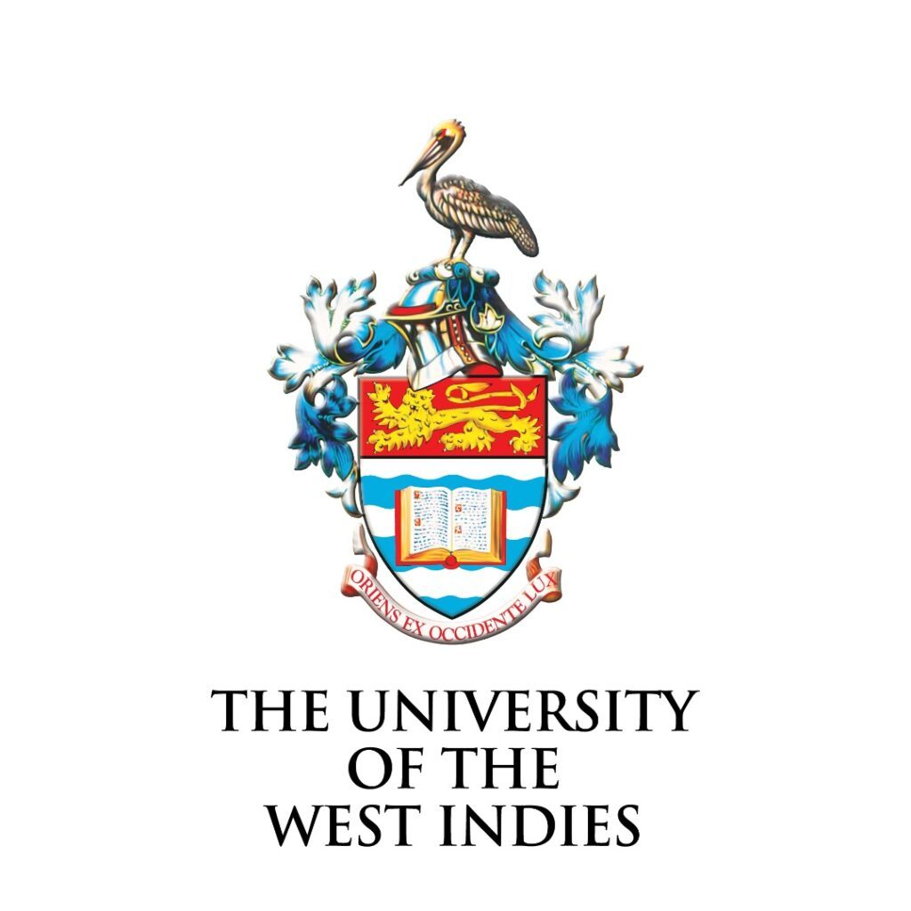

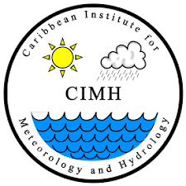
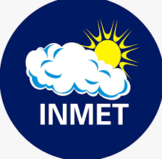

Inter-institutional Learning/Opportunities
Regional Knowledge Sharing on institutional/Organizational levels
Notes:
As leaders of NMHSs, we must think beyond national borders. The Caribbean is strongest when we work as a unified community.
We share similar hazards, similar vulnerabilities, and similar constraints. When one of us strengthens capacity, the entire region benefits.
Our path forward must include:
Strategic Leadership Development
Strengthening communication with policymakers, improving our visibility, and ensuring our services are recognized as essential components of national development.
Competency and Quality Management Systems
Embedding WMO’s competency frameworks and QMS processes into our operations ensures sustainability, accountability, and continuous improvement.
Regional Knowledge Sharing
Through the CIMH, CMO, and WMO systems, we have platforms for training, calibration, data sharing, and collaborative projects. We should leverage these even more aggressively:
joint radar and marine observation initiatives,
shared training programs,
collaborative forecasting,
and regional ICT solutions.

Slide 10
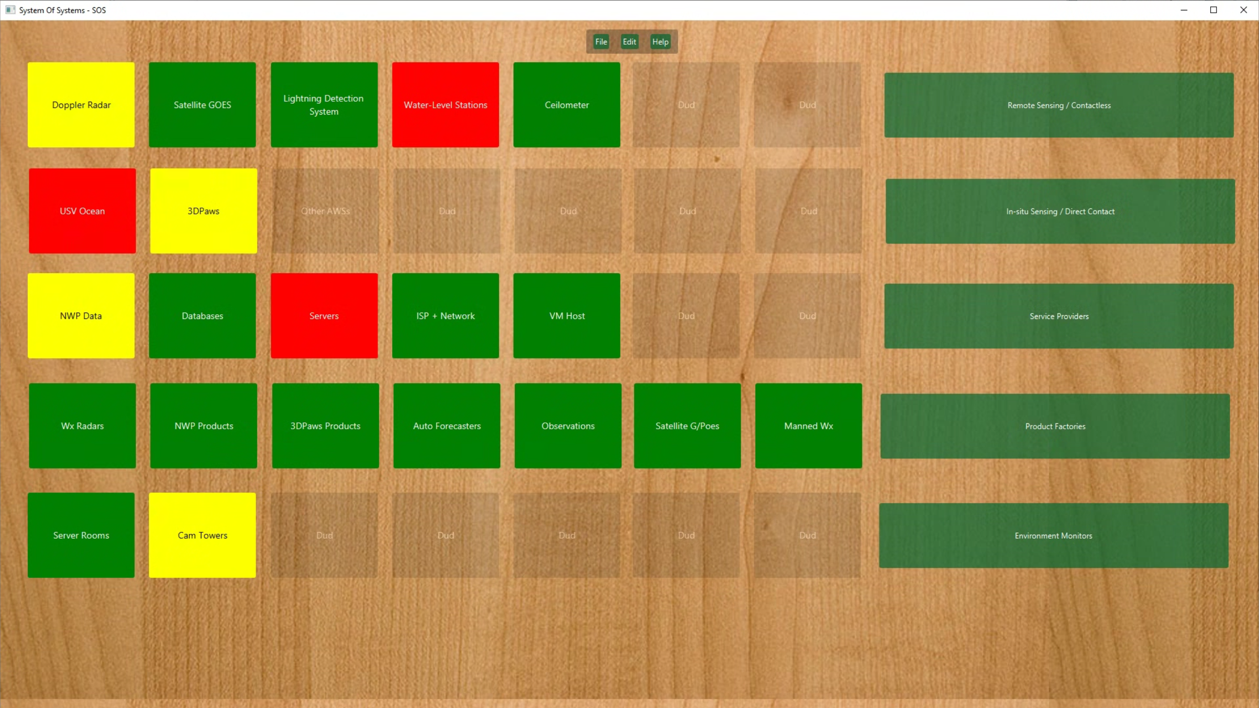
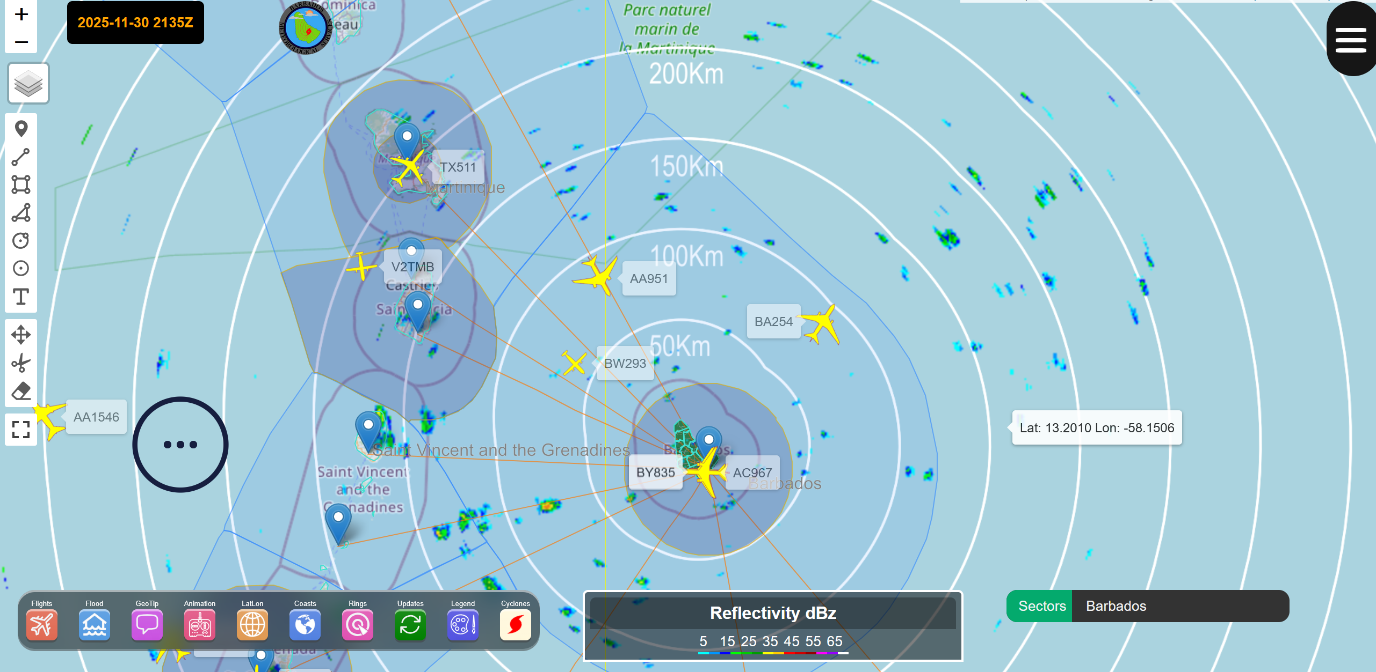
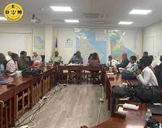
Case Study
Improving Early Warning Coordination During Tropical Systems
Notes:
Case Study: Improving Early Warning Coordination During Tropical Systems
During a recent tropical disturbance affecting Barbados, our enhanced data-sharing platform allowed forecasters, technicians, and disaster management partners to view the same real-time information simultaneously. Radar loops, model outputs, and AWS reporting were accessible through a shared digital dashboard.
This meant that:
Our Disaster Emergency Management Agency received clearer, earlier briefings.
Impact scenarios were generated more rapidly.
Our public messaging became more unified and confident.
The lesson here is not that technology solves all our problems — but that the right technology, properly integrated, can make us more collaborative, more anticipatory, and more trusted.
And as leaders, we must ensure our teams understand that modernization is not a project with an end date. It is a continuous process that requires planning, communication, and alignment with national priorities and WMO frameworks such as QMS, competencies, and the Global Basic Observing Network.

Slide 11
Conclusion & Questions
Please don’t ask very hard questions.
Notes:
Conclusion
Colleagues, meteorology is ultimately a human service. While innovation and technology enhance what we do, it is our people who give meaning to our mission.
If we continue to invest in modern systems, empower the next generation, and encourage mutual learning across all levels of our organizations, we will not only improve the quality of our services, we will strengthen the resilience of our countries.
Our collective leadership has the power to transform the Caribbean’s NMHSs to make them more integrated, more reliable, and more prepared for the challenges ahead.
Let us continue to work together, learn from each other, and support each other as we build a region where meteorological services remain strong, respected, and essential.

Slide 12


